Slide 1

Smart Food Waste Analytics
Department of Computer Science and Engineering
Review – 4 (Batch – 2)
Team Members
Roll No Name
2420030353 Madini Ramyasri
2420030369 Avadhari Sahithya
2420090011 Chillancherila Lasya
Under the Guidance of :
Dr. N. Shirisha
Associate professor

Slide 2
Introduction
Food waste is a major problem in hostels, restaurants, canteens, and food service organizations.
Food is wasted due to over-preparation, low consumption, and inefficient planning.
Traditional recording methods are manual, time-consuming, and difficult to analyze.
The system collects and processes food preparation, consumption, and waste data.
ETL, SQL, and analytics identify high-waste foods, meals, and locations.
Dashboards and predictive analysis help monitor waste and improve future planning.

Slide 3
Objectives
Develop an automated PySpark pipeline to clean, validate, transform, and prepare large-scale food-waste data for analysis.
Build a machine-learning model to predict food waste using factors such as city, hotel, food type, meal, people served, and preparation quantity
Identify major food-waste patterns through city-wise and food-item-wise analytics to determine where waste is highest.
Provide an integrated analytics dashboard that enables dataset upload, waste analysis, predictions, and actionable insights in one platform.

Slide 4
Literature Survey
S.No | Link | Authors | Demerits | Future Direction
1. | https://www.nature.com/articles/s41598-026-53202-2 | Prakhash Neelemagam | Mainly focuses on waste-generation prediction; does not provide a complete end-to-end data pipeline | Integrate real-time data, improve local-level prediction, and extend the model to waste-management operations.
2. | https://www.researchgate.net/publication/363421551_An_Apache_Spark_Framework_for_IoT-enabled_Waste_Management_in_Smart_Cities | Gerasimos Vonitsanosl. | Requires IoT infrastructure and continuous sensor data; mainly targets smart-city environments. | Integrate more real-time data sources, advanced analytics, and scalable waste-management applications.
3. | https://link.springer.com/article/10.1007/s43621-024-00483-0 | Jacintha Menezes | Hyperspectral imaging requires specialized equipment and can be costly and complex. | Develop low-cost sensing methods and integrate real-time Big Data analytics for waste classification.

Slide 5
Literature Survey
S.No | Link | Authors | Demerits | Future Direction
4. | https://www.sciencedirect.com/science/article/pii/S0959652623044232 | Miguel Rodrigues | Focuses on food-catering demand rather than municipal solid waste. | Apply forecasting techniques to municipal waste generation and integrate additional environmental factors.
5. | https://www.sciencedirect.com/science/article/pii/S0956053X25001072 | Evangelia G. Sigala | Requires specialized AI tracking devices and focuses on HORECA environments. | Expand AI-based tracking to larger waste-management systems and integrate predictive analytics
6. | https://link.springer.com/article/10.1007/s10479-023-05272-y | Mehrbakhsh Nilashi | Provides a broad industry-level perspective rather than a complete technical implementation. | Develop real-time Big Data platforms and integrate predictive analytics with waste-management operations.

Slide 6
Literature Survey
S.No | Link | Authors | Demerits | Future Direction
7. | https://www.mdpi.com/2071-1050/15/4/3482 | Sahar Ahmadzadeh Ghahnaviehei | Review-based study; mainly focuses on food waste and not general MSW implementation. | Develop food/waste-specific IoT solutions and investigate suitable sensors for different waste categories
8. | https://doi.org/10.1145/3549737.3549764 | Gerasimos Vonitsanos | The system depends on IoT sensors and real-time data, which may require additional infrastructure and maintenance. | Test the system using real-world datasets and explore more machine learning algorithms to improve prediction accuracy.
9. | https://doi.org/10.18280/ijei.080105 | Vaishnavi Jayaraman | The model is mainly focused on predicting municipal waste generation and is evaluated using data from Singapore. | Include socio-economic factors such as population, income, and education to improve waste-generation predictions.

Slide 7
Literature Survey
S.No | Link | Authors | Demerits | Future Direction
10. | https://doi.org/10.1007/s13762-025-06488-0 | S. Alam, Md. Rokonuzzaman, K. S. Rahman, W. S. Tan. | The prediction accuracy can be affected by seasonal changes, population growth, and economic conditions. | Use more diverse and accurate datasets and develop forecasting models that can adapt to changing conditions.

Slide 8
Research Gap Identification
Lack of standardized and comparable food-waste measurement approaches.
Digital monitoring systems still face human-input and data-quality issues.
AI-based tracking mainly focuses on identification and measurement, with limited integration into decision-making.
Limited end-to-end integration of recording, analytics, classification, recommendations and notifications.

Slide 9
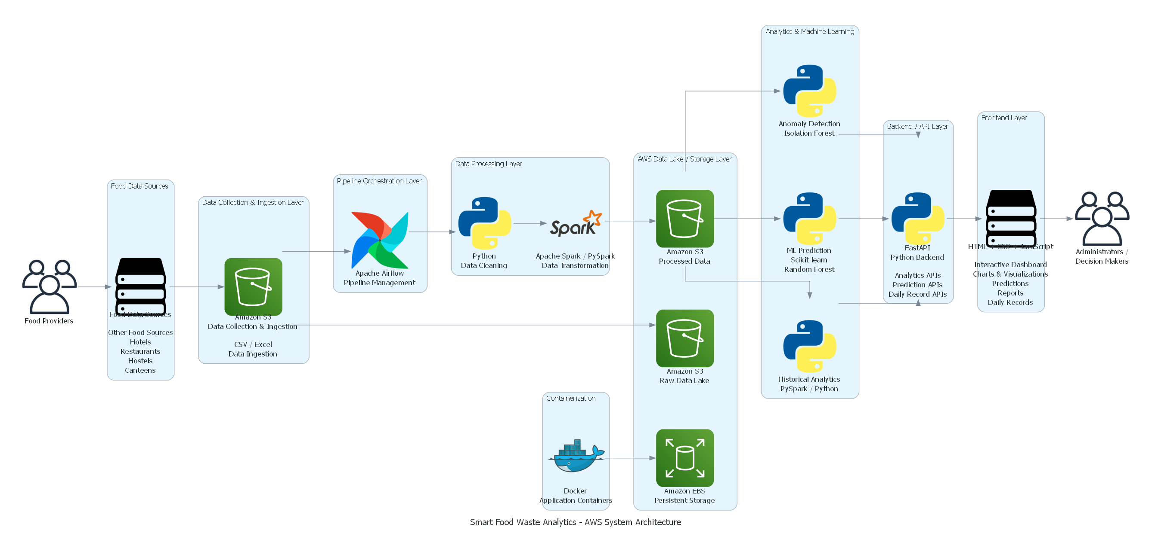
System Architecture

Slide 10
Methodology
Data Collection – Collect historical food-waste data containing city, hotel, food item, meal, preparation, consumption and waste details.
Data Preprocessing – Use PySpark to remove duplicates, handle invalid values, calculate waste percentage and prepare the dataset.
ML Prediction – Train a Random Forest model on processed data to predict food waste quantity.
Analytics & Insights – Perform city-wise and food-wise analysis and identify high-waste patterns and financial loss.
Recommendation & Dashboard – Generate AI-based waste-reduction recommendations and display predictions, analytics and insights through the web dashboard.

Slide 11
Methodology
Data Collection – Collect historical food-waste data containing city, hotel, food item, meal, preparation, consumption and waste details.
Data Preprocessing – Use PySpark to remove duplicates, handle invalid values, calculate waste percentage and prepare the dataset.
ML Prediction – Train a Random Forest model on processed data to predict food waste quantity.
Analytics & Insights – Perform city-wise and food-wise analysis and identify high-waste patterns and financial loss.
Recommendation & Dashboard – Generate AI-based waste-reduction recommendations and display predictions, analytics and insights through the web dashboard.

Slide 12
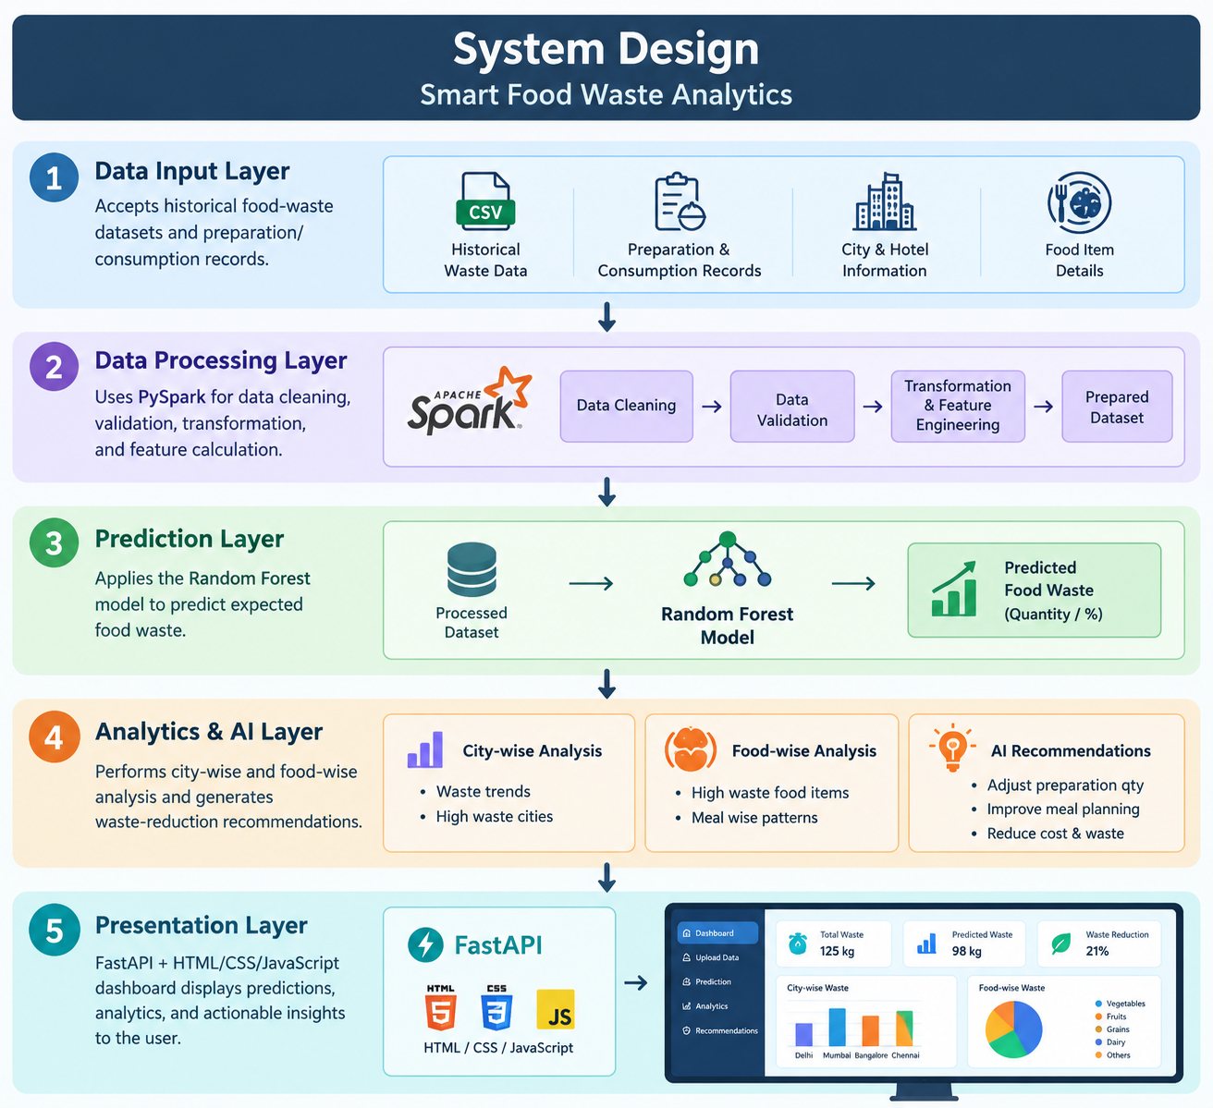
System Design

Slide 13
Existing System
The existing system mainly uses manual or fixed-format data input, which makes handling different datasets difficult.
Analysis is mainly based on predefined data and basic reports, with limited city-wise and food-wise insights. The system does not provide integrated food-waste prediction, making future waste estimation difficult.
Anomaly detection is limited or unavailable, so unusual food-waste patterns may not be identified effectively.
Recommendations are mostly generated manually, which makes the decision-making process less automated.

Slide 14
Limitations of Existing Systems
Limited integration of food-waste data collection, analysis, prediction, and reporting.
Dependence on manual data entry can lead to errors and inconsistent records.
Limited real-time monitoring and decision support for food-waste management.
Existing systems mainly focus on tracking and measurement rather than predicting future waste.
Limited use of machine learning for food-waste quantity prediction.
Lack of actionable recommendations for reducing food preparation and consumption waste.
Analytics and reporting are often separate from the waste-management process.
Limited scalability for handling large volumes of food-waste data across multiple locations.

Slide 15
Proposed System
Automated Data Processing – Uses PySpark to clean, validate, transform and prepare food-waste data efficiently.
Waste Prediction – Uses a Random Forest ML model to predict expected food waste based on historical and operational data.
City & Food Analytics – Provides city-wise and food-item-wise analysis to identify the major sources of food waste.
AI-Based Recommendations – Generates actionable suggestions such as adjusting preparation quantities and improving meal planning.

Slide 16
Existing Systems vs Proposed System
Existing Systems | Proposed System
Basic waste monitoring | Integrated waste management
Manual data entry | Digital data collection
Historical analysis | ML-based prediction
Limited analytics | Food-wise & location-wise analytics
Few recommendations | AI-based recommendations
Limited alerts | Threshold-based notifications
Basic reports | Interactive dashboard
Limited scalability | Microservices-based architecture

Slide 17
Hardware Requirements
Component | Minimum Requirement
Processor | Intel Core i5 / AMD Ryzen 5
RAM | 8 GB
Storage | 256 GB SSD
Display | 1366 × 768 resolution
Internet | Stable Internet connection
System | 64-bit computer/laptop

Slide 18
Software Requirements
Software | Requirement
Operating System | Windows 10/11, Linux or macOS
Programming Language | Python
Frontend | HTML, CSS, JavaScript
Backend | Python-based REST APIs
Database | Relational/Document Database
Data Processing | PySpark
Machine Learning | Scikit-learn
Development Tool | Visual Studio Code
Browser | Google Chrome / Microsoft Edge
Version Control | Git & GitHub

Slide 19
Functional Requirements
S.No. | Functional Requirement
1 | Food Waste Data Management – Add, update, view and delete food-waste records.
2 | Data Collection – Record food item, prepared, consumed and wasted quantities, date and waste reason.
3 | Waste Calculation – Calculate waste quantity and waste percentage.
4 | Data Analysis – Analyze daily, weekly and monthly waste patterns.
5 | Waste Classification – Classify waste into Low, Medium and High levels.
6 | Prediction – Predict food-waste quantity using machine learning.
7 | Recommendations – Provide suggestions to reduce food waste.
8 | Notifications – Generate alerts when waste exceeds defined thresholds.
9 | Dashboard & Reports – Display charts, trends, insights and reports.

Slide 20
Non-Functional Requirements
S.No. | Requirement
1 | Performance – The system should process and display waste data efficiently.
2 | Scalability – The system should support increasing amounts of food-waste data and users.
3 | Reliability – The system should provide consistent results and minimize failures.
4 | Security – Food-waste data and system access should be protected.
5 | Usability – The dashboard should be simple and easy to use.
6 | Maintainability – Services should be easy to update and maintain independently.
7 | Availability – The system should be accessible whenever required.
8 | Accuracy – Waste calculations, analytics and predictions should provide reliable results.

Slide 21
Functionality
Data Management – Add, update, view and delete food-waste records.
Waste Calculation – Calculate waste quantity and percentage.
Data Analysis – Analyze food-wise and time-based waste patterns.
Waste Classification – Classify waste as Low, Medium or High.
Prediction – Predict future food-waste quantity using ML.
Recommendations – Suggest actions to reduce food waste.
Notifications – Generate alerts when waste exceeds the threshold.
Dashboard – Display waste trends, insights and reports.

Slide 22
Code Quality
Modular Code – Divide the system into separate services and modules.
Readable Code – Use clear names, proper formatting and meaningful comments.
Reusable Components – Avoid duplicate code and promote code reuse.
Error Handling – Handle invalid inputs and runtime errors properly.
Maintainability – Keep the code easy to modify, test and maintain.
Version Control – Use Git/GitHub to track code changes.

Slide 23
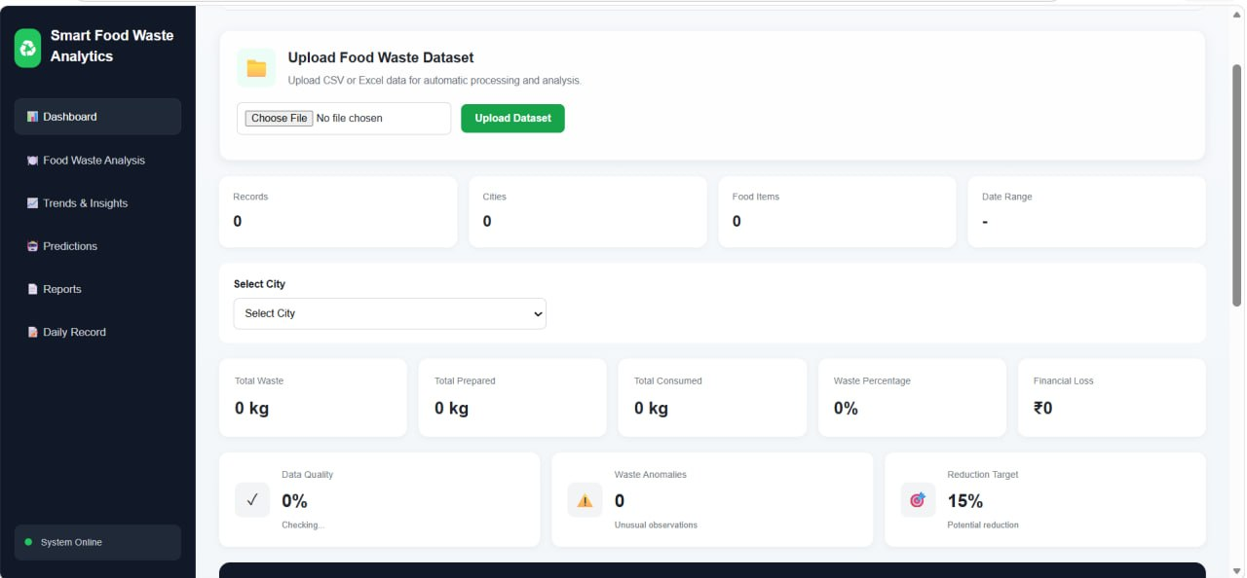
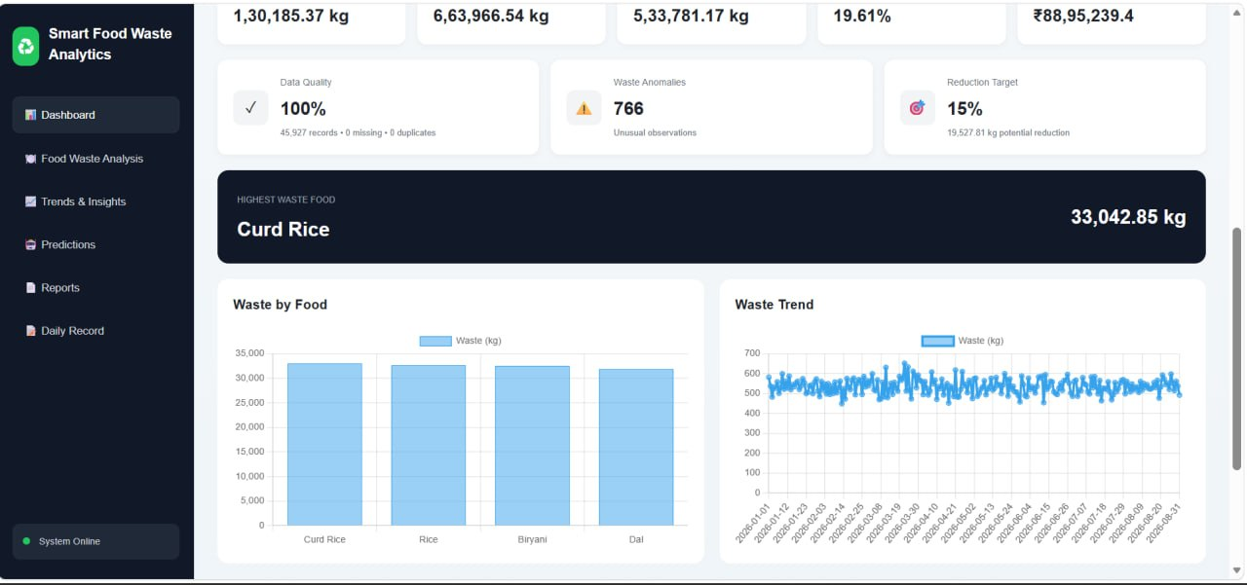
Implementation

Slide 24
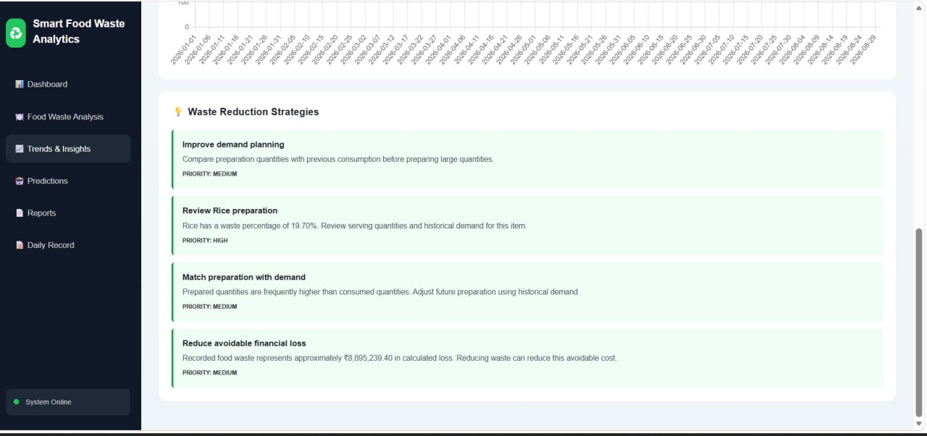
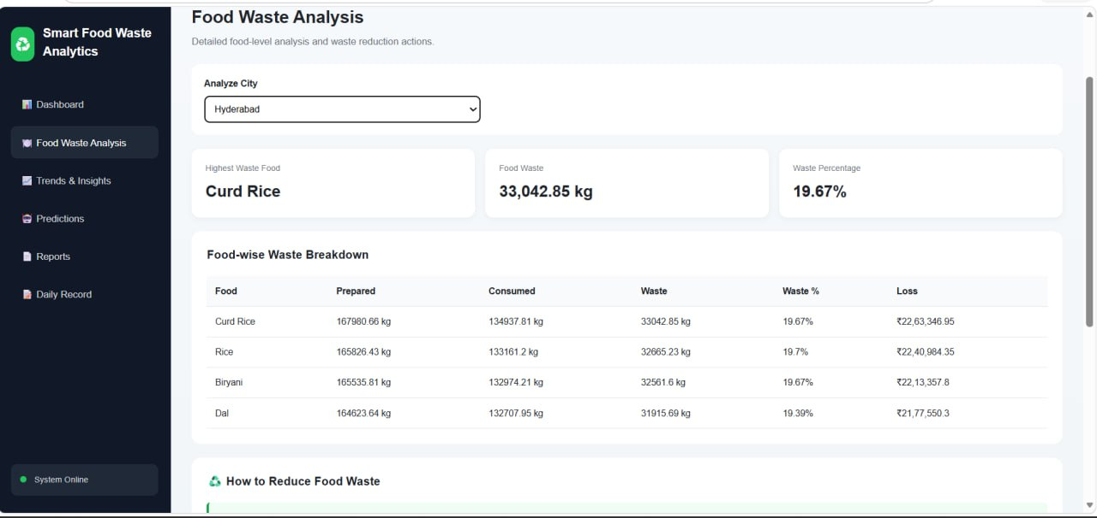
Implementation

Slide 25
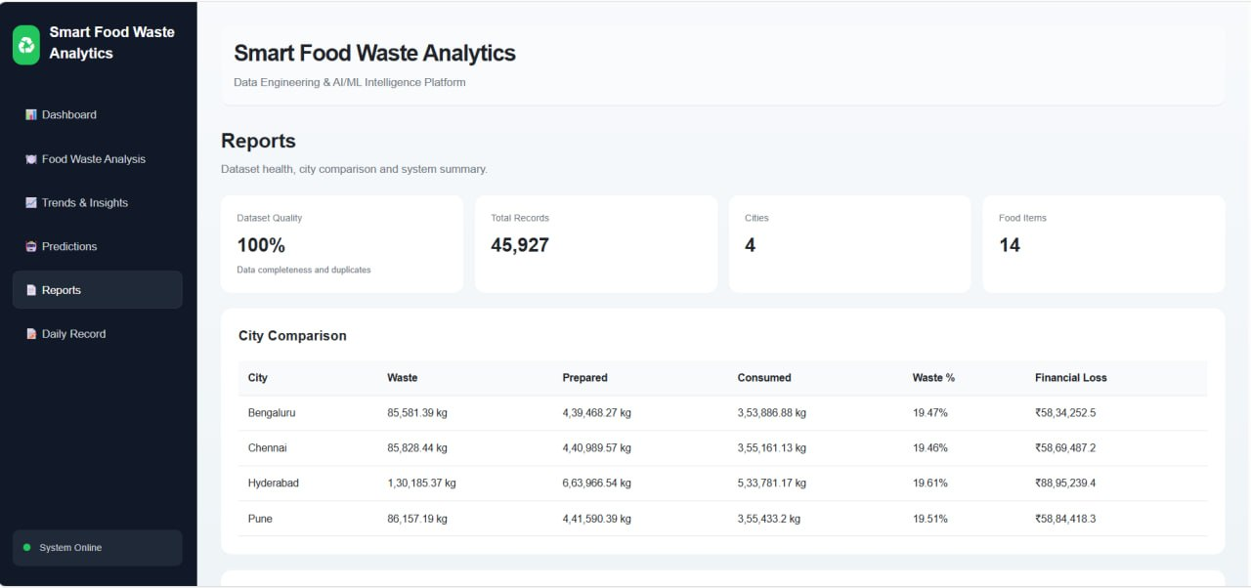
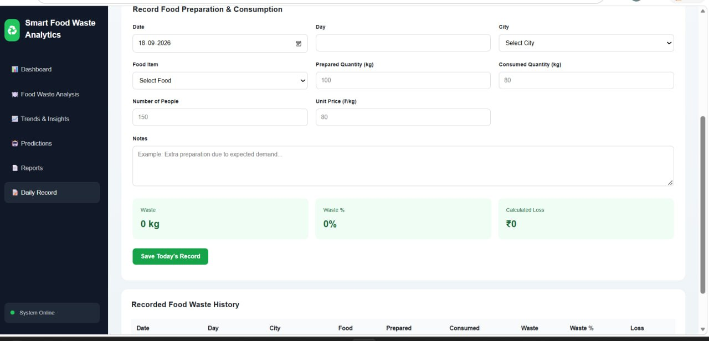
Implementation

Slide 26
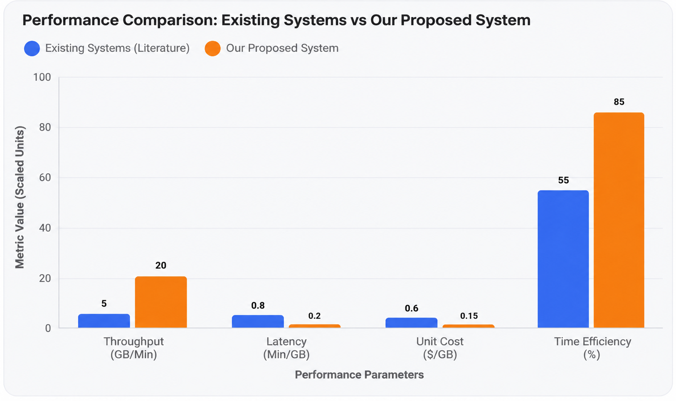
Comparison Graph

Slide 27
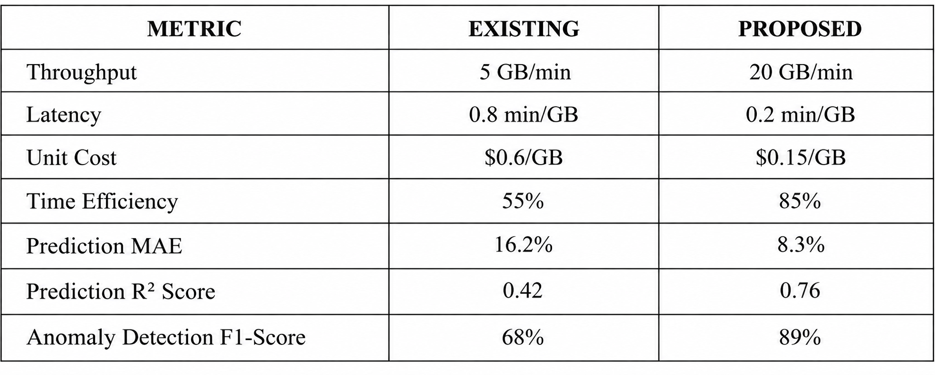
PERFORMANCE COMPARISON

Slide 28
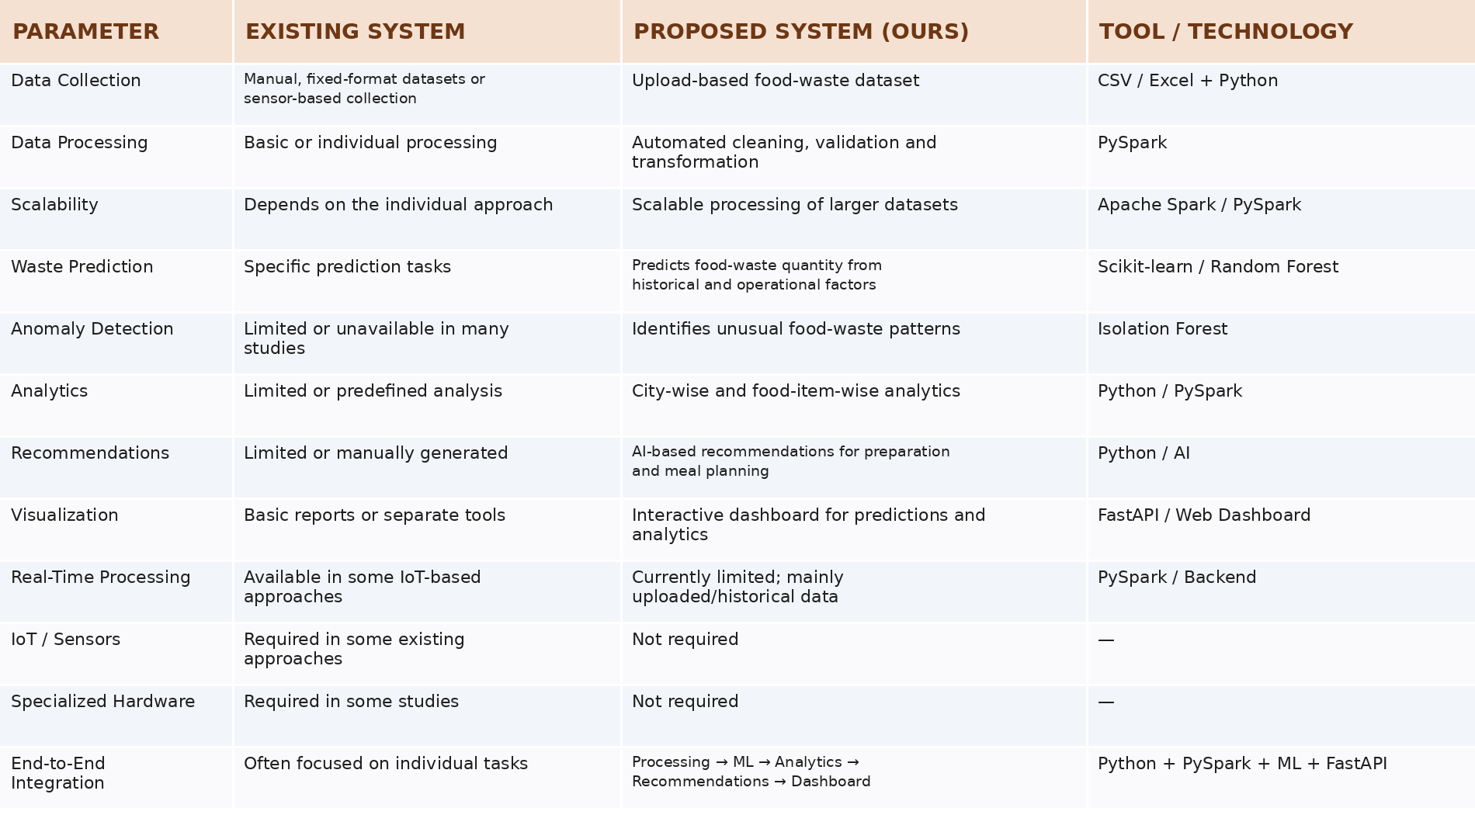

Slide 29
DISCUSSION
The proposed Smart Food Waste Analytics Platform provides a more integrated approach compared with existing food-waste management systems. Existing approaches mainly focus on recording, monitoring, or analyzing food waste, whereas our system combines data processing, storage, analytics, prediction, anomaly detection, recommendations, and visualization in a single workflow.
Automated Processing: PySpark automates data cleaning and transformation, reducing manual processing.
Scalable Analytics: The system can process large food-waste datasets and perform city-wise, food-wise, and time-based analysis.
Data Lake Storage: MinIO stores both raw and processed datasets, providing organized and persistent data storage.
Waste Prediction: Random Forest predicts food-waste quantities using factors such as city, food, meal, people count, and prepared quantity.
Anomaly Detection: Isolation Forest identifies unusual food-waste patterns that may require attention.
Actionable Recommendations: The system converts analytical results into recommendations for reducing unnecessary food preparation and waste.
Integrated Dashboard: FastAPI connects the processed data and ML results to an HTML, CSS, and JavaScript dashboard for easier interpretation.
Pipeline Automation: Apache Airflow coordinates schema mapping, ETL processing, MinIO storage, and ML execution.

Slide 30
Conclusion
End-to-End Pipeline: Integrates data ingestion, schema mapping, PySpark ETL, storage, analytics, and machine learning into one workflow.
Scalable Processing: Uses PySpark to efficiently process large food-waste datasets.
Reliable Data: Applies validation, cleaning, and transformation to produce consistent data.
Actionable Analytics: Identifies food-wise, city-wise waste patterns.
Waste Prediction: Uses Random Forest to predict food-waste quantities.
Anomaly Detection: Uses Isolation Forest to identify unusual waste patterns.
Waste Reduction: Generates recommendations based on identified waste levels and patterns.

Slide 31
References
Amicarelli, V., & Bux, C. (2021). Food Waste Measurement and Management: A Review of Current Practices and Challenges.
Jagtap, S., & Rahimifard, S. (2019). Monitoring Food Waste in Ready-Meal Production Using IoT-Based Systems.
Sigala, M., et al. (2025). AI-Based Food Waste Tracking Using Computer Vision and Deep Learning.
Research papers and studies related to Food Waste Management, Machine Learning, Data Analytics and Microservices Architecture.
Official documentation for Python, PySpark, Scikit-learn and REST APIs.

Slide 32


