Slide 1

LENDING CLUB CASE STUDY SUBMISSION
Group Members: Shravan madipelly and Shubham

Slide 2
Case Study Objectives
Identification of Loan Applicant traits that tend to ‘default’ paying back
Understand the ‘Driving Factors’ or ‘Driver Variables’ behind Loan Default phenomena
Loan Lending Organizations may choose to utilize this knowledge for its portfolio and risk assessment of new loan applicants

Slide 3
Data Cleaning Steps
Delete columns: Delete unnecessary columns.
Remove outliers: Remove high and low values that would disproportionately affect the results of your analysis.
Missing values: Treat missing values with appropriate approach.
Duplicate data: Remove identical rows, remove rows where some columns are identical.
Filter rows: Filter by segment, filter by date period to get only the rows relevant to the analysis.

Slide 4
Analysis
The essence of the whole project is to analyze and understand how consumer attributes and loan attributes are influencing the tendency of defaulting.
We performed data cleaning and preparation on the Loan dataset:
○ Imputed the NA values for all the variables
○ Created two new columns:
Profit and Loss column
Ratio of funded amount and annual income
During univariate analysis we have created:
○ Histograms and Bar charts to check out the distribution of all the driver variables
○ Box plots to detect the Outliers
○ Performed the Multivariate analysis to understand how different variables interact with each other

Slide 5
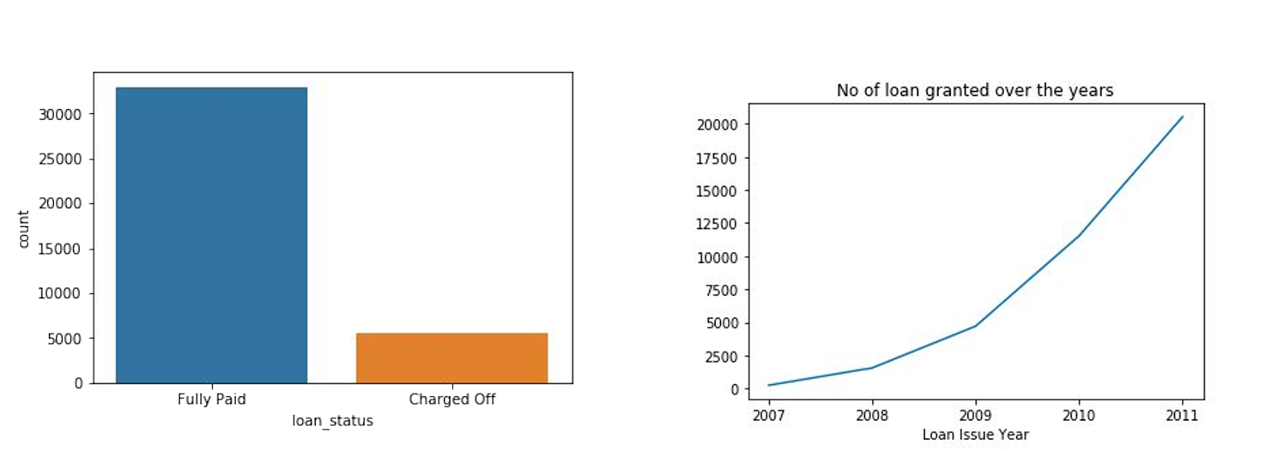
Loan Status Analysis
Observations:
Most of the loans are Fully Paid.
About 14% of loan are having status as defaulters.
The loan has been increasing exponentially over the years.

Slide 6
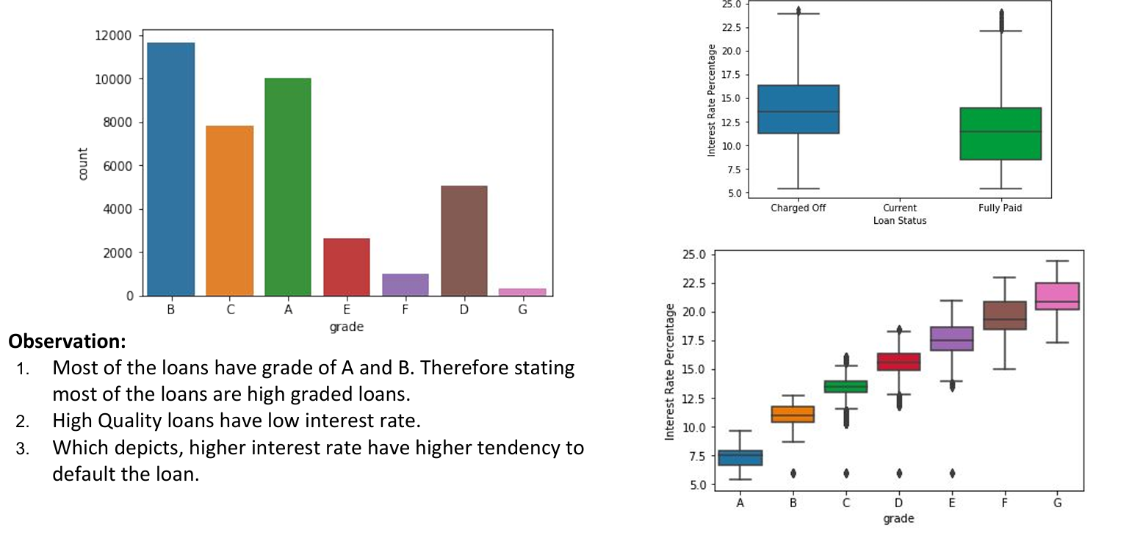
Loan Grade Analysis

Slide 7
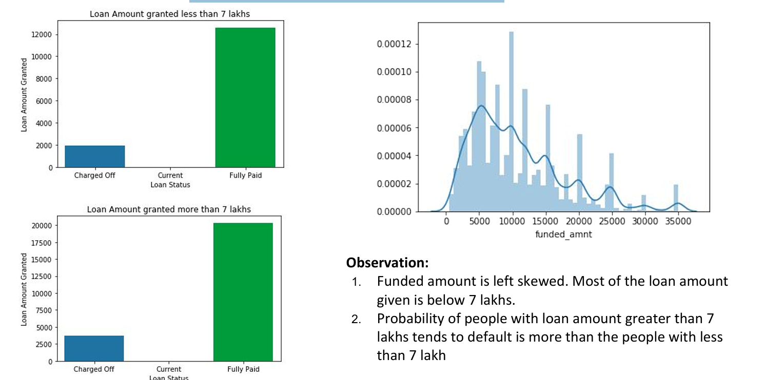
Loan Amount Analysis

Slide 8
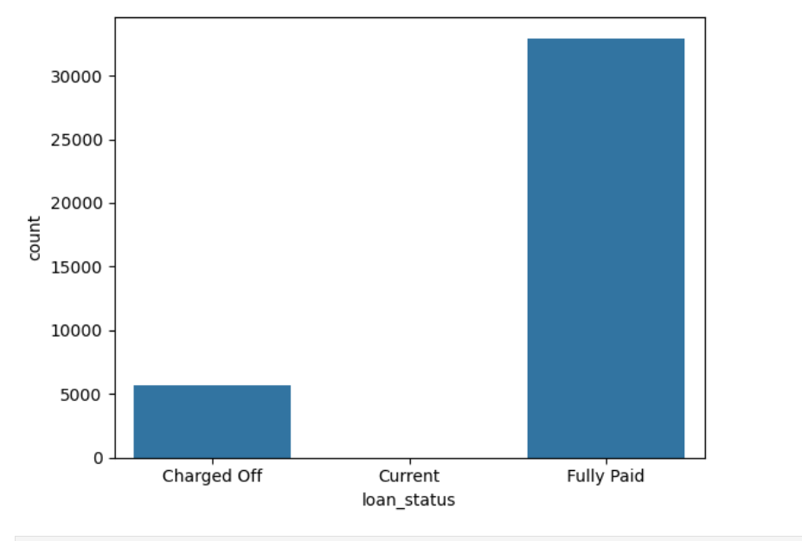
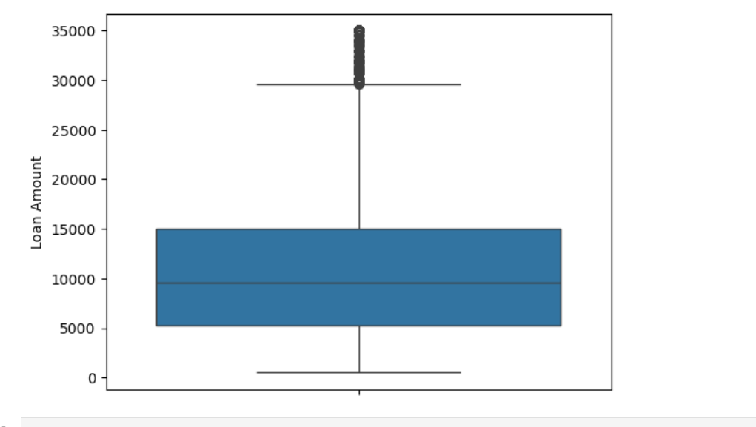
Univariate Analysis

Slide 9
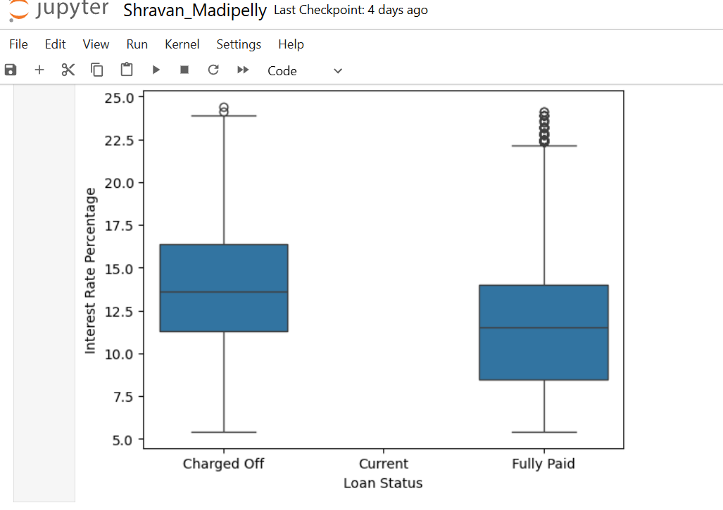
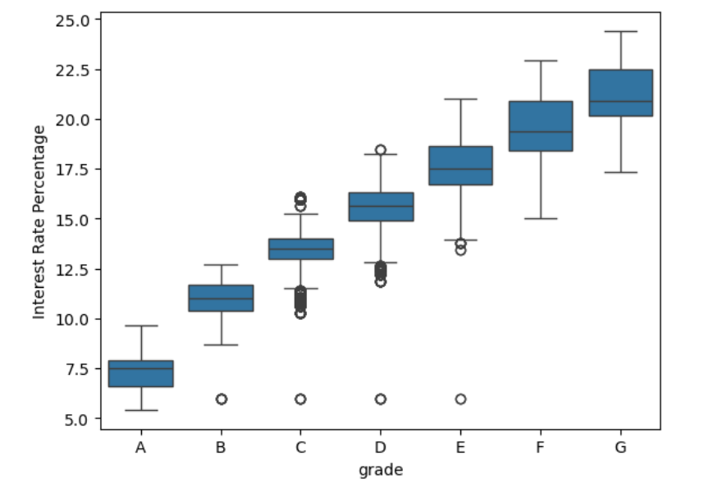
Univariate Analysis

Slide 10
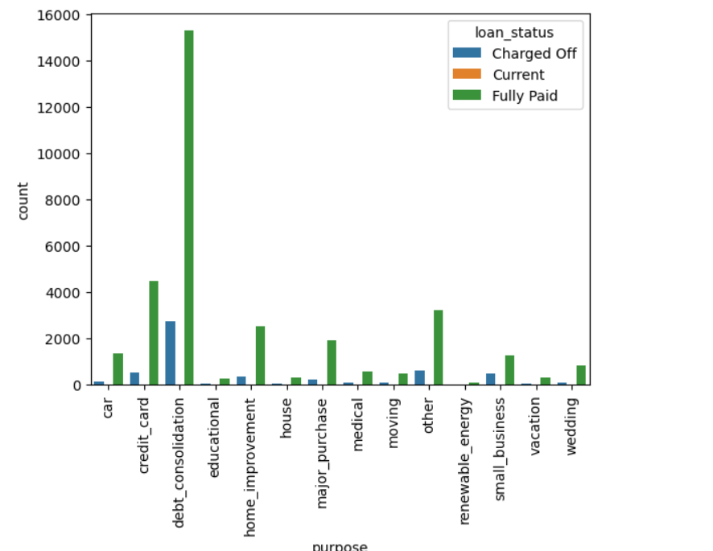
Segmented Univariate Analysis

Slide 11
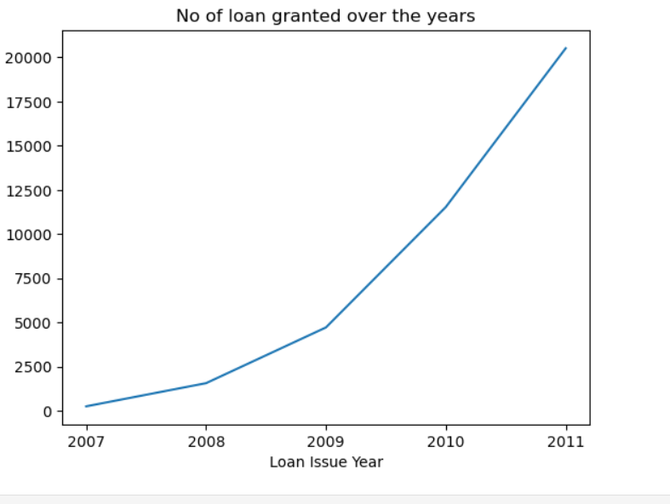
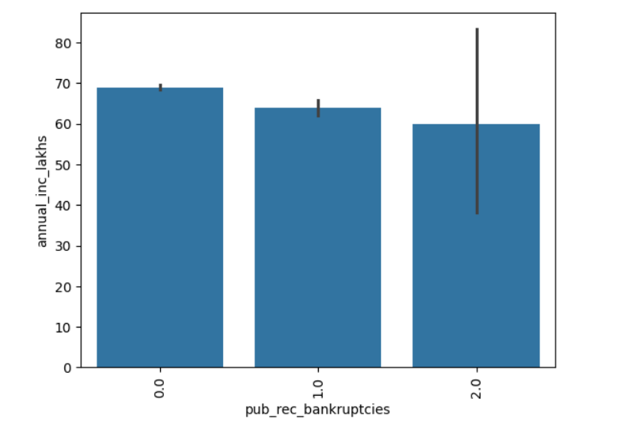
Bivariate Plots

Slide 12
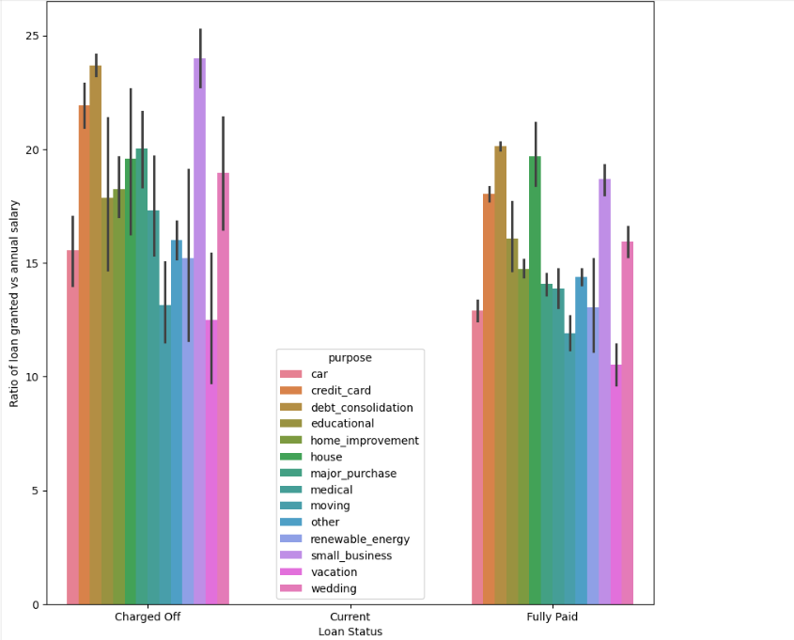
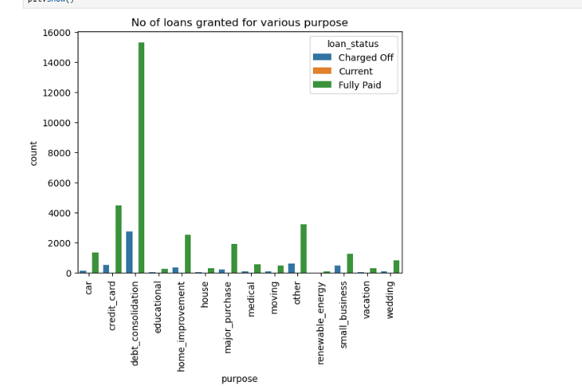
Purpose for applying Loan Analysis

Slide 13
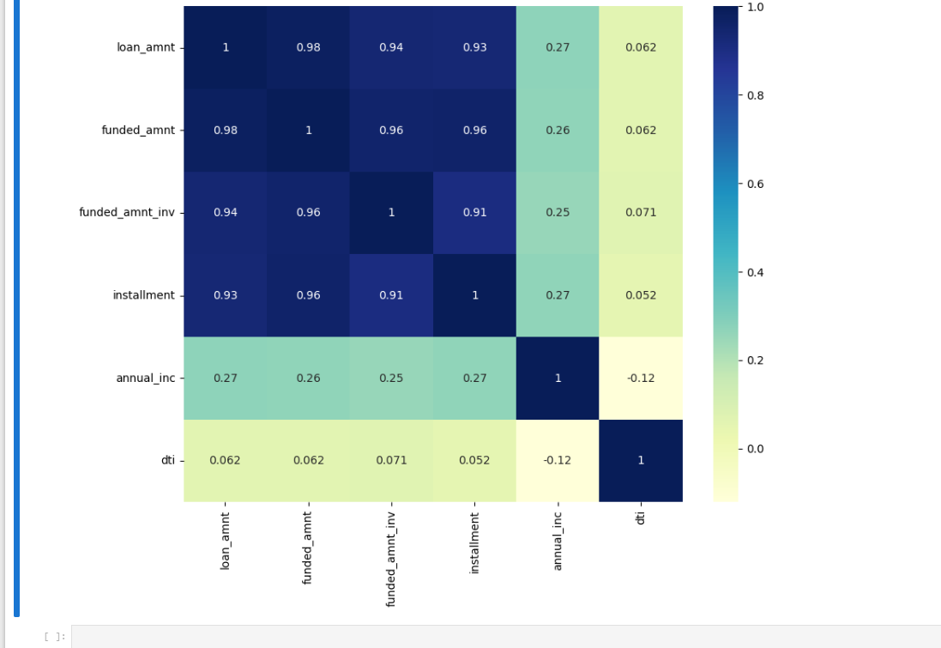
Multivariant analysis

Slide 14
Conclusion
Results
Low grade loans have high tendency to default. Grading system is working as expected.
Loans having higher interest rate have more defaulters. Check the background of applicant thoroughly if interest rate is high.
Extra scrutiny must be done for the applicants belonging to CA state, as tendency to default is high.
When the purpose is debt consolidation check applicant thoroughly as it has high tendency to default

