Slide 1
Team AMD
„Roboterspiel“ – „Robotergame“

Slide 2
Goal
Detect 3D printed letters and sort them based of their type or color
Sorting is based on a Universal Robot (https://www.universal-robots.com)
Object detection with the help of pyhton
Communication between roboter and python over TCP

Slide 3
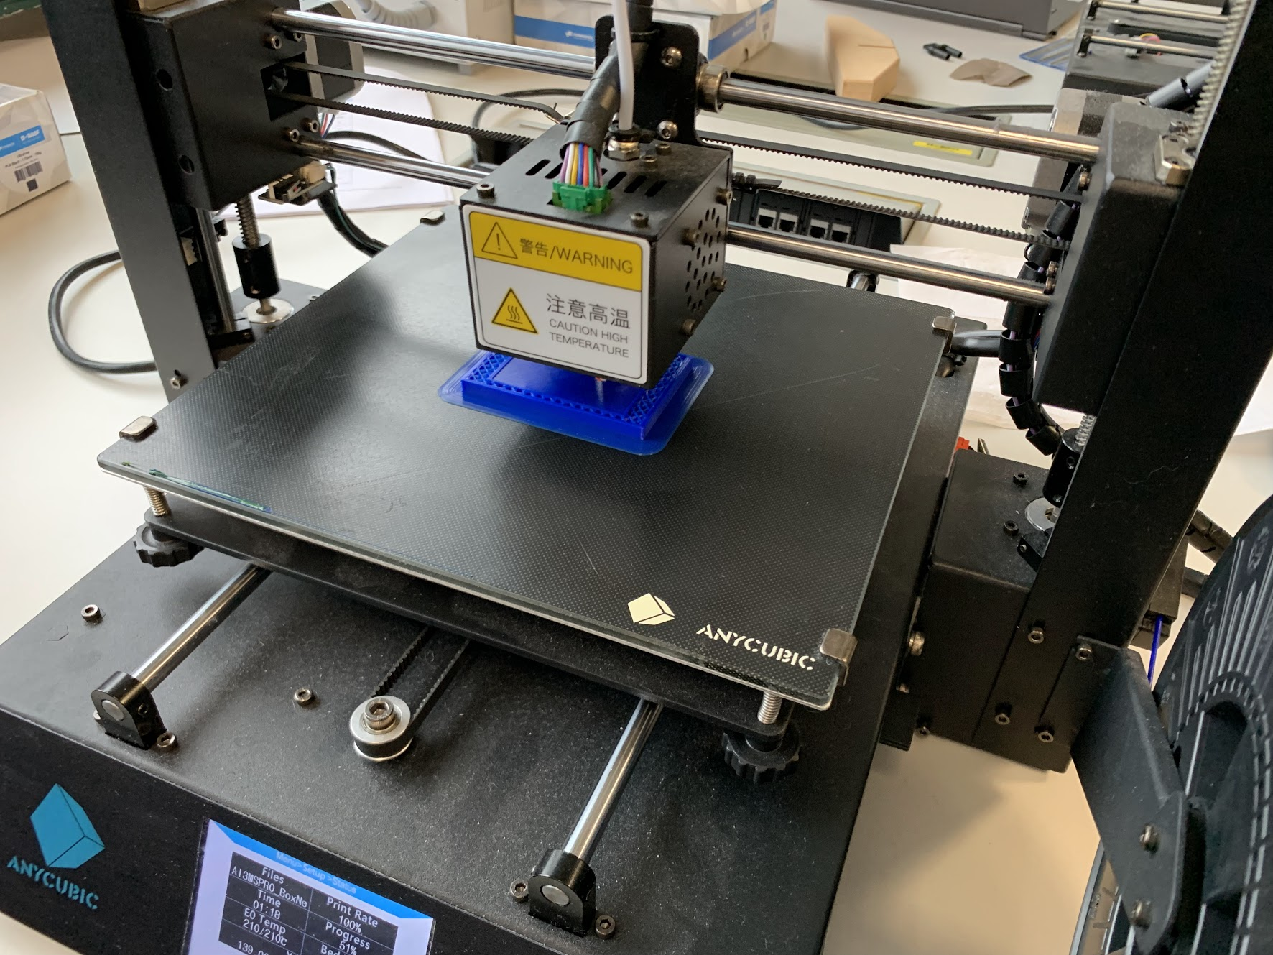
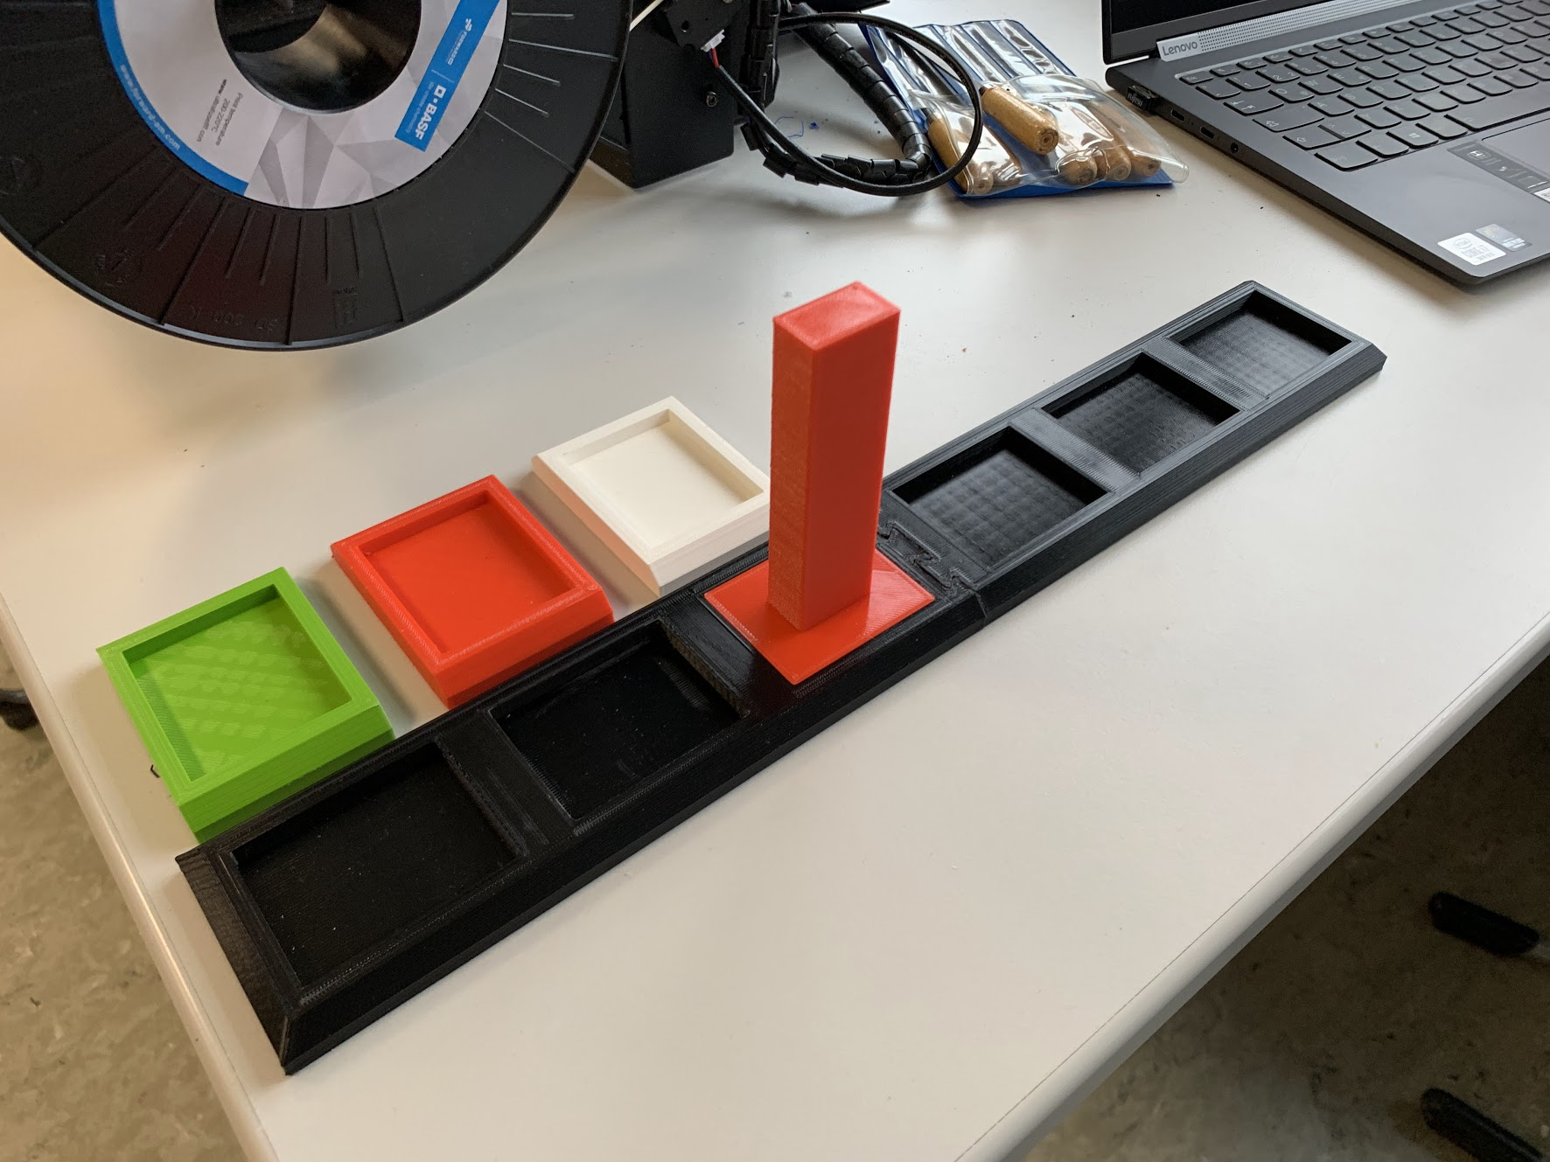
Current state
The 3D parts are constructed and half of them are already printed

Slide 4
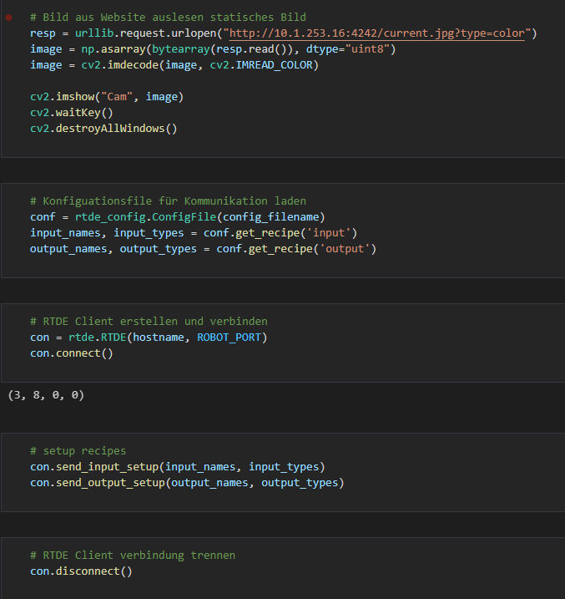
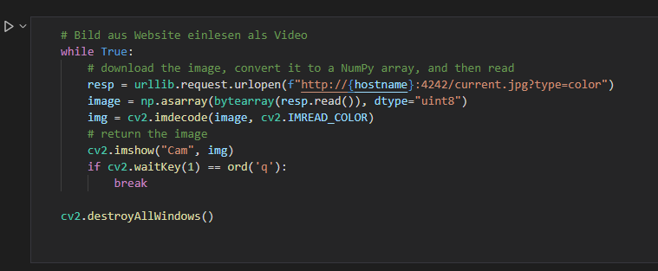
Current state
We can get a image from the roboter for the object recognition
and the basic for the rest of the communication are done
getting camera image
basics of the communication

Slide 5
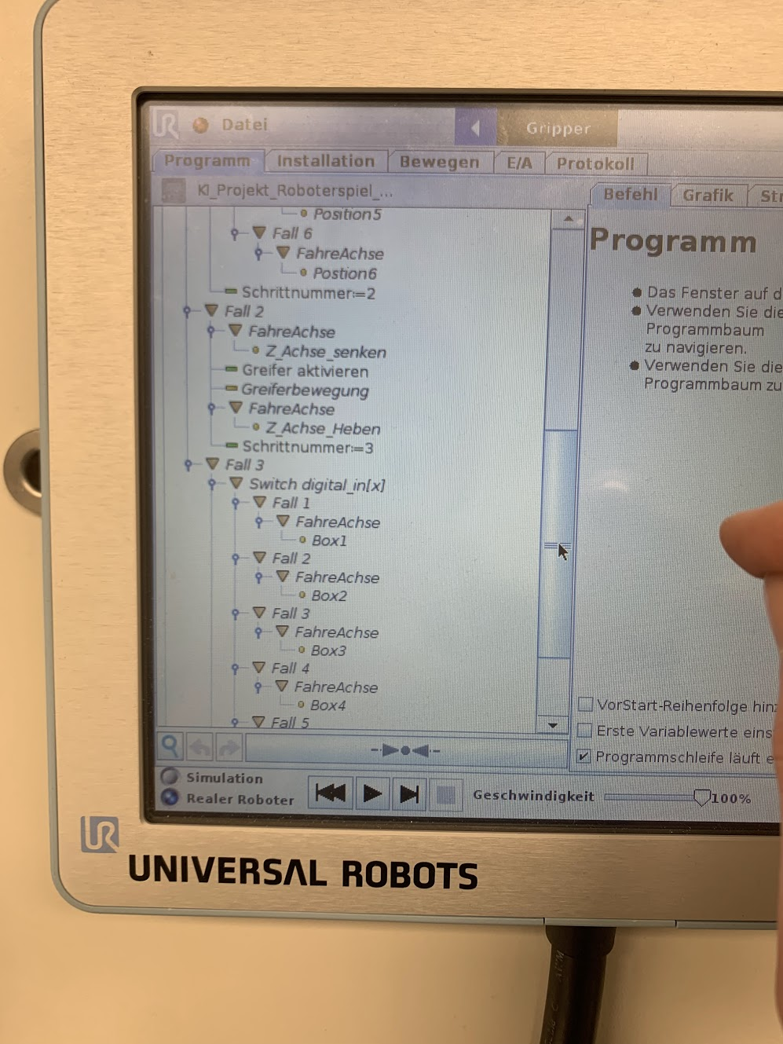
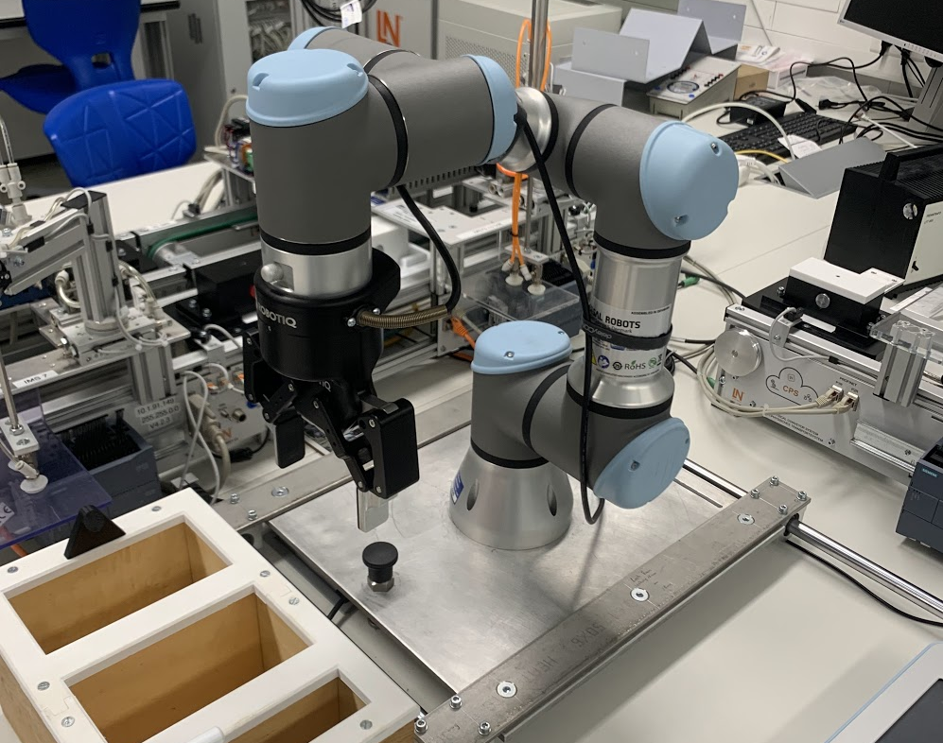
Current state
Some parts of the roboter programm are already created, but before we work on it again we want to print the last few pices

Slide 6
Next Steps
finish the 3D parts
getting the communication between laptop and roboter done
first tests with the roboter and the 3D parts

