Slide 1

Nullers Books
Ángel
Binwei
Daniel
Alexandru

Slide 2
Contenido
Arquitectura
Infraestructura
Elección de Tecnologías para
el Modelo de Datos
Análisis Tecnológico
Estimación de Gastos

Slide 3
Table of contents
01.
Objectives
03.
Results
02.
Methodology
04.
Conclusions
You can describe the topic of the section here
You can describe the topic of the section here
You can describe the topic of the section here
You can describe the topic of the section here

Slide 4
Table of contents
01.
02.
Presentation
Methodology
03.
04.
05.
Results
Conclusions
Bibliography
>
<
You can describe the topic of the section here
You can describe the topic of the section here
>
<
<
You can describe the topic of the section here
You can describe the topic of the section here
You can describe the topic of the section here
<

Slide 5
01
About generation of ‘27
You can enter a subtitle here if you need it

Slide 6
01
Presentation
You can enter a subtitle here if you need it

Slide 7
Introduction
Title of the thesis
Venus has a beautiful name and is the second planet in the Solar System. It’s terribly hot—even hotter than Mercury—and its atmosphere is extremely poisonous

Slide 8
Introduction
About generation of 27
Mercury is the closest planet to the Sun and the smallest one in the Solar System—it’s only a bit larger than the Moon. The planet’s name has nothing to do with the liquid metal since it was named after the Roman messenger god, Mercury

Slide 9
02
Methodology
You can enter a subtitle here if you need it

Slide 10
Methodology
Research
Analysis
Data Study
Comparison
Venus is the second planet from the Sun
Neptune is very far away from Earth
Despite being red, Mars is a cold place
Jupiter is the biggest planet of them all

Slide 11
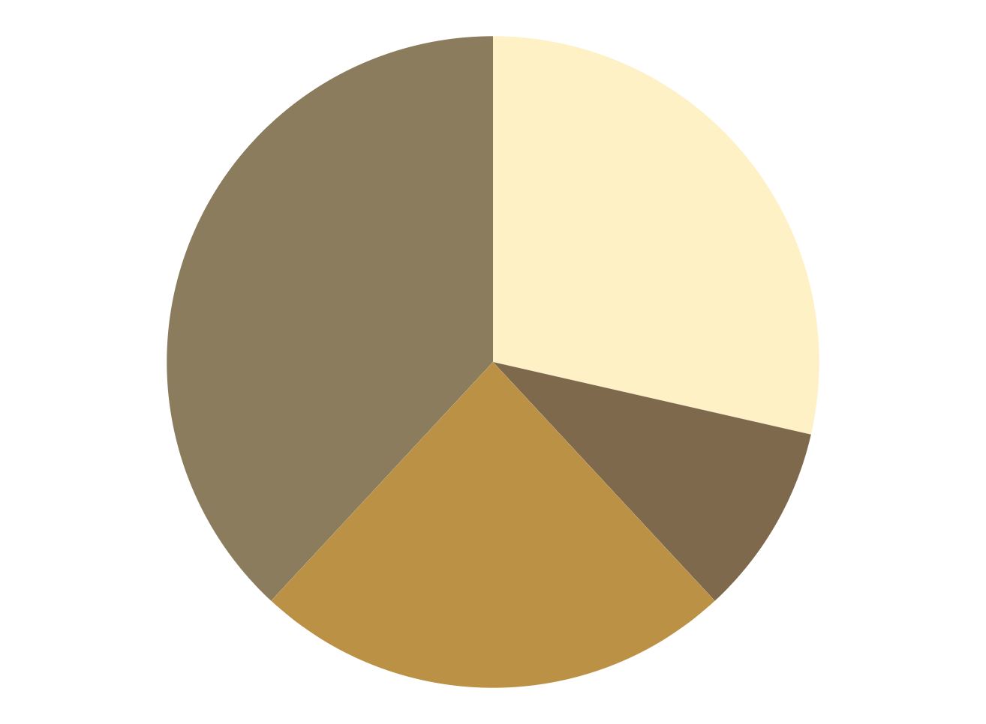
Methodology
Research
Analysis
Venus has a beautiful name, but it’s terribly hot
Jupiter is the biggest planet in the Solar System
Data Study
Comparison
Despite being red, Mars is actually a cold place
Saturn is the only planet with rings
To modify this graph, click on it, follow the link, change the data and paste the new graph here

Slide 12
Methodology
Research
Process
Jupiter is the biggest planet
Mercury is the smallest planet
Methodology
Idea
Income
Earth is the third planet from the Sun and the only one that harbors life in the Solar System. This is where we all live
Despite being red, Mars is cold
Venus has a nice name, but it’s hot
Aspiration
Goal
Saturn is a gas giant and has rings
Neptune is far away from Earth

Slide 13
“This is a quote, words full of wisdom that someone important said and can make the reader get inspired.”
—Someone Famous

Slide 14
Study objectives
Mercury
Venus
Mars
Mercury is the closest planet to the Sun and the smallest of them all
Venus has a beautiful name and is the second planet from the Sun
Despite being red, Mars is actually a cold place full of iron oxide dust

Slide 15
Study objectives
Research
Analysis
01
02
Jupiter is the biggest planet in the entire Solar System
Mercury is the smallest planet of them all
Data study
Comparison
03
04
Despite being red, Mars is actually a cold place
Venus is the second planet from the Sun. It’s really hot there

Slide 16
Study objectives
Despite being red, Mars is actually a cold place
Venus
01
Venus is the second planet from the Sun. It's hot there
Neptune is the farthest planet from the Sun
Saturn is a gas giant and has several rings
Mercury
02
Mercury is the smallest planet of them all
The Sun is at the center of our System
Earth is the third planet from the Sun
Ceres is located in the main asteroid belt
Jupiter
03
Jupiter is the biggest planet in the Solar System
Pluto is now considered a dwarf planet

Slide 17
Hypothesis
Mercury
Neptune
Mercury is the closest planet to the Sun and also the smallest one in the Solar System
It’s the farthest planet from the Sun and the fourth-largest in the entire Solar System

Slide 18
Hypothesis
Theory 1
Theory 2
Despite being red, Mars is cold. It's full of iron oxide dust, which gives the planet its reddish cast
Venus is the second planet from the Sun. It's hot there. It’s terribly hot, even hotter than Mercury
Jupiter
40%
Saturn
60%
Jupiter is a gas giant and the biggest planet
Saturn is a gas giant and has several rings
20%
80%
60%
40%
Mercury
Neptune
Venus
Mars
Mercury is the smallest planet
Neptune is far away from Earth
Venus is the second planet from the Sun
Mars is actually a cold place

Slide 19
Theories
Theory 1
Theory 2
Theory 3
Mercury is the closest planet to the Sun and the smallest one in the Solar System
Venus has a beautiful name and is the second planet from the Sun
Despite being red, Mars is a cold place, not hot. The planet is full of iron oxide dust

Slide 20
This is a map
Venus
Venus is the second planet from the Sun
Mercury
Mercury is the smallest planet
Earth
Earth is the only planet with life

Slide 21
Global vision
Jupiter
Mercury
Is a gas giant and the biggest planet of them all
Mercury is the smallest planet of them all
Mars
Venus
Despite being red, Mars is actually a cold place
Venus is the second planet from the Sun. It’s hot there

Slide 22
Literature Review
Theory 01
Theory 02
Mercury is the closest planet to the Sun and the smallest of them all
Despite being red, Mars is actually a cold place full of iron oxide dust

Slide 23
Literature review
Theory 02
Venus has a beautiful name and is the second planet from the Sun. It’s hot and has a poisonous atmosphere
Theory 01
Mercury is the closest planet to the Sun and the smallest one in the Solar System—it’s only a bit larger than the Moon

Slide 24
Objectives
Mercury
It’s the smallest planet of them all
Mars
Jupiter
Venus
Mars is actually a very cold place
Jupiter is the biggest planet of them all
Venus has extremely high temperatures
Saturn
Neptune
The Sun
Earth
Pluto
Ceres

Slide 25
Invested time
40%
20%
25%
15%
Jupiter
Mercury
Mars
Venus
Jupiter is the biggest planet in the entire Solar System
Mercury is the smallest planet of them all
Despite being red, Mars is actually a cold place
Venus is the second planet from the Sun. It's hot there

Slide 26
Primary objectives
Venus
Saturn
Jupiter
Mars
1
4
Jupiter is the biggest planet of them all
Neptune is very far away from Earth
Venus is the second planet from the Sun
Despite being red, Mars is a cold place
2
3

Slide 27
Secondary objectives
Mercury
Venus
Mars
Saturn
Earth
Jupiter
Mercury is the closest planet to the Sun
Venus has a beautiful name and high temperatures
Despite being red, Mars is actually a cold place
Saturn is a gas giant and has several rings
Earth is the third planet from the Sun
Jupiter is a gas giant and the biggest planet

Slide 28
Awesome
words

Slide 29

Your work
You can replace the image on the screen with your own work. Just delete this one, add yours and center it properly

Slide 30
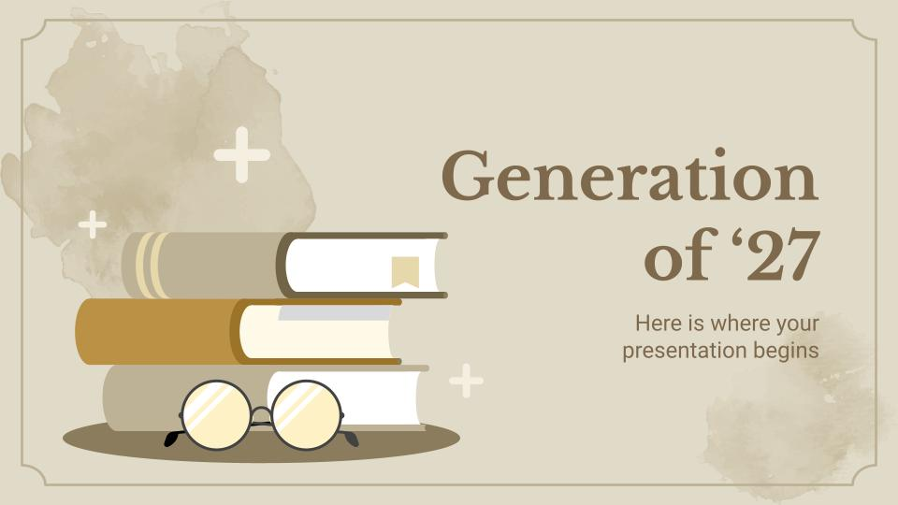
Your work
You can replace the image on the screen with your own work. Just delete this one, add yours and center it properly

Slide 31


Multimedia
If you want, you can insert your multimedia content here

Slide 32
Study program
Checklist
Status | Description | Status | Description
03/04 | Mercury is the smallest planet of them all | 04/03 | Jupiter is the biggest planet in the Solar System
03/07 | Venus has a beautiful name and is the second from the Sun | 04/09 | Neptune is the farthest planet from the Sun
03/10 | Despite being red, Mars is actually a cold place | 04/11 | The Sun is the star at the center of the Solar System
03/21 | Saturn is a gas giant and has several rings | 04/15 | Earth is the third planet from the Sun and where we all live

Slide 33
Schedule
1st phase
2nd phase
1st week
Mo
Tu
We
Th
Fr
Sa
Su
2nd week
Mo
Tu
We
Th
Fr
Sa
Su
3rd phase
4th phase

Slide 34
Schedule
February
March
April
Jupiter is a gas giant and the biggest planet in the Solar System
Venus has a beautiful name, but also very high temperatures
Despite being red, Mars is actually a cold place. It’s full of iron oxide dust
1
2
3

Slide 35
Schedule
May
June
It’s the closest planet to the Sun and the smallest in the Solar System
Despite being red, Mars is actually a cold place. It’s full of iron oxide dust
Investigation completed
4
5

Slide 36
Schedule
 | 1st week | 2nd week | 3rd week | 4ht week | 5th week
Research
Analysis
Data study
Comparaison

Slide 37
1,927
Big numbers catch your audience's attention

Slide 38
Table
 | Test 1 | Test 2 | Test 3 | Test 4
Indicator 1
Indicator 2
Indicator 3
Indicator 4

Slide 39
Comparation
 | Goals | Result
1st phase | Mercury is the closest planet to the Sun | Venus is the second planet from the Sun
2nd phase | Mars is actually a very cold place | Jupiter is the biggest planet of them all
3rd phase | Saturn is composed of hydrogen and helium | Neptune is the farthest planet from the Sun
4th phase | Saturn is a gas giant and has several rings | Despite being red, Mars is a cold place

Slide 40
Timeline
Mercury
Mars
Mercury is the closest planet to the Sun
Now
Mars is actually a very cold place
Venus
1927
2027
Venus is the second planet from the Sun

Slide 41
Study timeline
“Mercury is closest planet to the Sun and the smallest”
“Despite being red, Mars is actually a very cold place”
1st week
2nd week
3rd week
4th week
Finish
“Venus is the second planet from the Sun and is terribly hot”
“Neptune is the farthest-known planet from the Sun”
“Earth is the only planet known to harbor life. We all live here”

Slide 42
Important percentages
33.5%
26.7%
18.2%
Mercury is the closest planet to the Sun
Despite being red, Mars is a cold place
Saturn is the only planet with rings

Slide 43
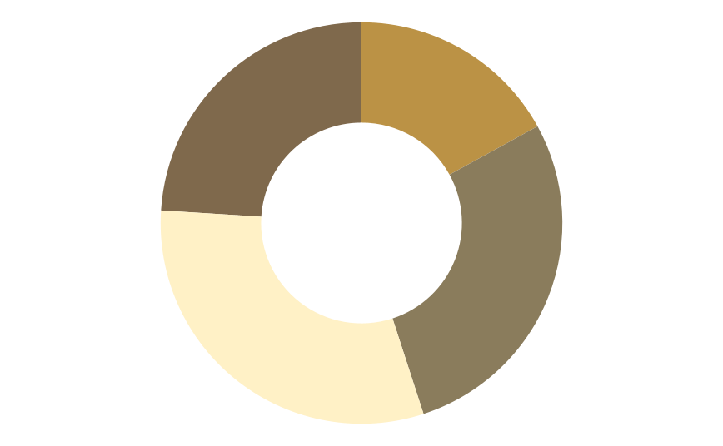
Important percentages
24%
17%
Phase 4
Phase 1
Mercury is small
Jupiter is big
31%
28%
Phase 3
Phase 2
Follow the link in the graph to modify its data and then paste the new one here. For more info, click here
Venus is hot
Saturn has rings

Slide 44
Important percentages
20%
35%
60%
50%
Jupiter
Mercury
Venus
Mars
Jupiter is the biggest planet in the entire Solar System
Mercury is the smallest planet in the Solar System
Venus is the second planet from the Sun. It's hot there
Despite being red, Mars is actually a very cold place

Slide 45
nullers
Estimación de gastos

Slide 46
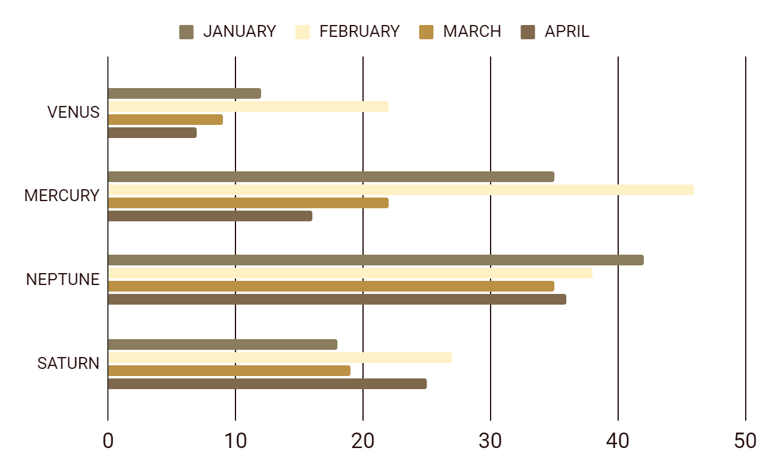
Results analysis
To modify this graph, click on it, follow the link, change the data and paste the new graph here

Slide 47
Investigation results
Venus
Mars
Venus is the second planet from the Sun
Despite being red, Mars is a very cold place
40%
70%
Mercury
Neptune
Mercury is the smallest planet of them all
Neptune is the farthest planet from the Sun
10%
30%
Jupiter
Saturn
Jupiter is the biggest planet in the Solar System
Saturn is a gas giant and has several rings
50%
60%

Slide 48
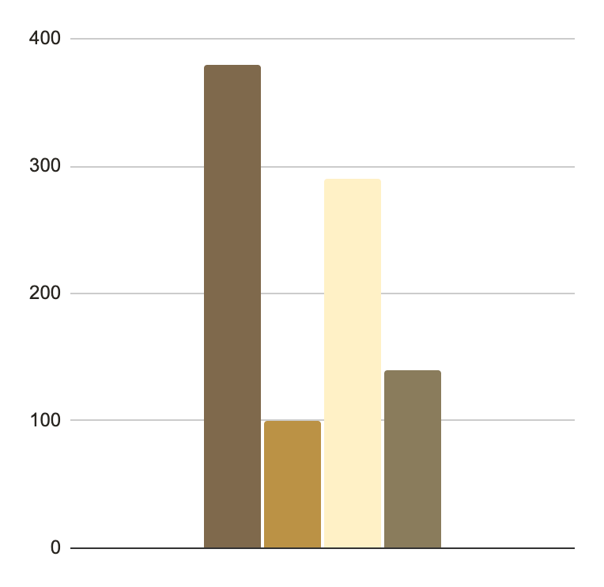
Research results
380
290
Jupiter
Mercury
Jupiter is the biggest planet in the entire Solar System
Mercury is the smallest planet of them all
100
140
Mars
Venus
Follow the link in the graph to modify its data and then paste the new one here. For more info, click here
Despite being red, Mars is actually a cold place
Venus is the second planet from the Sun. It’s hot there

Slide 49
Results analysis
Mercury
Jupiter
Venus
Mercury is the smallest planet of them all
Is the biggest planet in the Solar System
Venus is the second planet from the Sun
20%
50%
75%
Despite being red, Mars is actually a cold place
Neptune is the farthest planet from the Sun
Saturn is a gas giant and has several rings

Slide 50
Conclusions
04
You can enter a subtitle here if you need it

Slide 51
Conclusions
Conclusion A
Conclusion C
Conclusion B
Conclusion D
You can talk about the conclusions here
You can talk about the conclusions here
You can talk about the conclusions here
You can talk about the conclusions here

Slide 52
Public conclusions
Jupiter
40%
Jupiter is the biggest planet of them all
Mars
60%
Despite being red, Mars is actually a cold place
Venus
20%
Venus is the second planet from the Sun
Mercury
75%
Mercury is the smallest planet of them all

Slide 53
Conclusions
1
Mercury
Mercury is the closest planet to the Sun and the smallest one in the Solar System—it’s only a bit larger than the Moon
Venus
2
Venus has a beautiful name and is the second planet from the Sun. It’s terribly hot—even hotter than Mercury—and its atmosphere is extremely poisonous

Slide 54
Conclusion in numbers
200K
175K
Venus is the second planet from the Sun. It's hot there
Saturn is a gas giant and has several rings
Result analysis
Earth is the third planet from the Sun and the only one that harbors life in the Solar System
40K
135K
Jupiter is the biggest planet in the Solar System
Mercury is the smallest planet of them all

Slide 55
Numbers speak for themselves
333,000
24h 37m 23s
Earths is the Sun’s mass
is Jupiter’s rotation period

Slide 56
05
Bibliography
You can enter a subtitle here if you need it

Slide 57
Bibliographic references
AUTHOR (YEAR): Title of the publication. Publisher
AUTHOR (YEAR): Title of the publication. Publisher
AUTHOR (YEAR): Title of the publication. Publisher
AUTHOR (YEAR): Title of the publication. Publisher
AUTHOR (YEAR): Title of the publication. Publisher
AUTHOR (YEAR): Title of the publication. Publisher

Slide 58
Bibliographic references
Author | Tittle
Neptune | Neptune is the farthest planet from the Sun
Mercury | Mercury is the smallest planet of them all
Mars | Despite being red, Mars is actually a cold place
Saturn | Saturn is a gas giant and has several rings
The Sun | The Sun is the star at the center of our System
Notes
Venus has as a beautiful name and is the second planet from the Sun. It’s terribly hot and its atmosphere is extremely poisonous. It’s the second-brightest natural object in the night sky after the Moon

Slide 59
Gracias
Do you have any questions?
youremail@freepik.com
+91 620 421 838
yourcompany.com
Please keep this slide for attribution

