Slide 1
Final Presentation Group Two
Kenneth, Hashim, Jeffery, Mohamed, Madison

Slide 2
Intro & Objectives
A full-stack application that provides real-time threat analysis
User Authentication | Secure registration and login using hashed passwords (bcrypt)
Secure Data Storage | PostgreSQL with parameterized queries to prevent SQL injection
Secure Log In | CSRF Protected; session-based authentication with token storage
User Activity | Actively logged within the system via backend logging
Input Validation | All form fields sanitized; inputs checked server-side
Session Management | Secure server-side sessions with logout/timeout enforcement

Slide 3
System Architecture & Tech Used
OSINT Specialist
Risk Analyst
Shodan (scanning IPs & retrieving data based on parameters), VirusTotal
Python, OpenAI GPT-4 API, Node.js, Flask, NIST CSF/RMF frameworks, risk threshold modeling, alerting frameworks, cost-benefit analysis tools, OWASP Risk Assessment Framework
Main Developer
Git Admin
Flask, PostgreSQL, JSX, Node.js, Express.js, psycopg2-binary, Axios, Hugging Face AI, httpx, dotenv, flask-cors, cryptography, and SendGrid, EPSS, OSV APIs
PostgreSQL, Node.js, Flask, yaml, OpenAI GPT-4 API

Slide 4
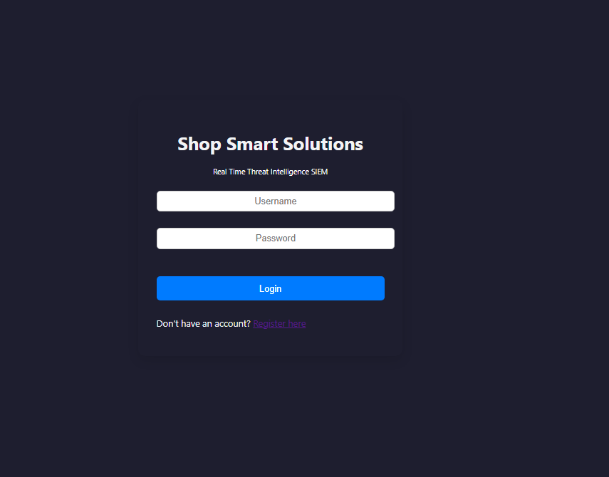
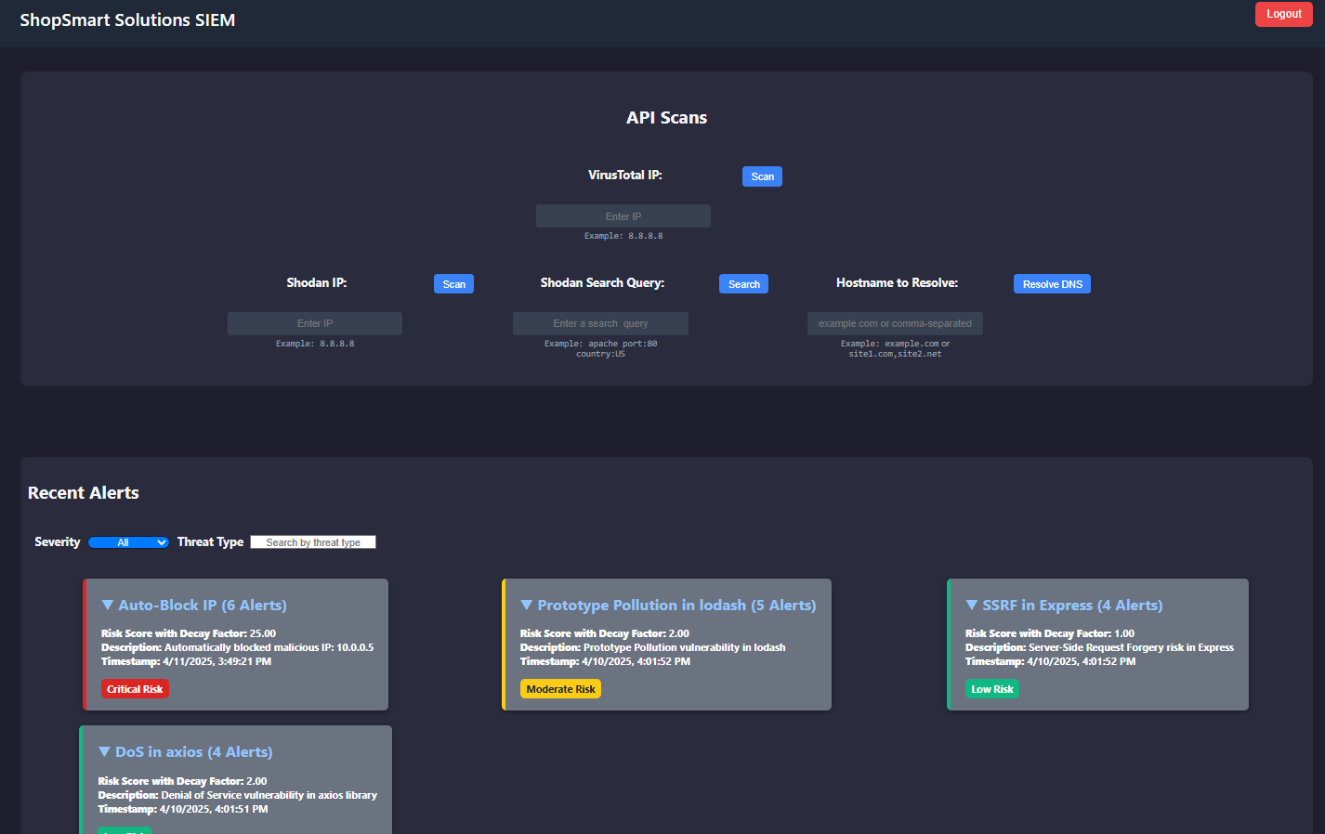
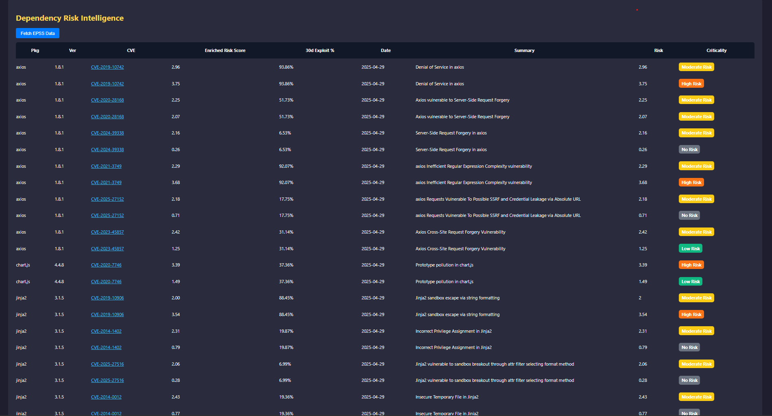
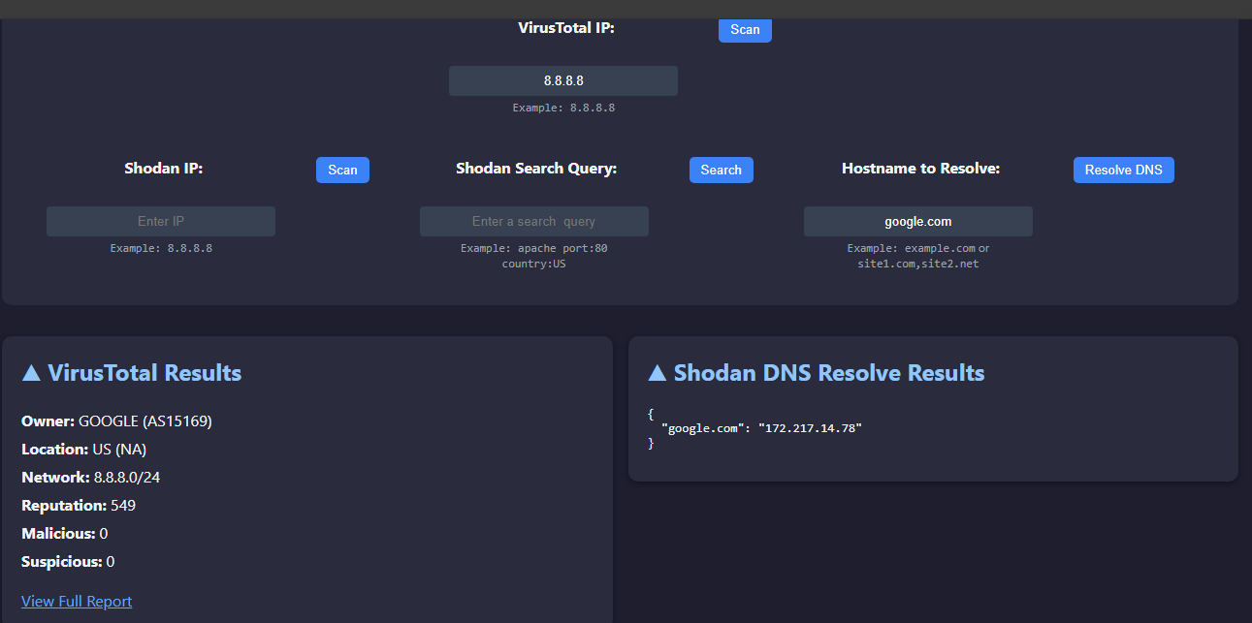
System Demo

Slide 5
Security Features & Risk Management
Measures
Risk Management
CSRF Tokens
Input Validation
API Key Protection
Rate Limiting
Session Management
Environment Variables
Access Control
Secure Headers
Output Encoding
CORS Handling
Secure Cookies
Dependency Audits
Active CVE Scanning

Slide 6

Testing & Evaluation
Key Tests Conducted
Shodan API Integration:
Validates the structure of the data returned for an IP (checks for dictionary format, ports key, and list type for ports).
VirusTotal API Integration:
Verifies that the data returned for a domain includes the malicious key and ensures it is an integer.
Evaluation Metrics
Test Coverage: Ensures the APIs return correctly structured and essential data.
Data Integrity: Confirms the response matches expected formats and values

Slide 7
Challenges → Solutions
Challenges
Solutions
Maintaining secure communication between frontend and backend.
Combining scan data with live CVE and EPSS feeds in real time.
Implemented CSRF protection, session-based authentication, and used parameterized queries to defend against SQL injection.
Created an asynchronous enrichment pipeline using OSV + EPSS APIs, integrated with Hugging Face to score risks and display them in the dashboard.

Slide 8
Future Improvements
Enhancements in RBACs
Broader API Integrations for richer and more diverse data sources
User Customerization
Contectional Help
(“What’s this?”)

