Slide 1
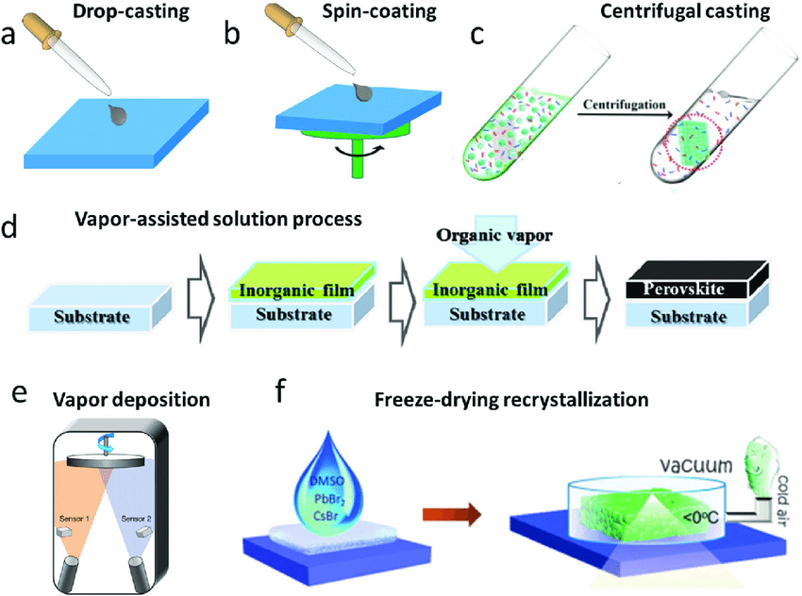
Types of Thin Film Production
Notes:
drop-castin>easy but not uniform layer,

Slide 2
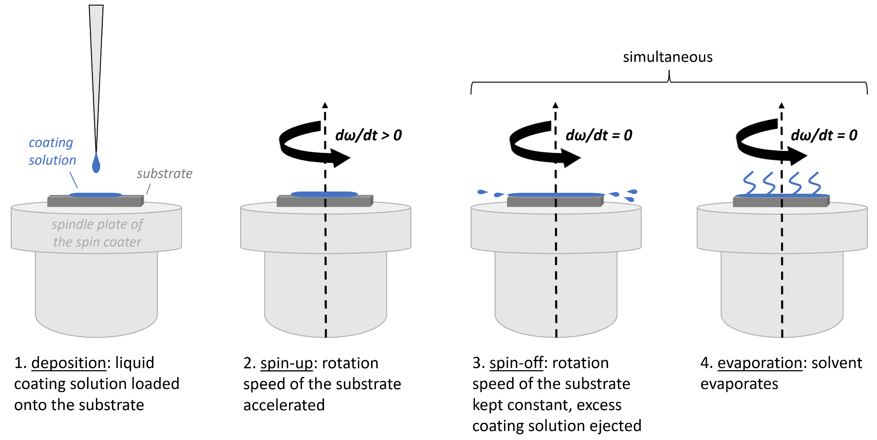

Slide 3
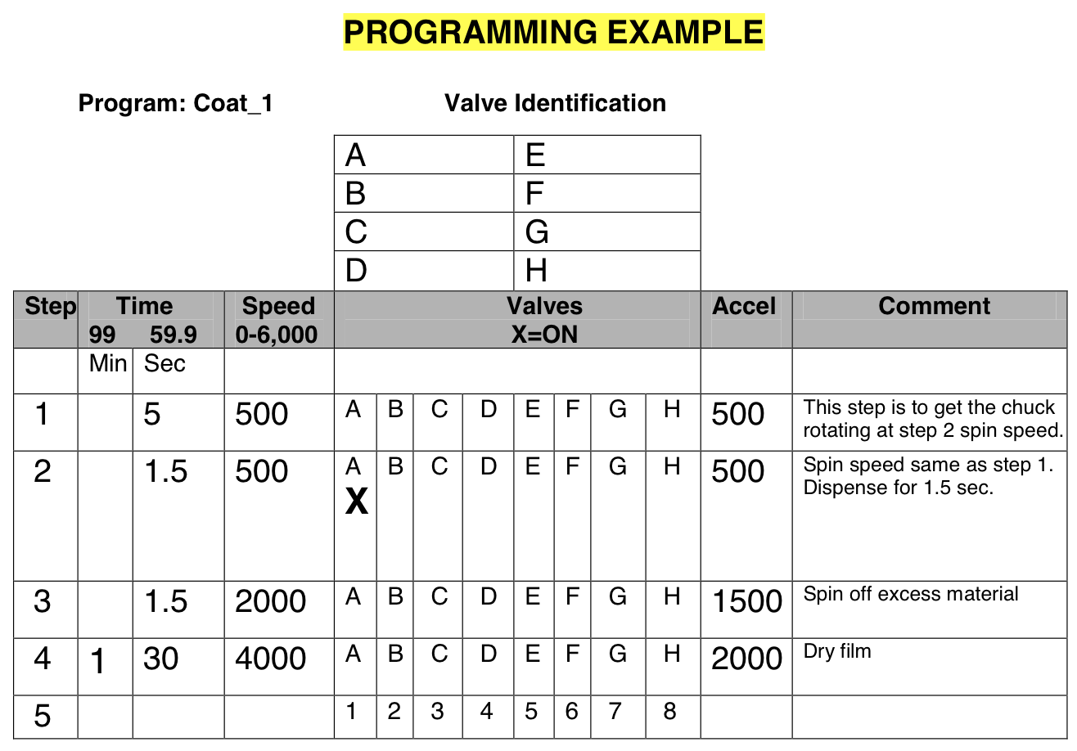
Software Controlled Variables
Spin speed
Spin acceleration
deposition method (dynamic vs static)
Number of steps
Vacuum
Temperature
Notes:
Dynamic(better-less time for evaporate before spin, but can be difficult to get full coverage at low rpm, uses less solution) vs Static(for low rpm or viscous, better so use less solution)

Slide 4
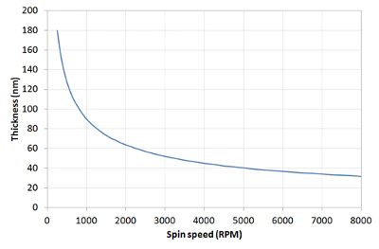

Solution Variables
Solvent
Concentration
Evaporation rate
Viscosity
Pressure
Humidity

Slide 5
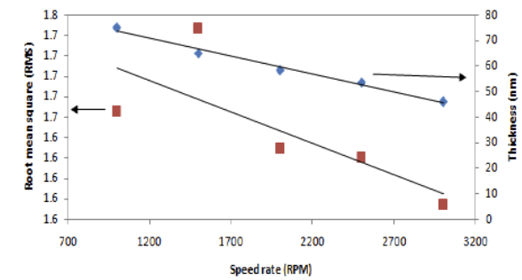
Possible methods
https://www.researchgate.net/publication/315894544
PTAA/Chloroform solution
“The thicknesses of the film measured using the Profilometer were at 74.91 nm, 65.10 nm, 58.45 nm, 53.65 nm and 45.81 nm, for the spin rat of 1000 rpm, 1500 rpm, 2000 rpm, 2500 rpm and 3000”
h∝ω^(-3/2)
https://opg.optica.org/directpdfaccess/c893b4d7-f0b4-4700-a5fcb7f893dfe5d0_439773/prj-8-10-a39.pdf?da=1&id=439 73&seq=0&mobile=no
15nm PTAA
2.5 mg/ml in Chlorobenzene,(static application) 500rpm for 5s (500rpm/s), 4500 rpm for 30s (1000rpm/s)
Annealed on hot plate at 105C for 10 min and cooled to 25C.

