Slide 1
Thermal Evaporation

Slide 2
Thin-Film Deposition
Physical Vapor Deposition
Chemical Vapor Deposition
What we’re using!
Evaporation
Sputtering
Thermal
Electron Beam
Ion Beam
Magnetron

Slide 3
Physical Vapor Deposition (PVD)
Used to deposit very thin films of a material (on the scale of nanometers to micrometers), particle-by-particle
Occurs in a vacuum (very low air pressure, very few air molecules to collide with/slow down material particles or contribute to defects/impurities in the deposited material)
Alternative to Chemical Vapor Deposition (CVD), in which a reaction occurs on the substrate to deposit the material
Two most common types:
Sputtering
Evaporation

Slide 4
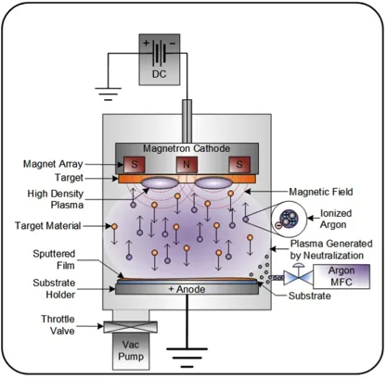
PVD - Magnetron Sputtering
Target material (the material we want to deposit) is placed on the cathode in an electrolytic cell (has a negative charge/excess of electrons)
An inert gas (typically Argon) is introduced into the cell
As electrons move from cathode to anode, they “knock” valence electrons off the Argon atoms, creating Argon cations
Argon cations are attracted to the negative cathode and strike the target material, “knocking” particles of target off
Target particles “fly” towards and land on the substrate (which sits on the positive anode)
The strength of the magnetic field (and thus the movement of particles/rate of deposition) is controlled with a magnetron

Slide 5
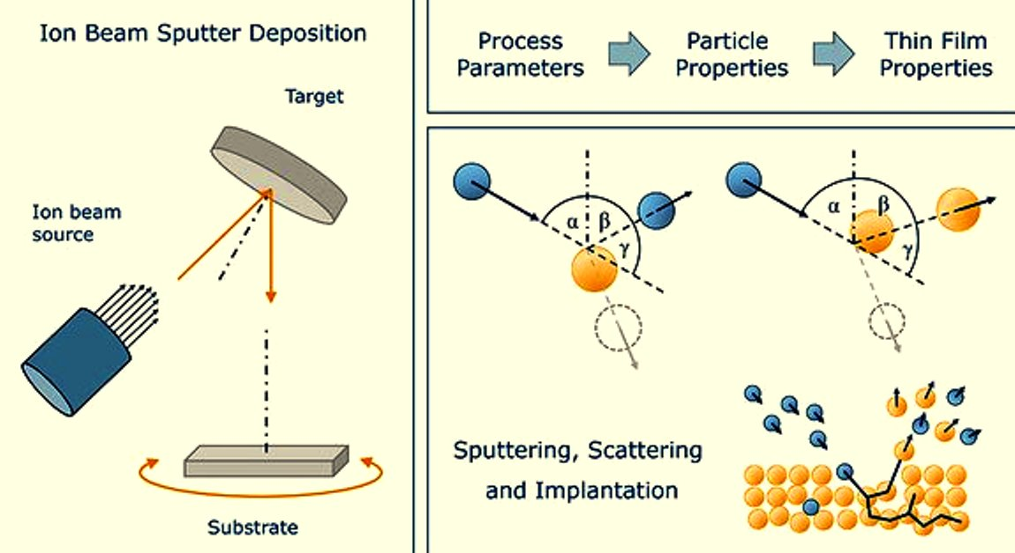
PVD - Ion Beam Sputtering
Particles are still dislodged by fast-moving ions (“sputtered”), but this time a focused beam of charged ions is used
Most “accurate” (most controlled process, so most uniform deposition, least impurities) of all options
Most expensive, most stressful for material, slowest rate of deposition by far (1-2 angstroms/s)

Slide 6
More Sputtering Considerations
Bombardment can heat up the target material too much, damaging it
Slower than evaporation, but more “accurate” (less impurities) and effective for metals
More expensive/complex than evaporation

Slide 7
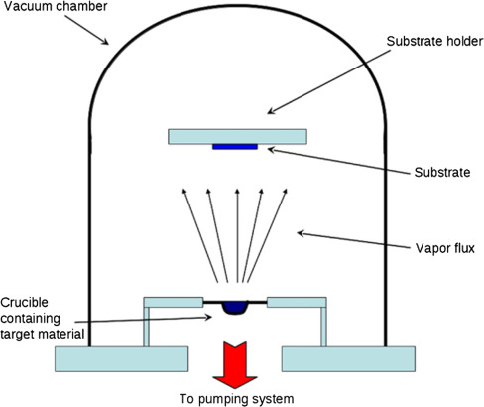
Resistive Thermal Evaporation
Target material is heated in a crucible (using a resistive heating source) to its boiling point
Volatilized particles move towards and deposit on substrate
Similar to boiling water condensing on the inside of a lid in a closed pot (happens faster in a vacuum, with less other air molecules to “block the way”)
Only suitable method for deposition (of the four presented) for nonmetals

Slide 8
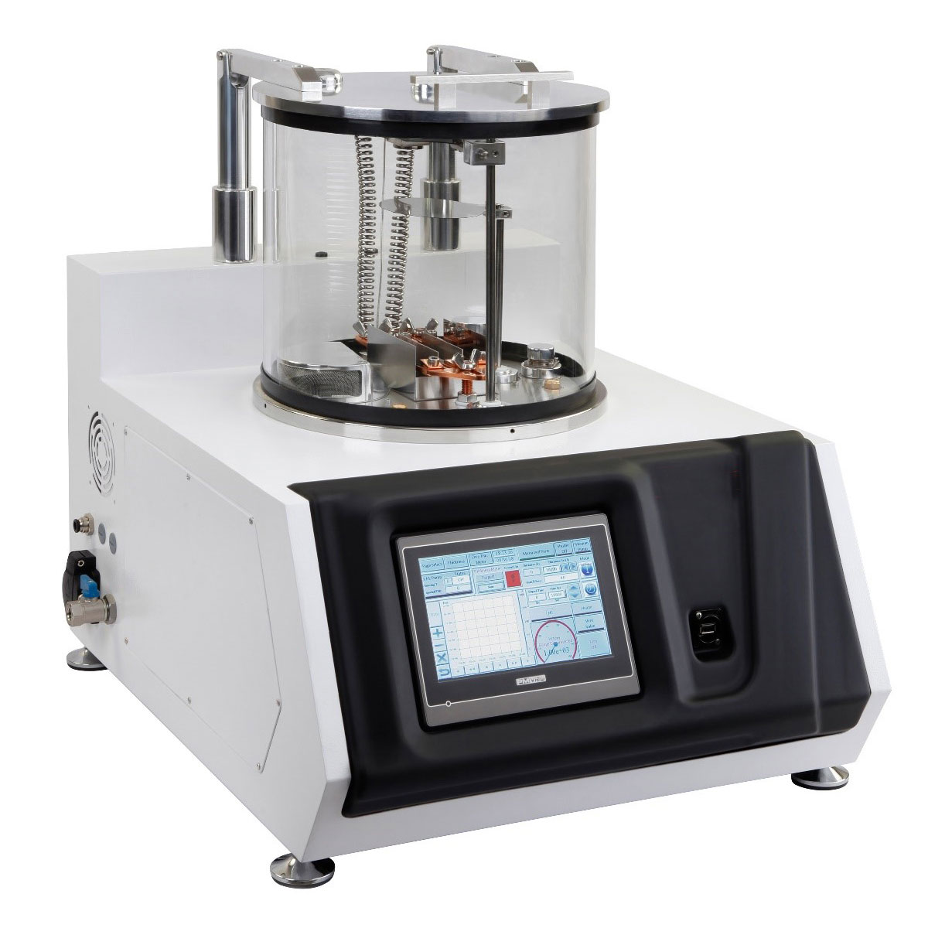
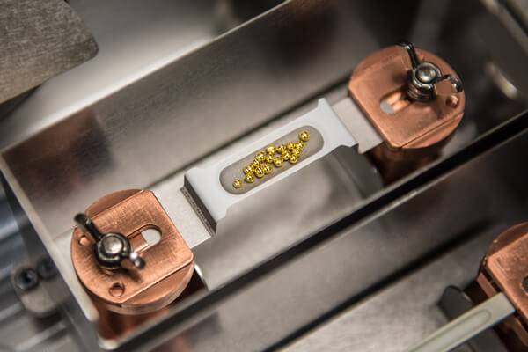
Thermal Evaporator with Crucible

Slide 9
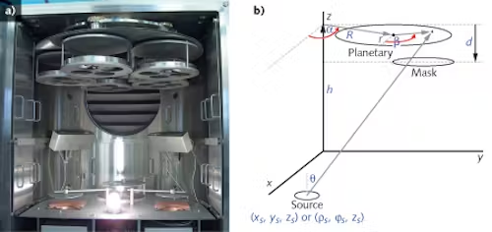
Electron Beam Evaporation
Similar procedure as thermal evaporation, but use a focused electron beam instead of a resistive heater (similar analog as ion beam sputtering)
“Better” (more uniform, less impurities, higher rate of deposition), if you’re willing to…
Pay more (more expensive)
Use a planetary and mask to control uniformity
Less efficient for larger surfaces

