Slide 1

Residential vs. Commercial Project: A Real Estate Risk Simulation
Based on the Case Study of Crawford Development Company & Southwest Bank of Texas
AD 616: Enterprise Risk Analytics
Madison Costanza
December 2022

Slide 2
The Business Problem:
Crawford Development Company (CDC) is seeking to take a loan of $38.375 from Southwest Bank of Texas (SBT) with a three-year maturity.
The analysis will take both parties’ perspectives:
Should the development company use these funds to build a residential or commercial development?
What interest rate should the bank charge to compensate for the riskier development option?

Slide 3

01
Investment Background
02
Modeling and Simulation
03
Result and Risk Analysis
04
Conclusion & Recommendations

Slide 4

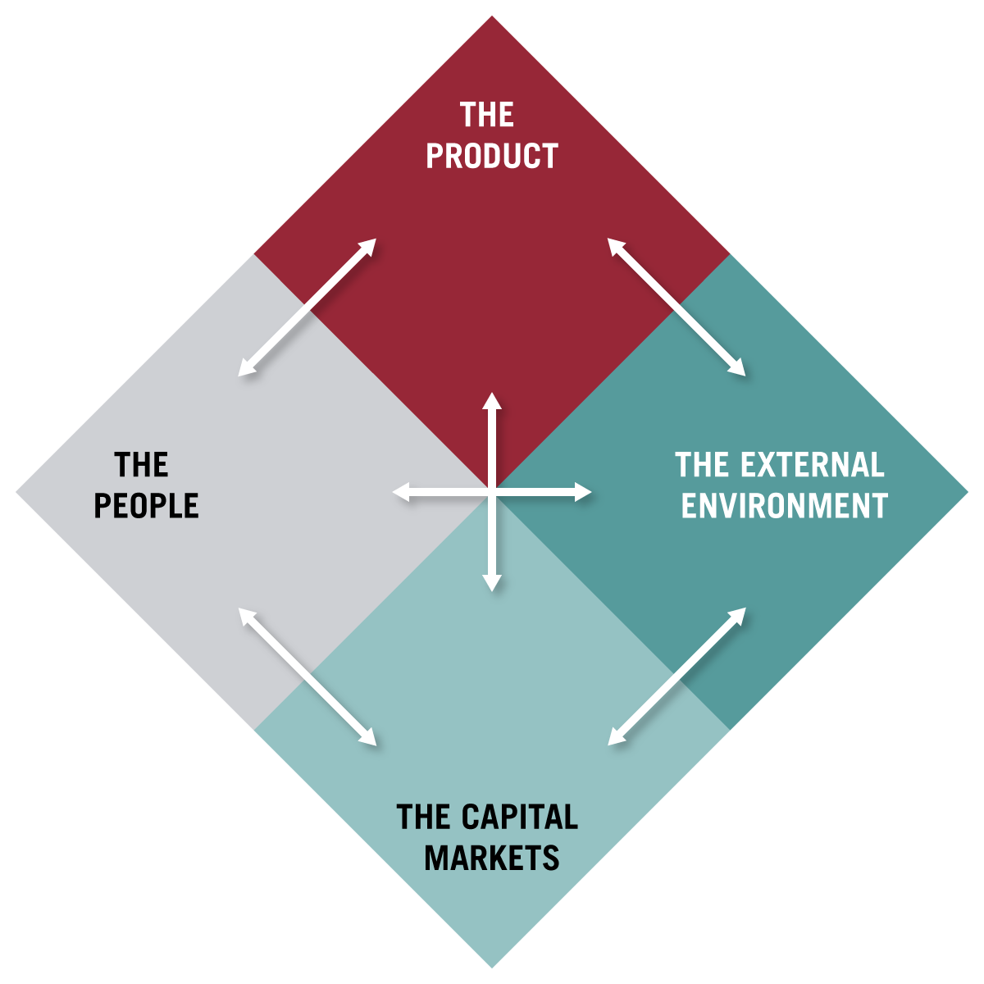
Investment Background
Diamond Framework for Real Estate Investment:
Product, People, External Environment, and Capital Markets
1. Product
Residential Market: Houston 2007
The residential market experienced a slowdown in growth during the spring of 2007. However, the Houston market has held up relatively well compared to other regions, and in July 2007, sales rebounded, and the value of properties sold increased.
Construction costs for the residential project could vary within 10% of the expected $20M in Oct ‘07, then a certain $9M in Jul ‘08 and $10.2M in Jul ‘09.
This project could produce nearly twice the sales expected from the office project: $130M if energy prices remain strong & job growth continues in the Houston area; worst case $20M and most likely $42.3M.
Commercial Market: Houston 2007
Houston’s commercial market is booming in 2007 due to the expansion of oil and gas companies and high demand for office space. The vacancy rate is at its lowest level in nearly a decade (10.6%), and rental rates are increasing.
Increasing absorption rates and price trends indicate that an office development could potentially be prosperous, with minimized downside.
Construction costs of this project include a certain $20M in Oct ‘07, $9M in Jul ‘08, and $10.2M in Jul ’09.
Expected sales are to be estimated from historical data; no dramatic potential upside, but attractive IRR of 12%.

Slide 5
Investment Background
Diamond Framework for Real Estate Investment:
Product, People, External Environment, and Capital Markets
2. People
3. External Environment
The case study highlights a long-standing relationship between CDC and SBT.
Peter Kloeckner, the business loan manager at SBT, has known Andy Crawford, the owner of CDC, for several years. This relationship implies a level of trust and familiarity that can influence decision-making and negotiations.
A Credit crunch is beginning to unwind in the residential mortgage market.
There have been eight recent consecutive interest rate increases by the Federal Reserve.
Further deterioration in the housing market is expected by most analysts.

Slide 6
Investment Background
Diamond Framework for Real Estate Investment:
Product, People, External Environment, and Capital Markets
4. Capital Environment
4. Capital Environment
Residential Project Capital Availability
For this project (deemed riskier) SBT is considering offering an interest rate between 7-11%, all with different probabilities that CDC accepts the loan:
7%: 100% probability CDC accepts loan
8%: 75% probability CDC accepts loan
9% 50% probability CDC accepts loan
10%: 25% probability CDC accepts loan
11%: 0% probability Crawford accepts loan
Commercial Project Capital Availability
Due to the stable commercial market compared to the residential market, SBT is willing to offer CDC a 7% interest rate on the $38.375 loan.

Slide 7
Presentation Agenda
01
Investment Background
02
Modeling and Simulation
03
Result and risk analysis
04
Conclusions
05
Recommendations

Slide 8
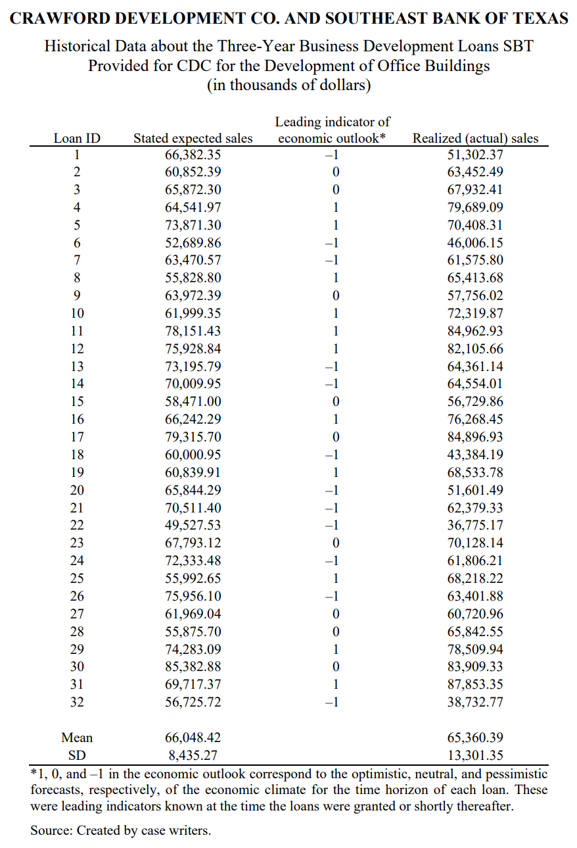
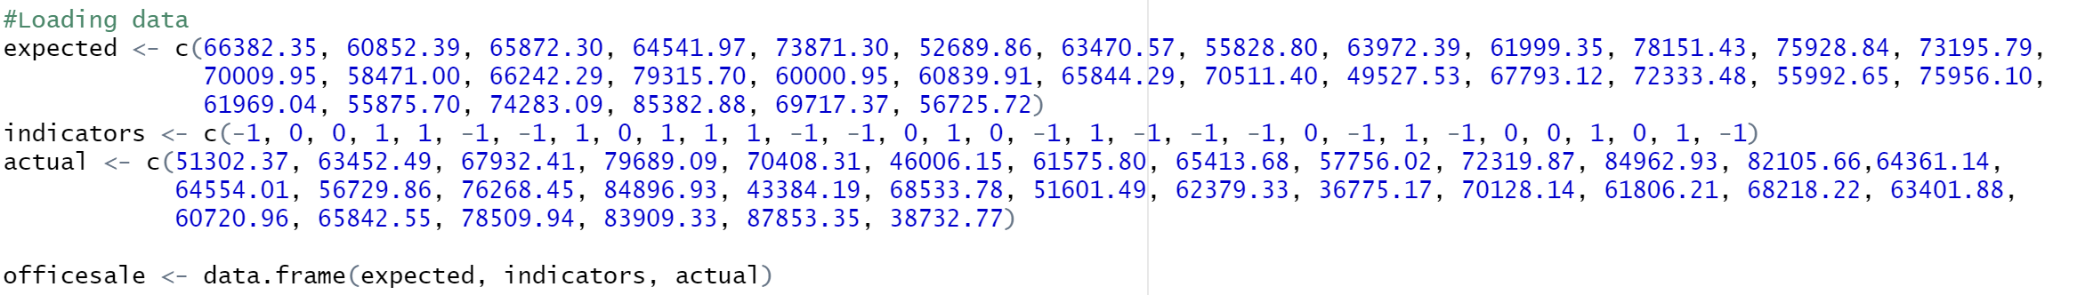
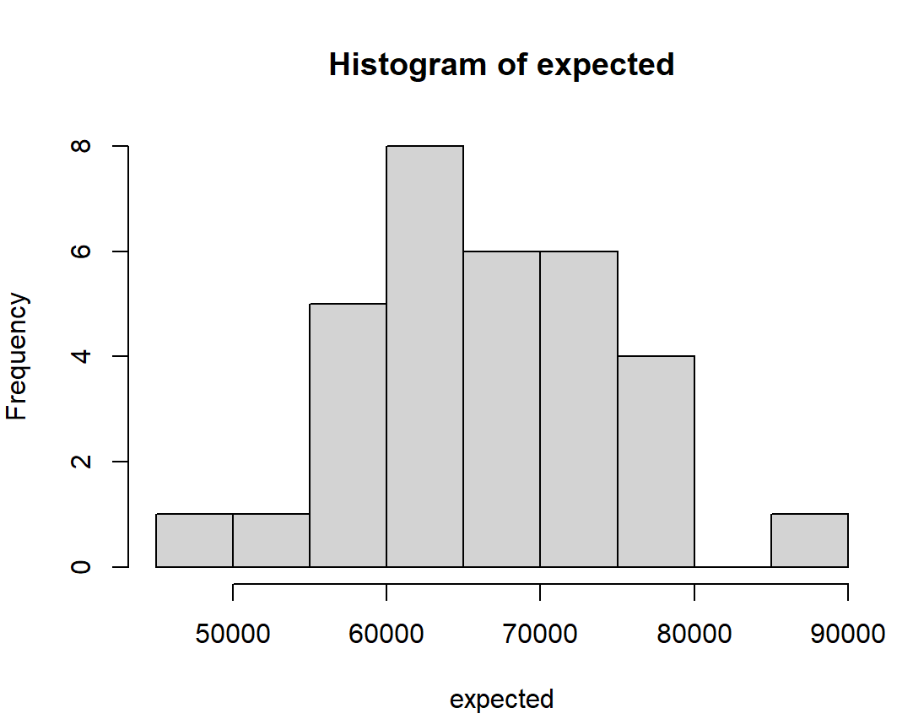
Modeling & Simulation: Predicting Commercial Project Sales
We begin by inputting the historical expected and realized sales in the Commercial Building sector provided in the case study into R.
We can then examine the histogram of Expected Sales to determine a possible distribution.
4. Capital Environment
We observe that the data is perhaps normally distributed, but we should investigate further to determine if it possibly follows a Weibull or Log-Normal Distribution. We will run this test on the next slide.

Slide 9
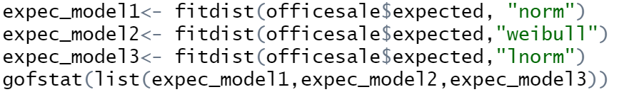
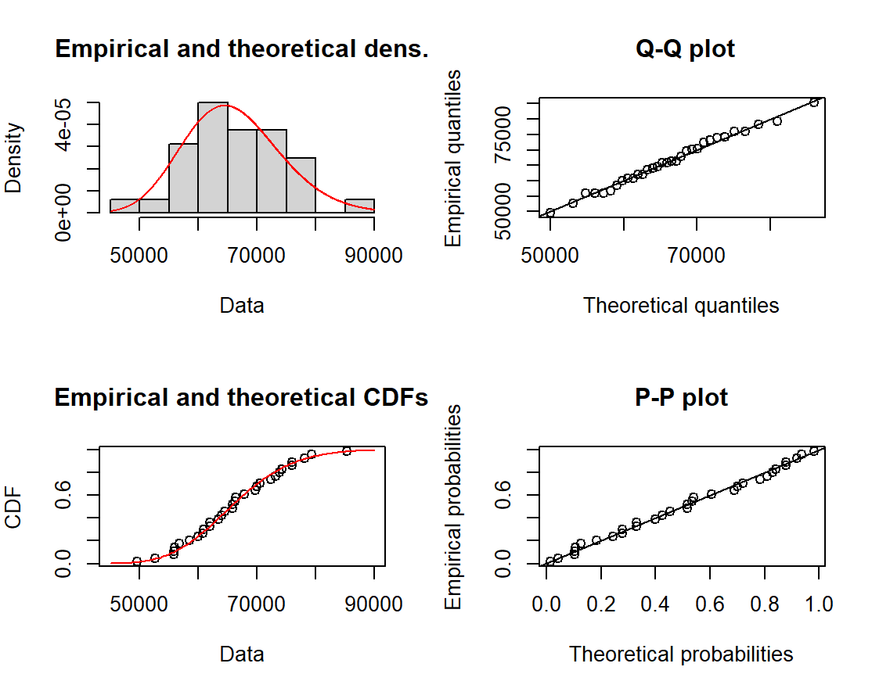
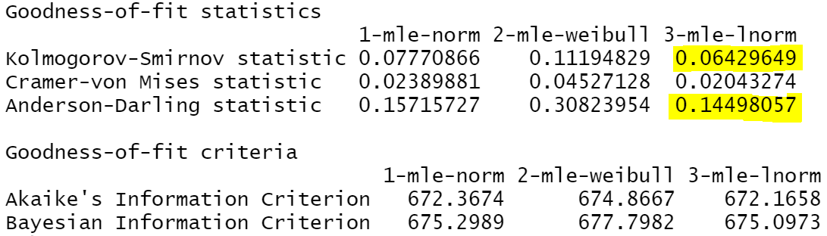

Modeling & Simulation: Predicting Commercial Project Sales
Identify the distribution of expected sales through Goodness of Fit capability in R:
Verify Log-Normal Relationship:
R Input:
R Output:
R Input:
Based on the comparatively lower K-S and A-D statistics, we build a suspicion that the data fits a log-normal distribution best.
To further test this theory, we can plot the data’s empirical and theoretical densities and CDFs, the quantiles of the two distributions against each other (Q-Q plot), and the cumulative distribution functions against each other (P-P plot).
We observe that the data is very closely aligned to these plots, so we may proceed with the assumption that the data is log-normally distributed.

Slide 10
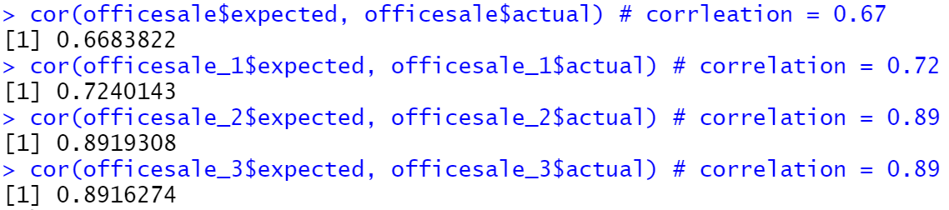
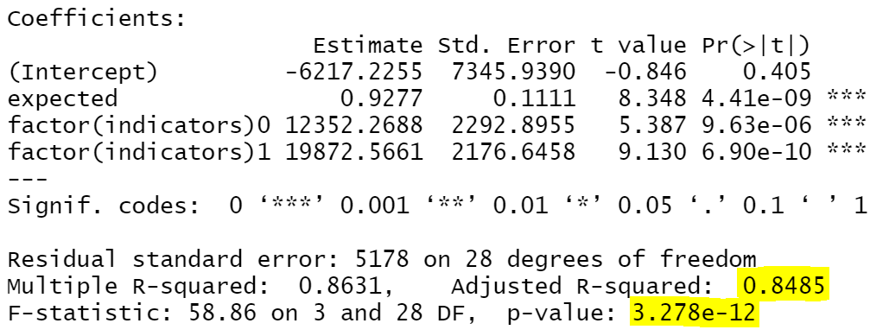
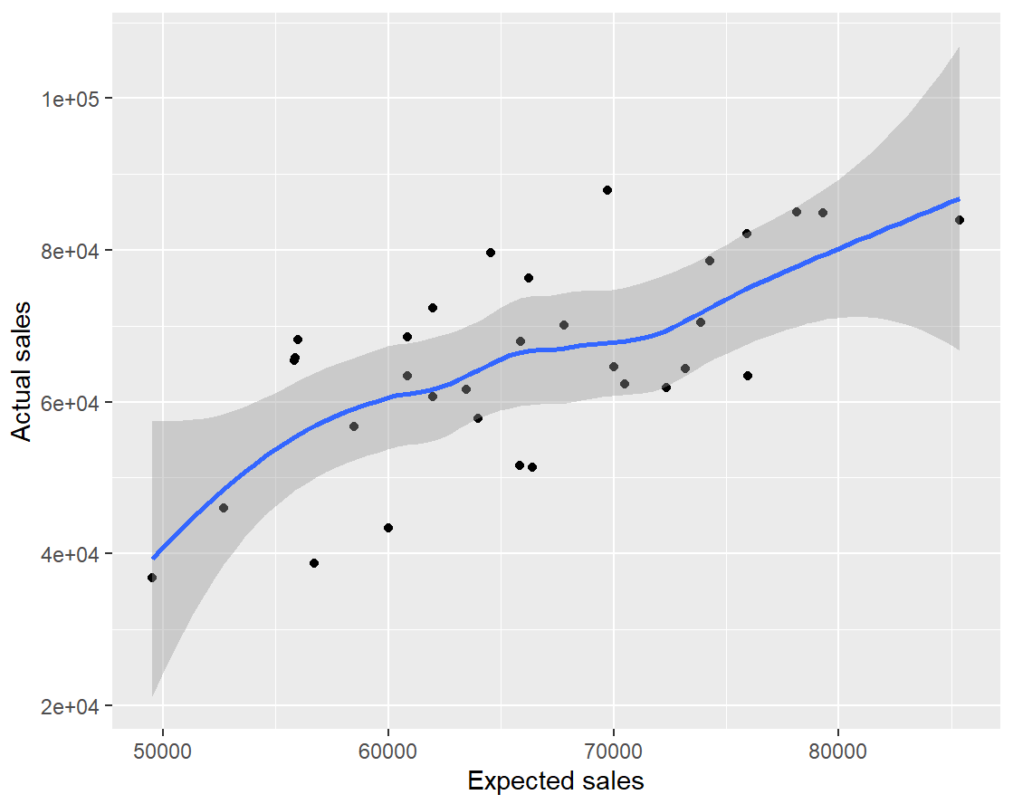
Modeling & Simulation: Predicting Commercial Project Sales
Check the correlation between actual and expected sales:
Build the first version of linear regression model:
R Input and Output:
R Input:
R Output:
Note: The coefficients in a log-linear model have an exponential interpretation, meaning they represent the multiplicative change in the response variable associated with a one-unit change in the predictor variable, holding all other predictors constant.
We observe that there are semi-strong correlations between expected and actual sales among all 3 economic indicators. This is further validated by the graph of actual against expected sales.
By running a log-linear regression on the data, we observe a relatively high adjusted R-squared value, indicating a strong goodness of fit to the data, as well as a p-value far below 0.05, indicating that the regression results are statistically significant.

Slide 11
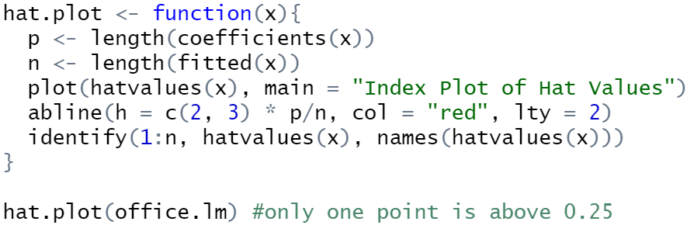

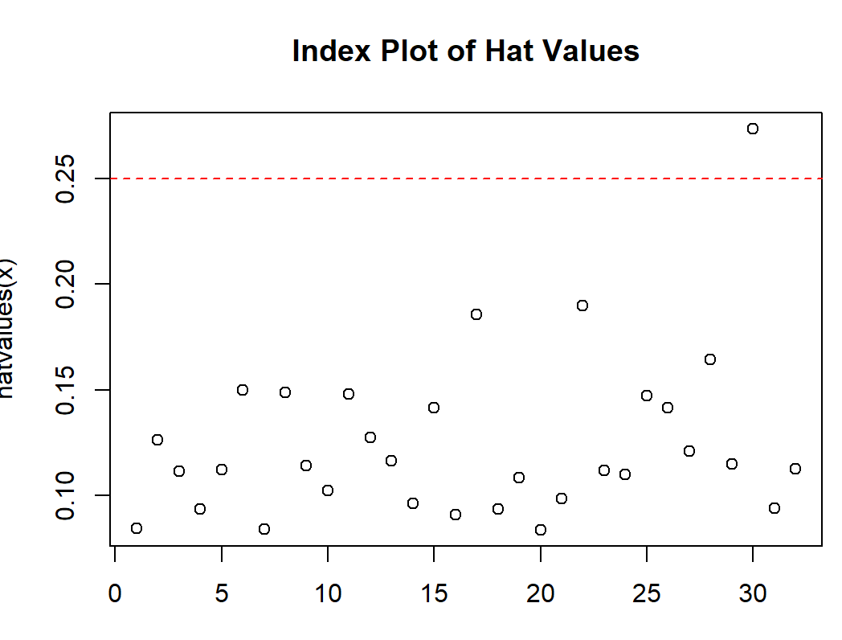
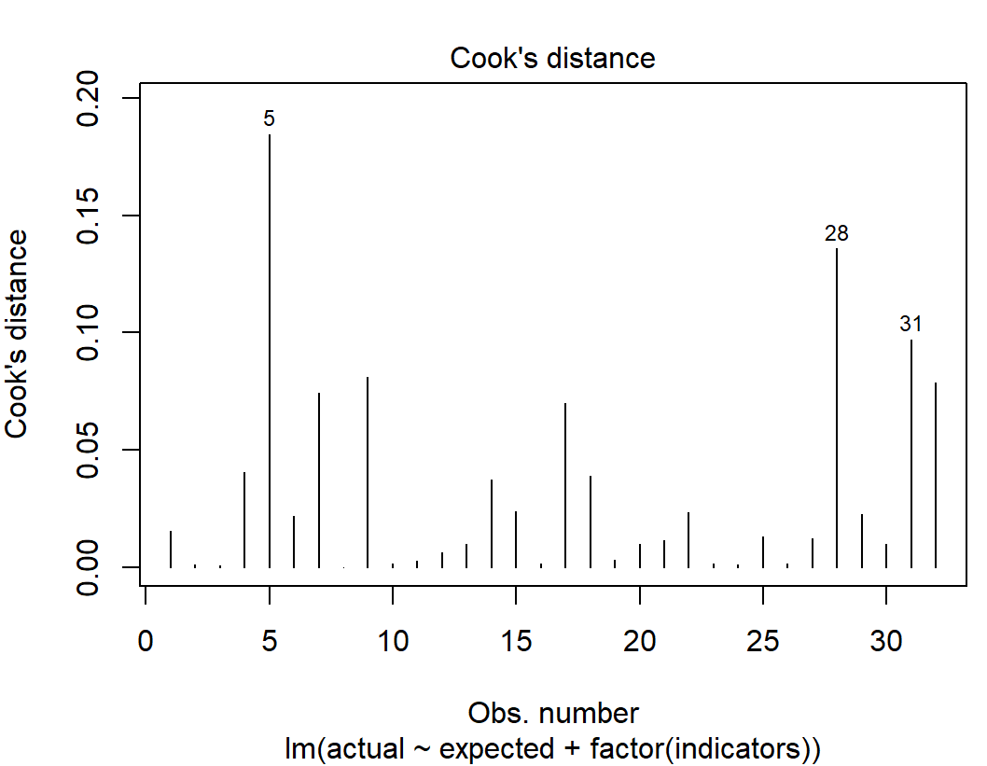
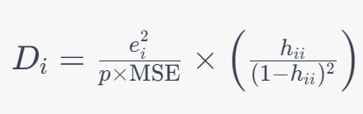
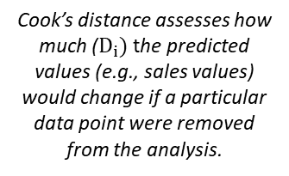
Modeling & Simulation: Predicting Commercial Project Sales
Plot Hat Values to investigate if there are Leverage Points with potential to cause biased regression results:
We can identify the specific Leverage Point(s) and Influence Points:
R Input:
R Input and Output for Leverage Points:
R Input for Influence Points:
R Output:
R Output:
Hat values closer to 1 indicate that a data point has a high influence on the coefficient estimates. One hat value is cause for concern here.
Cook’s distance assesses how much ($D_{i})$ the predicted values (e.g., sales values) would change if a particular data point were removed from the analysis.
Leverage points represent how far a data point is from the center of the predictor variables and measure the potential impact on the model coefficients.
Influence points quantify the actual influence a data point has on the regression model's estimates and fit.
Cook’s Distance has identified data points 5, 28, and 31 as influential, meaning they have a substantial effect on the model’s performance, so we will proceed on the next slide by running the model again without these data points.

Slide 12

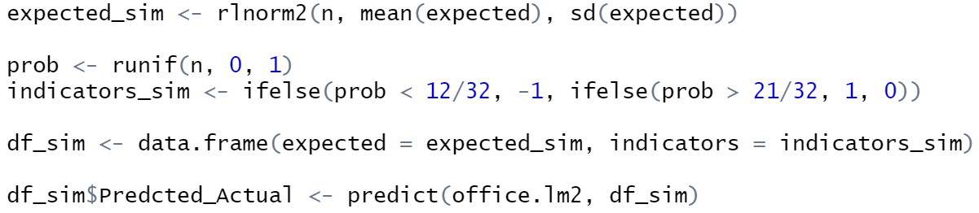
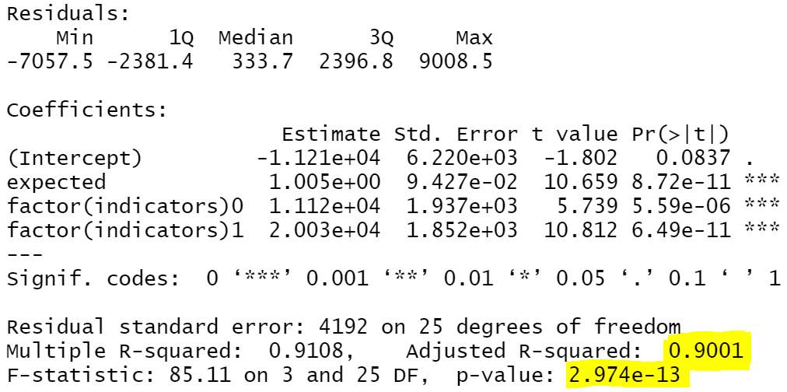
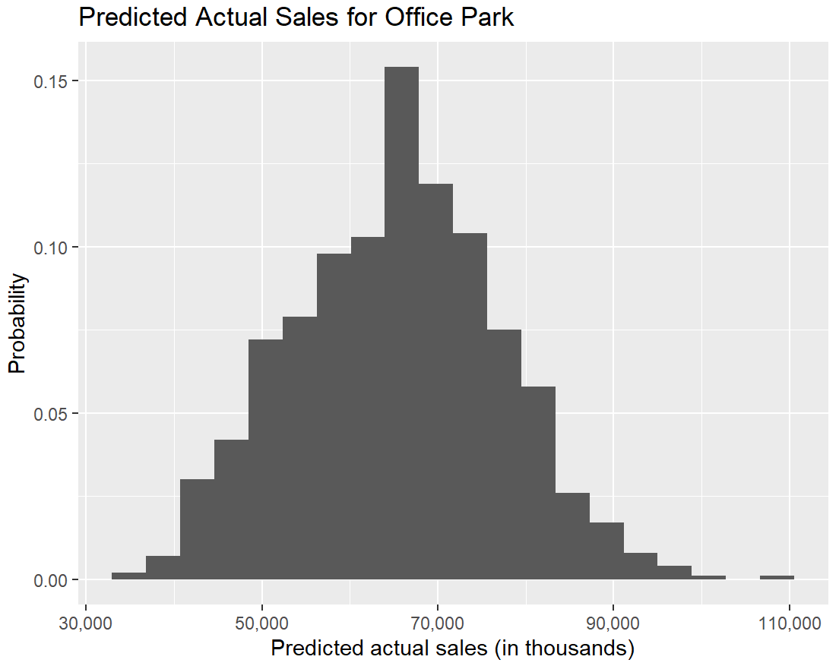
Modeling & Simulation: Predicting Commercial Project Sales
Next, we specify the log-normal model we want to use to simulate Expected Commercial Project Sales, also considering the probabilities of future economic favorability, specified in the case:
Refit the model after removing the data points influencing the model:
R Input:
R Input:
12/32 Chance of Pessimistic outlook
9/32
Chance of Neutral Outlook
11/32
Chance of Positive Outlook
R Output:
Com. Sales Model Results:
We can say with 95% certainty that the average expected commercial sales will fall between $64.705 M and $65.924 M.
By running the model again without the datapoints causing bias, we observe a more favorable adjusted R-squared value of 0.90 and an even smaller p-value indicating highly reliable regression results.
Our model indicates expected commercial sales will have expected value of $65.315 M. Minimum sales are expected to be $33.236 M and maximum expected sales should fall around $106.923 M.

Slide 13
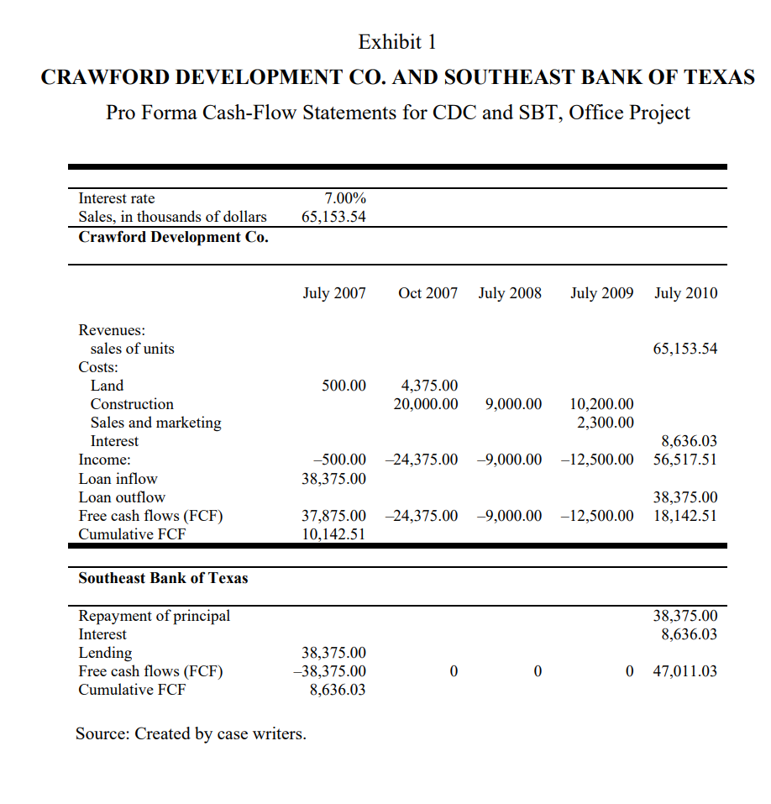
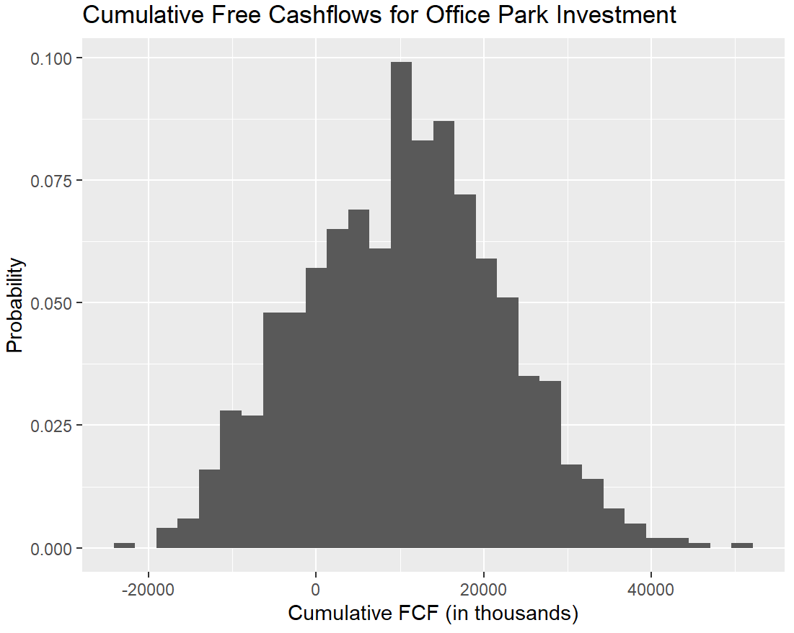
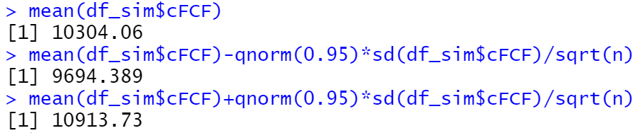
Modeling & Simulation: Simulating Office Project Cashflows
Exhibit 1 in the case provides expected Cashflow information on the commercial project:
We can simulate free cashflows using our simulated sales, constant construction costs, and loan costs:
Cumulative Free Cashflows = $37.875 M – $24.375 M – 9 M – 12.5 M + (Simulated Commercial Sales – $8.636.03 M – $37.875)
R Input:
We can build a Cumulative Free Cashflows formula that considers all costs and revenues for the office project.
We find that expected free cashflows of the office project have a 95% probability of being between $9.694 M and $10.914 M.
But we need to update our model slightly to account for the given discount rate of 6%. We will do so on the next slide.

Slide 14
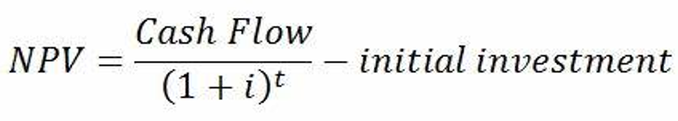
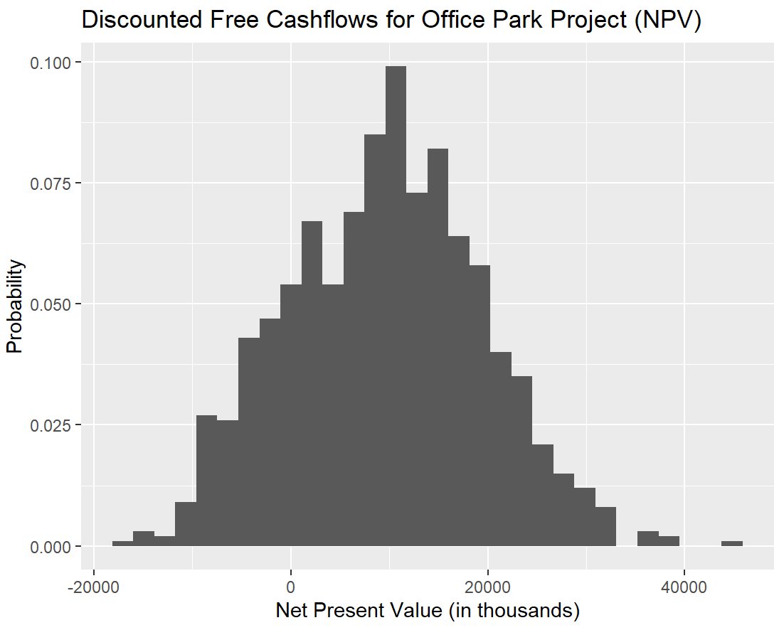
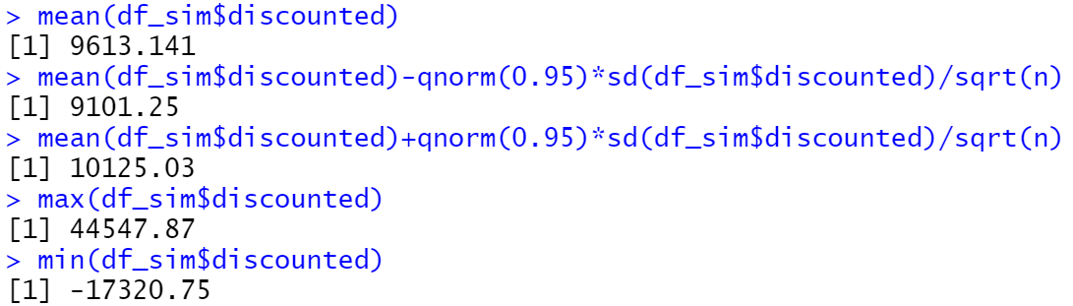
Modeling & Simulation: Simulating Office Project Cashflows
To consider cost of capital with the discount rate of 6%, we can apply the Net Present Value Formula to the cashflows:
Our final simulation of Office Project Discounted Free Cashflows or NPV:
R Input to compute discounted FCF, graph simulation and generate summary statistics:
We find that average Net Present Value of the office project has a 95% probability of being between $9.101 M and $10.125 M, with an expected average NPV of $9.613 M.
The largest potential gain from the project is $44.548 M and the largest potential loss is ($17.321 M).

Slide 15
Our Next Task is Simulating the Residential Project…

Slide 16
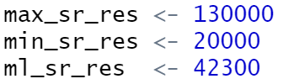
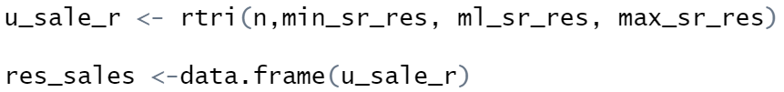
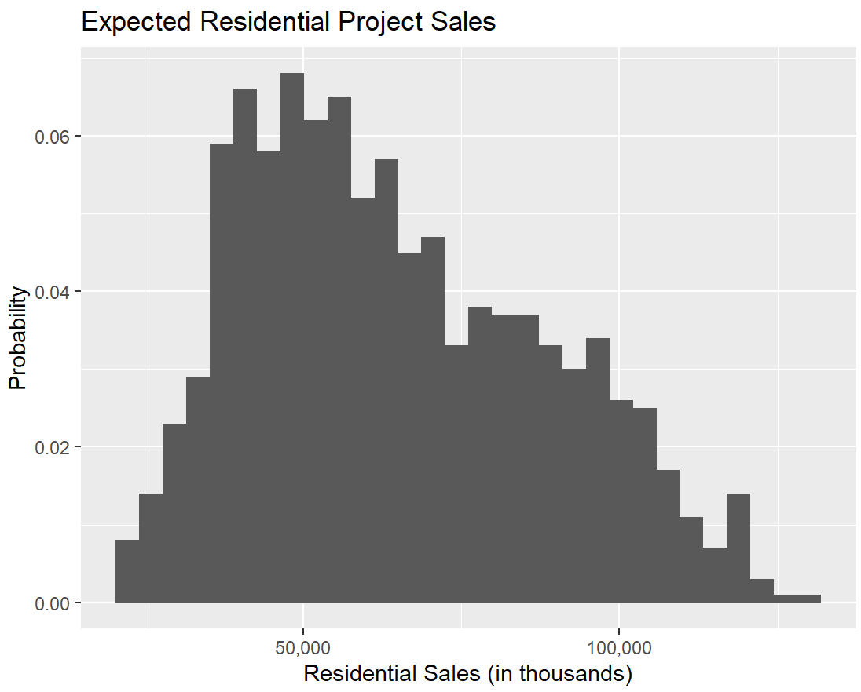
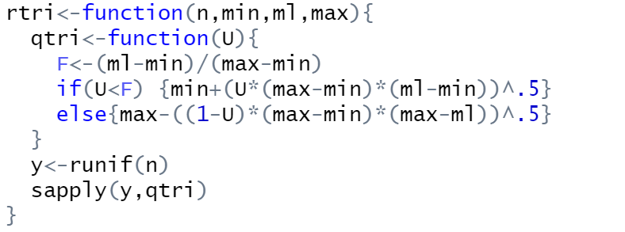
Modeling & Simulation: Residential Sales Simulation
Simulating Expected Residential Sales:
Run our triangular model and simulate residential sales:
The case tells us that residential sales will most likely be $42.3 M but if the market worsens, sales could be as low as $20 M. Blockbuster sales following the completion of this project predict sales as high as $130 M.
Input our expected sales figures:
Run our triangular model and save the results in a Data Frame:
With this information, we can model the sales using a triangular distribution, which we can specify in R as follows:
Res. Sales Model Results:
We can say with 95% certainty that the expected average residential sales will fall between $63.549 M and $65.999 M, only slightly higher than expected sales for the commercial project
Our model indicates that expected sales for the residential project will be $64.774 M, with the highest sale of $128.495 M and the lowest expected sales at $20.737 M.
Similar to our process for the Commercial Project, we will next incorporate this simulation into our expected cashflows.

Slide 17
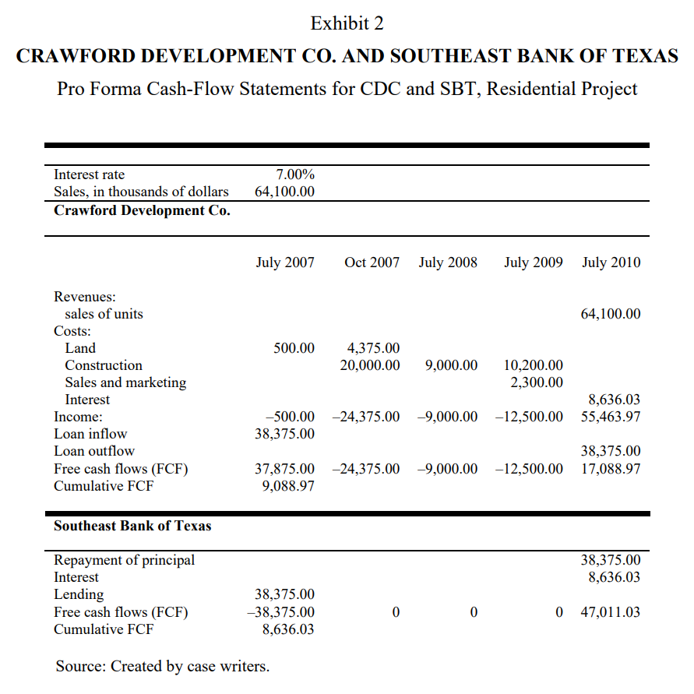
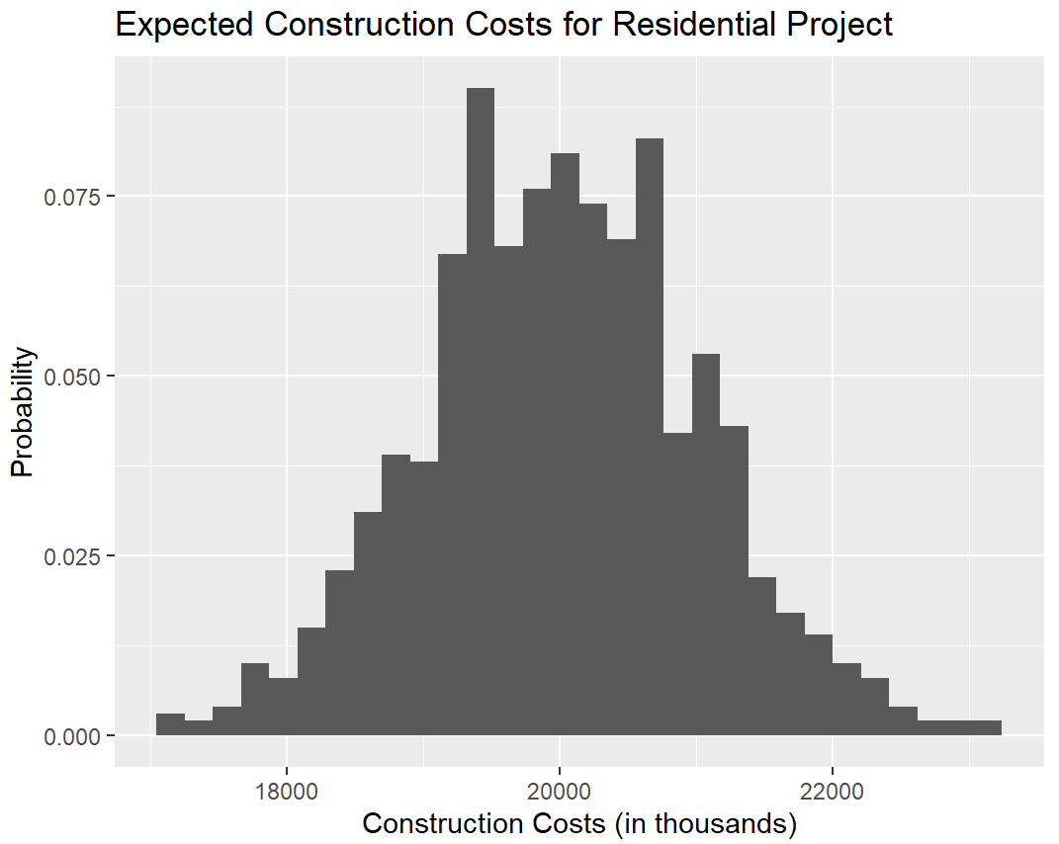
Modeling & Simulation: Simulating Residential Project Cashflows
We recall that the Case indicates that we can expect variation in initial construction costs, which we can model using a normal distribution:
Exhibit 2 in the case provides expected Cashflow information on the residential project:
Construction Costs will have a mean of $20 M with a Standard Deviation of $1 M:
We can update our Cumulative Free Cashflows formula including this variable cost:
$37.875 M – $4.375 M – (Simulated Construction Costs) – $9 M – $12.5 M + (Simulated Residential Sales – $8.636.03 M – $37.875)
To model our FCF for the residential project, we incorporate expected variation in construction costs by simulating this cost for all observations in the residential sales data frame.
We can next proceed in the next slide to apply this variable to our cumulative free cash flows formula.

Slide 18
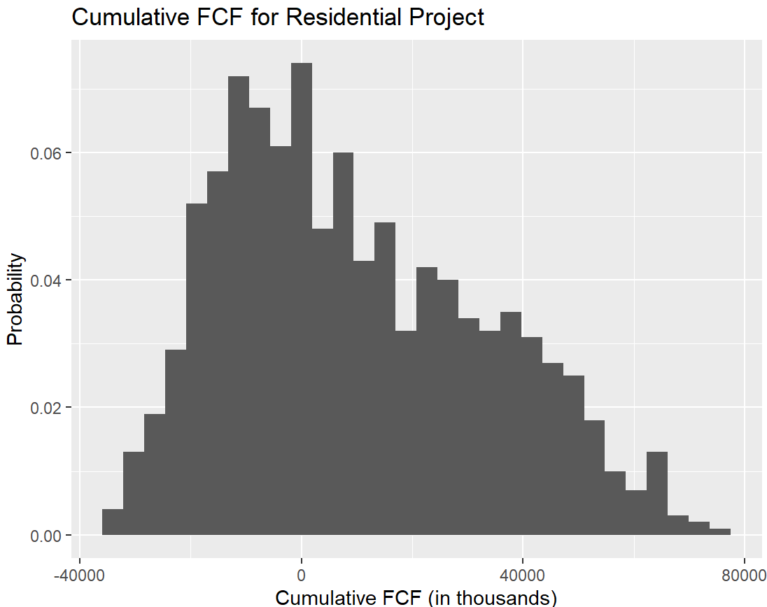
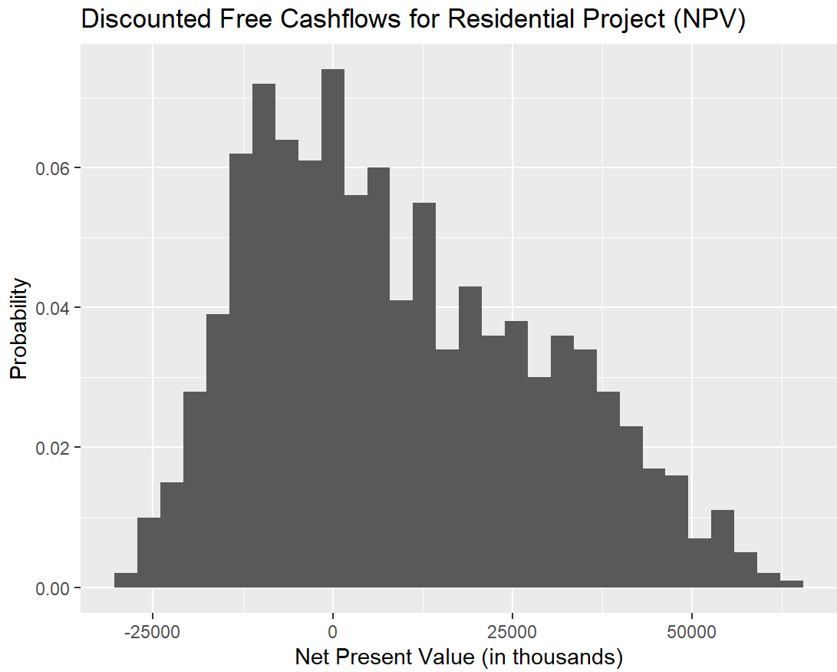
Modeling & Simulation: Simulating Residential Project Cashflows
We can apply our Discount Factor of 6% to the formula to generate our final Net Present Value of the project:
We can generate our cumulative expected free cashflows:
R Input to create Cumulative Free Cashflows Formula:
R Input to introduce discounting to the model:
Non-discounted cumulative FCF indicate we can be 95% certain average profits will be between $8.532 M and $10.979 M.
Discounted
cumulative FCF indicate we can be 95% certain Net Present Value is between $8.124 M and $10.179 M.
We find that expected discounted free cashflows of the office project have a 95% probability of being between $8.124 M and $10.179 M, with an expected profit of $9.151 M.
The largest potential gain from the project is $64.087 M and the largest potential loss is ($28.518 M), which is a much larger NPV range simulated in the Commercial Project scenario.

Slide 19
Table of content
01
Investment Background
02
Modeling and Simulation
03
Result and Risk Analysis
04
Conclusion & Recommendations

Slide 20
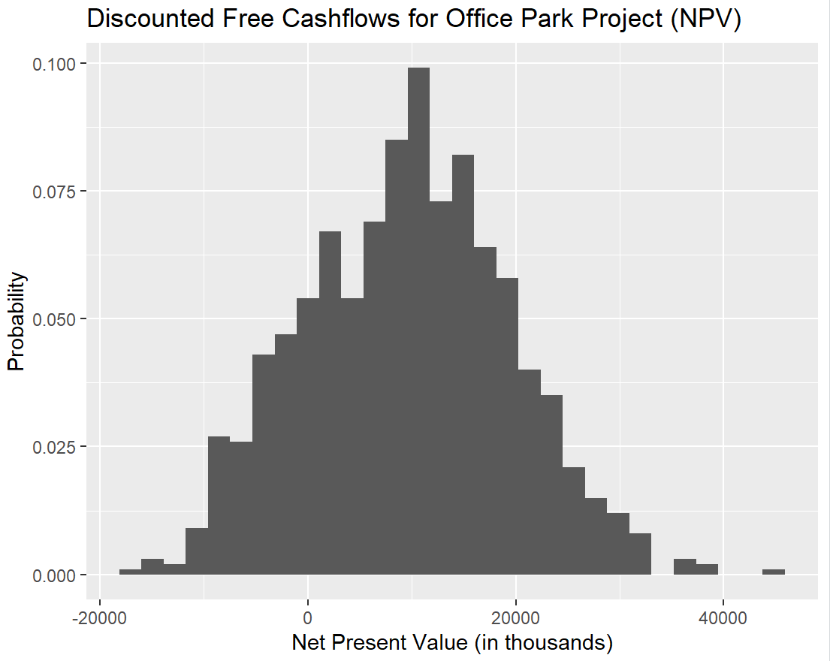

Results & Risk Analysis: Comparing Net Present Values of Both Projects
In comparing the Net Present Values of both projects, we find that the Office Park provides a slightly higher average NPV of $9.613 M.
While there is potential for dramatic upside when investing in the Residential Project, there is also potential for ~2x potential losses than that of the Office Park.
In fact, the difference in potential losses for the Residential Project is proportionally larger than the difference in potential gains between projects.
The likelihood of a negative NPV is approximately double for the Residential Project than that of the Office Park Project.
Office Park Project
Residential Project
Expected Net Present Value: $9.613 M
Largest Possible NPV: $44.548 M
Smallest Possible NPV: ($17.321 M)
Probability of negative NPV: 18.3%
Expected Net Present Value: $9.151 M
Largest Possible NPV: $64.087 M
Smallest Possible NPV: ($28.518 M)
Probability of negative NPV: 39.0%

Slide 21
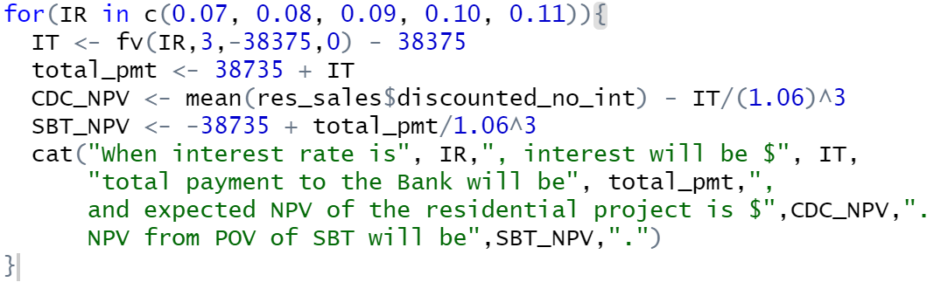
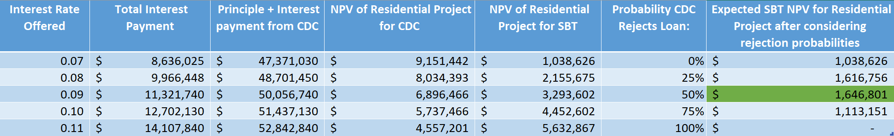
Results & Risk Analysis: Considering Interest Rate for Residential Project
To consider the implications of offering various interest rates in response to the riskier nature of the residential project, we can create a for-loop that will tell us the interest payments, total payments, and NPV of the residential investment for both parties:
We find that if Crawford Development Co. decides to pursue the residential project investment, Southeast Bank of Texas can maximize it’s NPV of the situation by offering the loan at 9% interest. In this scenario, even if CDC has a 50% chance of rejecting the loan, the bank’s expected NPV is still higher than the 7% scenario.
However, this deal would not be wise for the CDC because their NPV of the Office Project financed at 9% is $6.897 M, while the NPV of the Office Project financed at 7% is $9.613 M.

Slide 22
Table of content
01
Investment Background
02
Modeling and Simulation
03
Result and Risk Analysis
04
Conclusion & Recommendations

Slide 23
Conclusion & Recommendations
In conclusion, the sales volatility present in the residential market create an unfavorably expensive loan environment for Crawford Development Company should they choose to pursue this development route.
The Net Present Value of choosing the Residential Project at a 9% interest rate is $6.897 M, while the Net Present Value of investing in the Office Park Project at 7% is $9.613 M.
Crawford Development Company
Southeast Bank of Texas
The development company should choose to invest the loan in the Office Park project.
The bank should agree to fund the Office Park project.
If CDC for some reason decides to invest into the Residential Project, the bank should offer an interest rate of 9% in order to maximize potential loan interest.

Slide 24

Thank you!

