Slide 1

Student Planner
Group 8
Nicholas Flay, Madison Gosselin, Kayra Guner and Asifur Rahman
COMP 4200: Mobile Application Development Final Project

Slide 2
Motivation
Why did we choose this project?
Wanted to create an application with a realistic and relatable use.
Students often struggle with organizing their deadlines, tasks, and study schedule all in one place.
Existing apps are typically not tailored to student needs
Wanted to build a simple & easily usable planner with the student in mind.

Slide 3
Objectives
What does our app aim to achieve?
Provide a centralized dashboard for organizing academic duties
Allow the user to add, and edit their tasks
Track task details such as:
Due date
Priority
Notes
Completion status
Offer a clean & intuitive interface for students

Slide 4



Tools Used
Android Studio - Primary IDE
Room Database
Java - App logic
XML - UI design
GitHub - Version control
github.com/MadisonGosselin/COMP4200_StudentPlanner

Slide 5
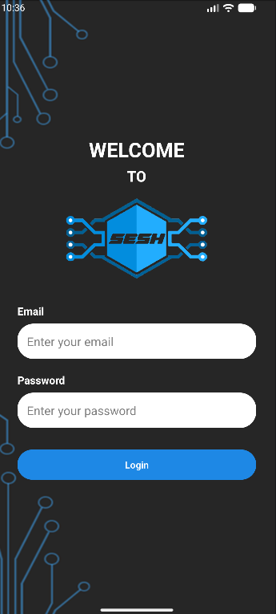
Login Screen
Features:
App logo & name
Login information fields
Pre-filled field hints
Login button → navigates to Home Screen

Slide 6
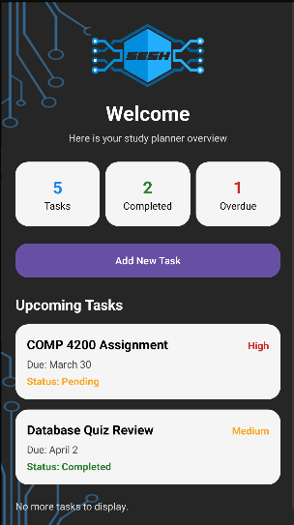
Home Page
Features:
Welcome message
Upcoming Tasks section
Summary tracker:
Total tasks
Completed tasks
Overdue tasks
Add New Task button

Slide 7
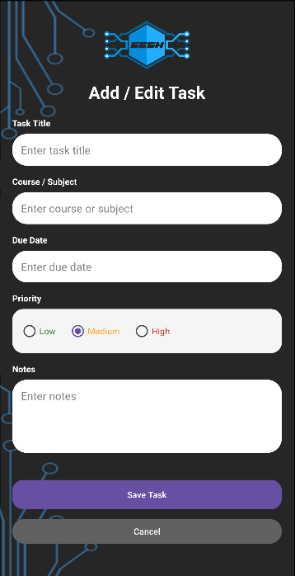
Add/Edit Task Page
Features:
Input boxes:
Task Title
Course/Subject
Due Date
Priority selectors
Area for extra notes
Pre-filled field hints
Save / Cancel buttons

Slide 8
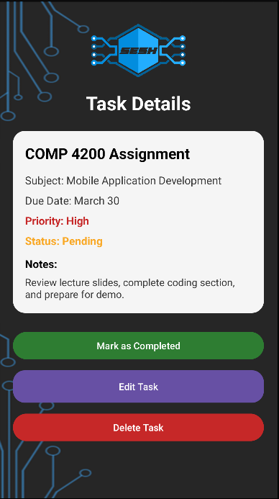
Task Detail Page
Features:
Task information
Completed Button
Edit Task Button
Delete Task Button

Slide 9
Limitations
Current Constraints
No cloud sync (offline-cached database)
No user authentication beyond login screen
Limited task categories
No notifications or reminders

Slide 10
Future Scope
Ways to Improve
Add login via Google
Setup a cloud sync database to access schedule across devices
Push notifications as reminders
Add a calendar view
Publish app to the Google Play Store

