Slide 1

Is this the right job for you?
Shih Yu Chang, Madison J Myers, Arvin Sahni

Slide 2

Choice of career
Individual’s aptitude and interest area
Job sector outlook
Financial remuneration
Hiring trends
FOCUS AREAS

Slide 3
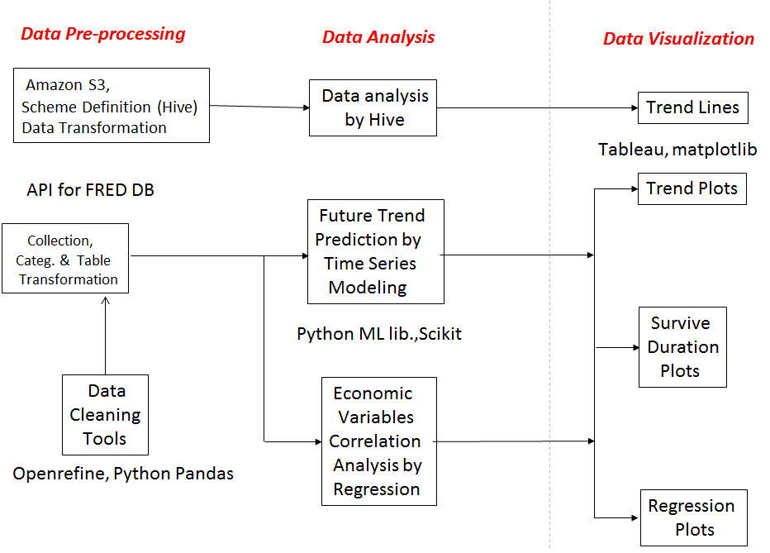
Solution Architecture

Slide 4
Technologies used
Cloud based storage and resources- Amazon S3, AMI
File system - HDFS
Data transformation and table creation - SQL with Hive CLI
Data Visualization - Tableau
Python Notebook
R Language
Python API

Slide 5
Data Sources
•Ministry of Manpower
•Department of Statistics Singapore
•FRED: http://research.stlouisfed.org/fred2/
• A rich database of U.S. and international economic data maintained by the research department of the Federal Reserve Bank of St. Louis.
•There are 390,000 time-series contributed by 79 various data sources, the data size is about 39 GB.
•Moreover, this database will be updated day-by-day.

Slide 6
Implementation for Singapore
Various measures are used to compare across various industry types ( including services) from 2009 onwards . This helps gauge sector attractiveness using multiple criterion to help an individual make an informed decision.
Measure 1 : Net employee flow across sectors using the recruitment rate net of resignations
Measure 2 : Compare the relative importance of manpower in different sectors . This is determined using the value added by employees
Measure 3 : Analyst outlook for the next 6 months averaged over each year historically for both services and manufacturing sector using the net weighted balance
Net income weighted by the unemployment rate net of monthly average expenditure for the median salary group is also analysed over the years:

Slide 7
Data Acquisition API
The Economic Research Division of the Federal Reserve Bank of St. Louis has created APIs (application programming interfaces) to allow developers to write programs and build applications that interact with content on its websites.
Users may query our Federal Reserve Economic Data (FRED) databases to retrieve the specific data desired (according to source, release, category and series among other preferences).

Slide 8
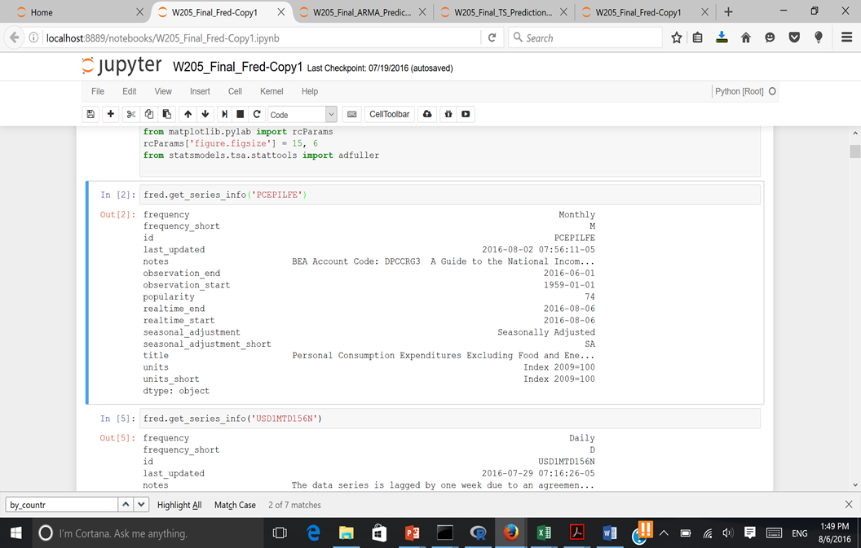
FRED API Demo: Last Updated

Slide 9
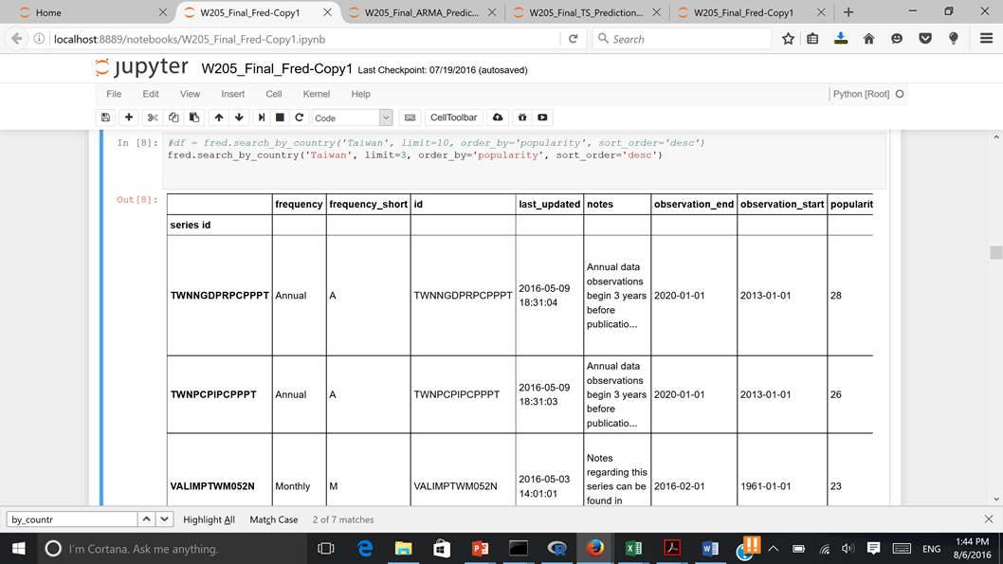
FRED API Demo: Search by Country

Slide 10
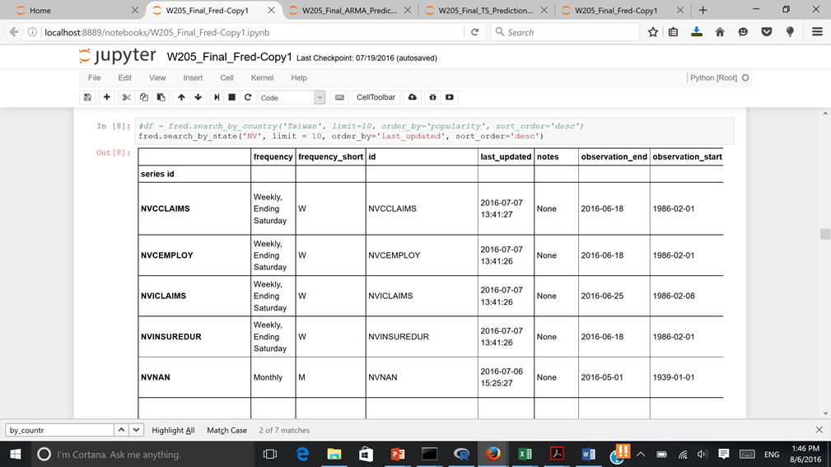
FRED API Demo: Search by State

Slide 11
Prediction Model by ARIMA
•In time series analysis, an autoregressive integrated moving average (ARIMA) model is a generalization of an autoregressive moving average (ARMA) model.
•By apply•Then, survival time duration range can be determined as MIN: X / (MAX living cost in prediction), and MAX: X/(MIN living cost in prediction).
ARIMA prediction mechanism, we can get range of survival time for each countries and states based on each individual all assets values at lay off time, say X.

Slide 12
Prediction Model by Exponential Smooth
•Another prediction method used in time series analysis is Exponential Smoothing (ES).
• Exponential Smoothing assigns exponentially decreasing weights as the observation get older. In other words, recent observations are given relatively more weight in forecasting than the older observations.

Slide 13
Challenges
Sector division is limited to the sectors covered in the government data and hence may be difficult to provide insights on specific jobs within a sector
Challenges of variety and volume of data will be higher for bigger nations like USA
No proper API to access data sources.
Short term changes in the job sector outlooks may have to be ignored unless non-official sources such as twitter feeds can provide reliable and timely data
Non-uniformity of sector names and frequency of data measurements across various tables

Slide 14
Results

Slide 15
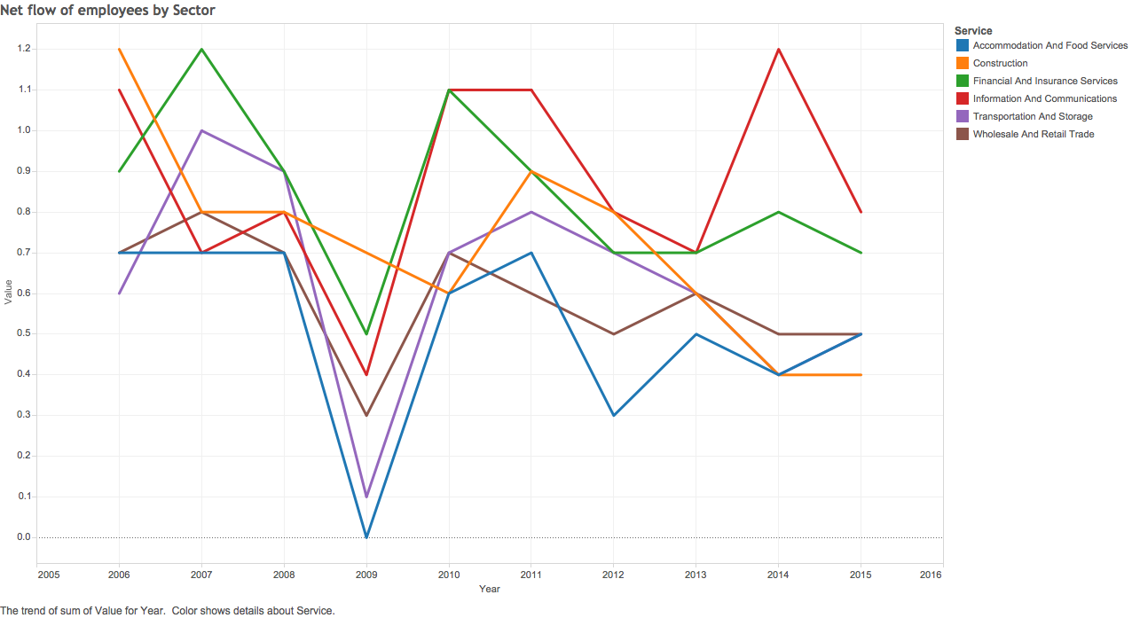
Net flow of Employees by Sector
bnbnm

Slide 16
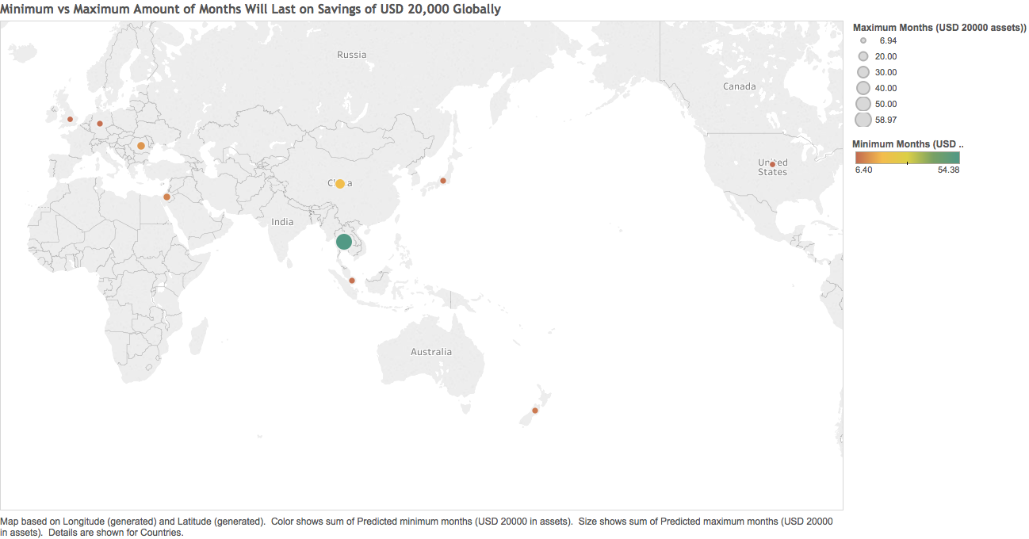
Min & Max Months on Savings

Slide 17
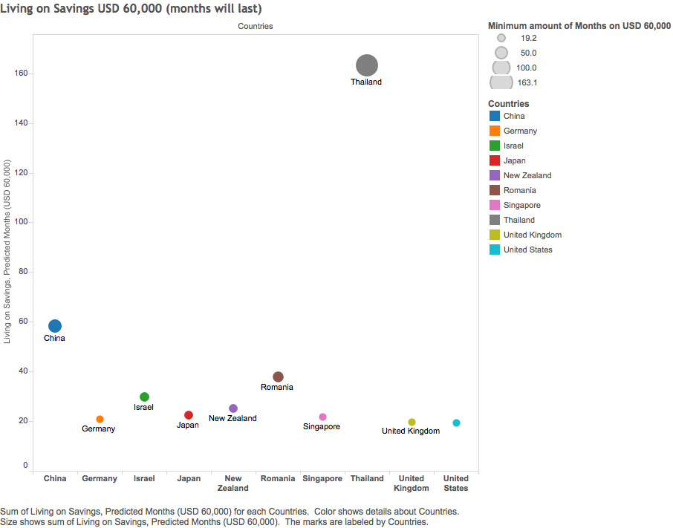

Slide 18
Future Developments
Changing monetary value per country will help the accuracy of our predictions.
Adding layers to our data such as city, education, experience and more can help better predict retention and layoffs.
Beyond this class there is a potential to see connections between sectors and their interconnectedness in hiring, layoffs and retention.

Slide 19
Thank You

