Slide 1
PYTHON FOR DATA ANALYSIS
Obesity Data Set

Slide 2
SOMMAIRE
PROBLEM DEFINITION
Problem
Data Set
DATA DISTRIBUTION AND EXCEPTIONS
Synthetic Data
Missing Values/Duplicates
Linear Combinations
MACHINE LEARNING
Best Algorithms
Results

Slide 3
PROBLEM DEFINITION
Python for Data Analysis

Slide 4



Problem
Data coming from a survey of 3 differents countries
Colombia
Peru
Mexico
Based on their eating habits and physical condition.

Slide 5

Problem
The data contains 17 attributes and 2111 records, the records are labeled with the class variable NObesity (Obesity Level), that allows classification of the data using the values of Insufficient Weight, Normal Weight, Overweight Level I, Overweight Level II, Obesity Type I, Obesity Type II and Obesity Type III.

Slide 6
Data Set
17 x 21111
Category | Feature Name | Description | Variable Type
Target Variables | Nobesity | Based on BMI | Categorical
Eating Habits | FAVC | Frequent consumption of high caloric food | Categorical
Eating Habits | FCVC | Frequency of consumption of vegetables | Ordinal
Eating Habits | NC¨P | Number of main meals | Ordinal
Eating Habits | CAEC | Consumption of food between meals | Ordinal
Eating Habits | CH20 | Consumption of water daily | Ordinal
Eating Habits | CALC | Consumption of alcohol | Ordinal
Physical Condition | SCC | Calories consumption monitoring | Categorical
Physical Condition | FAF | Physical activity frequency | Ordinal
Physical Condition | TUE | Time using technology devices | Ordinal
Physical Condition | MTRANS | Transportation used | Categorical
Physical Condition | SMOKE | Smokes Yes or No | Categorical
Responder Characteristics | Family History with Overweight | Yes or No | Categorical
Responder Characteristics | Gender | Gender Male or Female | Categorical
Responder Characteristics | Age | Age in years | Integer
Responder Characteristics | Height | Height in meters | Float
Responder Characteristics | Weight | Weight in kilograms | Float

Slide 7
Data distribution and exceptions
Python for Data Analysis

Slide 8

Synthetic Data
77% of the data was generated synthetically with WEKA, 23% of the data was collected directly from users through a web platform.
In order to avoid imballenced data. In fact, th population’s BMI is not equally distributed. So is the data collected. Thus they might end up with more people with a normal weight and very few people with Obesity Type III.
Computing a model out of this kind of data creates biais where the model is very precise but with a bad recall (it is mostly trained to recognize people with normal weight).

Slide 9

Synthetic Data
Different ways to generate sythetic data:
Taking random observations for each dimensions within a target and mix them up to create a new data point.
For continuous variable, taking random a number between the minimum and the maximum observation within a target.
Creating it manually by field knowledge.

Slide 10
Missing Values/Duplicates
No missing values to handle here
Only 4 duplicates rows which is a few and possible in real world, we keep them.

Slide 11
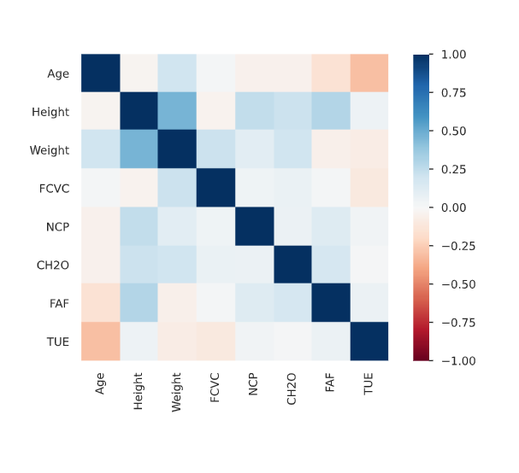
Linear Combinations
Height and Weight are strongly correlated (Pearson correlation)
However our target is based on BMI calculation
BMI = Weight/Height²
So our target is a linear combination of age and weight, thus we delete those 2 dimensions.

Slide 12
Machine learning
Python for Data Analysis

Slide 13

Best Algorithms
There are 17 features, no need to reduce the dimensionality.
There are a lot of categorical features, thus our first thought was to apply SVM since the data point should have good defined distance within each features.
We don’t have a lot of features, so decision trees and random forest should also do great.

Slide 14
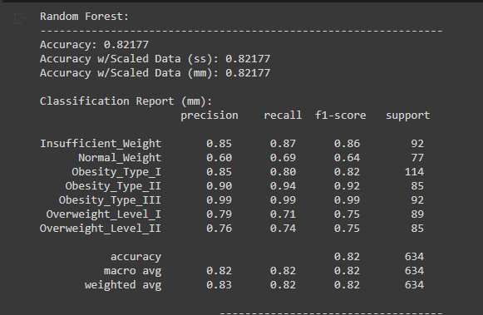
Results
Random forest

Slide 15
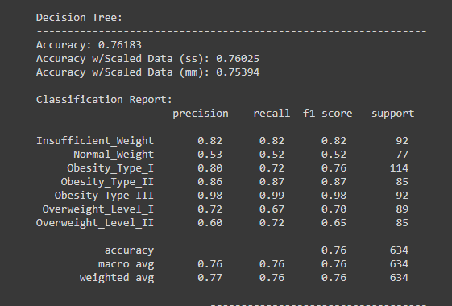
Results
Decision tree

Slide 16
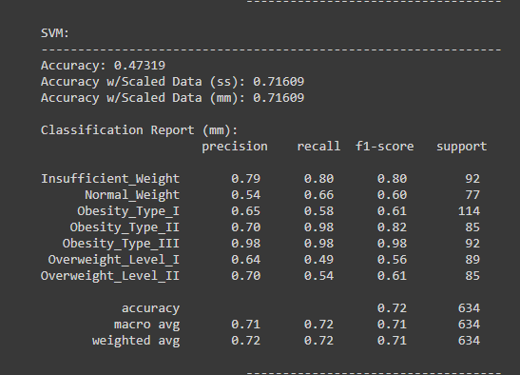
Results
Support Vector Machin

Slide 17
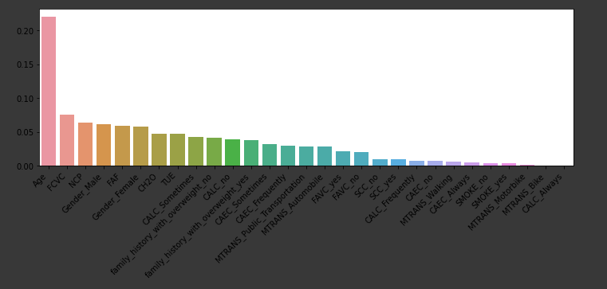
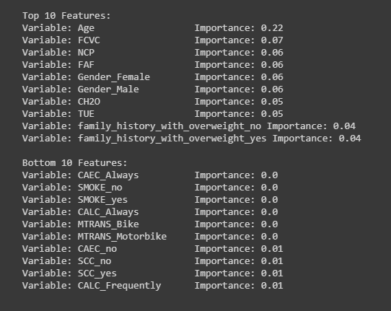
Results
Top features by contribution

Slide 18
Bibliography
Python for Data Analysis

Slide 19
Bibliography
F. Mendoza Palechor, A. de la Hoz Manotas, “Dataset for estimation of obesity levels based on eating habits and physical condition in individuals from Colombia, Peru and Mexico”, https://www.sciencedirect.com/science/article/pii/S2352340919306985?via%3Dihub
F. Mendoza Palechor, A. de la Hoz Manotas, “Estimation of obesity levels based on eating habits and physical condition Data Set”, https://archive.ics.uci.edu/ml/datasets/Estimation+of+obesity+levels+based+on+eating+habits+and+physical+condition+

