Slide 1
NLP Interview Task
Data exploration
Discovered hypothetical relationships
The presentation focus on methodology, findings, and next steps

Slide 2
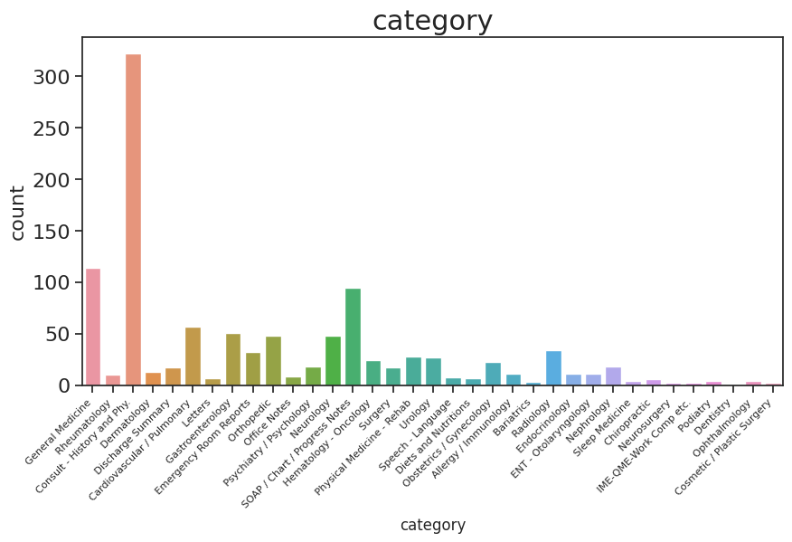
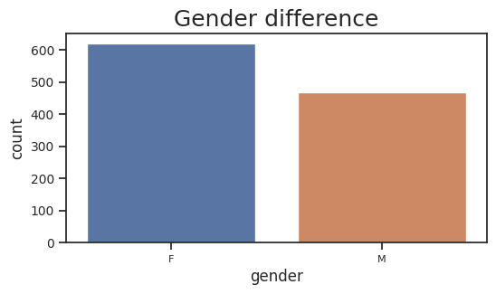
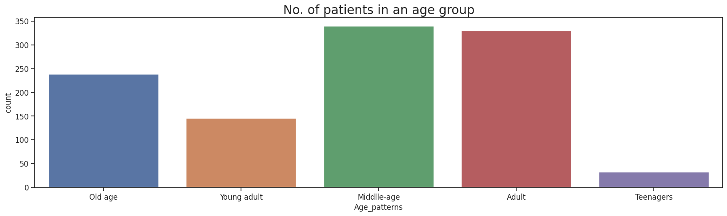
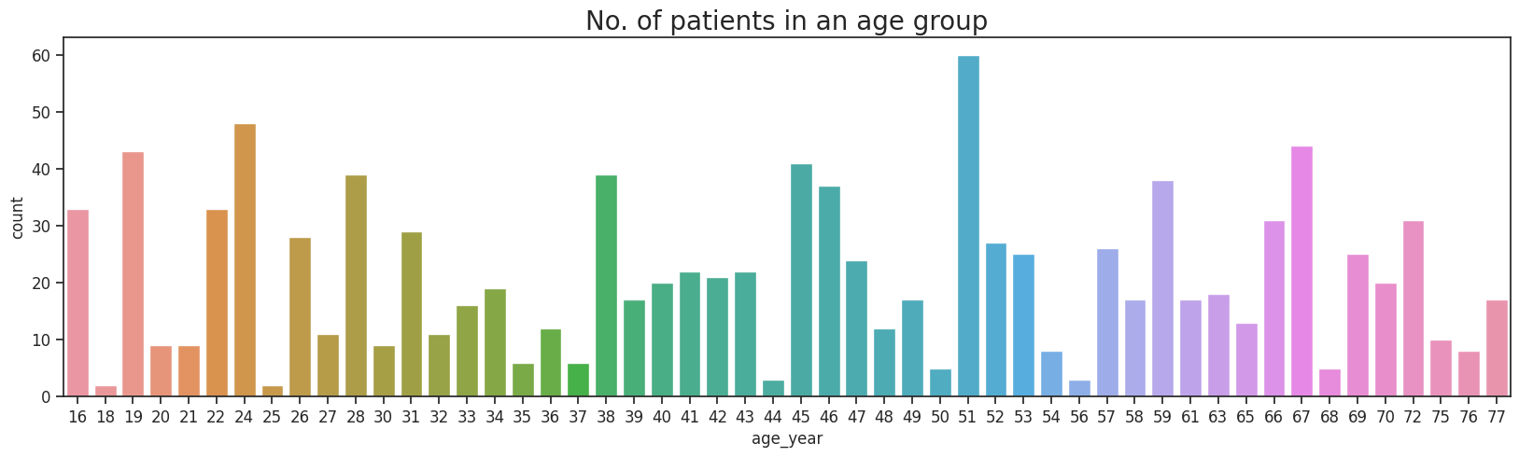
Data exploration
1/9/2023

Slide 3
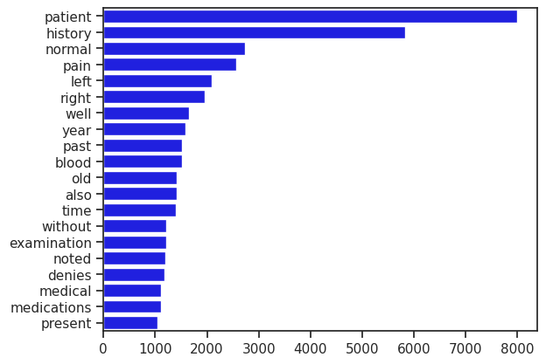
Methodology
Sentiment analysis with VADER
Combine the category and the text columns to create extra
Tokenize the words
Remove stopwords
Frequency distribution for the number of times each word occurred
1/9/2023

Slide 4
VADER lexicon
Polarity scores
Transform data structure for readability
Analyze data with highest positive and negative sentiment
1/9/2023

Slide 5
How?
1/9/2023

Slide 6
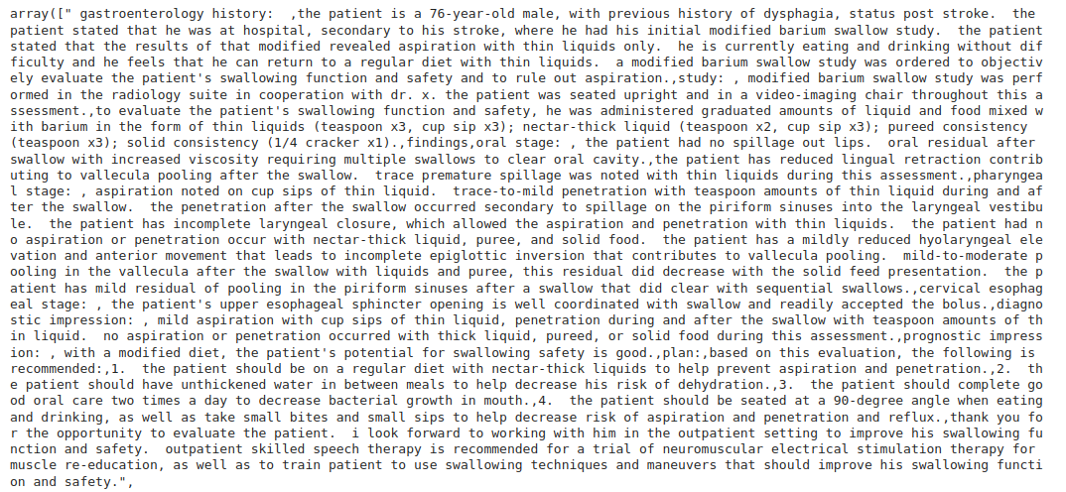
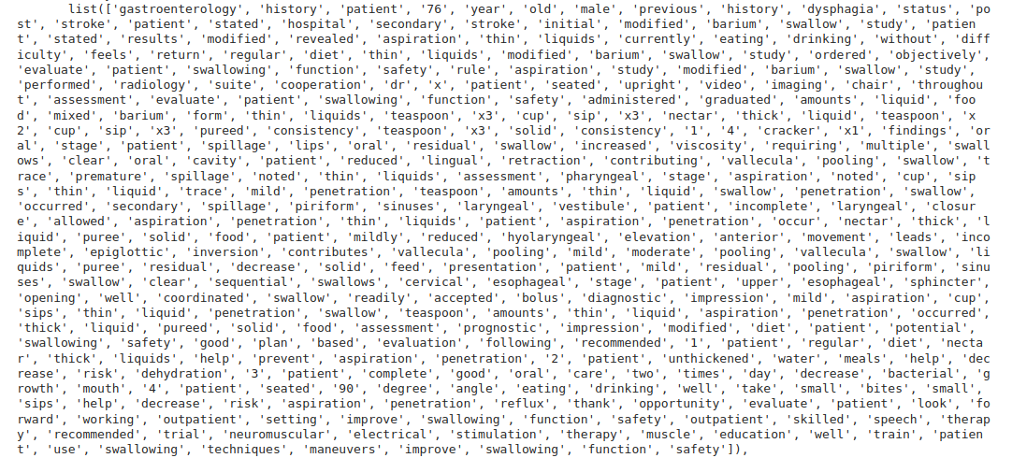
Positive
1/9/2023

Slide 7
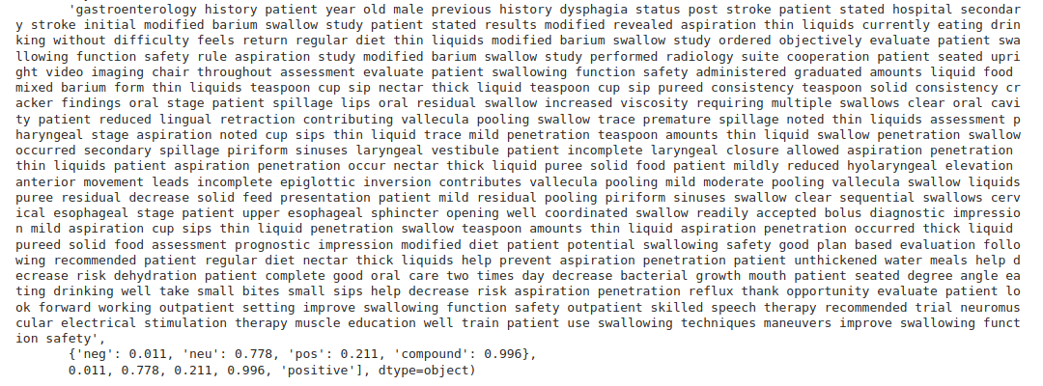
Positive
1/9/2023

Slide 8
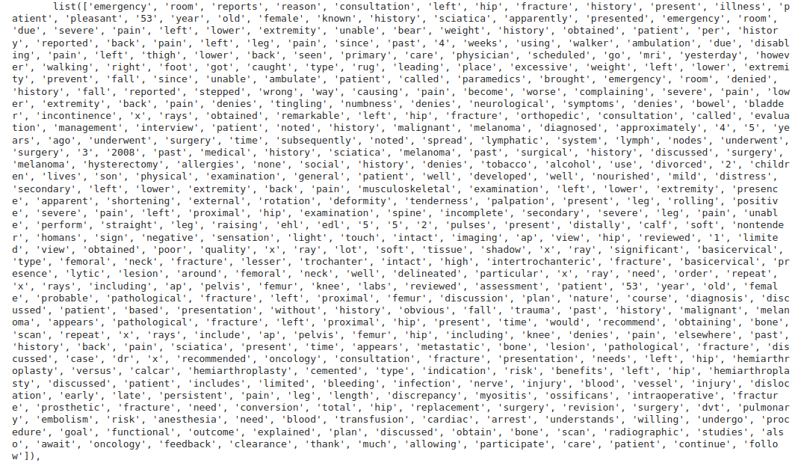
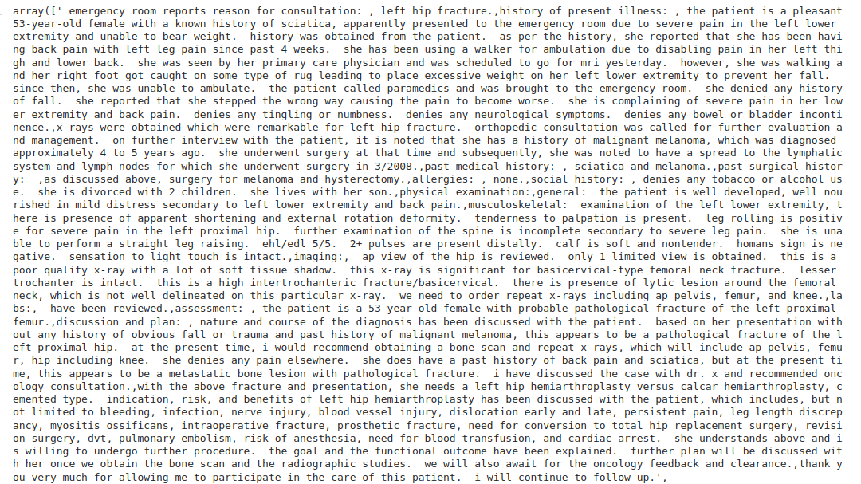
Negative
1/9/2023

Slide 9
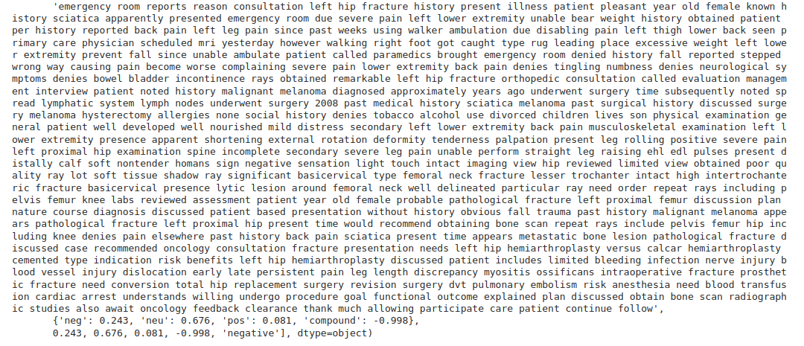
Negative
1/9/2023

Slide 10
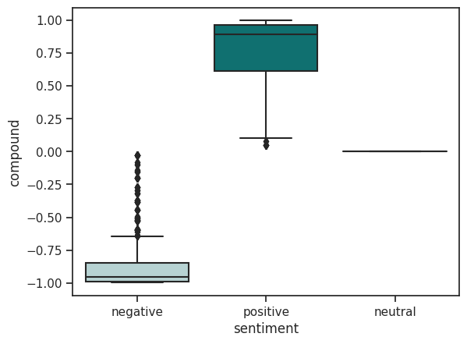
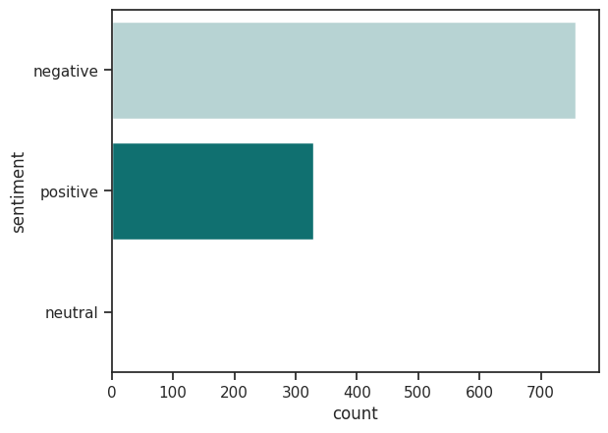
Findings
1/9/2023

Slide 11
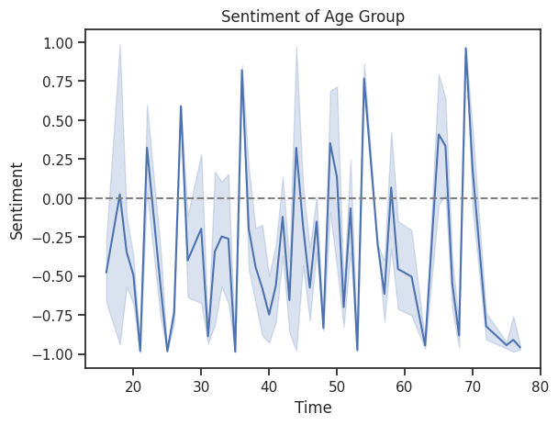
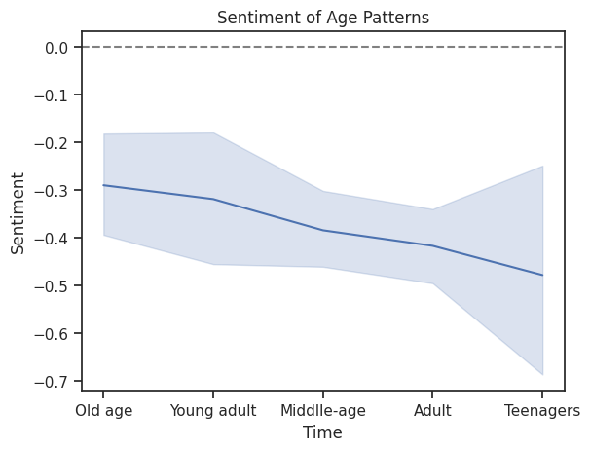
1/9/2023

Slide 12
Next Step
Topic modeling using Latent Dirichlet Allocation (LDA)
TF-IDF Cosine Similarity Keyword Matching
Text extraction using LDA and Bidirectional Encoder Representations from Transformers (BERT).
1/9/2023

Slide 13
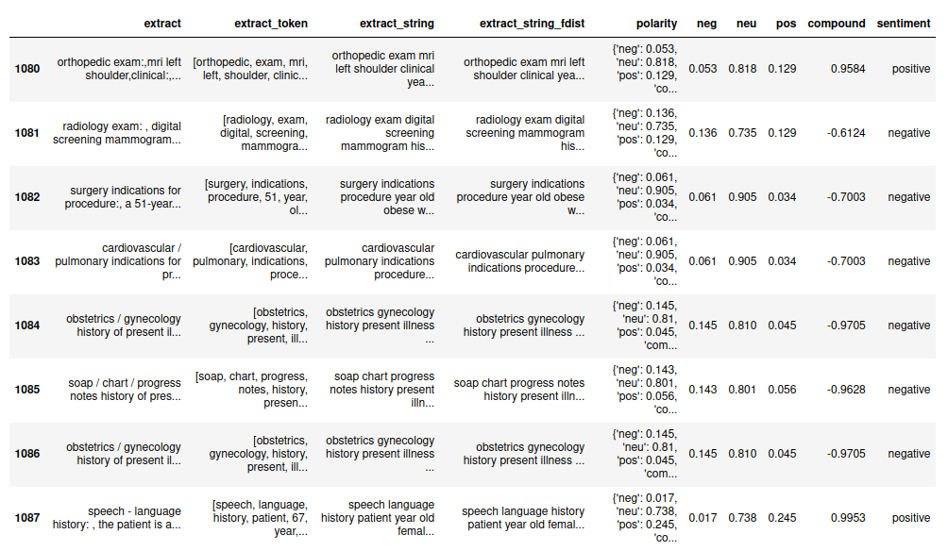
1/9/2023

Slide 14
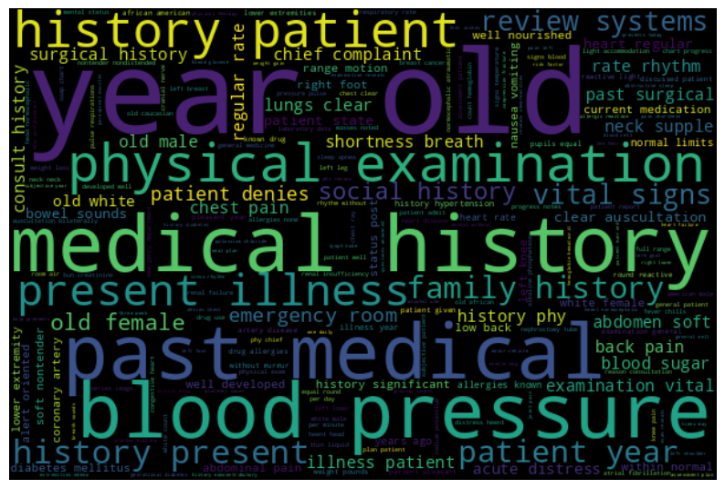
Thank you!
1/9/2023

