Slide 1
Lane detection
PREPARER
EROL BERK OKUDUCU

Slide 2
Project introduction
In this project, it was started to follow the lane. Necessary image processing steps were carried out to mark the strips.

Slide 3
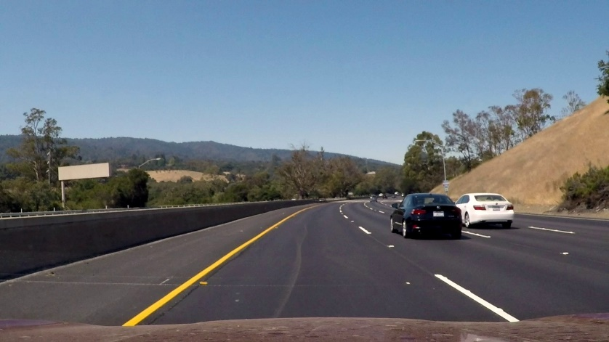
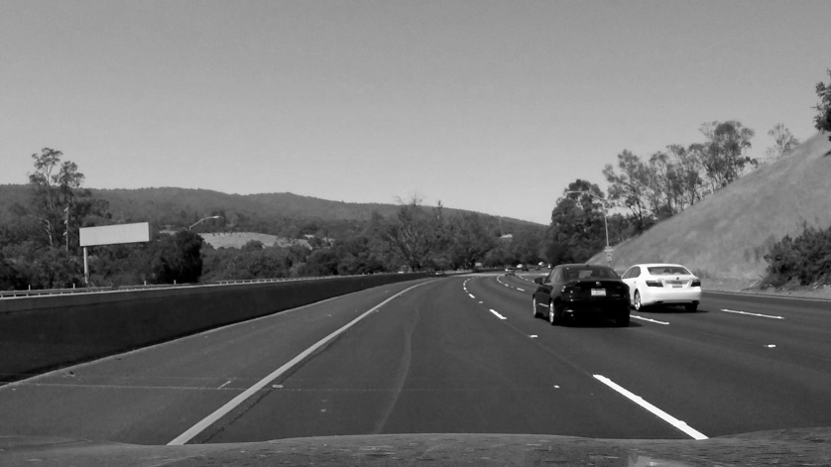
Steps followed : Color Change
A gray filter is used on the photo to make it easier to distinguish the lanes from the road. Thus, the stripes, which are usually white and yellow, gain a more precise appearance in a black and white photograph than in the original photograph.

Slide 4
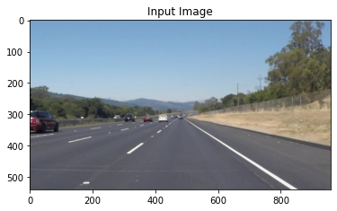
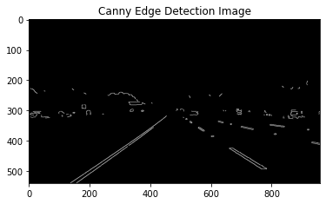
Steps followed : Edge detection
The strips are available in two forms, straight or cut. Using the Canny edge detection algorithm to detect these stripes, all the edges and lines in the image were found. This way we will have more information to recognize the stripes.

Slide 5
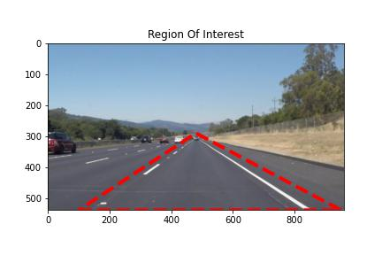
Steps followed: Masking the Area
In order to mask the area we want, we create a polygon by creating lines extending from the strips we find towards each other, thus limiting the area we are looking for.

Slide 6
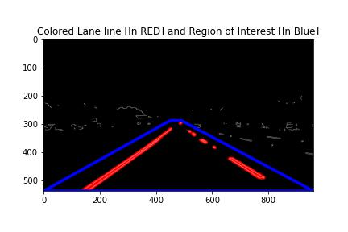
Steps followed: Hough transform
This method is used to connect the edge pixels we perceive in the image.

Slide 7

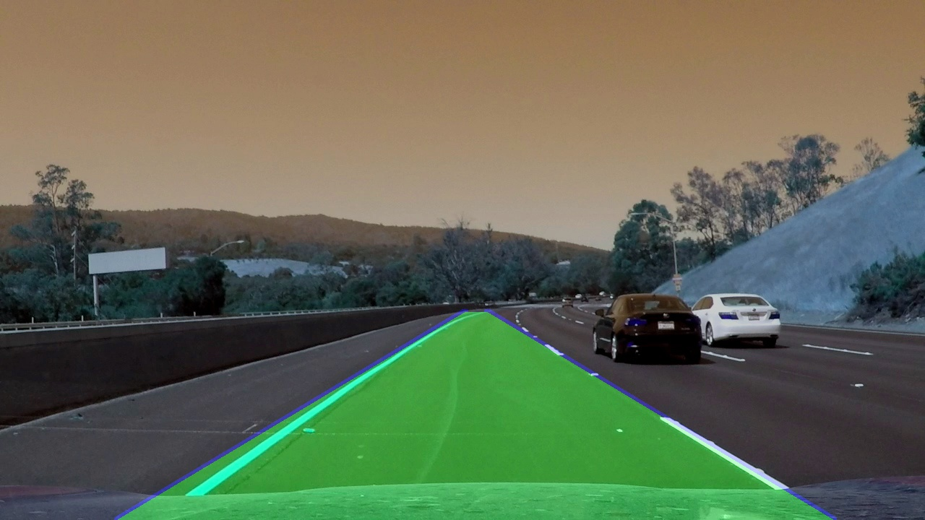
RESULT

Slide 8
rESOURCES
Youtube.com
Github.com
Stackoverflow.com
Medium.com
Geeksforgeeks.com

