Slide 1

Herding quantum cats
Qiskit Fall Fest 2026 · Herding Quantum Cats
Team Quantum Thinkers
Abhishek Vijay Potekar
Haniyeh Vakilian
Rajveer Shaw
Pakhi Rao
Ismail Paktiawal
Notes:
Speaker: Abhishek. Hi, we are Quantum Thinkers. Our challenge: build the cleanest 12-qubit cat (GHZ) state and the biggest certified one, on a simulator of IBM Heron and on the real ibm_kingston.

Slide 2
Our cat in three numbers
0.978
Fidelity of our 12-qubit cat on the simulator: 15× closer to a perfect cat than the organizers' baseline (0.41 in the same scorecard run).
0.913
The same cat on the real ibm_kingston, against F = 0.599 for the baseline measured in the same job.
40
Qubits certified as genuinely entangled on real hardware (lower bound 0.56, above the 0.5 limit). We also certified 32.
Simulator: Fall Fest simulator of fake_kingston, 24,000 shots.
Hardware: ibm_kingston (IBM Heron r2), 10 Nov 2026.
Notes:
Speaker: Abhishek. Headline numbers. F is a certified lower bound on the fidelity: F = P + (X - 1)/2, and F > 0.5 proves genuine N-qubit entanglement. The baseline is 0.41 in the 24,000-shot scorecard run and 0.44 in the 8,000-shot Mission 2 run (next slides): same circuit, the difference is shot noise.

Slide 3
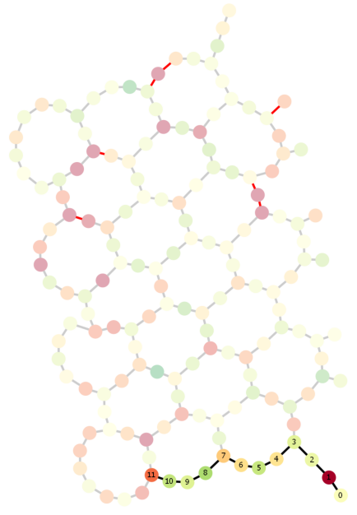
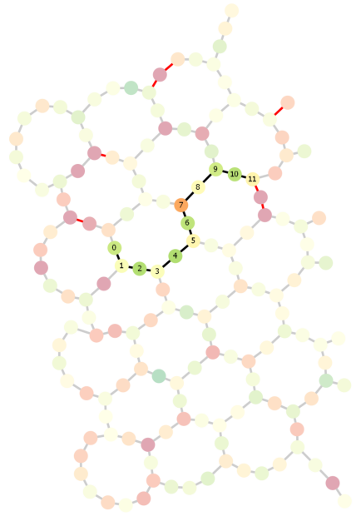

Our recipe: four steps to a clean cat
Baseline: qubits 0–11
Ours: searched chain
1
Layout search. DFS with pruning over ~6,000 chains avoids the 16.8% readout qubit. F 0.44 → 0.72
2
Grow from the middle. Half the depth (11 → 6 CZ layers), idle time 5.9 → 2.4 µs. F → 0.74
3
TREX readout mitigation. Removes readout errors from P and X. F → 0.94
4
Linear ZNE (noise ×1, ×3). Extrapolates gate noise to zero. F → 0.978, R ≈ 15
Notes:
Speaker: Haniyeh. The chip maps (from our notebook, Mission 2) show the baseline on qubits 0-11, which it uses just because they are numbered first; qubit 1 has 16.8% readout error. We searched the whole chip, grew the cat from the middle, then added TREX and linear zero-noise extrapolation.

Slide 4

What helped, and by how much
Each step on the simulator, 12 qubits (Missions 2–6). F is a certified lower bound; above 0.5 means real entanglement.
Biggest single gain: TREX, error ε* 0.267 → 0.069, at the cost of ~2× larger error bars.
Tried and rejected: exponential ZNE (great once, unstable across seeds), gate twirling and DD (no gain on the simulator).
Final scorecard: ≈ 25/25 points, stable over 4 simulator seeds.
Notes:
Speaker: Rajveer. Every bar is our own simulator run at a fixed shot budget. Grey is the organizers' baseline; magenta is our final scorecard. We also report what did not work.

Slide 5
On real hardware
ibm_kingston · IBM Heron r2
Cleanest cat: 0.913
Our 12-qubit cat reached 0.913 ± 0.016, against 0.599 for the baseline in the same job (R = 3.9).
Calibration drift
Today the baseline qubits were good: F = 0.60 on hardware vs 0.41 on the simulator, so R fell from 15 to 3.9.
Biggest cat: 40 ✓
48 qubits: F = 0.435 ✗
40 qubits, first try: 0.405 ✗
40 qubits: F = 0.599 ± 0.018 ✓
32 qubits: F = 0.587 ± 0.013 ✓
Simulator vs reality
Crosstalk and coherent errors are missing from the simulator: our 48-qubit tree fell from 0.69 to 0.44.
Notes:
Speaker: Pakhi. We re-ran the layout search on today's calibration and submitted the baseline and our cat in one job. For the biggest cat, our first 40-qubit try failed (0.405); Haniyeh's 40-qubit run was certified (0.599 +/- 0.018), and we also certified 32 qubits (0.587 +/- 0.013).

Slide 6
40 qubits, entangled on a real chip
Notes:
Speaker: Pakhi. 40 qubits certified on a real IBM Heron (Haniyeh's run, job dbpma344148s739us5c0): F = 0.599 +/- 0.018, so F - 2σ = 0.56 > 0.5, without ZNE. We also certified 32 qubits (F = 0.587 +/- 0.013), built as a breadth-first tree on good qubits with dynamical decoupling.

Slide 7
What we learned
Lessons
Qubit choice matters as much as the circuit.
Judge F together with its error bar.
Re-optimize for today's calibration.
Next
Error detection for bigger cats.
Notes:
Speaker: Ismail. One bad qubit sank the baseline, so where a circuit runs matters as much as what it is. Mitigation trades bias for variance, so we always compared F together with its error bar. The real chip drifts daily, so we re-ran the layout search on today's calibration. Next, we would add error detection with spare check qubits, the trick IBM used for its 120-qubit cat.

Slide 8
Thank you
Quantum Thinkers
Questions?
Notes:
Speaker: Ismail. Thank you! Questions?

