Slide 2
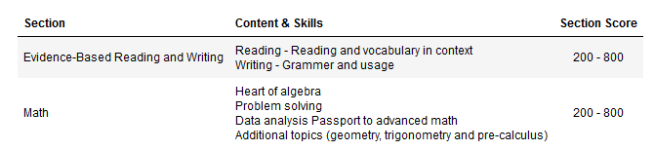
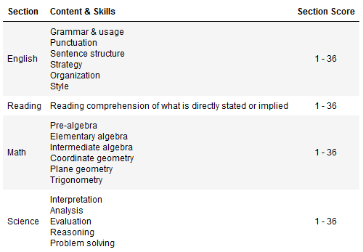
Background
SAT and ACT are standardized tests that many colleges and universities in the United States require for their admissions process.
This score is used along with other materials such as grade point average (GPA) and essay responses to determine whether or not a potential student will be accepted to the university.
ACT
SAT

Slide 3
Problem Statement
In 2016, SAT underwent a major restructuring in its format and scoring system, the ACT management board members are concerned that the ACT participation rate and reputation might have been negatively affected.
Being an analyst working in ACT, you are tasked by your supervisor to conduct a study on the participation rate and scores between SAT and ACT from 2017 to 2019 to: -
Determine if more students are scoring more easily for SAT as compared to ACT
Is more states opting for SAT
Is a restructuring of ACT needed to remain competitive

Slide 4
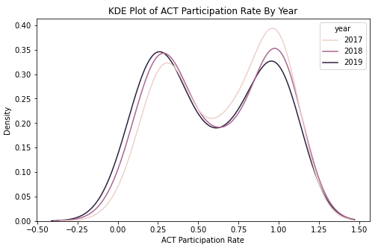
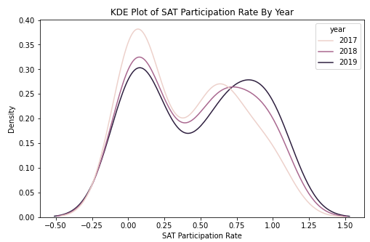
Avg Participation Rate Distribution
ACT
SAT
The participation rate for ACT and SAT are both a bimodal distribution from 2017 to 2019
SAT has a higher peak for lower participation rate across all 3 years

Slide 5
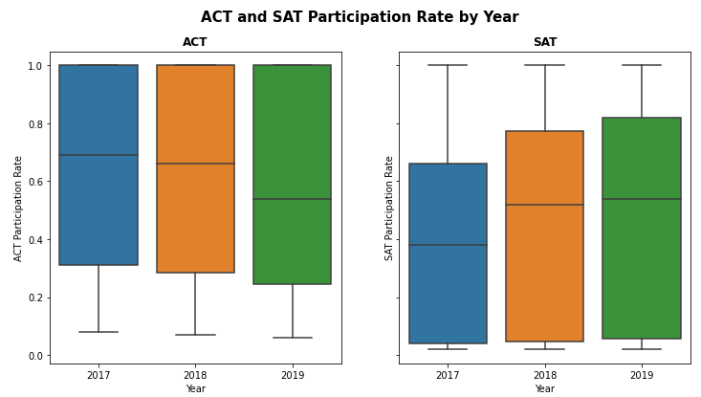
Avg Participation Rate Trend
ACT participation rate has been declining with each year while SAT participation rate has been increasing
For both ACT and SAT, both are showing higher standard deviation with each year

Slide 6
12

