Slide 1
Lesson 6
Local descriptors and graph neural networks.

Slide 2
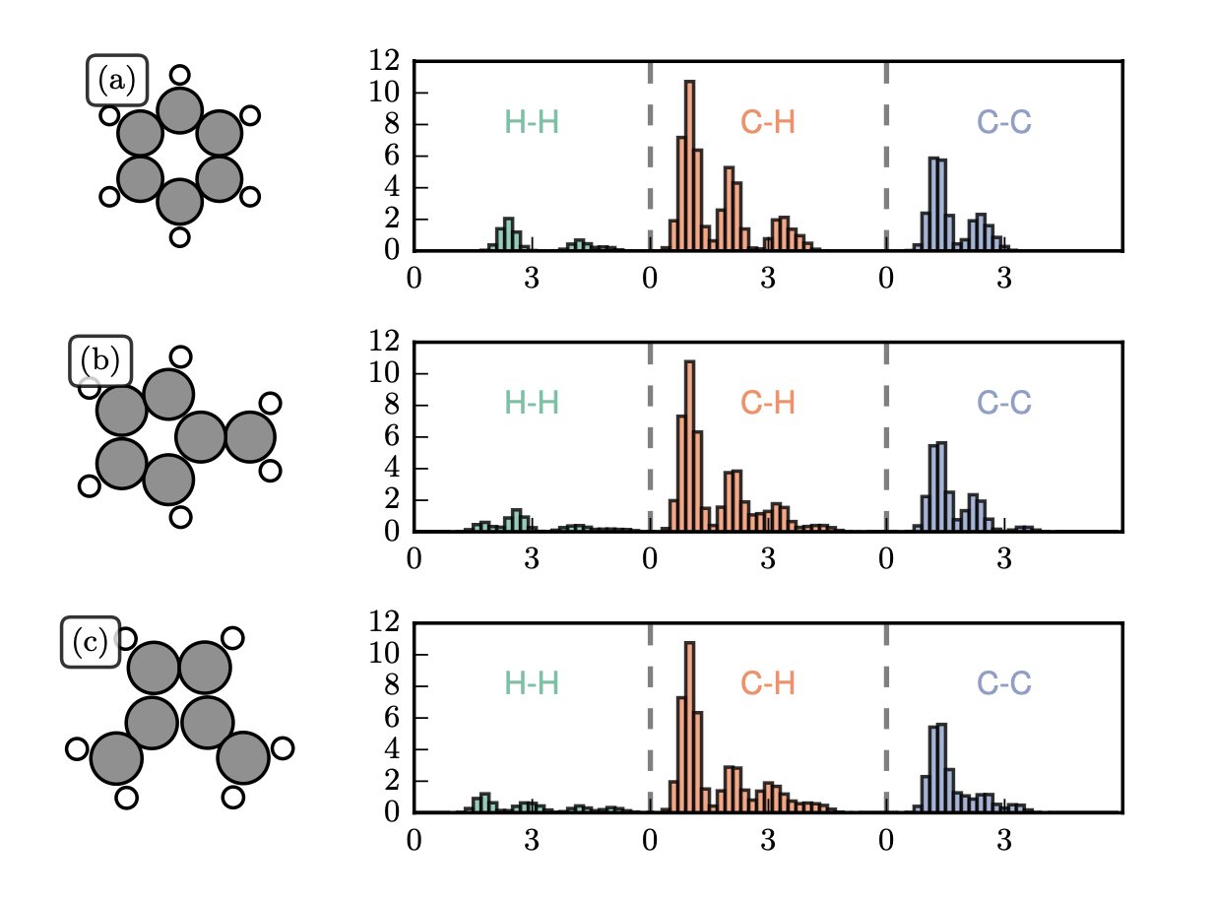
Global descriptors

Slide 3
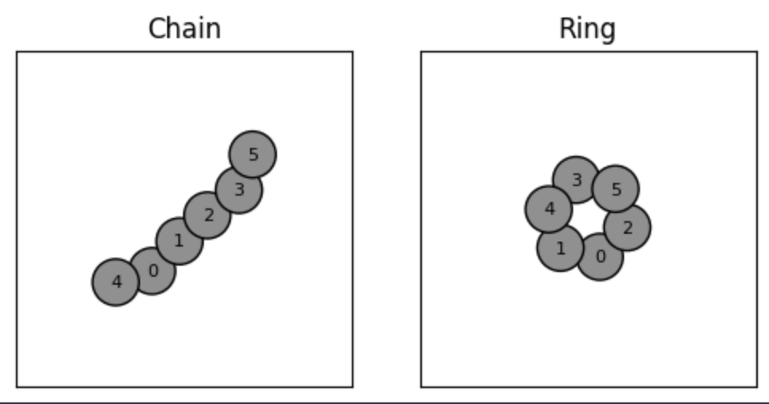
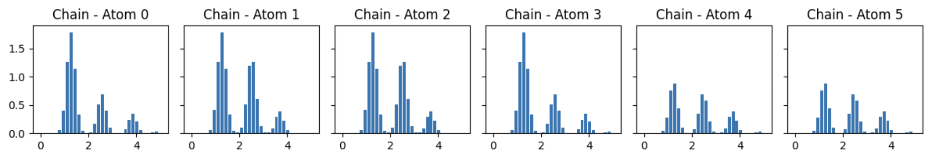
Local descriptors

Slide 4
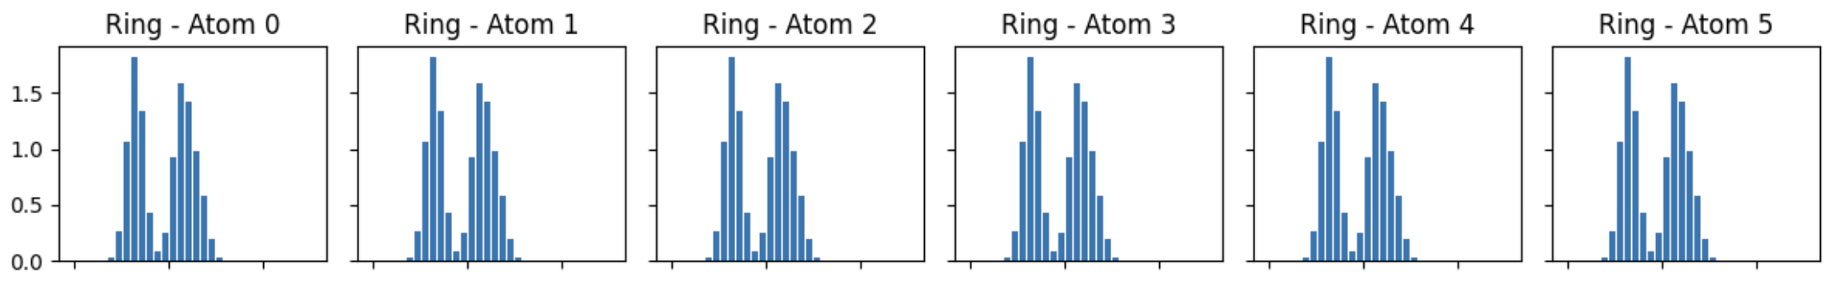
Local descriptors

Slide 5
Local descriptors

Slide 6
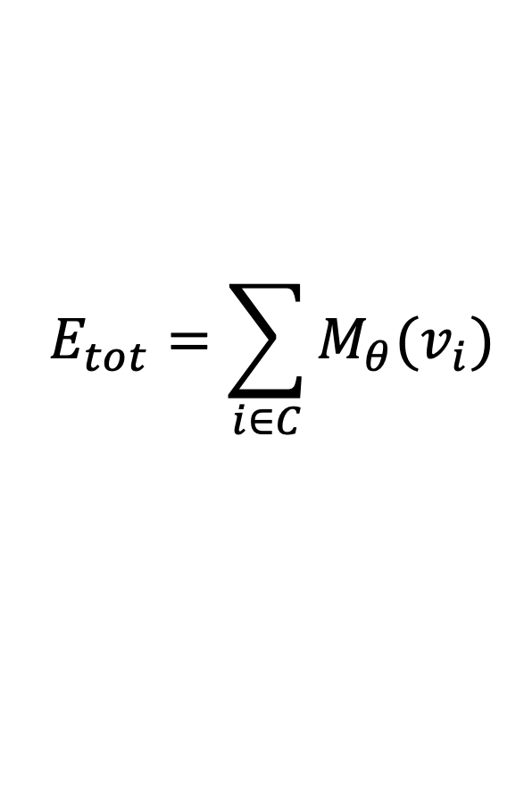
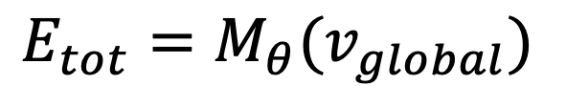
Global vs. local models
With global descriptors we model the total energy of a configuration in the straight forward way.
$$E_{tot}=M_{θ}(v_{global})$$
In a local model, we can model the total property as a function of atomic contributions
$$E_{tot}=\sum_{i∈C}{M_{θ}(v_{i})}$$
Where each $v_{i}$ is a local descriptor of an atom in configuration C.

Slide 7

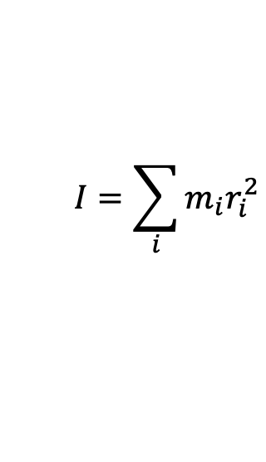
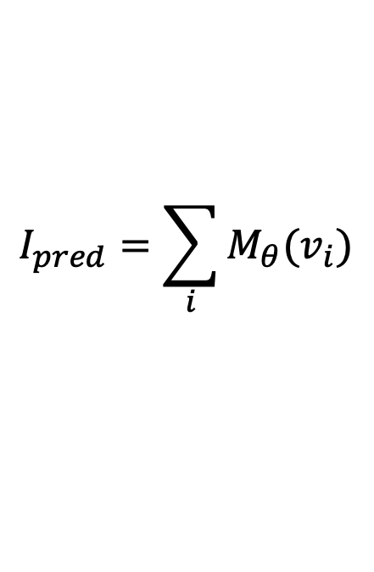
Example: Moment of Inertia
From mechanics we know that the moment of inertia is given by
Example with two weights.
$$I=\sum_{i}{m_{i}r_{i}^{2}}$$
Lets say that as local descriptors of this we have
$$v_{i}=[m_{i}, r_{i}]$$
Given observations of the total moment of inertia, the model needs to learn to model individual contributions.
We can then make a model where
$$I_{pred}=\sum_{i}{M_{θ}(v_{i})}$$

Slide 8
Convolutional local features.
One-hot representation (of the full configuration / state).
Atomic configuration
Discretization

Slide 9
Convolutional local features.
One-hot representation (of the full configuration / state).
Convolution operation
Kernel
0 | 1 | 0 | 1 | 0
1 | 2 | 1 | 2 | 0
0 | 3 | 0 | 3 | 0
1 | 2 | 1 | 2 | 0
1 | 2 | 1 | 1 | 0
0 | 1 | 0 | 1 | 0
1 | 2 | 1 | 2 | 0
0 | 3 | 0 | 3 | 0
1 | 2 | 1 | 2 | 0
1 | 2 | 1 | 1 | 0

Slide 10
Convolutional local features.
One-hot representation (of the full configuration / state).
Convolution operation
 |  |  |  | 1
Kernel
0 | 1 | 0 | 1 | 0
1 | 2 | 1 | 2 | 0
0 | 3 | 0 | 3 | 0
1 | 2 | 1 | 2 | 0
1 | 2 | 1 | 1 | 0
This is a feature vector with 1 feature

Slide 11

Convolutions & Features
Consider an atomic density function
Centered at some point in space.
$$ρ\left(r\right)=∑δ(r_{i}−r)$$
$$ρ\left(r\right)$$
$$r$$

Slide 12
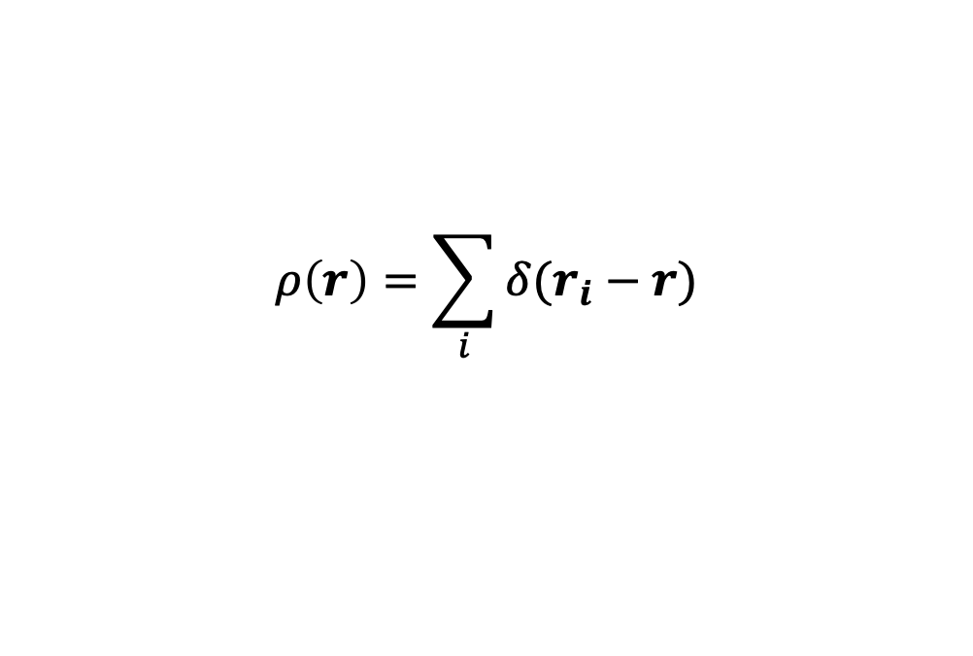
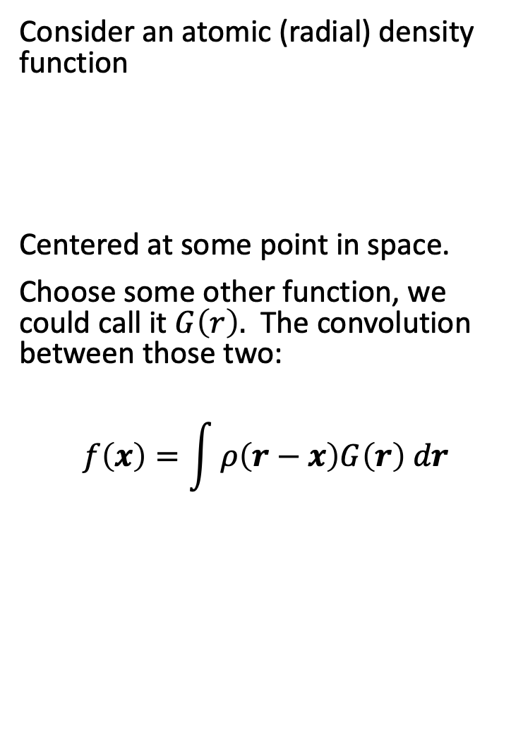


Convolutions & Features
Consider an atomic (radial) density function
Centered at some point in space.
Choose some other function, we could call it $G\left(r\right).$ The convolution between those two:
$$f\left(x\right)=\int{ρ\left(r−x\right)G\left(r\right) dr}$$
$$ρ\left(r\right)=\sum_{i}{δ(r_{i}−r)}$$
$$ρ\left(r\right)$$
$$r$$
$$G\left(r\right)$$
$$r$$

Slide 13
Convolutions and features.

Slide 14


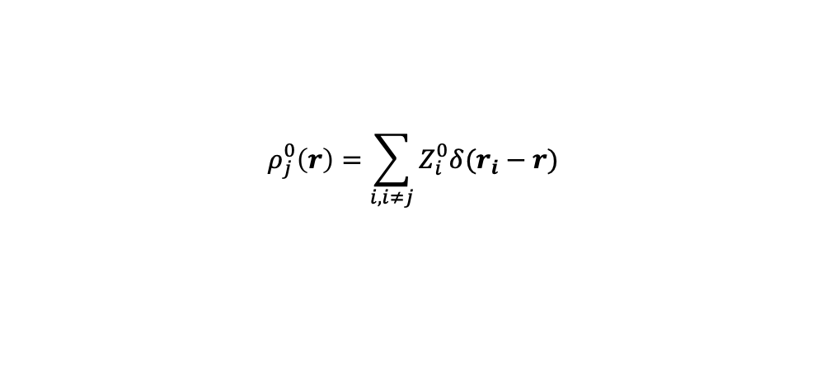


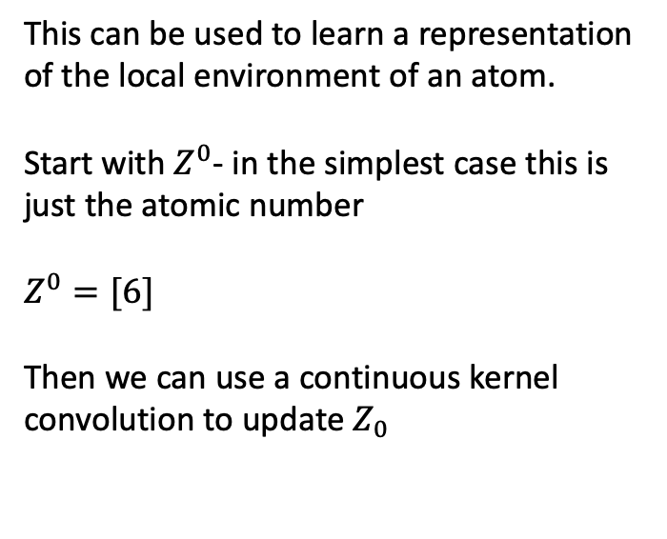


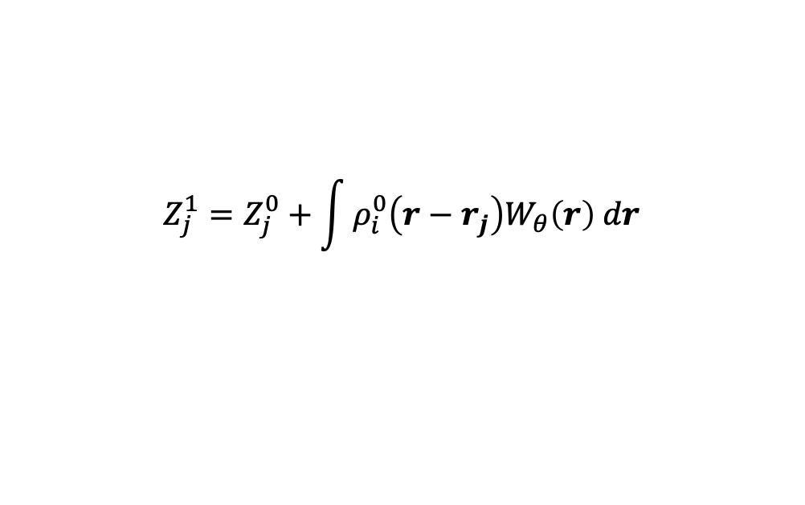


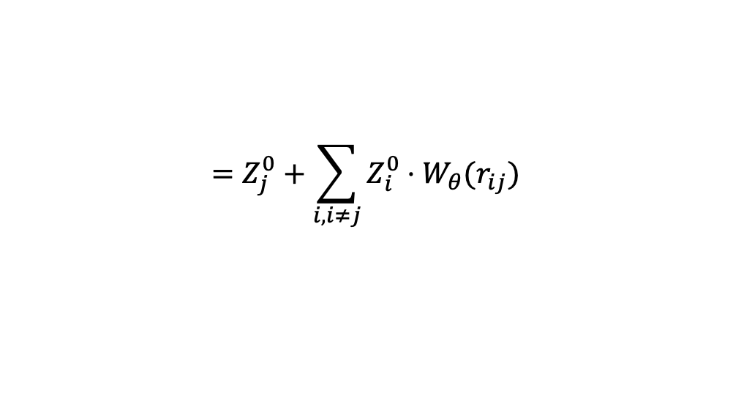


Learning continuous kernels
Initial descriptions – Just the atomic number
This can be used to learn a representation of the local environment of an atom.
Start with $Z^{0}$- in the simplest case this is just the atomic number
$Z^{0}=[6]$
Then we can use a continuous kernel convolution to update $Z_{0}$
$$Z_{0}^{0}$$
$$Z_{2}^{0}$$
$$Z_{1}^{0}$$
$$r_{01}$$
$$r_{12}$$
$$ρ_{j}^{0}\left(r\right)=\sum_{i,i≠j}{Z_{i}^{0}δ(r_{i}−r)}$$
Updated description – Depends on the neighborhood
$$Z_{0}^{1}$$
$$Z_{2}^{1}$$
$$Z_{j}^{1}=Z_{j}^{0}+\int{ρ_{i}^{0}\left(r−r_{j}\right)W_{θ}\left(r\right) dr}$$
$$Z_{1}^{1}$$
$$=Z_{j}^{0}+\sum_{i,i≠j}{Z_{i}^{0}⋅W_{θ}(r_{ij})}$$
$$r_{01}$$
$$r_{12}$$
The ‘effective species of an atom depends on its environment.

Slide 15



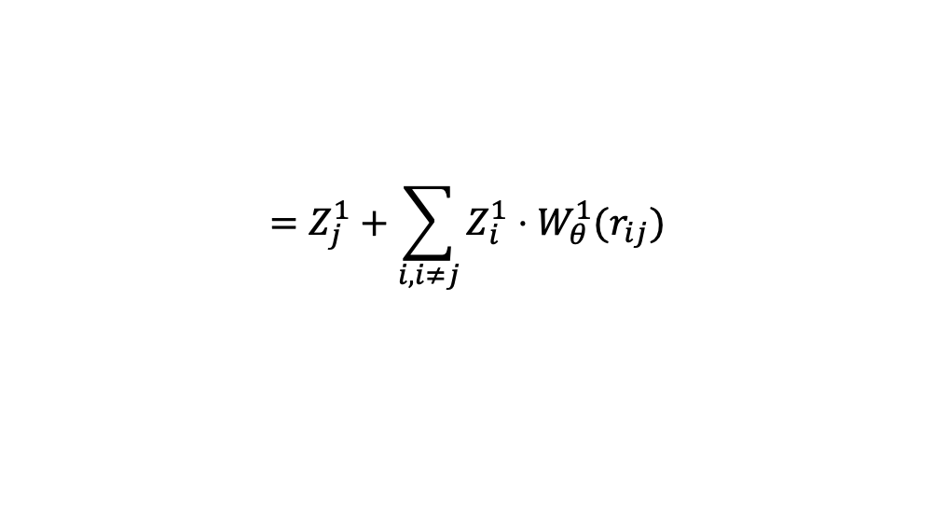
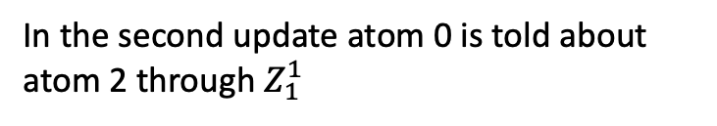



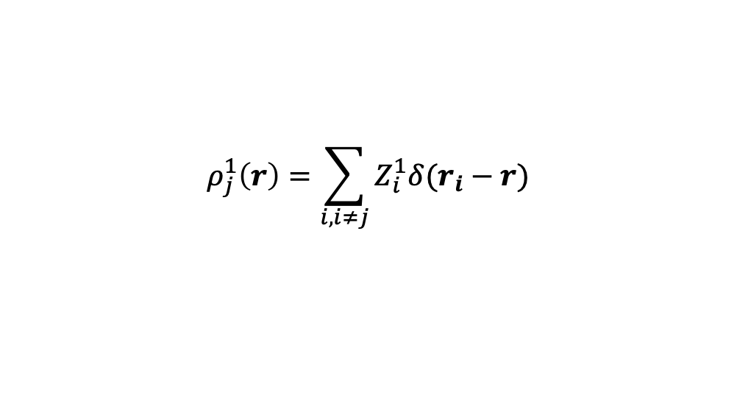





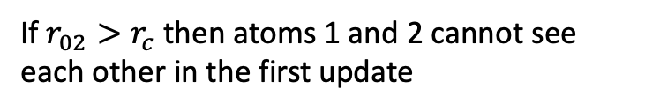


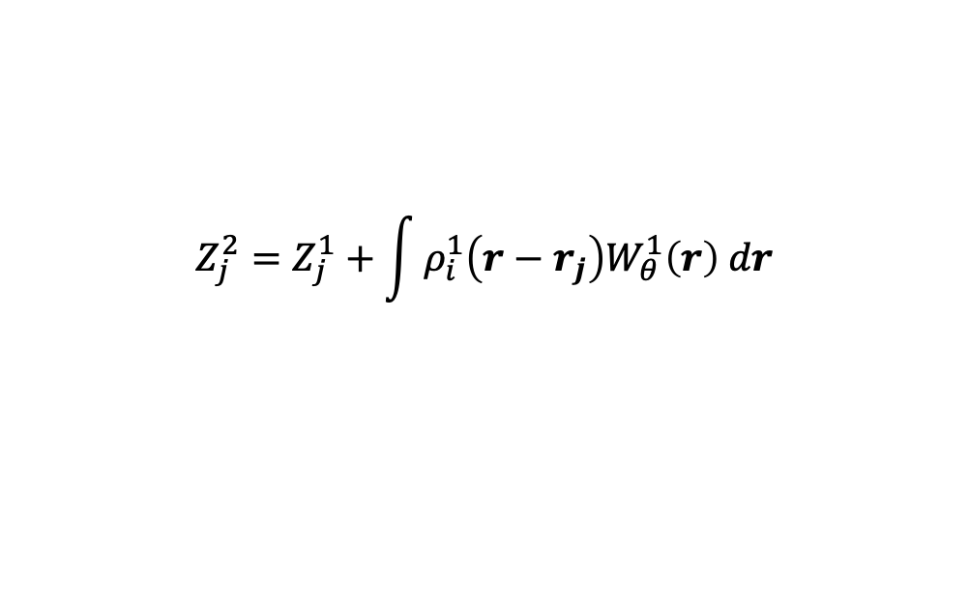


Multiple updates
$$Z_{0}^{0}$$
$$Z_{2}^{0}$$
$$Z_{1}^{0}$$
$$r_{01}$$
$$r_{12}$$
We can easily make more updates, its just a matter a different density function with a different kernel/filter.
If $r_{02}>r_{c}$ then atoms 1 and 2 cannot see each other in the first update
$$ρ_{j}^{1}\left(r\right)=\sum_{i,i≠j}{Z_{i}^{1}δ(r_{i}−r)}$$
$$Z_{0}^{1}$$
$$Z_{2}^{1}$$
$$Z_{j}^{2}=Z_{j}^{1}+\int{ρ_{i}^{1}\left(r−r_{j}\right)W_{θ}^{1}\left(r\right) dr}$$
$$Z_{1}^{1}$$
$$r_{01}$$
$$r_{12}$$
$$=Z_{j}^{1}+\sum_{i,i≠j}{Z_{i}^{1}⋅W_{θ}^{1}(r_{ij})}$$
In the second update atom 0 is told about atom 2 through $Z_{1}^{1}$
This is a form of a message-passing neural network.
The atoms are vertices of a graph, and the attributes of the vertices are updated through ’messages’.
$$Z_{0}^{2}$$
$$Z_{2}^{2}$$
$$Z_{1}^{2}$$
$$r_{01}$$
$$r_{12}$$

Slide 16







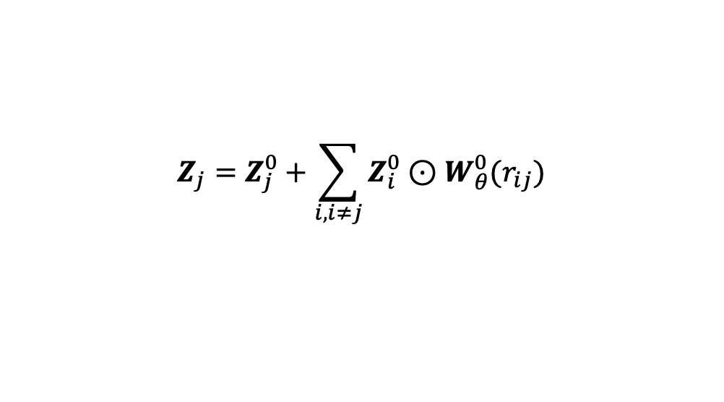




Vector representations.
Initial descriptions – vector that depends on the atomic number
$$Z_{0}^{0}$$
$$Z_{2}^{0}$$
Instead of the atomic number we can start with a vector.
Then the convolution becomes an element-wise product:
So now there’s a filter pr. dimension.
$$Z_{1}^{0}$$
$$Z_{j}^{0}=f_{θ}(Z_{j})$$
$$r_{01}$$
$$r_{12}$$
$$Z_{j}=Z_{j}^{0}+\sum_{i,i≠j}{Z_{i}^{0}⊙W_{θ}^{0}(r_{ij})}$$
Updated description – Depends on the neighborhood
$$⊙$$
$$=$$
$$Z_{0}^{1}$$
$$Z_{2}^{1}$$
$$Z_{1}^{1}$$
$$r_{01}$$
$$r_{12}$$
The vector-species of an atom depends on its environment.

Slide 17
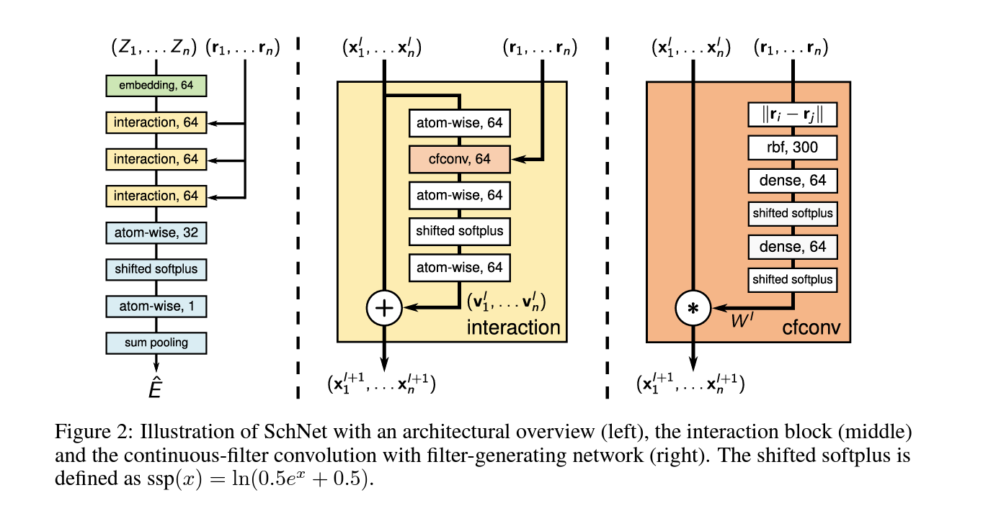
SchNet architecture.

Slide 18

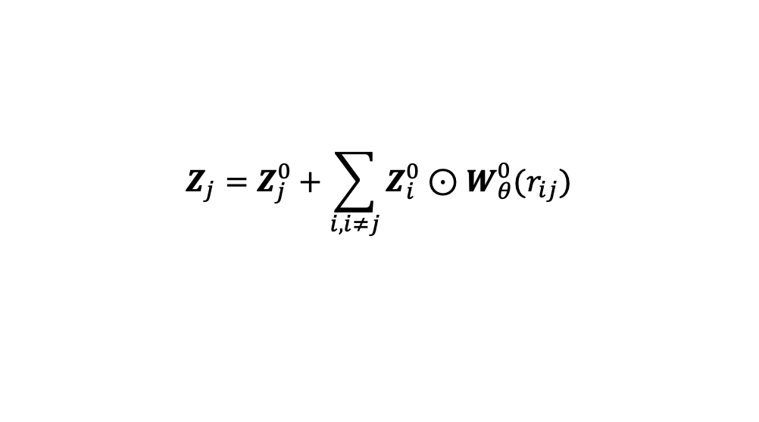
SchNet architecture.
Atom-wise is a feature recombination layer
$$\hat{Z}=a(Z⋅W^{T}+b)$$
Cfconv is the continuous convolution with a learnable filter:
$$Z_{j}=Z_{j}^{0}+\sum_{i,i≠j}{Z_{i}^{0}⊙W_{θ}^{0}(r_{ij})}$$

Slide 19
SchNet architecture.
Multiple message passing layers.
A standard local ansatz to predict local energies.

