Slide 1
Lesson 5: Descriptors of Atomic Systems

Slide 2
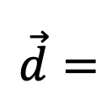
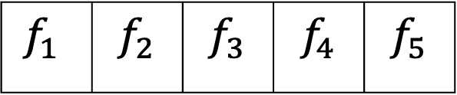
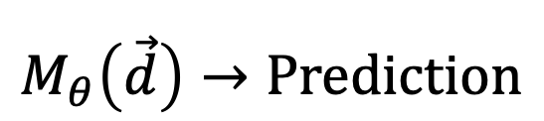
What are descriptors?
Feature
Descriptor
$$\vec{d}=$$
$$f_{1}$$ | $$f_{2}$$ | $$f_{3}$$ | $$f_{4}$$ | $$f_{5}$$
Our models are of the type
$$M_{θ}\left(\vec{d}\right)→Prediction$$

Slide 3

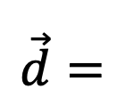
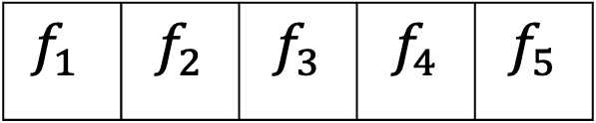
Descriptor for a cat picture
?
$$\vec{d}=$$
$$f_{1}$$ | $$f_{2}$$ | $$f_{3}$$ | $$f_{4}$$ | $$f_{5}$$

Slide 4


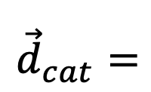


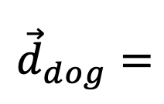
Descriptor for a cat picture
$${\vec{d}}_{dog}=$$
$$f_{1}$$ | $$f_{2}$$ | $$f_{3}$$ | $$f_{4}$$ | $$f_{5}$$
$${\vec{d}}_{cat}=$$
$$f_{1}$$ | $$f_{2}$$ | $$f_{3}$$ | $$f_{4}$$ | $$f_{5}$$
$${\vec{d}}_{cat}≠{\vec{d}}_{dog}$$

Slide 5
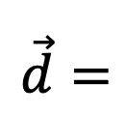
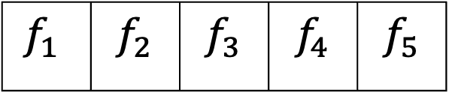
Descriptor for a cat picture
Translationally invariance
Descriptor should be the same for all translations
$$\vec{d}=$$
$$f_{1}$$ | $$f_{2}$$ | $$f_{3}$$ | $$f_{4}$$ | $$f_{5}$$

Slide 6
Descriptor for a cat picture
Rotational invariance
Descriptor should be the same for all rotations
$$\vec{d}=$$
$$f_{1}$$ | $$f_{2}$$ | $$f_{3}$$ | $$f_{4}$$ | $$f_{5}$$

Slide 7
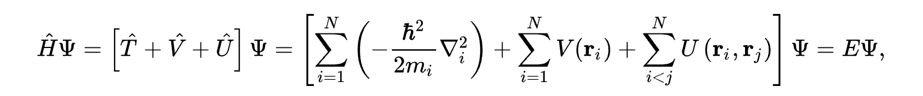
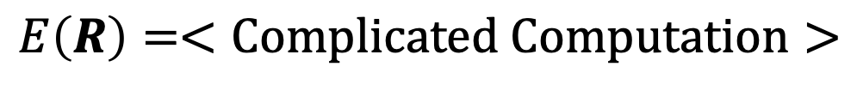
The many-electron time-independent Schrödinger equation is what governs at the atomic scale
Solve for E
$$E\left(R\right)=<Complicated Computation>$$
We want descriptors of R

