Slide 1
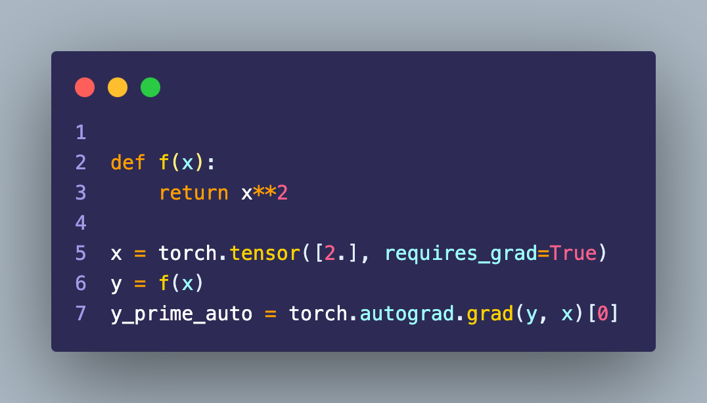
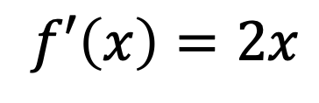
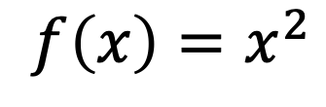
Recap: Derivatives using torch
$$f\left(x\right)=x^{2}$$
$$f′\left(x\right)=2x$$

Slide 2
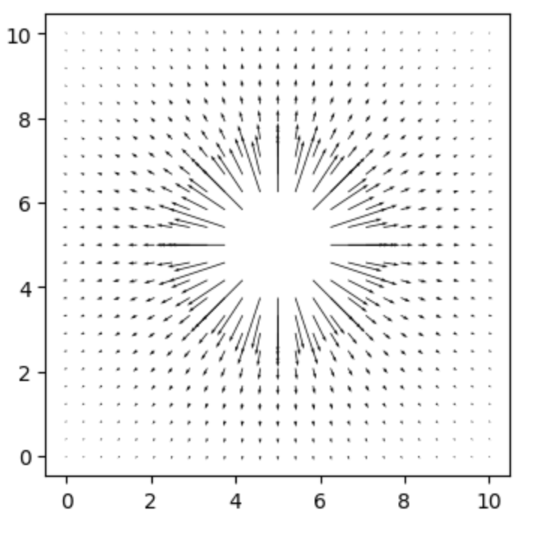
Recap: Electric field from scalar potential

Slide 3
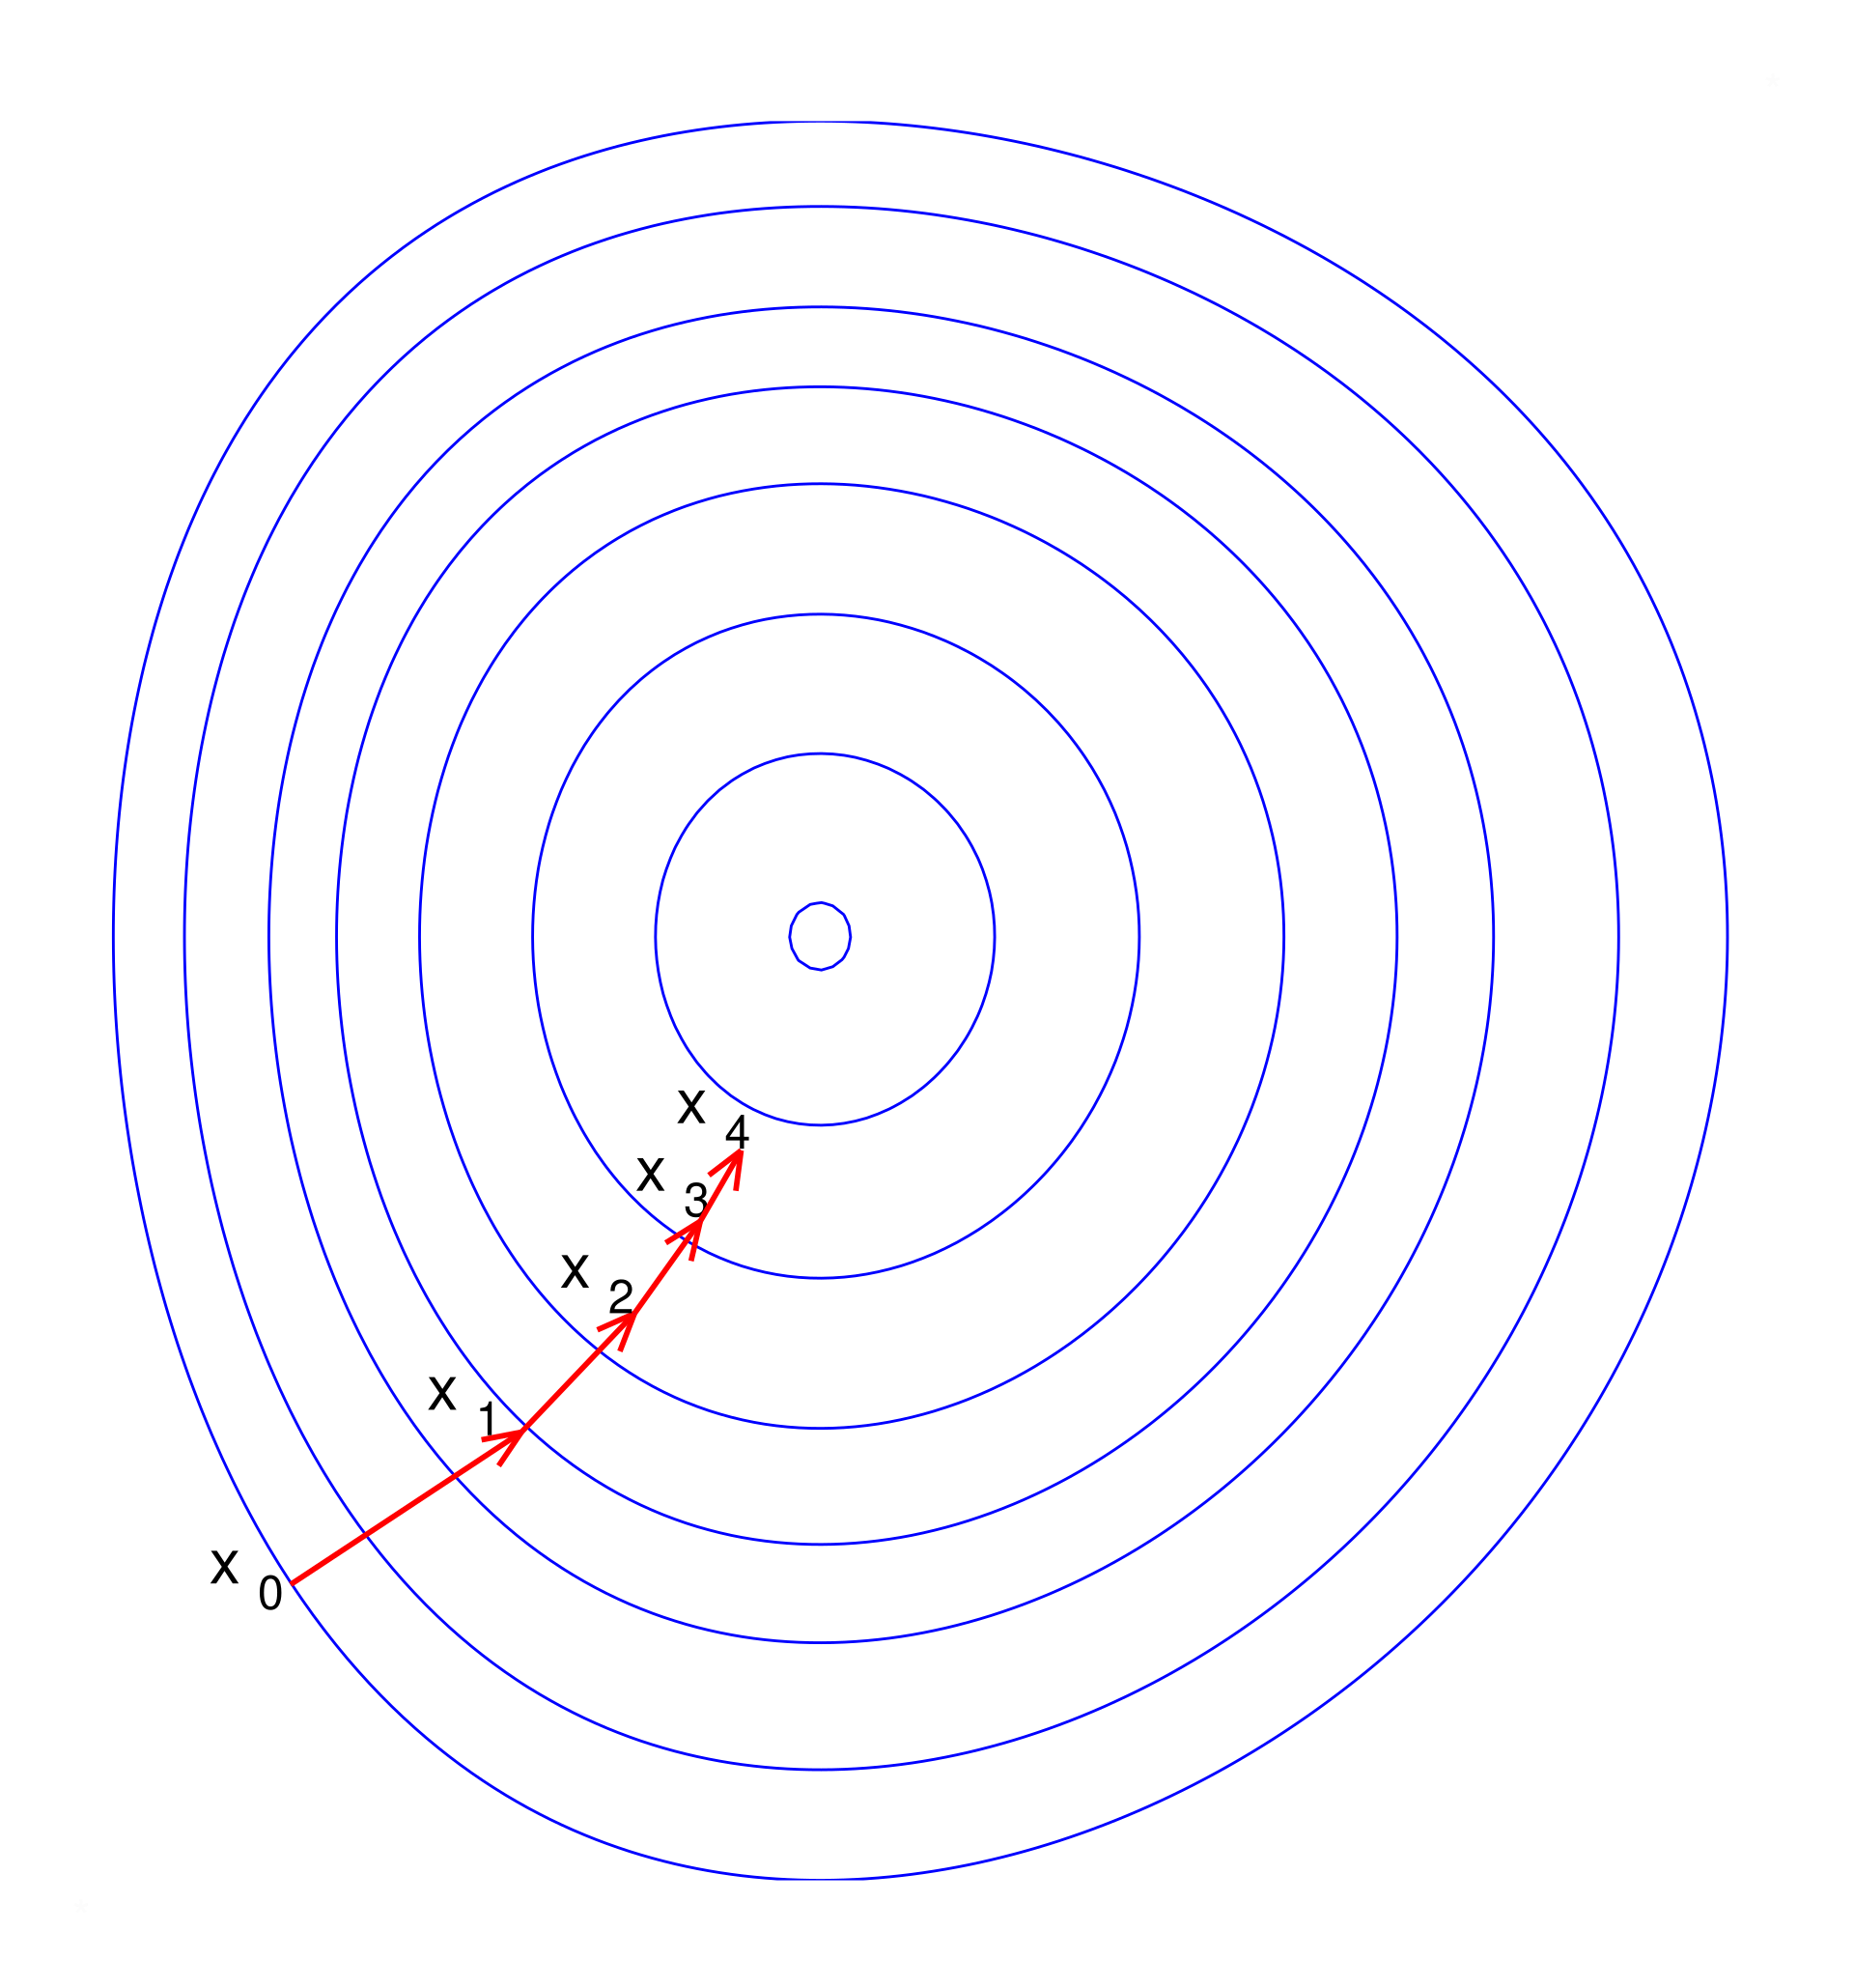
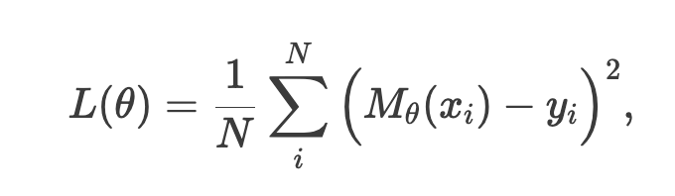
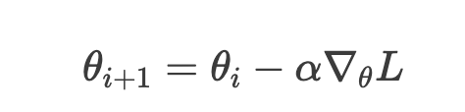
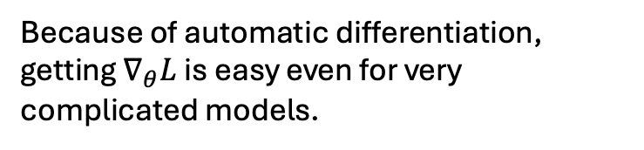
Recap: Gradient Descent
Loss function
Parameter update
Because of automatic differentiation, getting $∇_{θ}L$ is easy even for very complicated models.

Slide 4
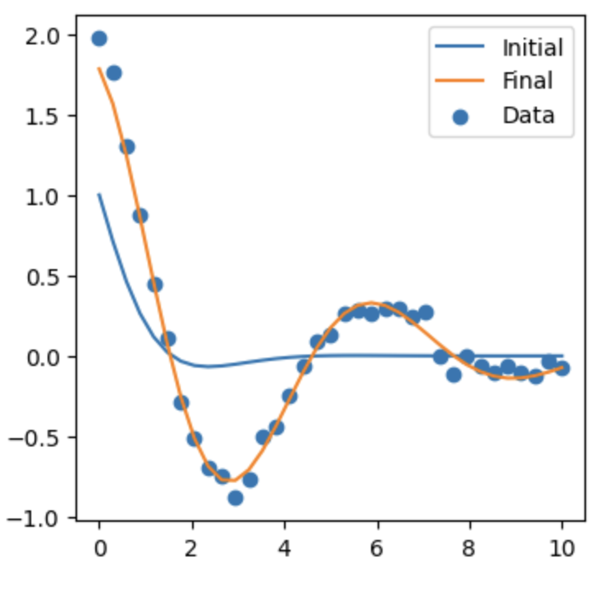
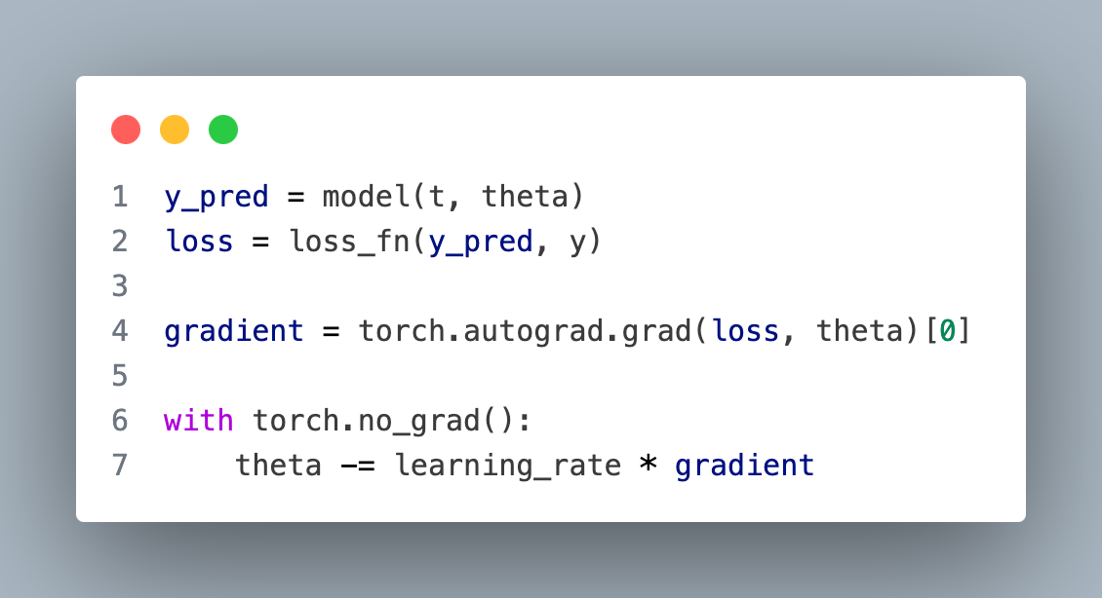
Recap: Training models using AD.

Slide 5
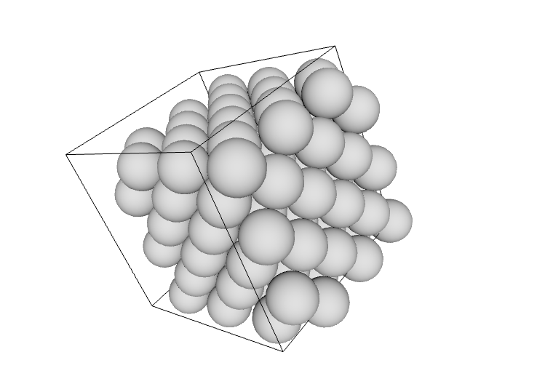
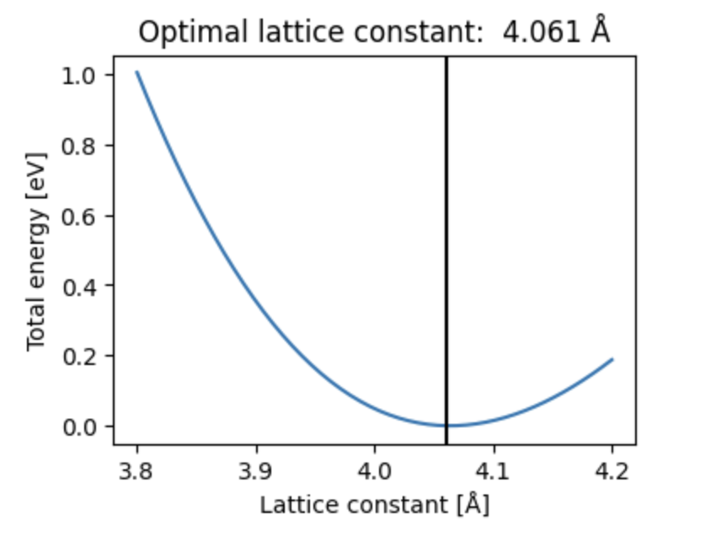
Recap: ASE
Calculating the energy of as a function of the lattice constant
Can build various systems
Here we see a bulk silver crystal

Slide 6
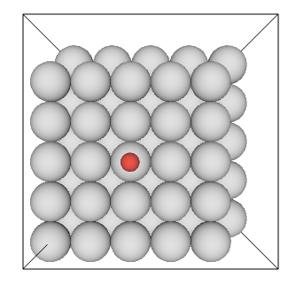
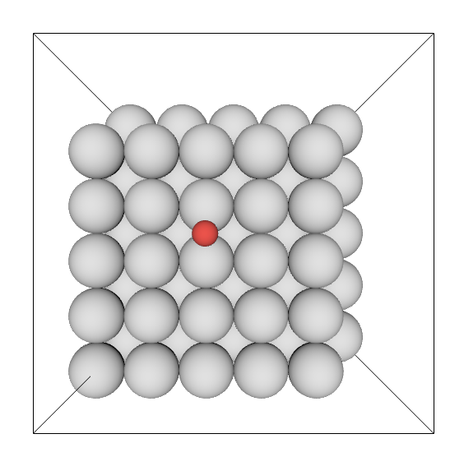
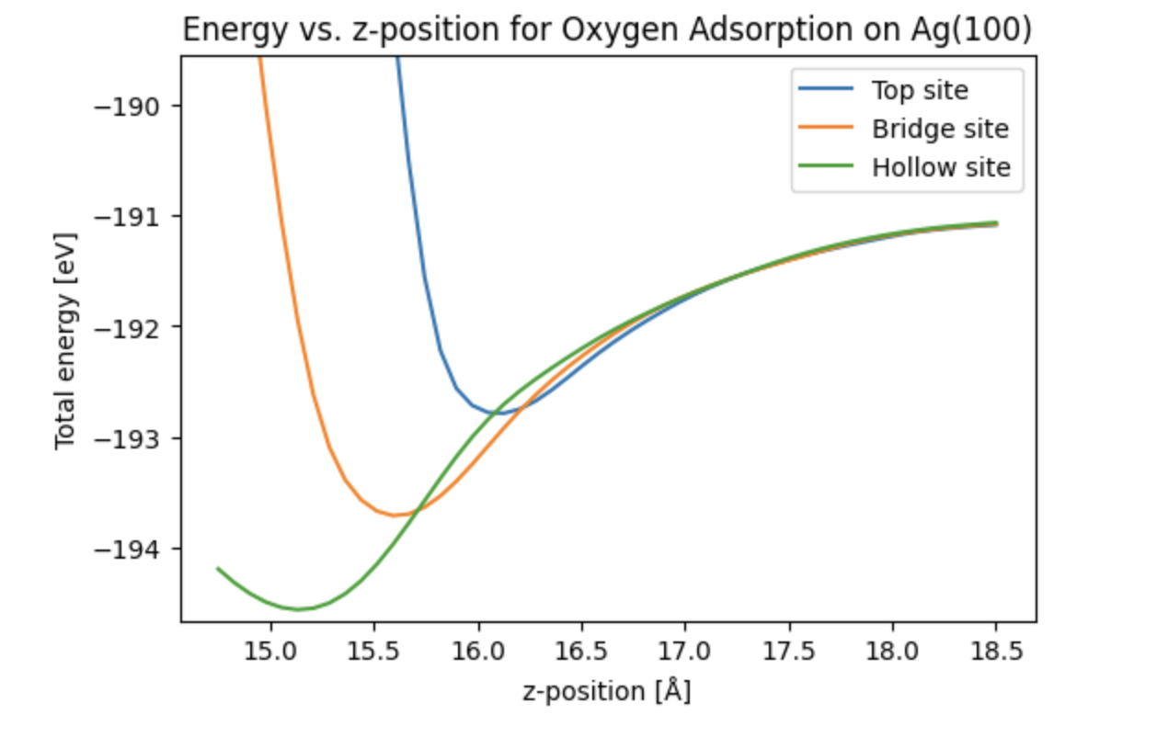
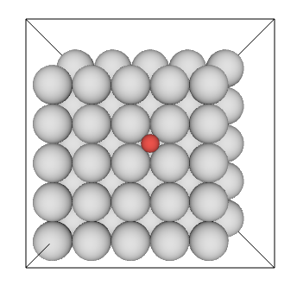
Recap: ASE

Slide 7
Potentials

Slide 8
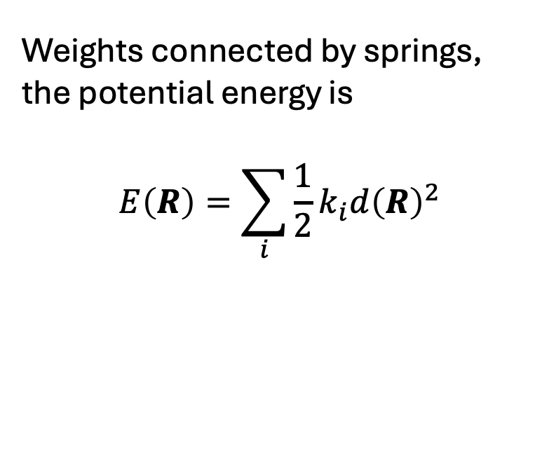
Springs
Weights connected by springs, the potential energy is
$$E\left(R\right)=\sum_{i}{\frac{1}{2}k_{i}d{\left(R\right)}^{2}}$$

Slide 9
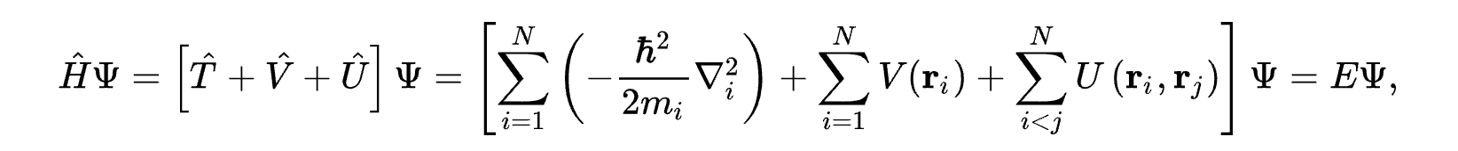
Atoms
The many-electron time-independent Schrödinger equation is what governs at the atomic scale
Generally unsolvable – so that’s a nice starting point. However, plenty of approximations exists,
specifically computational approximations.

Slide 10

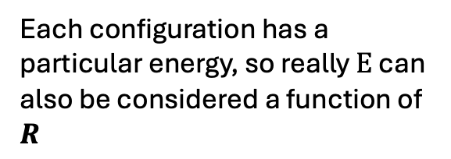
Atoms
Each configuration has a particular energy, so really $E$ can also be considered a function of $R$
Electron-electron interaction
Kinetic energy
This is an external potential that depends on the atomic positions $R$

Slide 11
Atoms
For atoms the potential energy is governed by
But can think about it as very complicated springs..

Slide 12
Atoms
Infinite chain of masses connected by identical springs
Infinite chain of atoms “connected” by quantum mechanics

Slide 13
Atoms
Energy
Equilibrium
distance
Infinite chain of masses connected by identical springs
Distance between masses
Infinite chain of atoms “connected” by quantum mechanics
Equilibrium lattice constant
Energy
Lattice constant

Slide 14
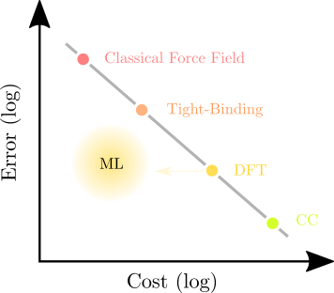
Approximations to Schrödinger equation

Slide 15
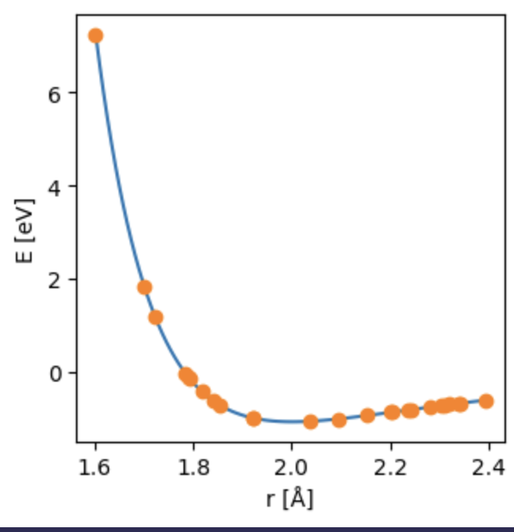
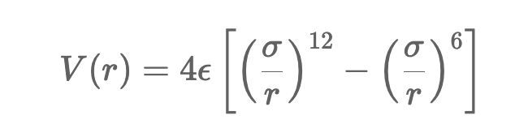
Learning the potential energy
Training data is dimers, really just a pretty simple regression
We will fit the parameters of the Lennard Jones potential

Slide 16
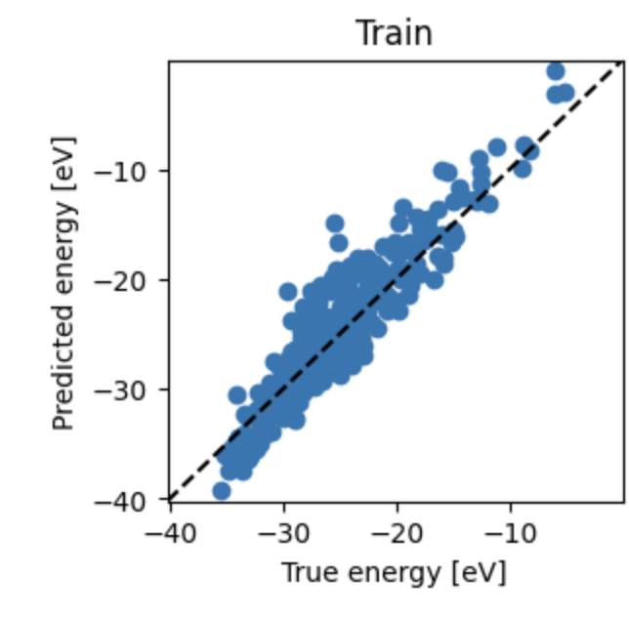
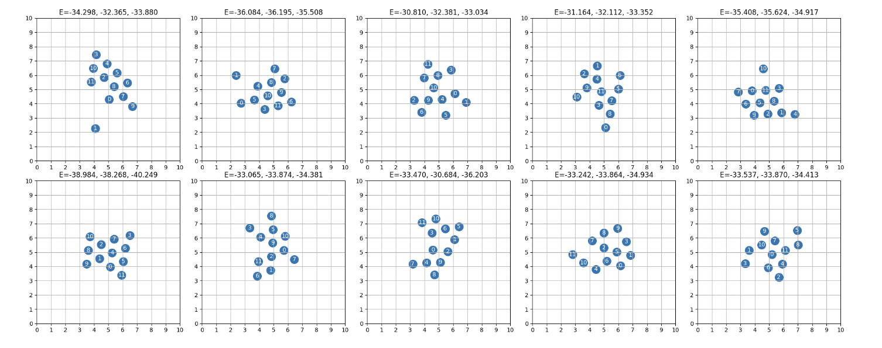
Learning the potential energy
Because the data does not come from the LJ-potential, we cannot get a perfect fit.
Training with cluster configurations, so now we have data with many dimensions (~60).
Geometries of some small clusters shown here.

Slide 17
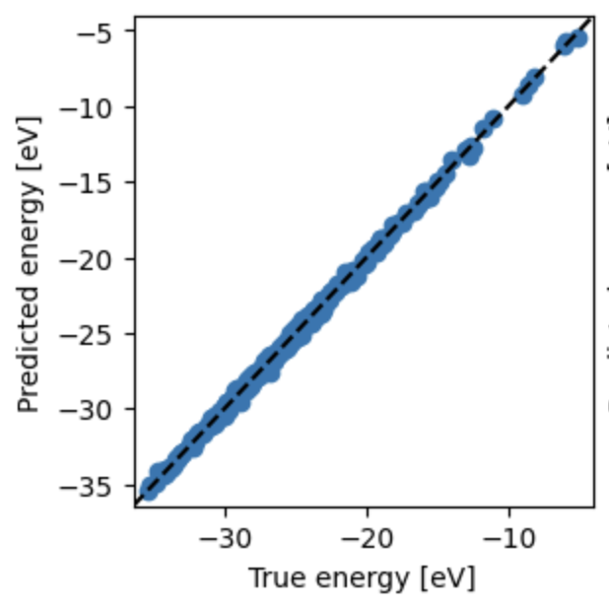

More expressive model
Then we can achieve very good agreement.
We will change our model to give it more more
Freedom
$$+G_{θ}(R)$$

Slide 18
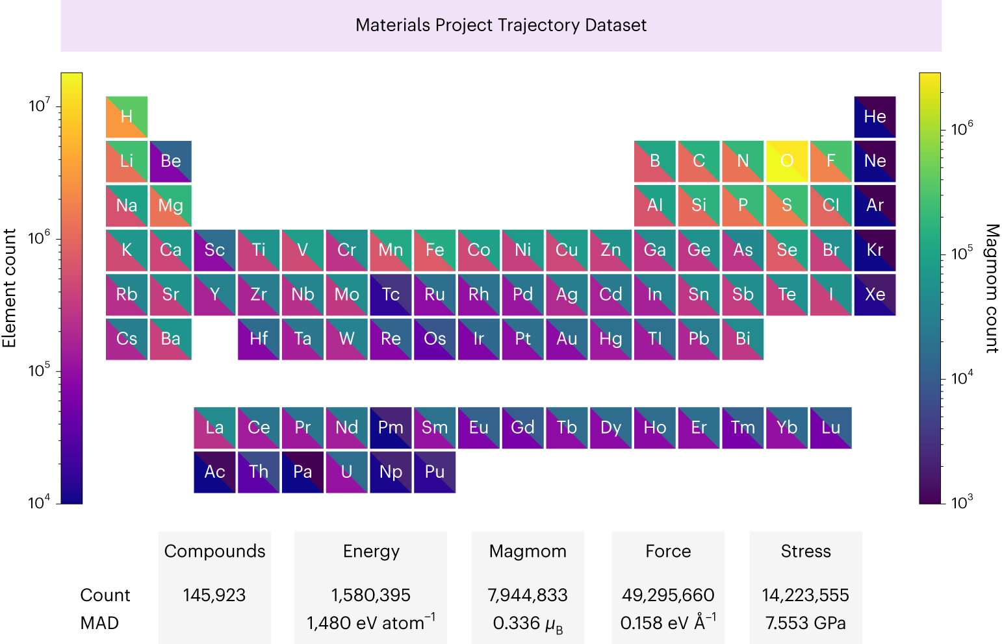
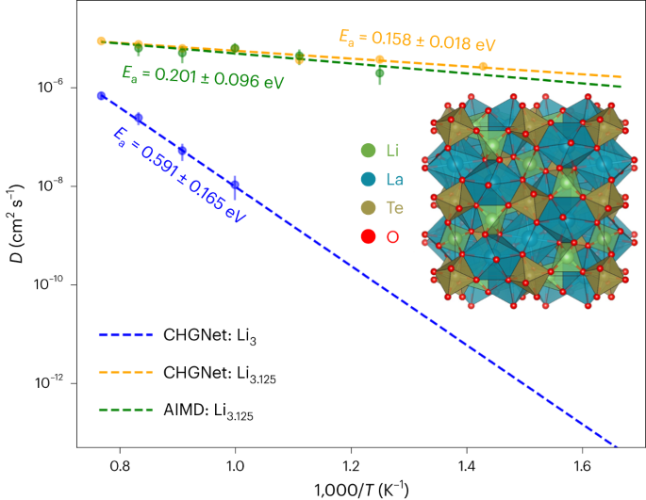
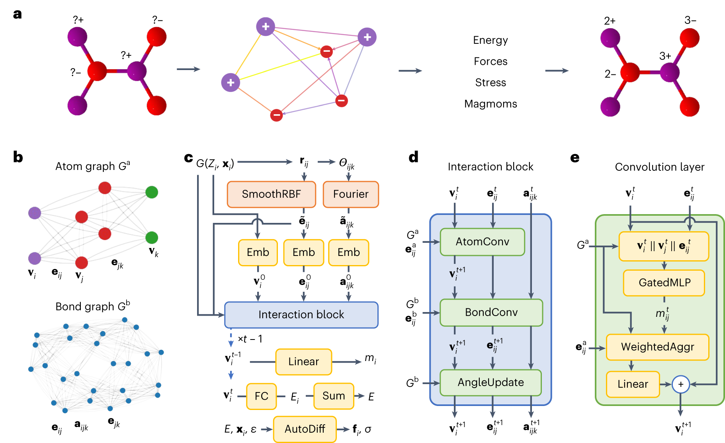

$\text{Li}\text{−}\text{ion} \text{diffusivit}$y predictions
> Deng, B., Zhong, P., Jun, K. et al. CHGNet as a pretrained universal neural network potential for charge-informed atomistic modelling. Nat Mach Intell 5, 1031–1041 (2023). https://doi.org/10.1038/s42256-023-00716-3

Slide 19
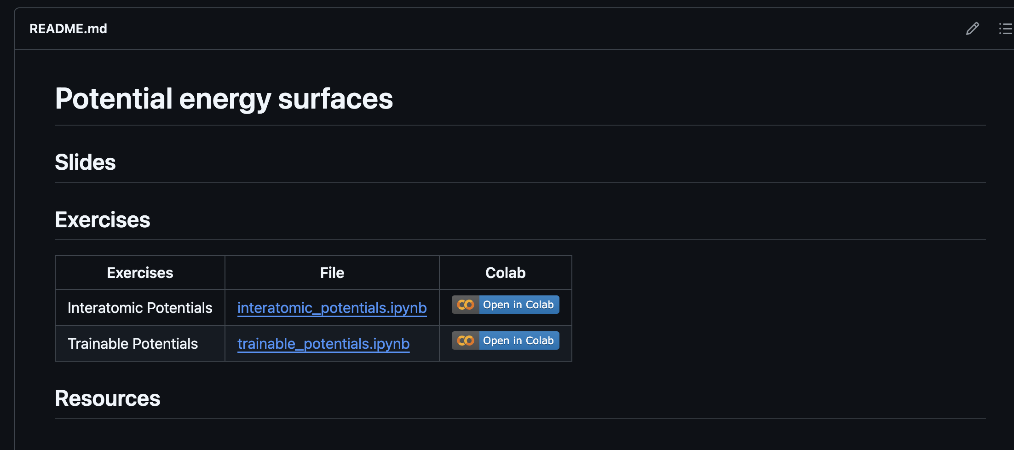
Todays Exercises: github.com/Mads-PeterVC/imlms/

