Slide 1
Introduction to Machine Learning for Materials Science
Unison 2025

Slide 2
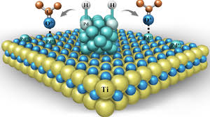
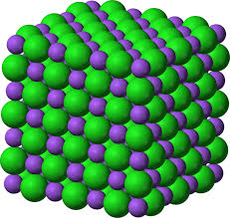
Materials Science
“Materials science is the study of the properties, structure, performance, and processing of materials, focusing on understanding and manipulating their composition to develop or improve materials for specific applications.”
- ChatGPT
“Computational materials science is a branch of materials science that uses computer simulations and modeling to study, predict, and design the properties and behavior of materials at various scales, from atomic to macroscopic levels.”
- ChatGPT

Slide 3
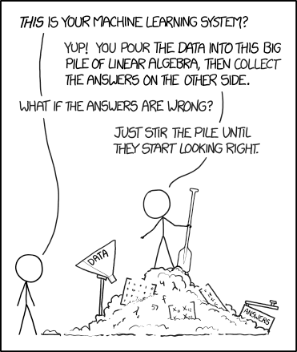
Machine Learning
“Machine learning is a branch of artificial intelligence that involves developing algorithms and models that enable computers to learn patterns and make decisions or predictions from data without being explicitly programmed.”
- ChatGPT

Slide 4


Workshop structure
We have 6 lessons over the next two weeks – the outline of the subjects for each lesson is as follow
1. Python for computational science intro / recap
2. Torch / The Atomic Simulation Environment
3. Potential energy surfaces
4. Introduction to Machine Learning
5. Machine Learning for atomic systems 1
6. Machine Learning for atomic systems 2
Each lesson will be partly a presentation and partly you working on the exercises.

Slide 5
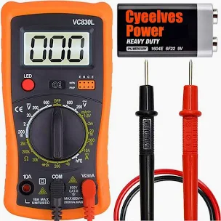
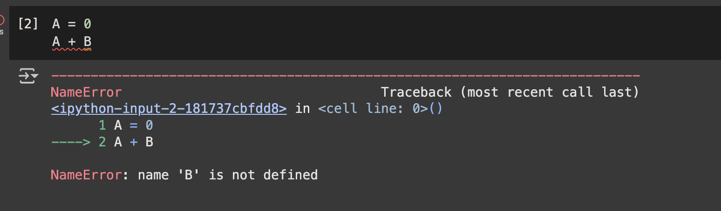
Experimental
Computational
In one of my first projects at uni I fried two expensive voltmeters.
Nothing can truly break – the two worst things
are error messages or incorrect results
You will experience errors and make mistakes, but those will help you learn.
My professor probably regretted teaching through exercises that day.

Slide 6
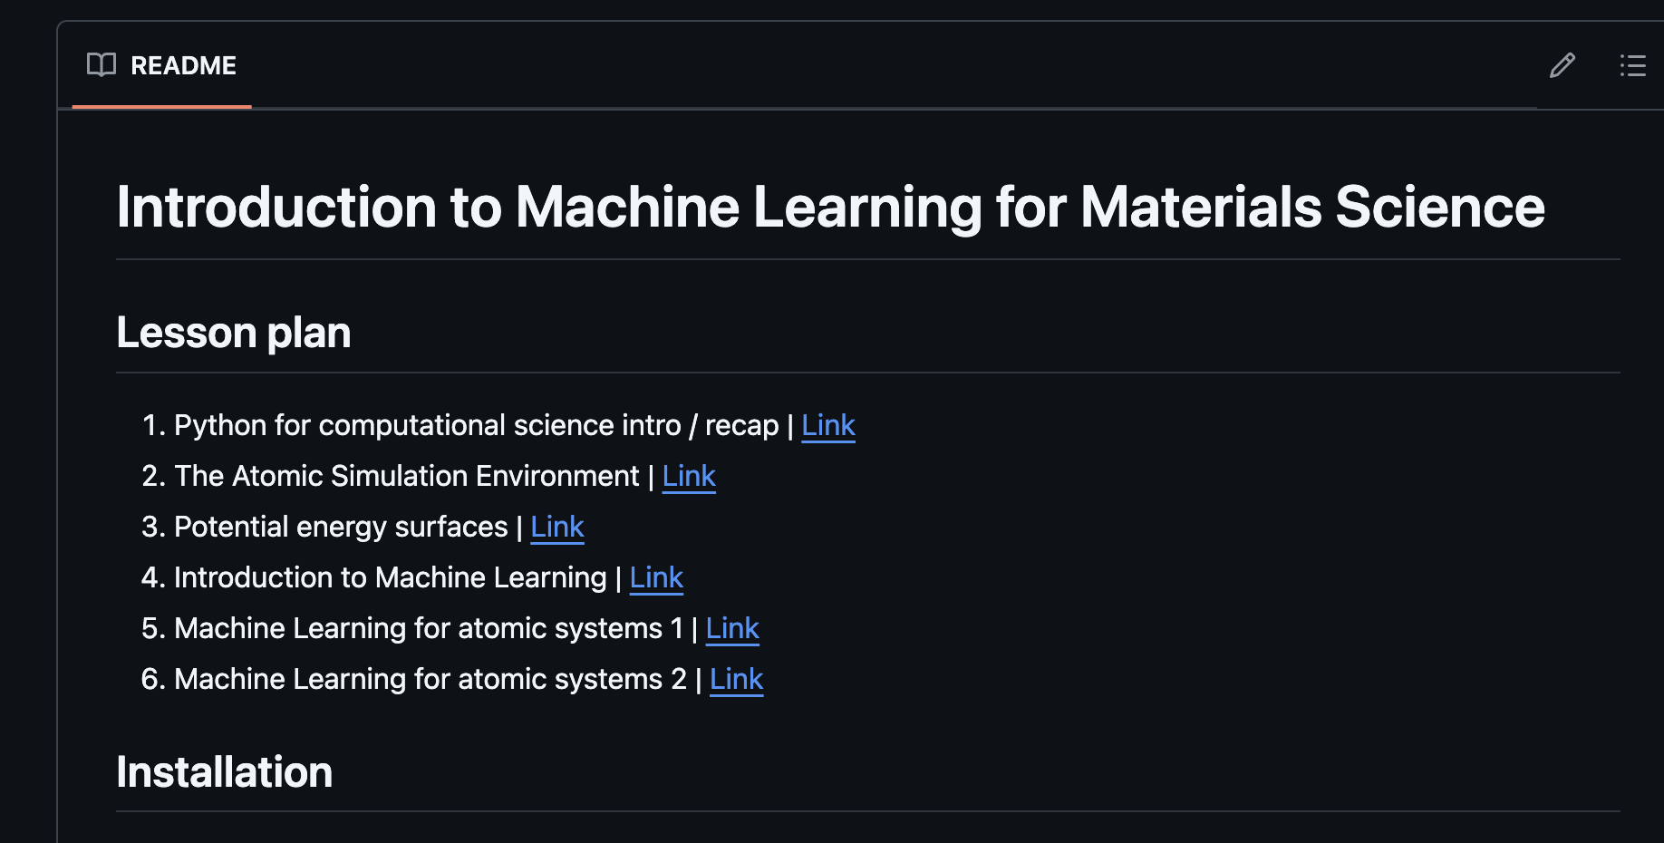
Content: github.com/Mads-PeterVC/imlms/
Click here

Slide 7
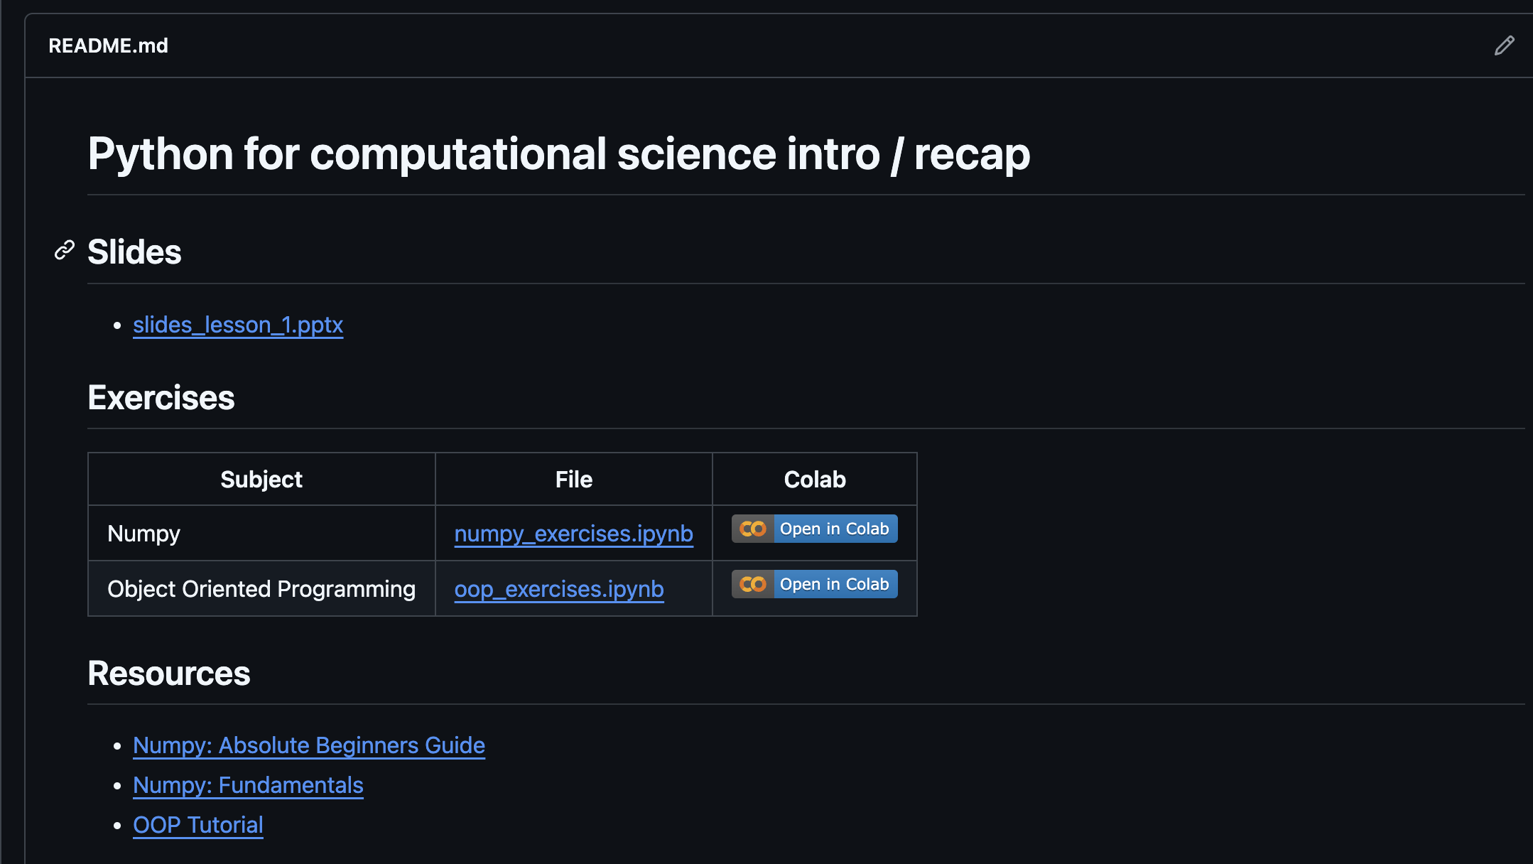
Content: github.com/Mads-PeterVC/imlms/
Click here

Slide 8
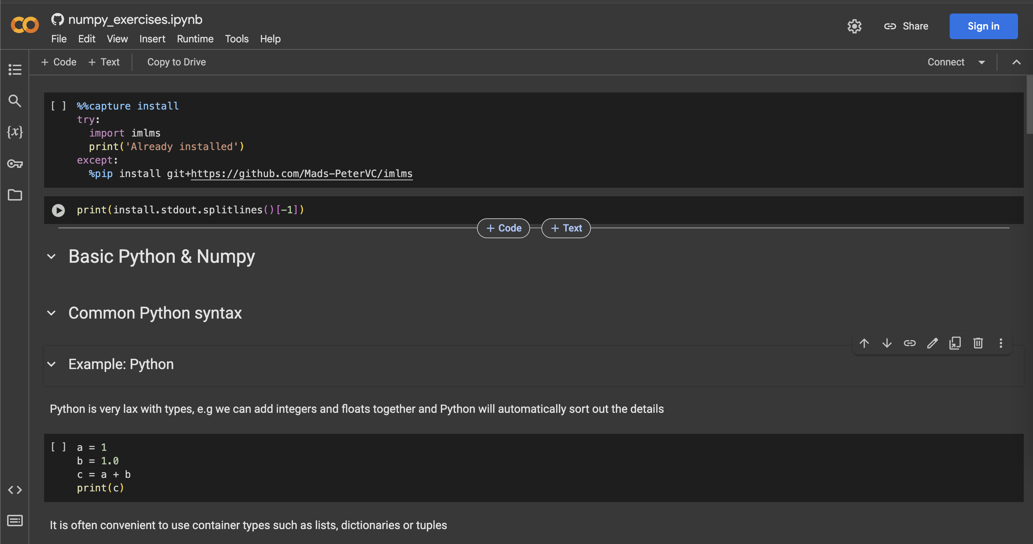
Content: github.com/Mads-PeterVC/imlms/
Sign in to be able to continue
Once signed in you can run a cell. [ctrl-enter] or click the arrow

Slide 9
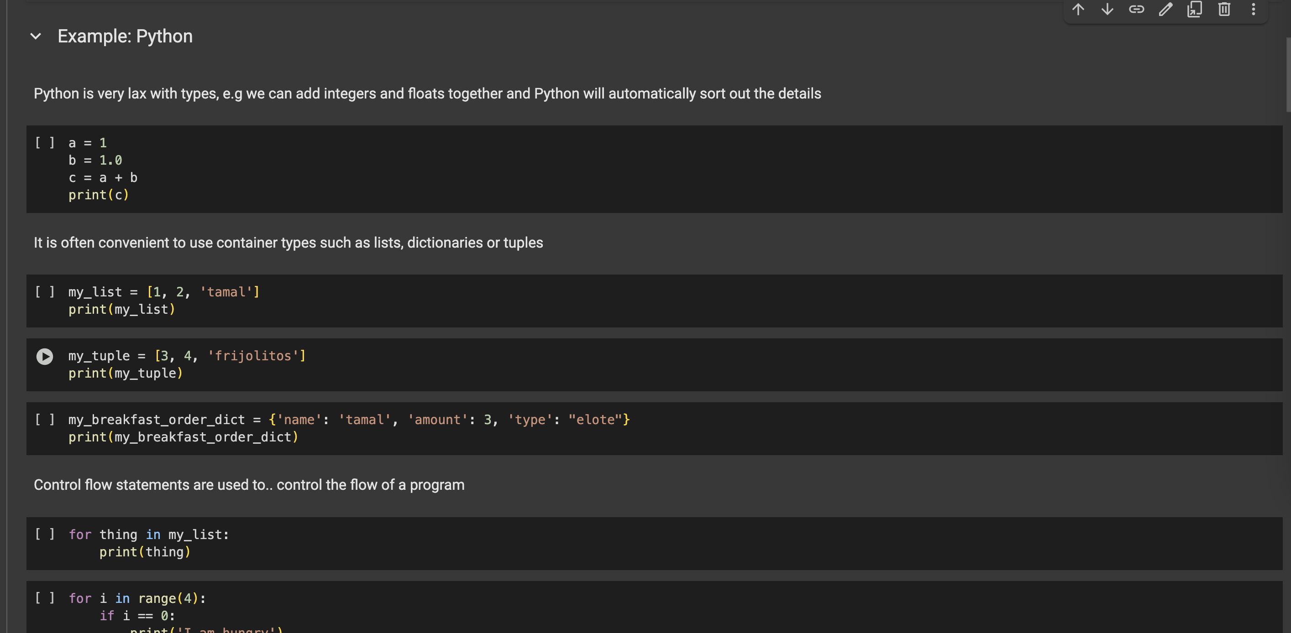
Content: github.com/Mads-PeterVC/imlms/
Some of the cells will provide examples without requiring you to write any code.

Slide 10
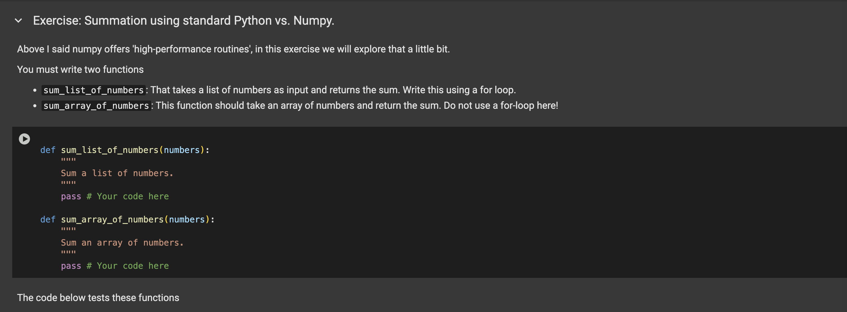
Content: github.com/Mads-PeterVC/imlms/
Others are exercises with parts or all of the code left for you to write.

