Slide 1
Lesson 5: Descriptors of Atomic Systems

Slide 2
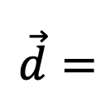
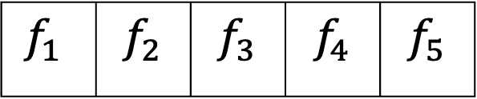
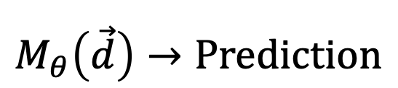
What are descriptors?
Feature
Descriptor
$$\vec{d}=$$
$$f_{1}$$ | $$f_{2}$$ | $$f_{3}$$ | $$f_{4}$$ | $$f_{5}$$
Our models are of the type
$$M_{θ}\left(\vec{d}\right)→Prediction$$

Slide 3

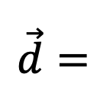
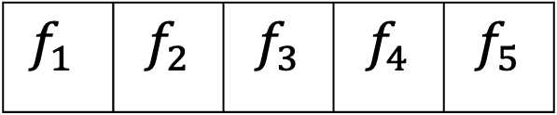
Descriptor for a cat picture
?
$$\vec{d}=$$
$$f_{1}$$ | $$f_{2}$$ | $$f_{3}$$ | $$f_{4}$$ | $$f_{5}$$

Slide 4


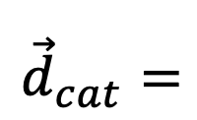


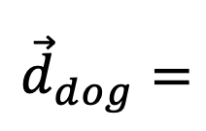
Descriptor for a cat picture
$${\vec{d}}_{dog}=$$
$$f_{1}$$ | $$f_{2}$$ | $$f_{3}$$ | $$f_{4}$$ | $$f_{5}$$
$${\vec{d}}_{cat}=$$
$$f_{1}$$ | $$f_{2}$$ | $$f_{3}$$ | $$f_{4}$$ | $$f_{5}$$
$${\vec{d}}_{cat}≠{\vec{d}}_{dog}$$

Slide 5
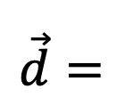
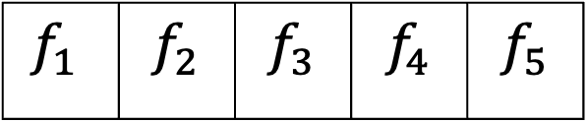
Descriptor for a cat picture
Translationally invariance
Descriptor should be the same for all translations
$$\vec{d}=$$
$$f_{1}$$ | $$f_{2}$$ | $$f_{3}$$ | $$f_{4}$$ | $$f_{5}$$

Slide 6
Descriptor for a cat picture
Rotational invariance
Descriptor should be the same for all rotations
$$\vec{d}=$$
$$f_{1}$$ | $$f_{2}$$ | $$f_{3}$$ | $$f_{4}$$ | $$f_{5}$$

Slide 7
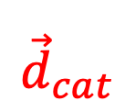
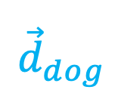
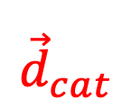
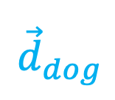
Comparing descriptors
$${\vec{d}}_{cat}$$
$${\vec{d}}_{cat}$$
$${\vec{d}}_{dog}$$
$${\vec{d}}_{dog}$$

Slide 8
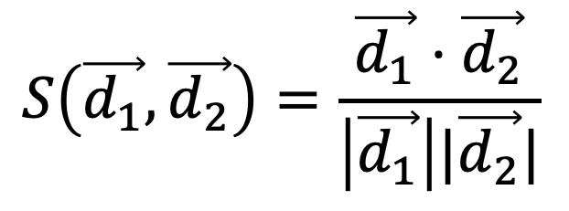
Comparing descriptors
Similarity measure
$$S\left(\vec{d_{1}},\vec{d_{2}}\right)=\frac{\vec{d_{1}}⋅\vec{d_{2}}}{\left|\vec{d_{1}}\right||\vec{d_{2}}|}$$
$${\vec{d}}_{cat}$$
$${\vec{d}}_{cat}$$
$${\vec{d}}_{dog}$$
$${\vec{d}}_{dog}$$

Slide 9
Comparing descriptors
Similarity measure
$$S\left(\vec{d_{1}},\vec{d_{2}}\right)=\frac{\vec{d_{1}}⋅\vec{d_{2}}}{\left|\vec{d_{1}}\right||\vec{d_{2}}|}$$
$${\vec{d}}_{cat}$$
$$S\left(\vec{d_{cat}},\vec{d_{cat}}\right)=1$$
$${\vec{d}}_{cat}$$
$$S\left(\vec{d_{dog}},\vec{d_{dog}}\right)=1$$
$$S\left(\vec{d_{cat}},\vec{d_{dog}}\right)<1$$
$${\vec{d}}_{dog}$$
$${\vec{d}}_{dog}$$

Slide 10
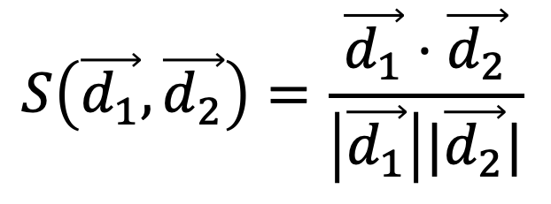
Similarity Matrix
Cat
Translated dog
Translated cat
Rotated cat
Cat
Dog
Rotated cat
$$S\left(\vec{d_{1}},\vec{d_{2}}\right)=\frac{\vec{d_{1}}⋅\vec{d_{2}}}{\left|\vec{d_{1}}\right||\vec{d_{2}}|}$$
Translated cat
Dog
Translated dog

Slide 11
Similarity Matrix
Cat
Translated dog
Translated cat
Rotated cat
Cat
Dog
Rotated cat
$$S\left(\vec{d_{1}},\vec{d_{2}}\right)=\frac{\vec{d_{1}}⋅\vec{d_{2}}}{\left|\vec{d_{1}}\right||\vec{d_{2}}|}$$
Translated cat
Dog
Translated dog

Slide 12
Similarity Matrix
Cat
Translated dog
Translated cat
Rotated cat
Cat
Dog
Rotated cat
$$S\left(\vec{d_{1}},\vec{d_{2}}\right)=\frac{\vec{d_{1}}⋅\vec{d_{2}}}{\left|\vec{d_{1}}\right||\vec{d_{2}}|}$$
Translated cat
Dog
Translated dog

Slide 13
Similarity Matrix
Cat
Translated dog
Translated cat
Rotated cat
Cat
Dog
Rotated cat
$$S\left(\vec{d_{1}},\vec{d_{2}}\right)=\frac{\vec{d_{1}}⋅\vec{d_{2}}}{\left|\vec{d_{1}}\right||\vec{d_{2}}|}$$
Translated cat
Dog
Translated dog

Slide 14
Similarity Matrix
Cat
Translated dog
Translated cat
Rotated cat
Cat
Dog
Rotated cat
$$S\left(\vec{d_{1}},\vec{d_{2}}\right)=\frac{\vec{d_{1}}⋅\vec{d_{2}}}{\left|\vec{d_{1}}\right||\vec{d_{2}}|}$$
Translated cat
Dog
Translated dog

Slide 15
Similarity Matrix
Cat
Translated dog
Translated cat
Rotated cat
Cat
Dog
Rotated cat
$$S\left(\vec{d_{1}},\vec{d_{2}}\right)=\frac{\vec{d_{1}}⋅\vec{d_{2}}}{\left|\vec{d_{1}}\right||\vec{d_{2}}|}$$
Translated cat
Dog
Translated dog

Slide 16
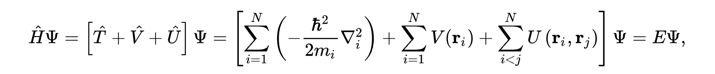
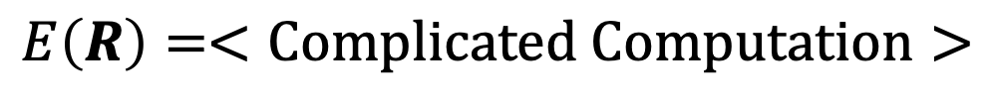
The many-electron time-independent Schrödinger equation is what governs at the atomic scale
Solve for E
$$E\left(R\right)=<Complicated Computation>$$
We want descriptors of R

Slide 17
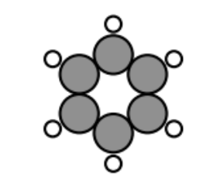
Hamiltonian – Translational Invariance

Slide 18
Hamiltonian – Rotational Invariance

Slide 19
Hamiltonian –Permutational Invariance
1
1
6
6
2
5
2
5
1
5
3
6
3
4
2
4
4
3

Slide 20
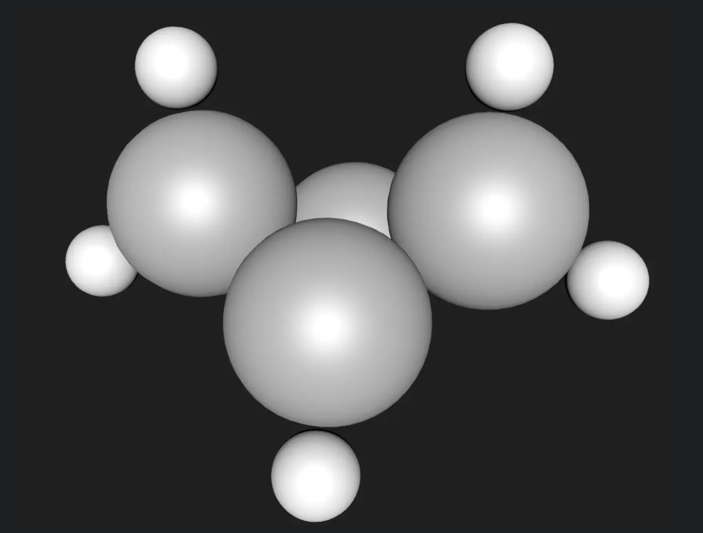
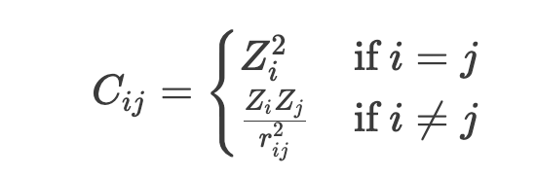
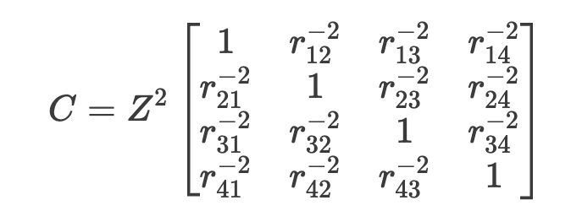
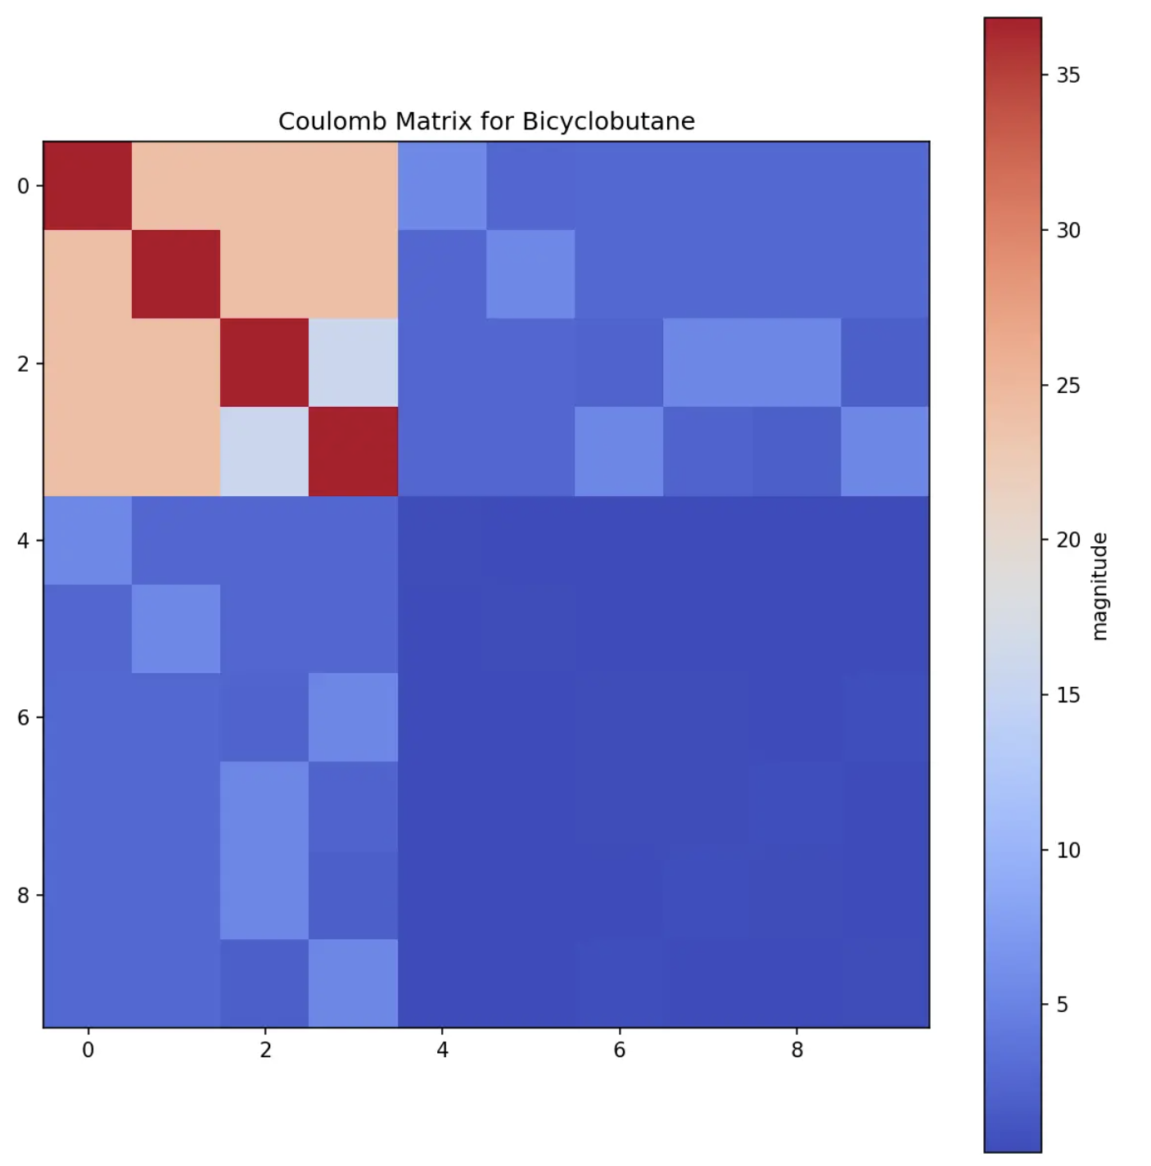
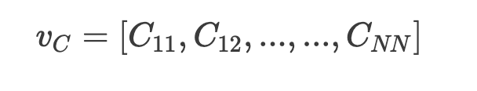
Coulomb Matrix

