Slide 1
Potentials

Slide 2
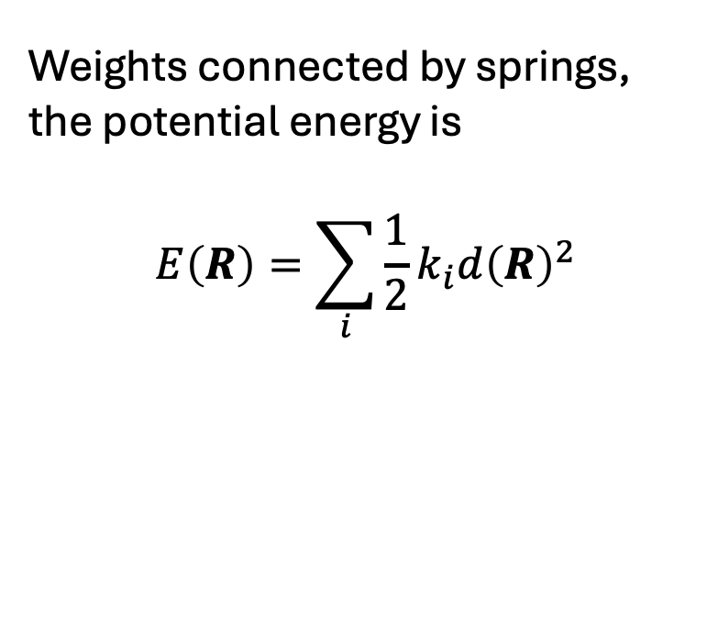
Springs
Weights connected by springs, the potential energy is
$$E\left(R\right)=\sum_{i}{\frac{1}{2}k_{i}d{\left(R\right)}^{2}}$$

Slide 3
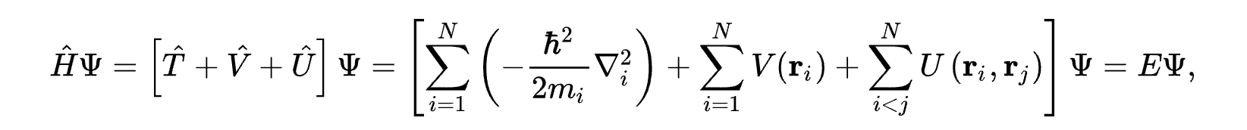
Atoms
The many-electron time-independent Schrödinger equation is what governs at the atomic scale
Generally unsolvable – so that’s a nice starting point. However, plenty of approximations exists,
specifically computational approximations.

Slide 4

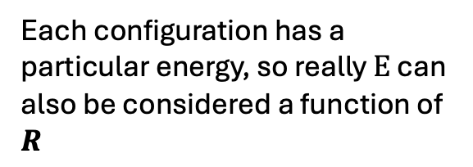
Atoms
Each configuration has a particular energy, so really $E$ can also be considered a function of $R$
Electron-electron interaction
Kinetic energy
This is an external potential that depends on the atomic positions $R$

Slide 5
Atoms
For atoms the potential energy is governed by
But can think about it as very complicated springs..

Slide 6
Atoms
Infinite chain of masses connected by identical springs
Infinite chain of atoms “connected” by quantum mechanics

Slide 7
Atoms
Energy
Equilibrium
distance
Infinite chain of masses connected by identical springs
Distance between masses
Infinite chain of atoms “connected” by quantum mechanics
Equilibrium lattice constant
Energy
Lattice constant

Slide 8
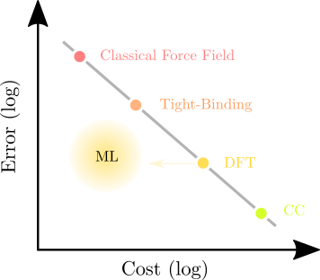
Approximations to Schrödinger equation

Slide 9
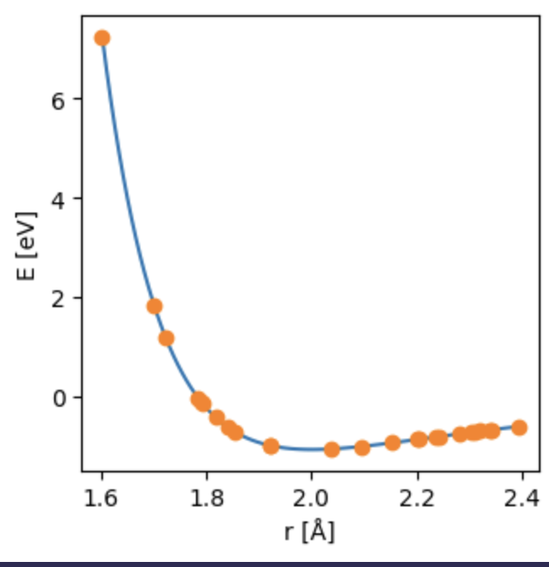
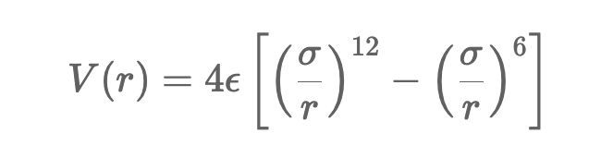
Learning the potential energy
Training data is dimers, really just a pretty simple regression
We will fit the parameters of the Lennard Jones potential

Slide 10
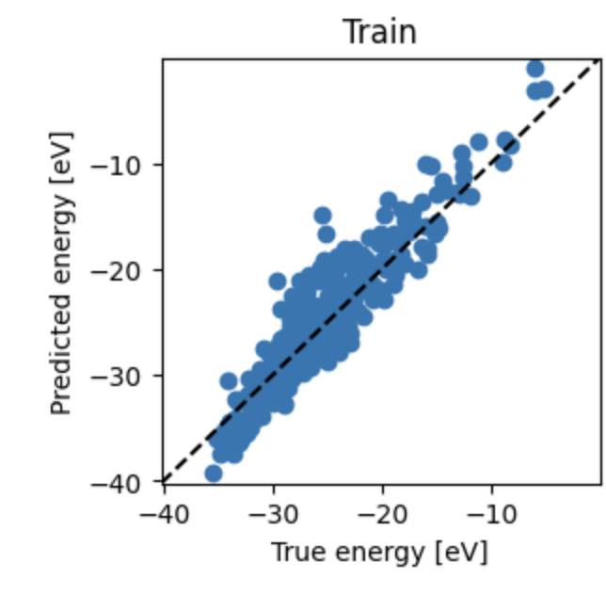
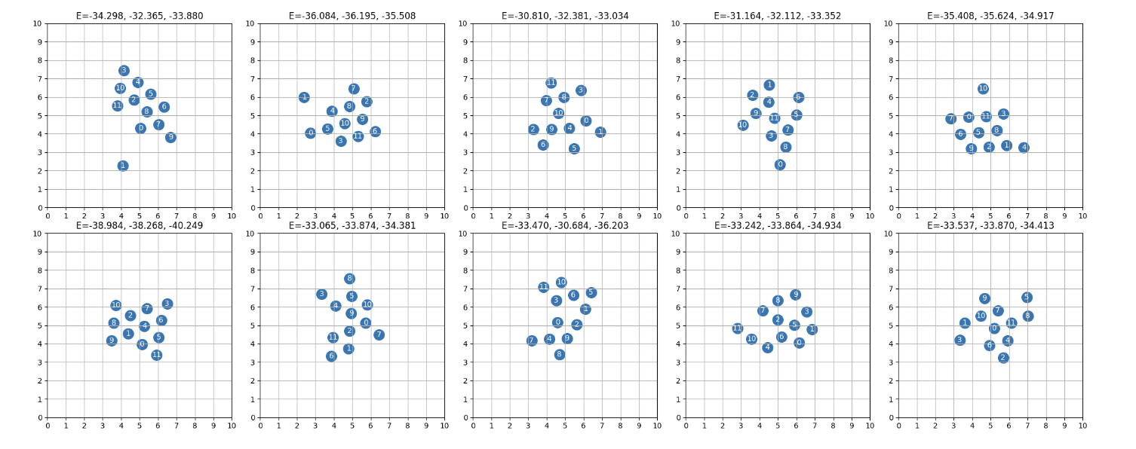
Learning the potential energy
Because the data does not come from the LJ-potential, we cannot get a perfect fit.
Training with cluster configurations, so now we have data with many dimensions (~60).
Geometries of some small clusters shown here.

Slide 11
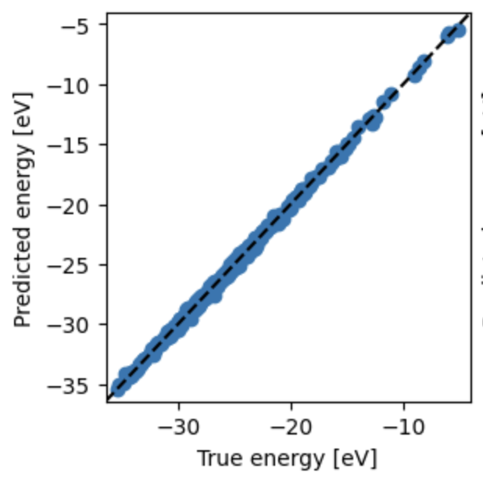

More expressive model
Then we can achieve very good agreement.
We will change our model to give it more more
Freedom
$$+G_{θ}(R)$$

