Slide 1
Introduction to Machine Learning for Materials Science
Unison 2025

Slide 2
Materials Science
“Materials science is the study of the properties, structure, performance, and processing of materials, focusing on understanding and manipulating their composition to develop or improve materials for specific applications.”
- ChatGPT
“Computational materials science is a branch of materials science that uses computer simulations and modeling to study, predict, and design the properties and behavior of materials at various scales, from atomic to macroscopic levels.”
- ChatGPT

Slide 3
Machine Learning

Slide 4
Workshop Structure

Slide 5
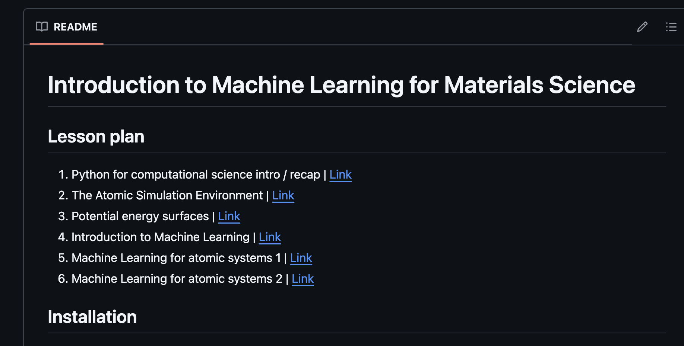
Content: github.com/Mads-PeterVC/imlms/
Click here

Slide 6
Content: github.com/Mads-PeterVC/imlms/

