Slide 1
Lesson 2: Pytorch & ASE

Slide 2
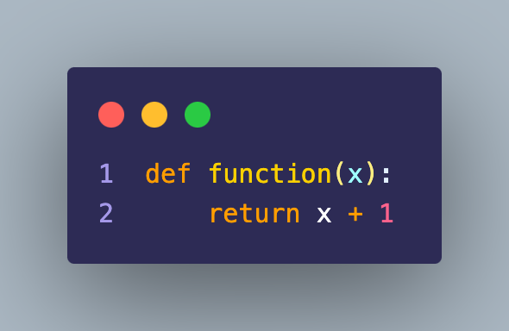
Recap from yesterday: Functions
One input
One output
Lets us make reusable, self-contained blocks of code
that we can use anywhere else in our program.

Slide 3
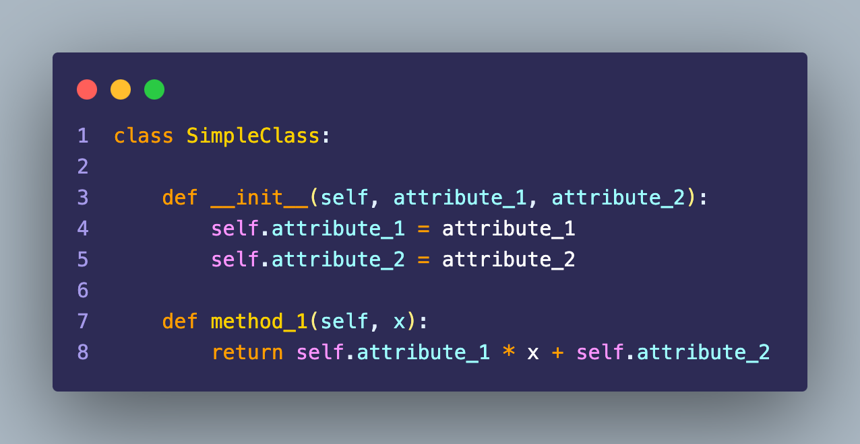
Recap from yesterday: Classes
Method for creating an instance
Attributes
Access to attributes in methods with `.`-notation.

Slide 4
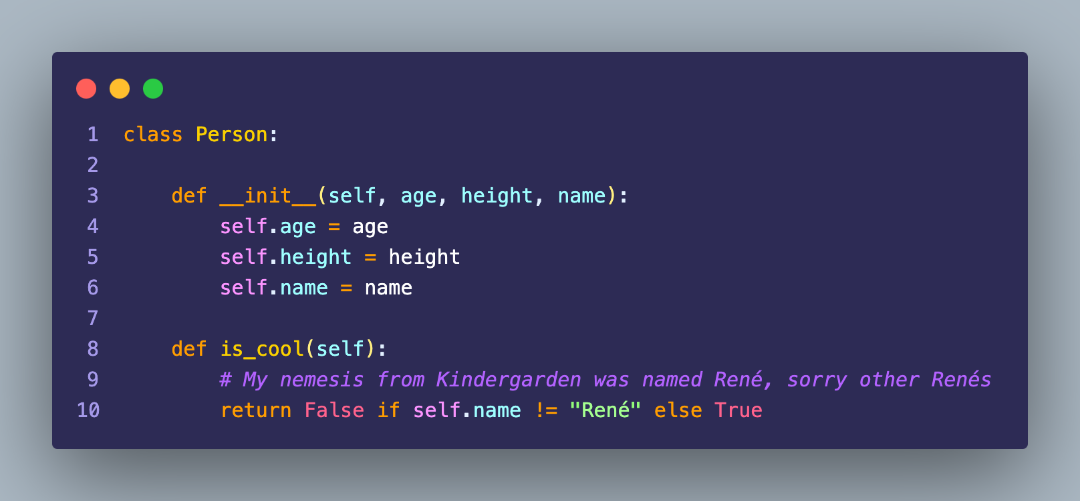
Recap from yesterday: Classes

Slide 5
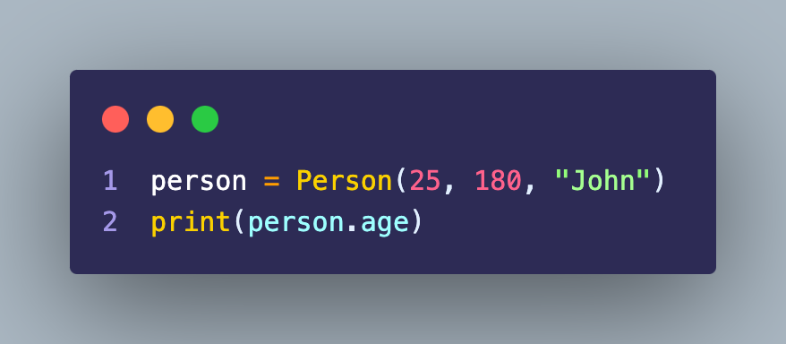
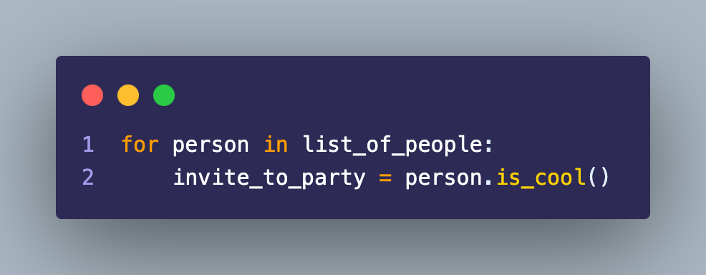
Recap from yesterday: Classes
Similarly for methods.
Can access the attribute on an instance of the class again with `.`-notation.

Slide 6
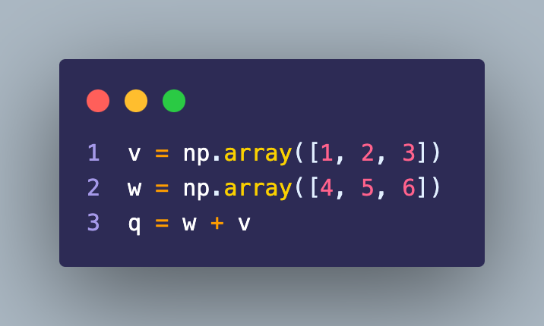
Recap from yesterday: Numpy
Numpy arrays act like vectors, so
We can sum them
Calculate their lengths
Linear algebra operations – e.g. dot

Slide 7
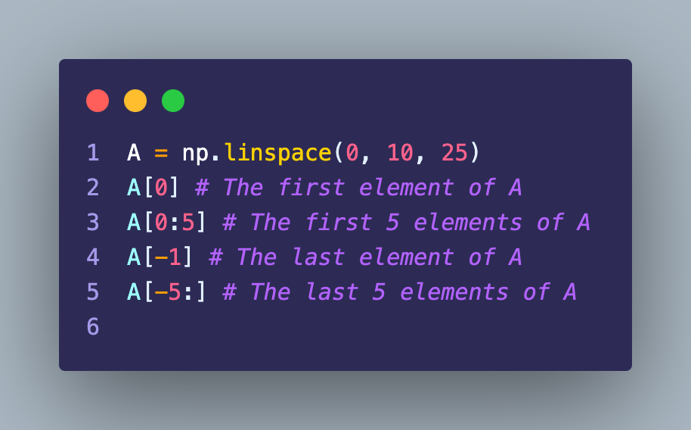
Recap from yesterday: Numpy
Lots of way of indexing arrays.

Slide 8
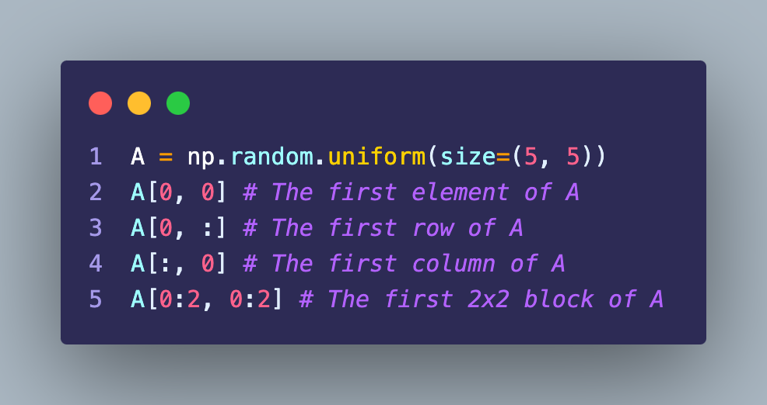
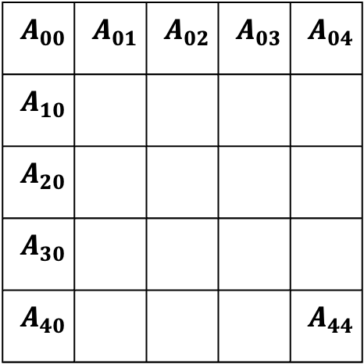
Recap from yesterday: Numpy
$$A_{00}$$ | $$A_{01}$$ | $$A_{02}$$ | $$A_{03}$$ | $$A_{04}$$
$$A_{10}$$
$$A_{20}$$
$$A_{30}$$
$$A_{40}$$ |  |  |  | $$A_{44}$$

Slide 9
Recap from yesterday: Numpy
$$A_{00}$$ | $$A_{01}$$ | $$A_{02}$$ | $$A_{03}$$ | $$A_{04}$$
$$A_{10}$$
$$A_{20}$$
$$A_{30}$$
$$A_{40}$$ |  |  |  | $$A_{44}$$

Slide 10
Recap from yesterday: Numpy
$$A_{00}$$ | $$A_{01}$$ | $$A_{02}$$ | $$A_{03}$$ | $$A_{04}$$
$$A_{10}$$
$$A_{20}$$
$$A_{30}$$
$$A_{40}$$ |  |  |  | $$A_{44}$$

Slide 11
Recap from yesterday: Numpy
$$A_{00}$$ | $$A_{01}$$ | $$A_{02}$$ | $$A_{03}$$ | $$A_{04}$$
$$A_{10}$$
$$A_{20}$$
$$A_{30}$$
$$A_{40}$$ |  |  |  | $$A_{44}$$

Slide 12
Today
Torch & Atomic Simulation Environment

Slide 13

Derivatives

Slide 14
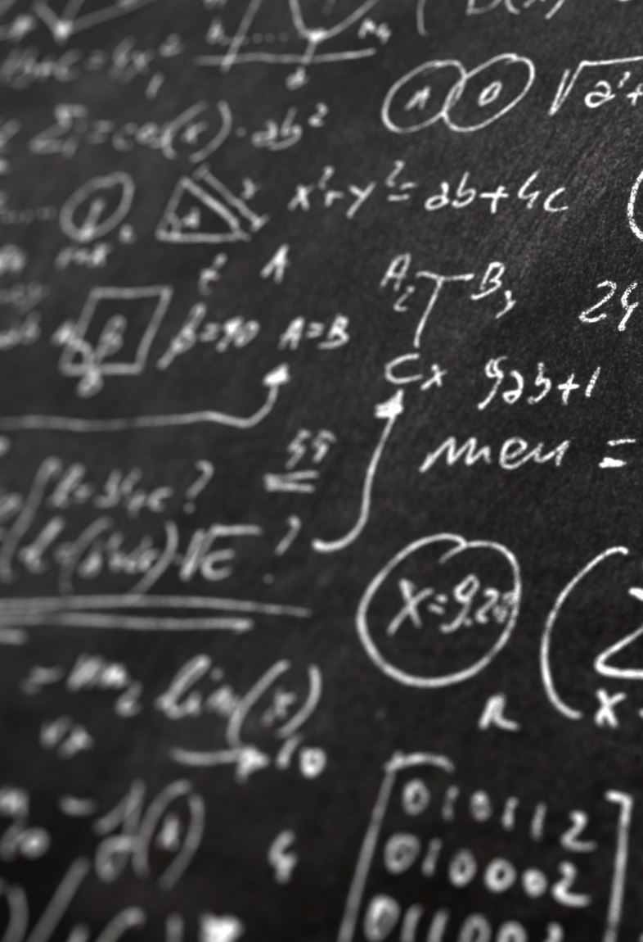
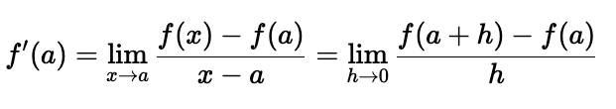
Analytical Derivatives
“Let 𝑓(𝑥) be a real-valued function. Then the derivative of 𝑓(𝑥) at 𝑎, denoted 𝑓′(𝑎), is given by”
> Some math book.

Slide 15

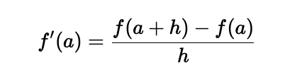
Numerical Derivatives
Trick is to throw away the fancy parts of the definition
And take the expression literally
Very poor scaling..

Slide 16
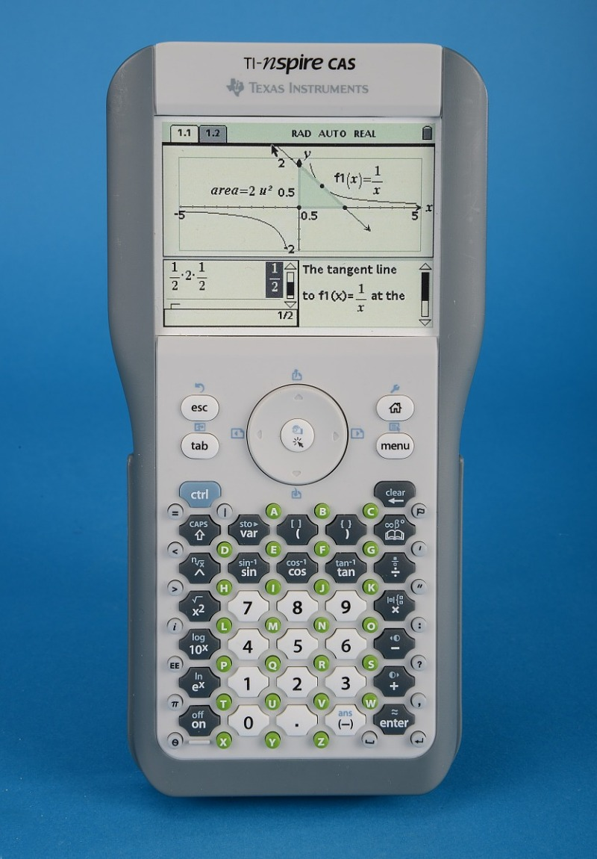

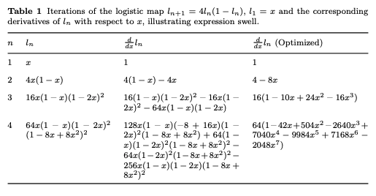
Symbolic Derivatives
Exact derivatives
Can suffer from expression swell
Expression swell

Slide 17

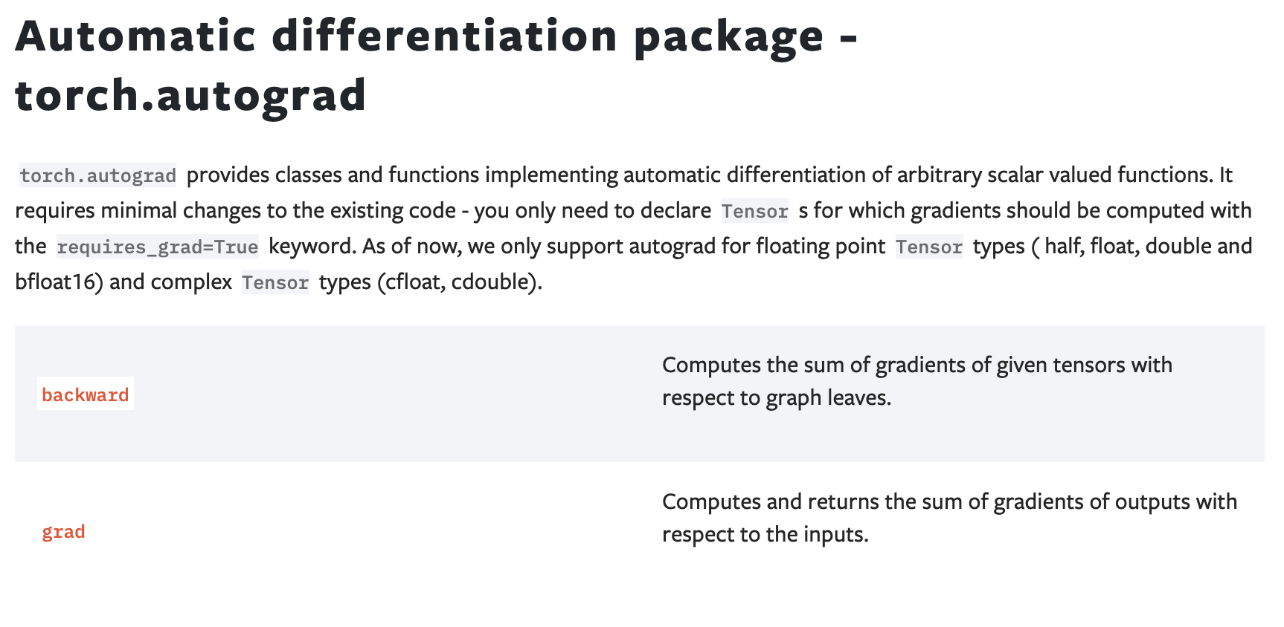
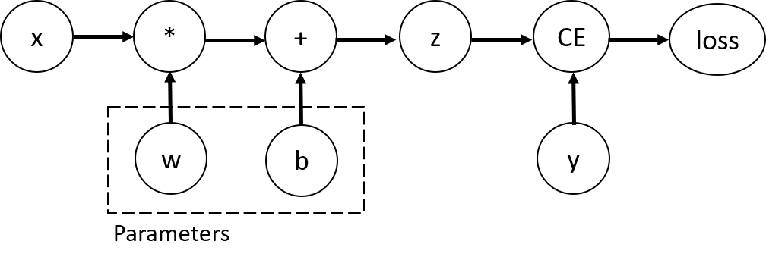
Automatic Derivatives

Slide 18
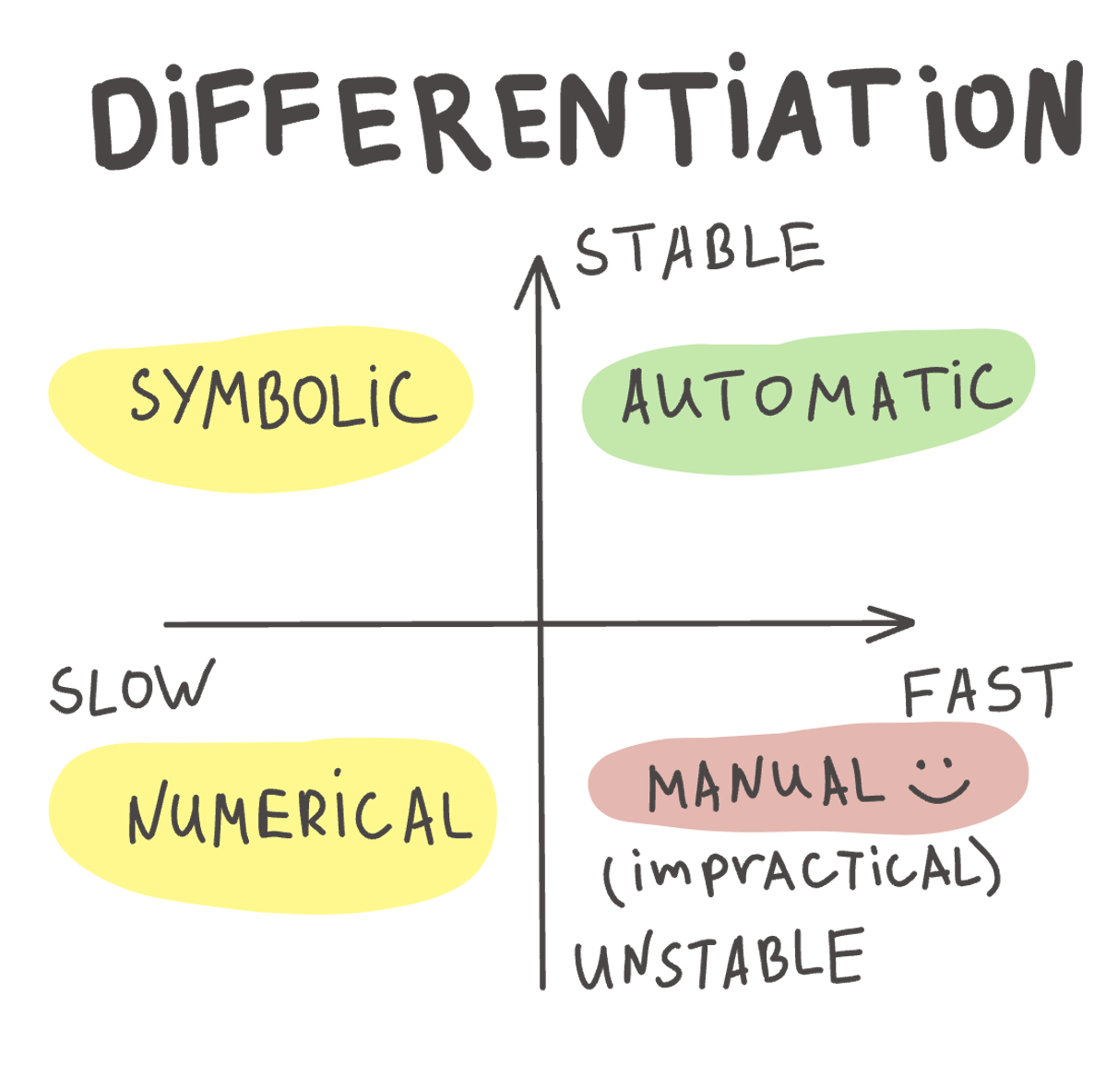
> https://fmin.xyz/docs/methods/Autograd.html#fn1

Slide 19
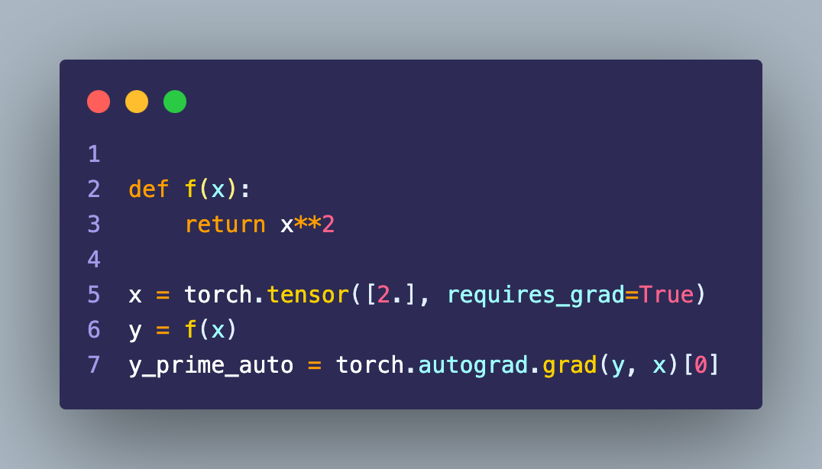
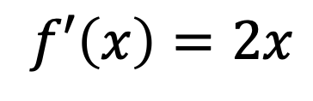
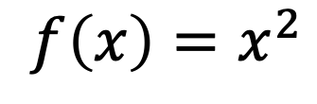
Example: Polynomial
We need to tell torch that we will want derivatives wrt. x
$$f\left(x\right)=x^{2}$$
$$f′\left(x\right)=2x$$

Slide 20
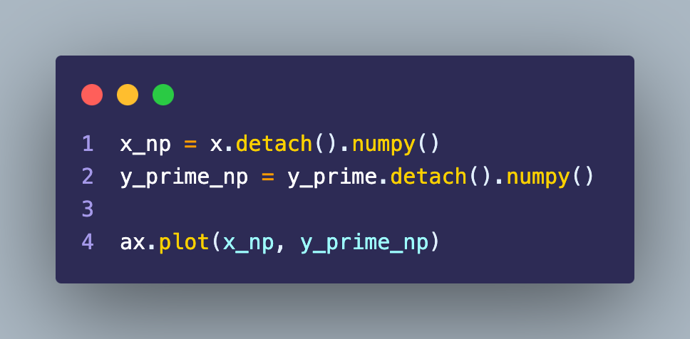
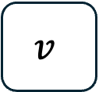
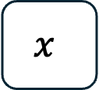
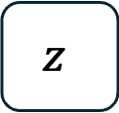


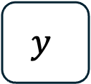
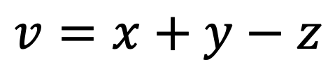
Computational Graphs
Torch keeps track, so sometimes to work with the result we need to detach
$$v=x+y−z$$
$$x$$
$$+$$
$$−$$
$$v$$
$$y$$
$$z$$
We tell torch we will not need gradients of further calculations

Slide 21
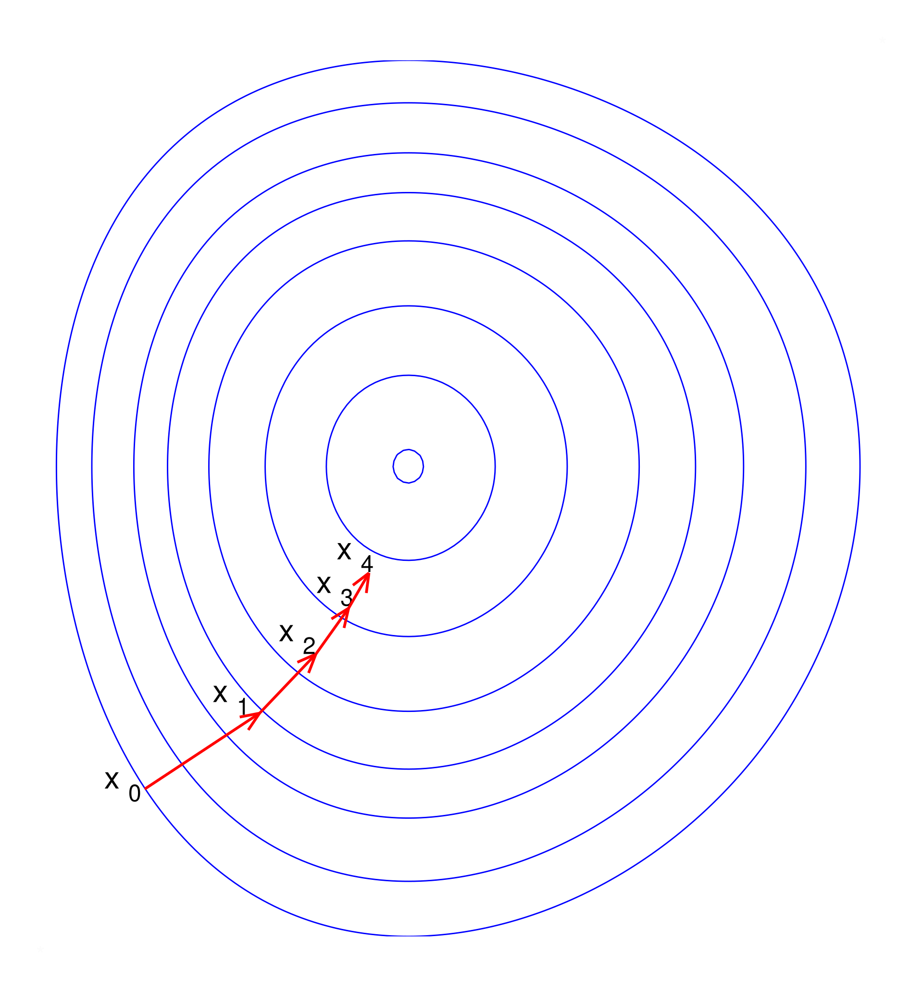
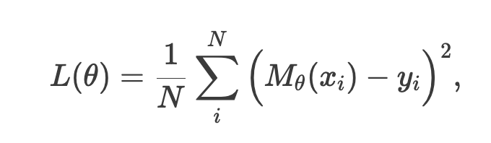
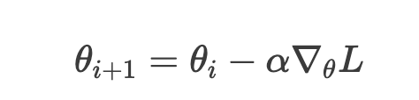
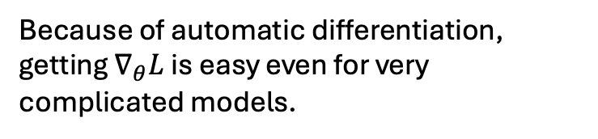
Gradient Descent
Loss function
Parameter update
Because of automatic differentiation, getting $∇_{θ}L$ is easy even for very complicated models.

Slide 22

Atomic Simualtion Environment
Python package for handling atomic simulations.
The `Atoms`-class lets us build complicated atomic system.
The exercises involve:
Using ASE to calculate the lattice constant of a crystal
Study the adsorption of oxygen on a surface.

Slide 23

Lattice constant
Computational cell
1D periodic
$a$ Lattice constant

Slide 24
Lattice constant
We can calculate the energy of an atomic system using quantum mechanics.
The lattice constant that leads to the lowest energy is the equilibrium lattice constant.
Energy
Equilibrium lattice constant
Lattice constant

Slide 25
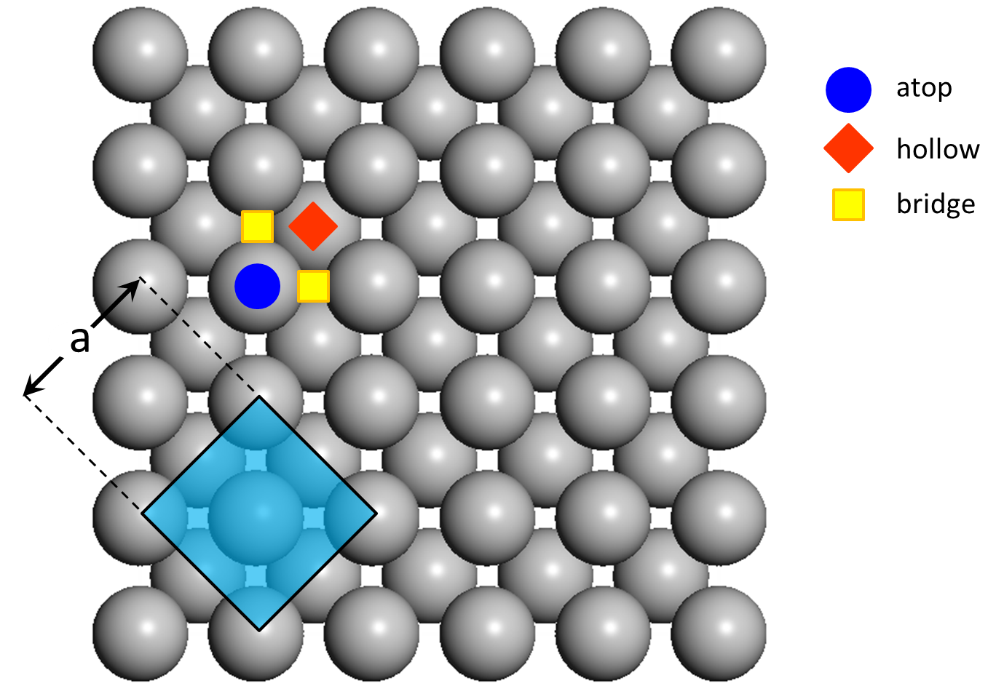
Adsorption sites
On an fcc(100) surface there are three unique adsorption sites.
We will calculate the energy as a function of the height above the surface for each site.
This can tell us which site is preferably – and give us the adsorption energy.

