Slide 1
Exploring Reinforcement Learning in FOR Materials Science

Slide 2
Agenda
Introductory presentation: This is what you’re looking at currently.
Hands-on: Working on the exercises.
Possible intermediate interuption(s):
Hands-on: Working on exercises.
Recap & perspectives

Slide 3
Learning GOALS
Introduction to concepts from reinforcement learning
Environments
Reward functions
State & action spaces
Value functions
Implementation of two RL algorithms
Tabular Q-learning
Deep Q-networks
Implementation of a custom materials science environment
Designing minimum energy path finding as an RL problem

Slide 4
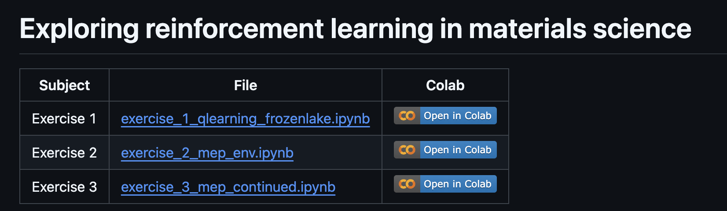
Setup in COLAB
Exercises are on my github: https://github.com/Mads-PeterVC/rlmep
Click to open the notebook in Colab

Slide 5
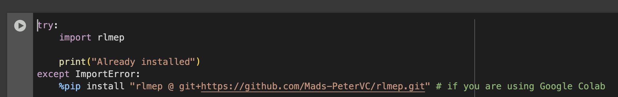
Run The first cell
Exercises are on my github: https://github.com/Mads-PeterVC/rlmep
Will install all the required dependencies into the colab environment.

Slide 6
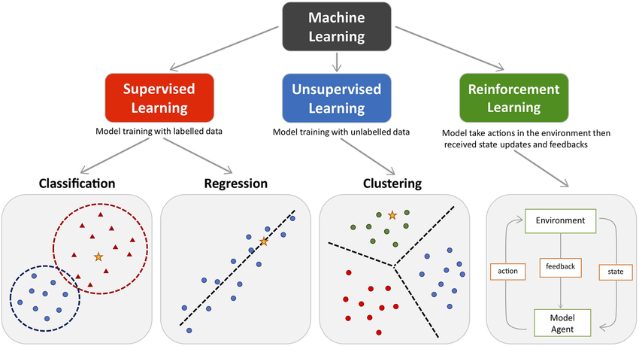
Introduction to Reinforcement LEARNING
[1]: J. Peng et al, Front Pharmacol (2021), 10.3389/fphar.2021.720694

Slide 7
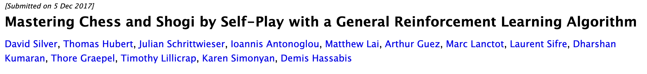
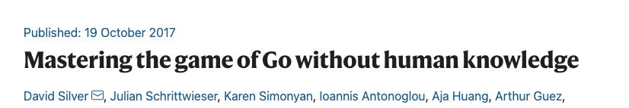
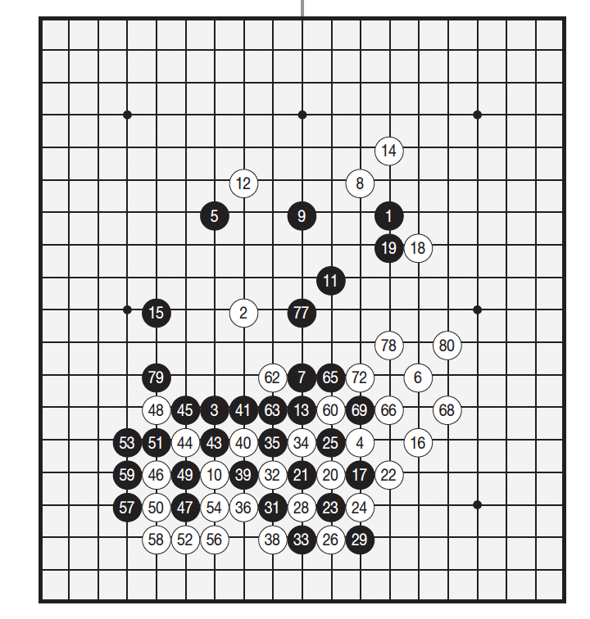
Reinforcement LEARNING

Slide 8
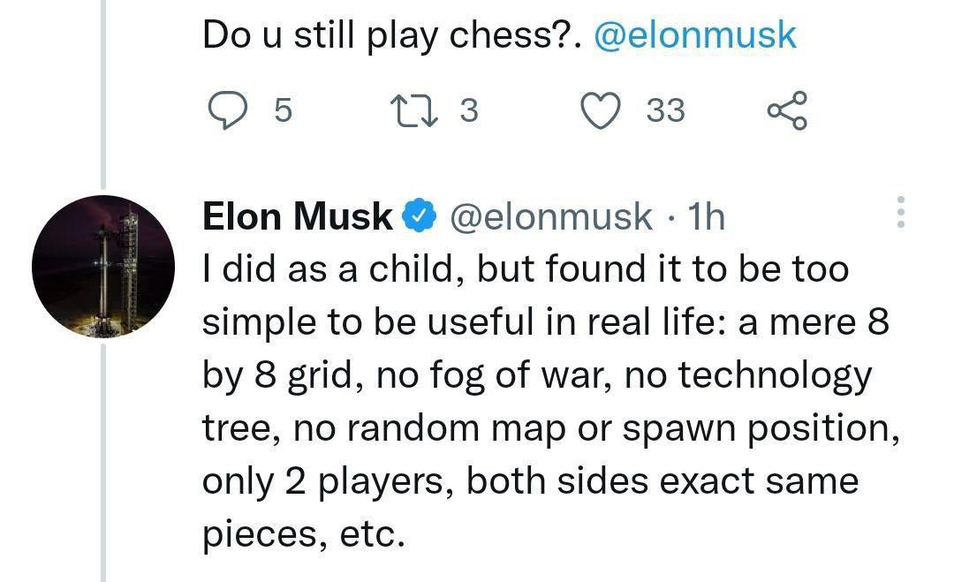
Reinforcement LEARNING

Slide 9
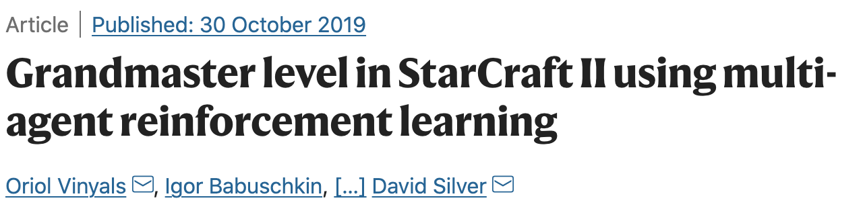
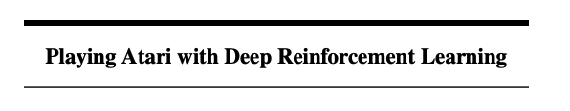
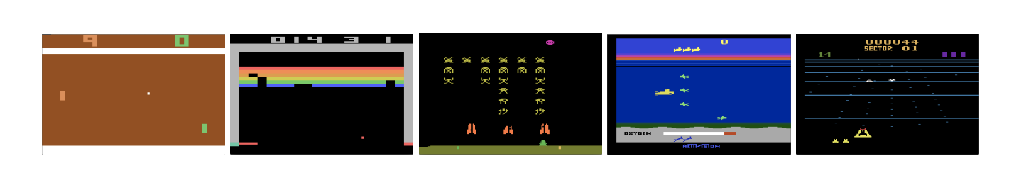
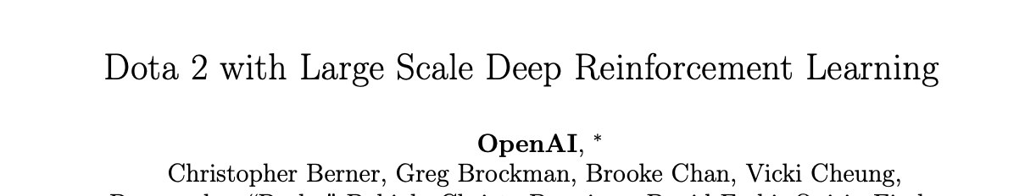
Reinforcement LEARNING

Slide 10
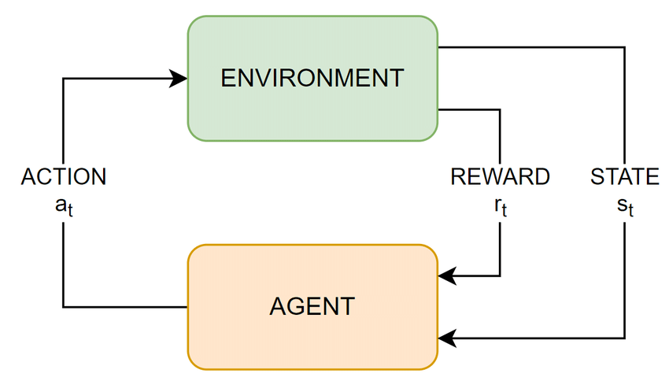
The Reinforcement Learning CYCLE
[1]: Tommaso Tedeschi et al. 2022, 10.48550/arXiv.2208.06437

Slide 11
The Reinforcement Learning CYCLE
Environment
The ‘world’ of the problem we wish to apply reinforcement learning to.
For example moving through a landsacpe with obstacles – such as in FrozenLake.

Slide 12
The Reinforcement Learning CYCLE
State
The information about the environment our agent uses to make decisions.
E.g. the position of the character in the environment represented in some fashion.
Representations
A number between 0 and 15
A tuple of (x, y)
A one-hot encoded matrix

Slide 13

The Reinforcement Learning CYCLE
Action
Actions are the agent’s ways of interacting with the environment.
Can be discrete or continuous.
For FrozenLake, the actions are the directions in which to move so we can for example define the action space as
$0: ←$
1: $↓$
2: $→$
3: $↑$
With integers mapped to each of the four available actions in the discrete action space.

Slide 14

The Reinforcement Learning CYCLE
Agent
The agent takes actions in the environment.
Typical this is done from a probability distribution based on the state information called a policy
$$a_{t}←π(a|s_{t})$$
The objective of an RL algorithm is to learn a
”good” policy.

Slide 15
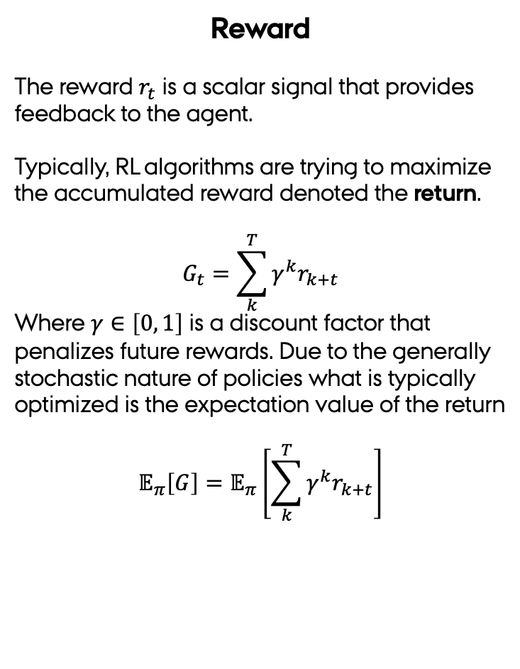
The Reinforcement Learning CYCLE
Reward
The reward $r_{t}$ is a scalar signal that provides feedback to the agent.
Typically, RL algorithms are trying to maximize the accumulated reward denoted the return.
$$G_{t}=\sum_{k}^{T}{{γ^{k}r}_{k+t}}$$
Where $γ∈\left[0, 1\right]$ is a discount factor that penalizes future rewards. Due to the generally stochastic nature of policies what is typically optimized is the expectation value of the return
$$𝔼_{π}\left[G\right]=𝔼_{π}\left[\sum_{k}^{T}{{γ^{k}r}_{k+t}}\right]$$

Slide 16
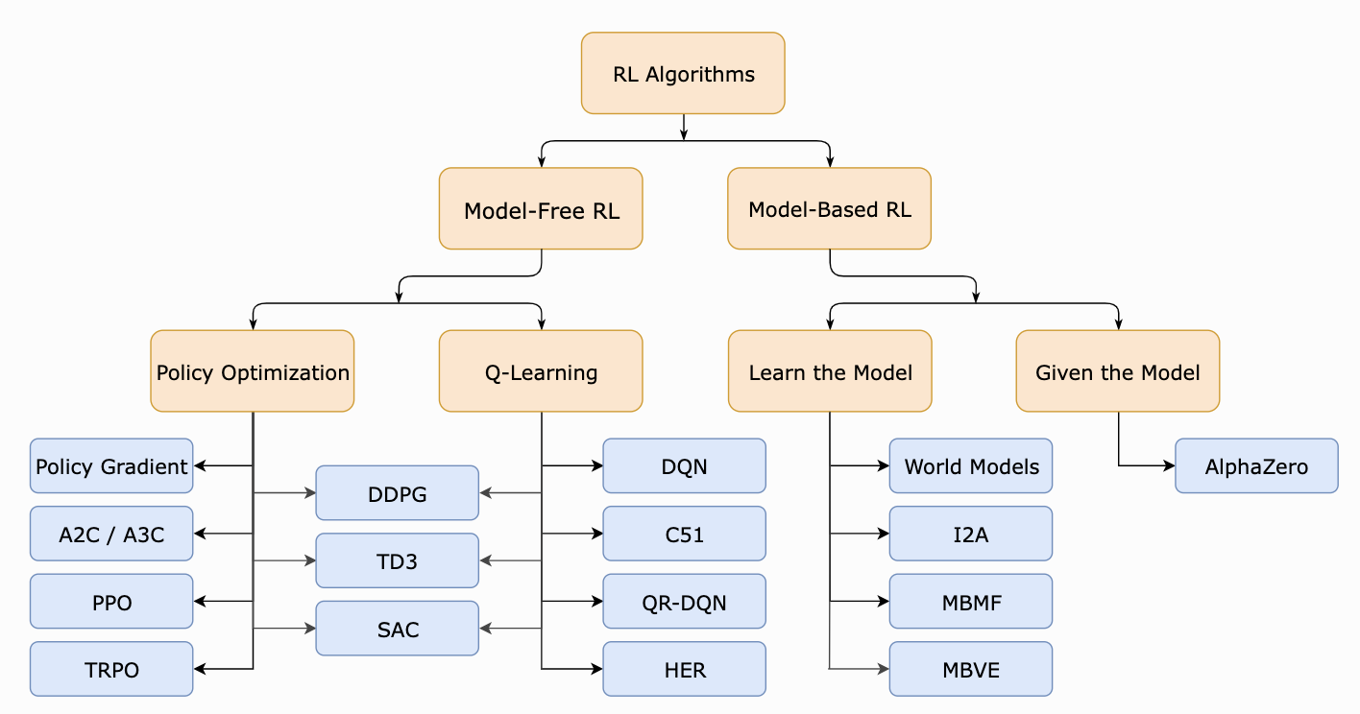
Reinforcement LEARNING TaxiNOMY
We will stick to this branch

Slide 17
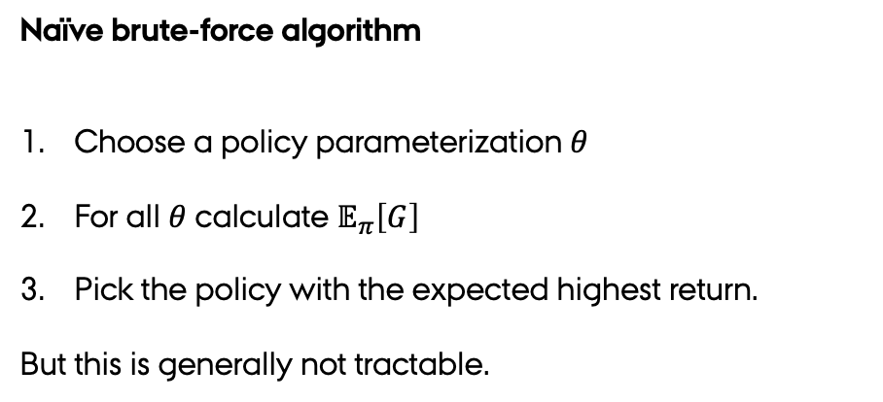
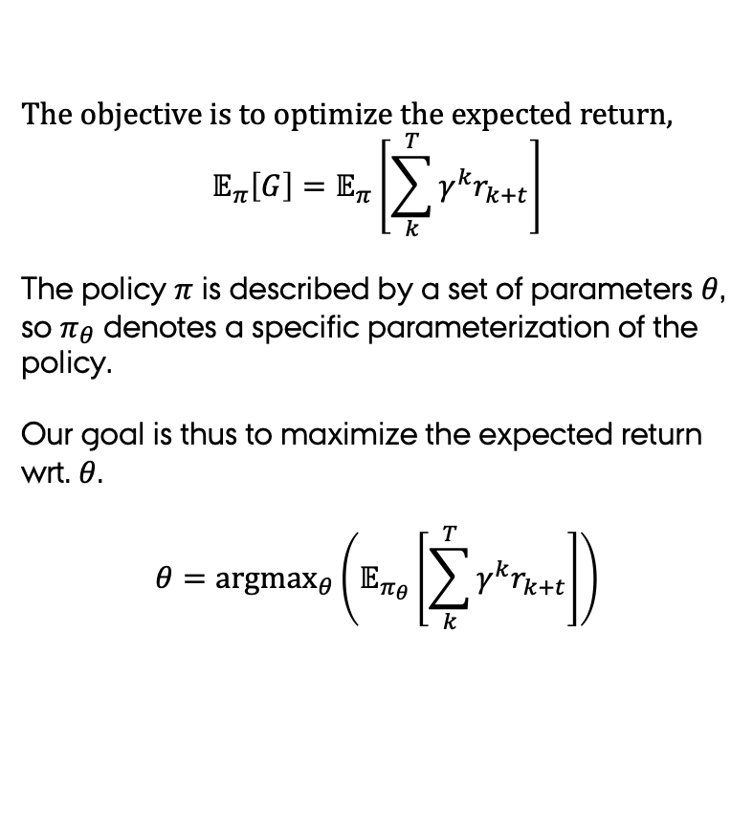
RL Objective and ALGORITHMS
The objective is to optimize the expected return,
$$𝔼_{π}\left[G\right]=𝔼_{π}\left[\sum_{k}^{T}{{γ^{k}r}_{k+t}}\right]$$
The policy $π$ is described by a set of parameters $θ$, so $π_{θ}$ denotes a specific parameterization of the policy.
Our goal is thus to maximize the expected return wrt. $θ$.
$$θ={argmax}_{θ}\left(𝔼_{π_{θ}}\left[\sum_{k}^{T}{{γ^{k}r}_{k+t}}\right]\right)$$
Naïve brute-force algorithm
Choose a policy parameterization $θ$
For all $θ$ calculate $𝔼_{π}\left[G\right]$
Pick the policy with the expected highest return.
But this is generally not tractable.

Slide 18
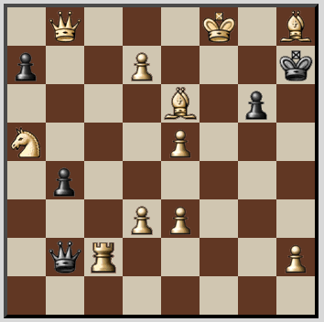
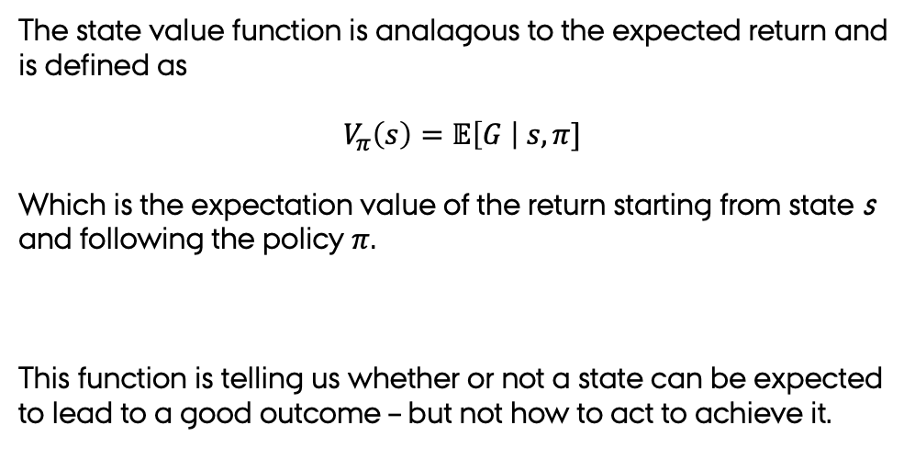
State-Value FUNCTIOn
The state value function is analagous to the expected return and is defined as
$$V_{π}\left(s\right)=𝔼\left[G \right| s, π]$$
Which is the expectation value of the return starting from state s and following the policy $π$.
This function is telling us whether or not a state can be expected to lead to a good outcome – but not how to act to achieve it.

Slide 19
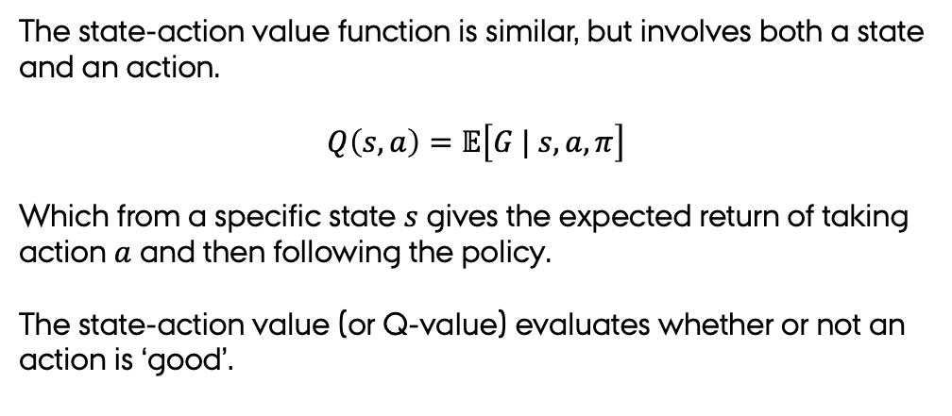
STATE-ACTION VALUE FUNCTION
The state-action value function is similar, but involves both a state and an action.
$$Q\left(s,a\right)=𝔼\left[G | s, a, π\right]$$
Which from a specific state $s$ gives the expected return of taking action $a$ and then following the policy.
The state-action value (or Q-value) evaluates whether or not an action is ‘good’.

Slide 20
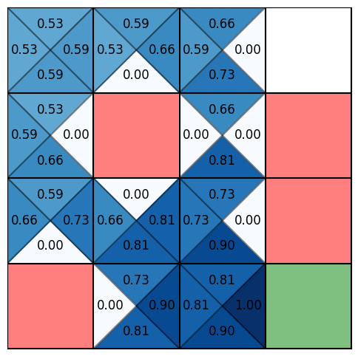

Tabular Q-lEARNING
The Bellman equation defines a recursive expression for Q
$Q\left(s,a\right)=𝔼_{π}\left[r\left(s_{t},a_{t}\right)+γ \max_{a^{∗}} Q(s_{t+1}, a^{∗})\right]$
From this an update rule for Q-value can be formulated
Algorithm outline
Let the agent step through the environment.
Update the Q-table based on the received rewards using the update rule.
Details explained in the notebooks.

Slide 21
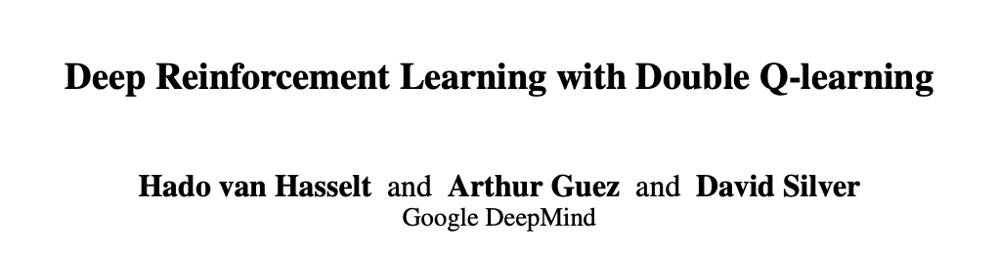
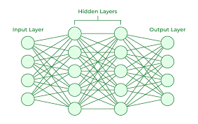
DEEP Q-NETWORKS (DQN)
Q-table
actions
Q-network

Slide 22
DEEP Q-NETWORKS (DQN)
With a table we found an update rule
With a neural network we reformulate this as a loss
$$L={\left(Q\left(s_{t},a_{t}\right)−[r_{t}−\max\left(Q_{a}\left(s_{t+1},a^{∗}\right)\right] \right)}^{2}$$
To stabilize training we use experience replay to train on batches of data.

Slide 23

DEEP Q-NETWORKS (DQN)
With a table we found an update rule
With a neural network we reformulate this as a loss
$$L={\left(Q\left(s_{t},a_{t}\right)−[r_{t}−\max\left(Q\left(s_{t+1},a^{∗}\right)\right] \right)}^{2}$$
To stabilize training we use experience replay to train on batches of data.

Slide 24



DEEP Q-NETWORKS (DQN)
Main network with $θ$
Double Q-learning – a very useful trick is to use two networks. We use this second network iin the loss function going from
$$L={\left(Q\left(s_{t},a_{t}\right)−[r_{t}−\max\left(Q\left(s_{t+1},a^{∗}\right)\right]\right)}^{2}$$
To introducing two sets of network parameters $θ$ and $θ^{∗}$
$$L_{θ}={\left(Q\left(s_{t},a_{t}:θ\right)−[r_{t}−\max\left(Q\left(s_{t+1},a^{∗};θ^{∗}\right)\right]\right)}^{2}$$
Secondary network with $θ^{∗}$
To update $θ$ and then occassionally we will set e.g. every 100 steps.
$$θ^{∗}←θ$$
During a rollout we use the $θ parameters$

Slide 25
A Materials SCIENCE ENVIRONMENT
Find the minimum energy path

Slide 26
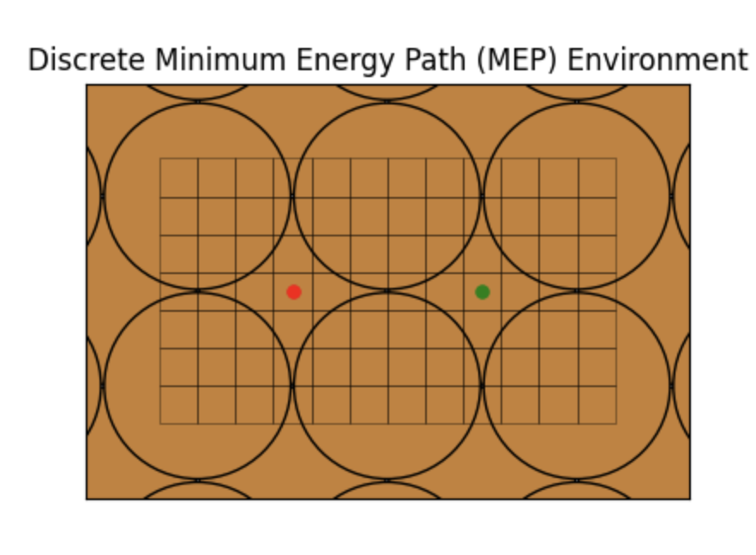
A Materials SCIENCE ENVIRONMENT
Designing an environment
State space
Action space
Reward function
The second exercise will cover this.
Disclaimer: The environment we are building is a toy problem – but the ideas can be extended.

Slide 27
HANDS-OFF FOR ME. HANDS-ON FOR YOU.
https://github.com/Mads-PeterVC/rlmep

Slide 28
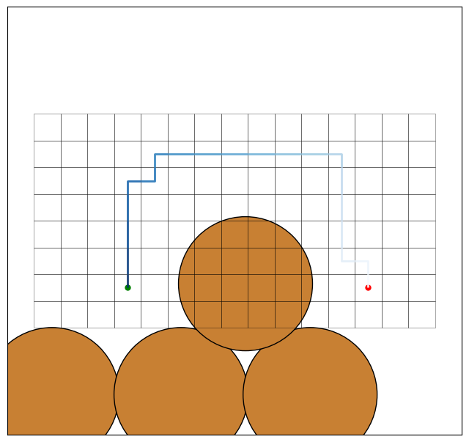
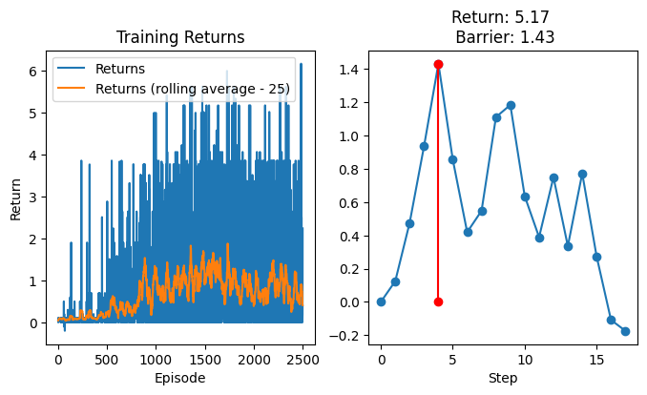
RECAP

Slide 29
DOMAIN KNOWLEDGE
Invariant features: ACSF/SOAP/GNN
Invariant state representations
(0, 7)
(4, 3)
(7, 3)
(0, 1)
(0, 0)
(1, 0)

Slide 30
DOMAIN KNOWLEDGE
Invariant action representations
State representation: Predict Q-values for all actions from that state.
(0, 7)
Action representation: Predict Q-value for a single action.

Slide 31



DOMAIN KNOWLEDGE
Equivariant representations
(0, 7)
$$\vec{v}$$
$$↑$$
$$Q\left(s,↑\right)=\vec{v_{θ}}\left(s\right)⋅↑$$

Slide 32


DOMAIN KNOWLEDGE
Equivariant representations – continuous action space
E.g. let the action space be the acceleration on an atom.
(0, 7)
$$\vec{a}$$
$$↑$$
$$\vec{a}$$
Th environment propagates the system using the acceleration action – like in a MD simulation

Slide 33


DOMAIN KNOWLEDGE
Equivariant representations – continuous action space
E.g. let the action space be the acceleration on an atom.
(0, 7)
$$\vec{a}$$
$$\vec{a_{i}}$$
$$\vec{a_{i}}$$
Th environment propagates the system using the acceleration action – like in a MD simulation

