Slide 1
Havehjornet: Marketing Mix Modelling
Portfolio project – simulated client data, real external data

Slide 2
Executive summary
All client sales and media data in this project are simulated, with a known ground truth – weather, Danish consumer confidence, CPI, and public holidays are real public data.
Media explains an estimated 24.8% of weekly revenue (90% credible interval [18.5%, 31.7%]), vs. a true simulated value of 16.6%.
Platform dashboards overstate incrementality for brand search and retargeting – their platform-reported ROAS is 3.1x and 2.5x, while the Bayesian model estimates their true incremental ROAS much lower.
A simulated geo experiment on 98 Danish municipalities validates paid social prospecting’s effect and is used to sharpen the model’s estimate for that channel.
A budget reallocation is recommended with an explicit uncertainty range, not a single number presented as fact.

Slide 3
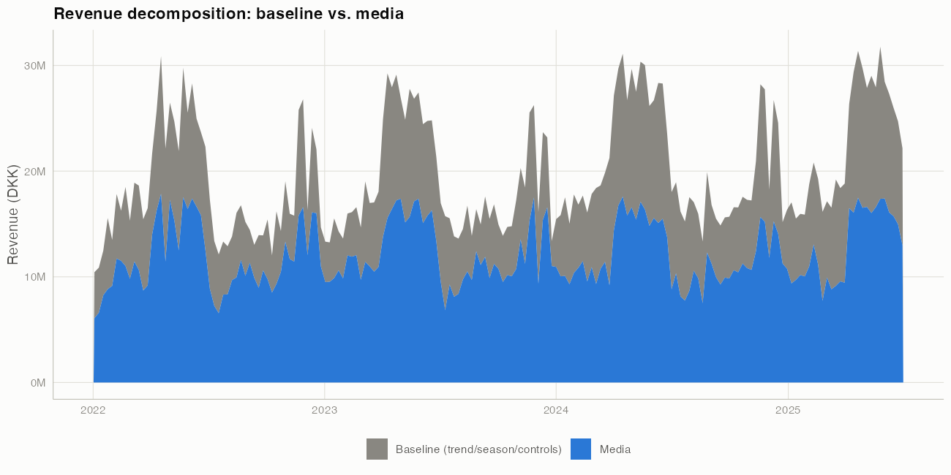
What drove sales

Slide 4
Baseline (trend, season, holidays, price, weather, macro, store count) vs. media contribution, ridge/elastic-net decomposition.

Slide 5
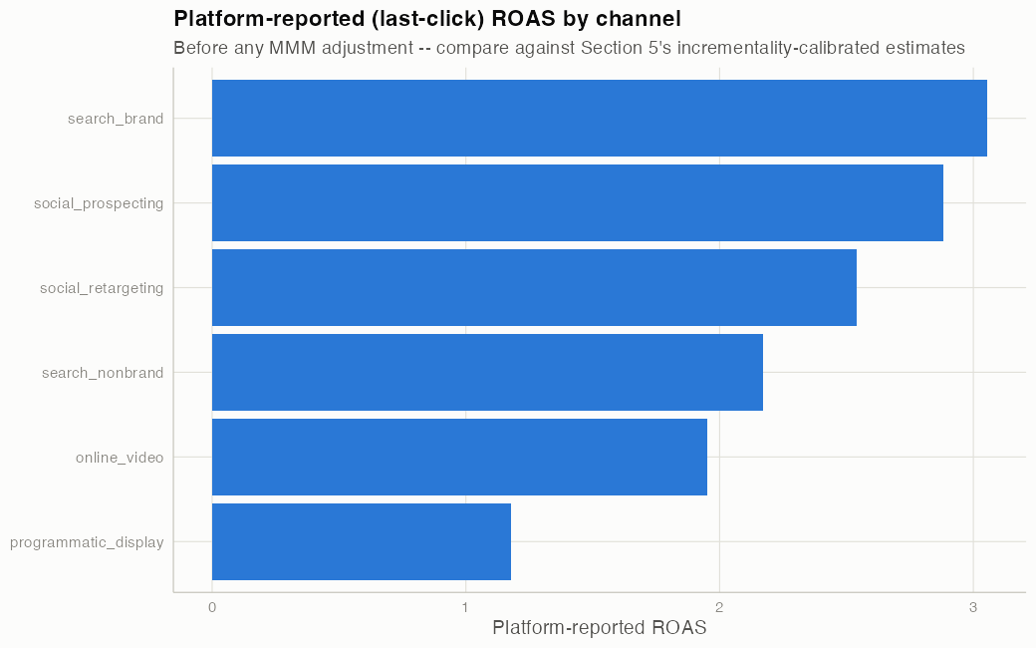
Platform-reported vs. incremental ROAS

Slide 6
Platform dashboards report last-click ROAS – credit assigned to whichever channel touched a customer last, regardless of whether that channel caused the purchase. TV, out-of-home, and leaflets have no platform-reported number at all (no last-click tracking for offline channels).

Slide 7
The regularised model’s known limitation
Media share, ridge/elastic-net point estimate: 63.5% of revenue – vs. a true 16.6%.
Not a bug: a lambda-sensitivity sweep shows no single regularisation strength is simultaneously well-fitting and causally accurate when media and seasonal controls are this collinear. Several different attributions fit the observed data almost equally well.

Slide 8
The Bayesian model, with sensible priors
Channel | True ROAS | Ridge estimate | Bayesian estimate
social_retargeting | 0.6 | 33.61 | 5.99
search_brand | 0.5 | 1.45 | 5.87
ooh | 1.0 | 8.00 | 4.88
search_nonbrand | 2.2 | 22.63 | 4.63
programmatic_display | 1.1 | 0.00 | 3.40
leaflets | 3.4 | 14.20 | 2.30
online_video | 1.9 | 4.06 | 2.31
social_prospecting | 2.6 | 4.84 | 2.33
tv_linear | 1.4 | 1.15 | 1.47

Slide 9
Weakly informative priors (a channel fully saturated is unlikely to explain most of weekly revenue – generic business judgement, not the true answer) pull media share to 24.8% (90% CI [18.5%, 31.7%]).

Slide 10
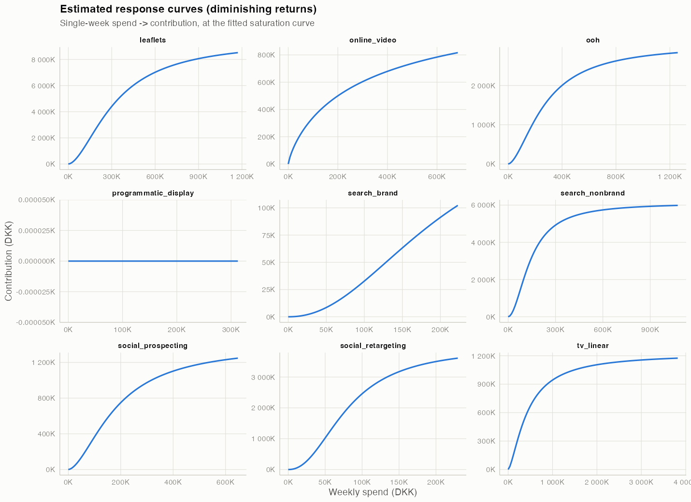
Carryover and diminishing returns

Slide 11
Each channel’s estimated response curve: carryover (adstock) plus diminishing returns (Hill saturation), fit via rolling-origin time-series cross-validation – never using the true answer.

Slide 12
Incrementality: the geo experiment
DiD estimate | Clustered SE | Permutation SD | MDE (90% power) | Achieved power (%) | Randomisation p | Bootstrap CI lower | Bootstrap CI upper
-0.065 | 0.024 | 0.025 | 0.082 | 73.578 | 0.004 | -0.106 | -0.028

Slide 13
Paid social prospecting switched off in a randomly assigned half of Denmark’s 98 municipalities for 6 weeks. Experiment-implied ROAS: 2.42 (SE 0.91).

Slide 14
Does the experiment improve the model?
True ROAS | Before calibration | After calibration | Error before | Error after
2.6 | 2.33 | 2.48 | 0.27 | 0.12

Slide 15
Recommended reallocation
Channel | Current spend (DKK/wk) | Recommended spend (DKK/wk) | Change (%)
tv_linear | 705251 | 423150 | -40
online_video | 159032 | 101293 | -36
social_prospecting | 139932 | 192848 | 38
social_retargeting | 50013 | 70018 | 40
search_brand | 48406 | 67768 | 40
search_nonbrand | 109669 | 153537 | 40
programmatic_display | 92219 | 129106 | 40
ooh | 228306 | 319628 | 40
leaflets | 188696 | 264175 | 40

Slide 16
Caveat: the recommended increases for search_brand and social_retargeting rely on posterior ROAS estimates still inflated by known, uncorrected endogeneity (see the previous two slides) – discount or exclude those two pending further identification work.
Expected uplift: 708,443 DKK/week (90% CI [289,551, 1,130,086]). Probability the recommended mix beats the current one: 100%.

Slide 17
Model validation
Model | RMSE | MAPE (%) | R2 | Bias (%)
Seasonal naive | 1707463 | 5.6 | 0.9 | -1.2
xgboost | 1945051 | 6.7 | 0.9 | -2.6
ranger (random forest) | 2365844 | 8.7 | 0.8 | -4.6
Ridge/elastic-net MMM | 3105718 | 12.2 | 0.7 | -1.8
Naive OLS on raw spend | 3022272 | 12.7 | 0.7 | -4.7
Bayesian MMM | 2950834 | 12.9 | 0.8 | -6.3
No-media model | 3317423 | 15.5 | 0.7 | -10.2

Slide 18
Out-of-time holdout: 26 weeks, never touched by any tuning decision. Seasonal naive wins on pure forecast accuracy (strong, repeatable category seasonality) – but cannot answer any “what if we changed spend” question, which is the MMM’s actual purpose.

Slide 19
Risks and limitations
Search brand and social retargeting remain overestimated even in the Bayesian model – endogenous spend that priors alone cannot fix; only search_brand was never experimentally tested.
No observable proxy for competitor activity, despite it being a true driver in the simulation.
Adstock decay / saturation shape are weakly identified even where overall ROAS recovers well.
Rolling-origin CV is volatile with ~180-209 weekly observations (mean fold R²=0.019, ranging -1.91 to 0.60) – in-sample fit (R²=0.868) overstates true generalisation.
See docs/assumptions_and_limitations.md for the full list.

Slide 20
Next steps
Run an equivalent experiment (or find a valid instrument) for search_brand, the other clearly endogenous channel.
Source a real competitor-activity proxy.
Refresh the model monthly on an expanding window (see results/figures/09_roas_stability.png for how stable estimates have been historically in this simulation).
Extend the recovery study across many simulated data re-draws to check whether credible intervals actually achieve their nominal coverage, not just in this one run.

Slide 21
Appendix: what’s real vs. simulated
Simulated (known ground truth, used only in scripts/05b_recovery_study.R and the geo experiment’s outcome data): all client sales, all media spend, all platform-reported revenue.
Real: weather (Open-Meteo), Danish consumer confidence and CPI (Statistics Denmark StatBank), computed Danish public holidays.
Full data dictionary: data/processed/data_dictionary.csv.

