Slide 1
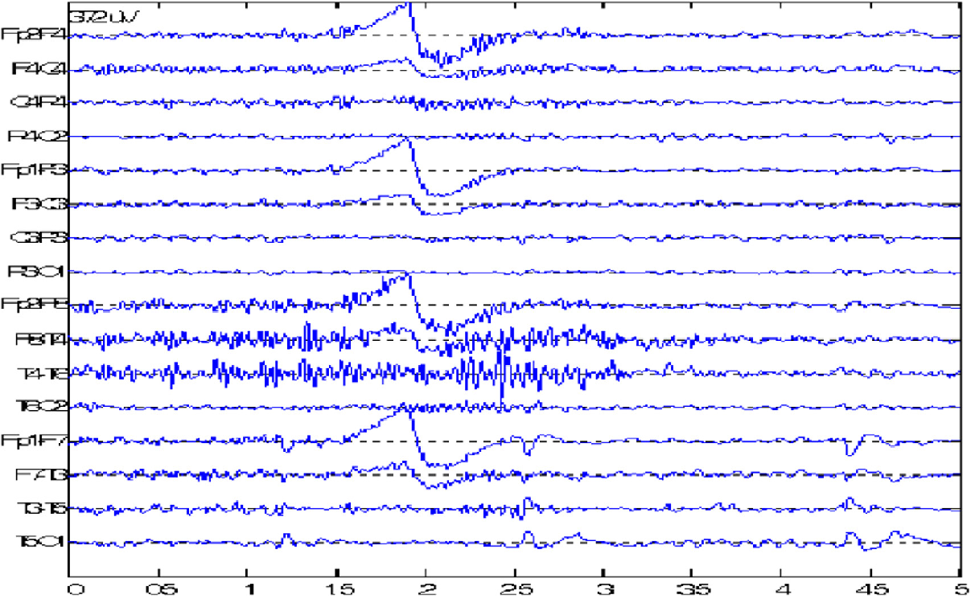
Import data:
(Sortering af dårlige kanaler)
Preprocessing data:
Feature extraction:
ICA
BAND Filter
Down-sampling and scaling
Baseline normalization
Spatial | Spectral | Temporal
… | …. | …
… | … | …
Explainability
Clustering
Model valg
Latent space
CNN?
Classification

Slide 2
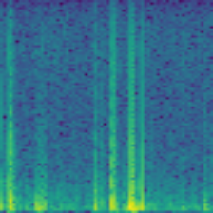
Import data:
Preprocessing data:
Feature extraction:
Filters
Resize and crop
Normalization
ML Classification
VGG16
Latent space
Novelty detection
Visualization
Trained VGG16
Latent space
CNN Classification
Saliency mapping
Explainability

Slide 3
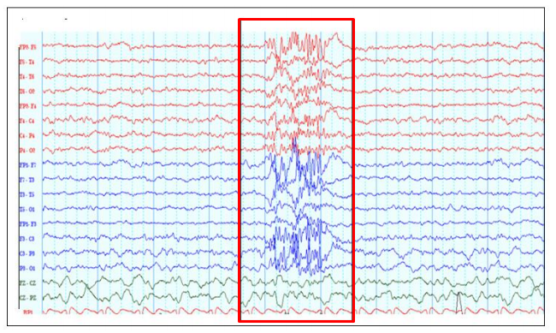
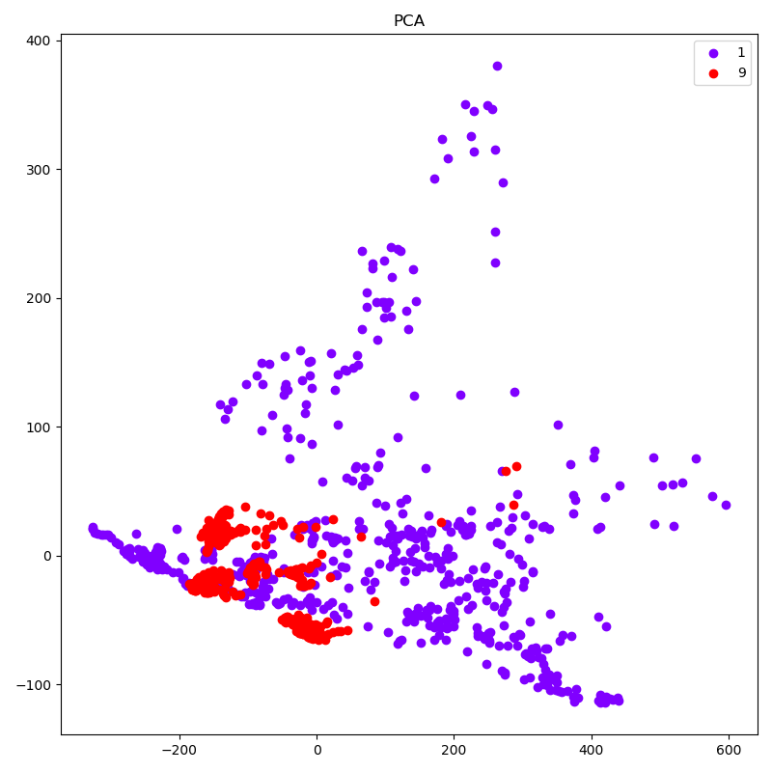
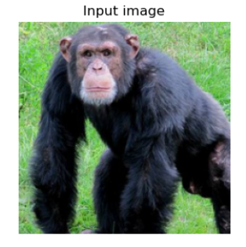
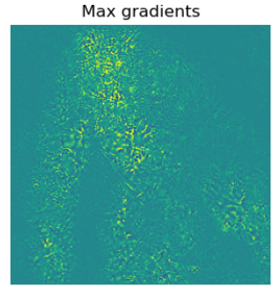
Preprocessing
ML Classification
Novelty detection
Filters
Resize and crop
Normalization
VGG16
Latent space
Trained VGG16
CNN Classification
CNN and latent representation
Explainability

Slide 4
Import af et helt signal:
Preprocessing data:
Gennemfør med labelled data
Send unlabelled data igennem
og se om der dannes mønstre.
Multi channel
Opdeling af signal til hver EEG kanal.
Standardiser BC og TUH.
1d vektorer
Pretrained ImageNet (CNN). Add extra layer and train on labelled data
Pretrained (TCN).
GMM
Output dim 1dx50?
/Latent space
Uncertain measures can be classified as novel
Otherwise one of the artifact types we have labels on

