Slide 1
Capstone Project 1: Liver Disease Prediction
Nils Madsen
6/20/2018

Slide 2
Introduction
The liver controls many digestive and detoxification functions in the body
Liver disease needs to be diagnosed early to prevent permanent liver damage (cirrhosis) that may require liver transplant
Gold standard test for liver disease diagnosis is liver biopsy, which is invasive and expensive

Slide 3
Goal and Utility
What if liver disease could be predicted from blood tests?
Blood tests are less invasive and much less expensive than liver biopsy
A machine learning model that uses blood tests to predict liver disease might prevent patients from undergoing unnecessary biopsy, and relieve some burden from the medical system
Insurance companies might also find such a model useful in prior-authorization processes

Slide 4
Data
583 patients from Andhra Pradesh, India
416 liver disease patients
167 controls
10 diagnostic metrics:
1 categorical feature: sex
9 continuous quantitative features: age, total bilirubin, direct bilirubin, alkaline phosphatase (ALP), alanine aminotransferase (ALT), aspartate aminotransferase (AST), total protein, albumin, and albumin-globulin ratio (a-g ratio)
Discovered on Kaggle: “Indian Liver Patient Records”
Data collected from UCI Machine Learning Repository

Slide 5
Data Cleaning
There were 4 missing values in the a-g ratio column; these were imputed from the mean of the column
There were 13 duplicate rows; these were not removed, since there is no unique identifier for each patient to indicate whether they were truly duplicated
There are significant amounts of outliers in total bilirubin, direct bilirubin, ALP, AST, and ALT; this is expected, as these measures can rise multiple-fold in the presence of liver disease

Slide 6
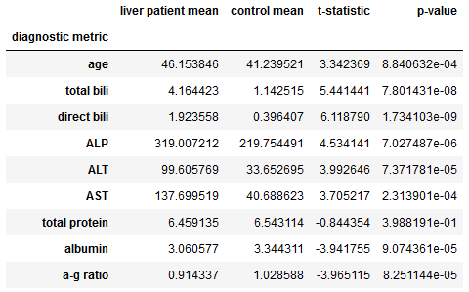
Data Exploration
Most of the diagnostic metrics differ between liver disease patients and controls
Student’s t-test indicates that only total protein did not differ between controls and liver disease patients
Liver disease rates also differ between men and women
Thus, this feature set should be predictive of liver disease

Slide 7
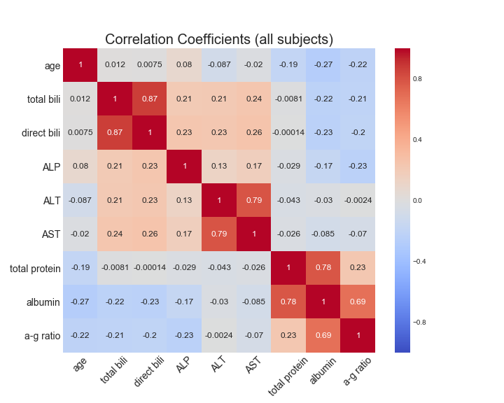
Data Exploration
The covariance structure of the data indicates that there is a good amount of independent predictive power in the feature set
Most features are not strongly correlated
Strong correlations exist between total/direct bili, ALT/AST, and albumin with total protein and a-g ratio
Feature pruning or dimensionality reduction may be justified to limit the impact of covariance on machine learning models

Slide 8
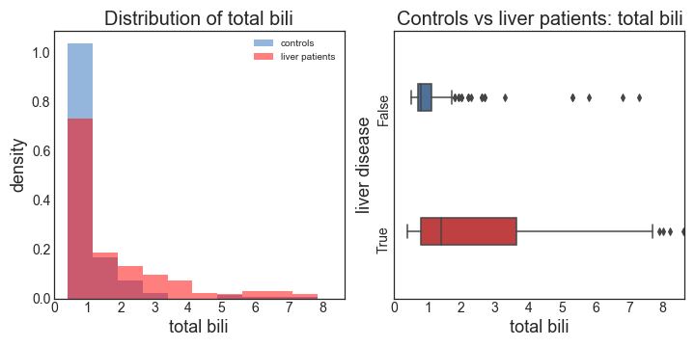
Data Exploration
The blood tests have low sensitivity for liver disease
Many liver patients have blood tests that are normal or close to normal, making them indistinguishable from controls
The distribution for total bilirubin is shown below for illustration, but a similar effect can be seen in direct bilirubin, ALP, ALT, and AST
This will limit the utility of prediction models to only functioning as rule-in tests, i.e. they can only make a confident positive prediction, not a confident negative prediction

Slide 9
Limitations of the Dataset for Machine Learning
Small size (only 583 observations)
Reduces the reliability of any predictive model, making it more likely to vary in performance between different train-test splits
Class imbalance
Many more liver disease patients than controls
Class imbalance can cause ML models to overpredict the more represented class
Small size of the dataset prevents use of the best-practice method for dealing with class imbalance; down-sampling the liver patients to be more equal in number with controls would make the dataset too small to be useful
The features are not powerful predictors of liver disease
Low sensitivity of the blood tests for liver disease will limit the performance of any machine learning model

Slide 10
Machine Learning: Overview
Principal Components Analysis (PCA) was used to produce uncorrelated features and reduce dimensionality
Overall strategy:
Split the data into training and test datasets
Deskew the quantitative variables using various transformations
Standardize the features
Use PCA to produce uncorrelated components and reduce dimensionality
Train various learning models, with cross-validated hyperparameter tuning
Apply the models to the test dataset to get measures of performance
Sex, as a categorical variable, was held out for deskewing, standardization, and PCA. It was reintroduced before training the models
Precision will be the main performance metric in model evaluation, as it most closely reflects usage of the model as a rule-in test for liver disease

Slide 11
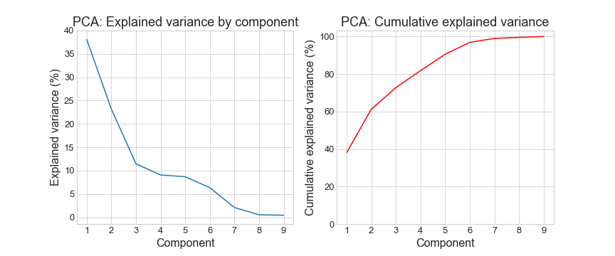
Machine Learning: Deskewing and PCA
Age and albumin were not skewed; total bilirubin was deskewed using a reciprocal transformation; all other features were deskewed using Box-Cox transformation
PCA reveals two elbows in the explained variance plot (at 3-4 and 7-8 components)

Slide 12
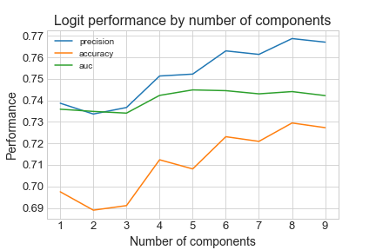
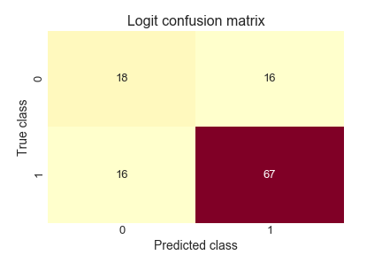
Machine Learning: Logistic Regression
Logistic Regression performed best with 8 components and a C-parameter value of less than 10⁻³, indicating strong regularization performs best
Confusion matrix reveals decent error profile, with the majority of controls being predicted as not having liver disease, and most liver disease patients being predicted as diseased

Slide 13
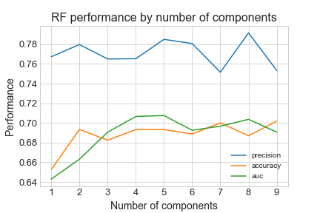
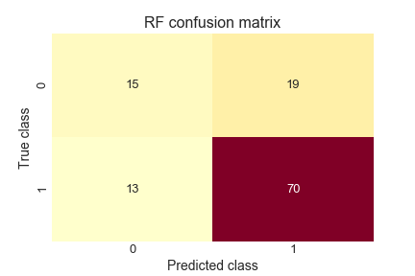
Machine Learning: Random Forest
Random forest also performs best with 8 components
The best hyperparameters included a tree count of 100, max depth of 50, and allowing trees to consider all features
Confusion matrix reveals that the model is predicting the majority of both groups to be diseased, indicating it may not be as useful as logit

Slide 14
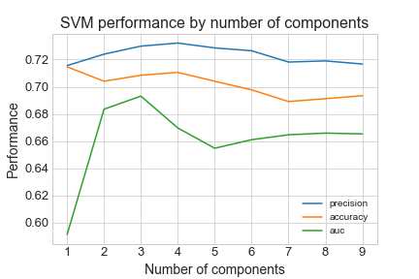

Machine Learning: Support Vector Machine
SVM performs best on 3 components
Optimal hyperparameters are C = 9, gamma = 0.07, sigmoid kernel
Confusion matrix reveals relatively poor error profile, with many false positives and false negatives

Slide 15
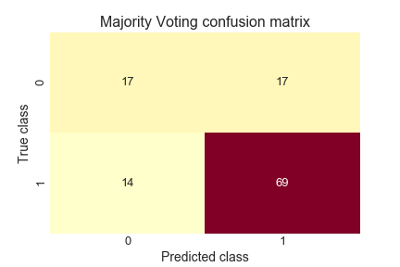
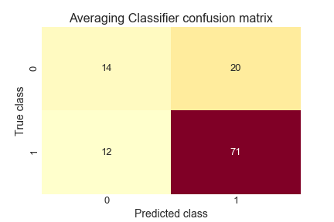
Machine Learning: Ensembles
Two ensemble methods were tried
Majority voting among logistic regression, random forest, and SVM
Averaging of probabilities between logistic regression and random forest, since they perform substantially better than SVM
Majority voting performed better than the probability-averaging classifier

Slide 16
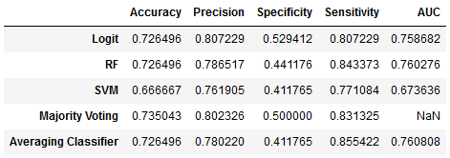
Machine Learning: Model comparison
Logistic Regression performed the best of all the individual classifiers, with the same accuracy as random forest but better precision
SVM performed the worst of the individual classifiers, with no performance advantage over logistic regression or random forest
Deciding between logistic regression and the majority voting classifier is more difficult, as logit has a slight advantage in precision and specificity, while majority voting has a slight advantage in accuracy and sensitivity
The difference between logit and majority voting is likely within the margin of error due to the small size of the dataset

Slide 17
Future Directions
Clustering analysis may yield interesting insights into this dataset
To what degree do the controls and liver patients overlap?
What proportion of liver patients are indistinguishable from controls?
Are there subclasses of liver patients, reflecting different types of liver disease?
Altering the probability thresholds for the learning models may yield models with higher precision; however, this would require a larger dataset to investigate rigorously

