Slide 1
PROJECT PRESENTATION
BigQuery Sales Analysis
Retail sales insights with SQL in Google BigQuery
Querying regional revenue, monthly trends, top products, order value, and repeat buyers.
Google BigQuery
SQL Aggregation
Sales Insights
Table: sales_dataset.sales_dataset_2024_2025
Presented by Amado Jr Sombreno
Data Analysis Project

Slide 2
Agenda
What we will cover today
01
Project Objective
Why this analysis was done and what questions it answers.
02
The Dataset
The retail sales table stored and queried in BigQuery.
03
How BigQuery Was Used
The SQL steps used to group, rank, and compare sales.
04
Key Findings
Regions, months, products, order value, and repeat customers.
05
Insights & Recommendations
What the business should notice next.
BigQuery Sales Analysis · SQL · Retail Dataset
02 / 17

Slide 3
Project Objective
Turn a retail sales table into clear regional and customer insights
GOAL
Use BigQuery SQL to explore a 2024–2025 retail dataset and explain sales by region, month, product, and customer.
01
Query
02
Compare
Write SQL in BigQuery to group, rank, and summarize 2,000 orders.
See which regions and product categories lead, and how sales move by month.
03
Go deeper
04
Interpret
Measure average order value and find customers who bought more than once.
Turn query results into simple notes a business team can use.
BigQuery Sales Analysis · SQL · Retail Dataset
03 / 17

Slide 4
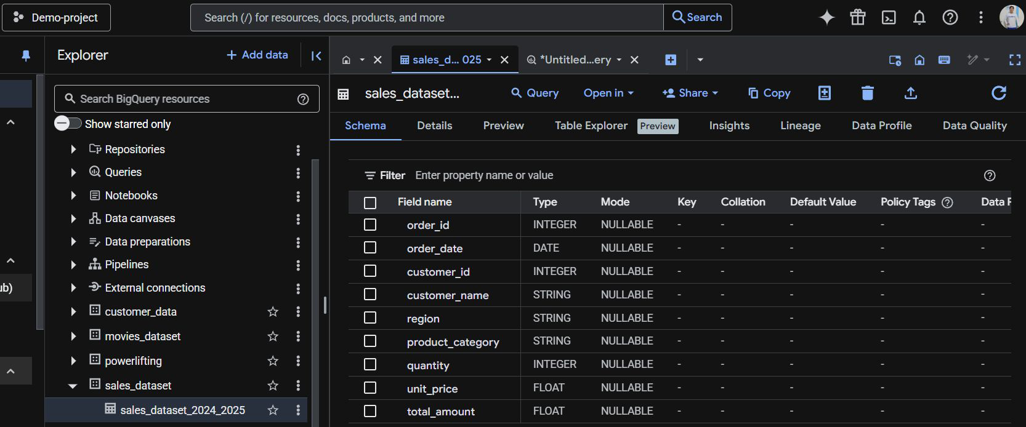
Dataset in BigQuery
Table: sales_dataset.sales_dataset_2024_2025
2,000
9
4
5
Orders
Fields
Regions
Categories
Each row is one order: who bought, where, what category, how many units, and the total amount.
BigQuery Sales Analysis · SQL · Retail Dataset
04 / 17

Slide 5
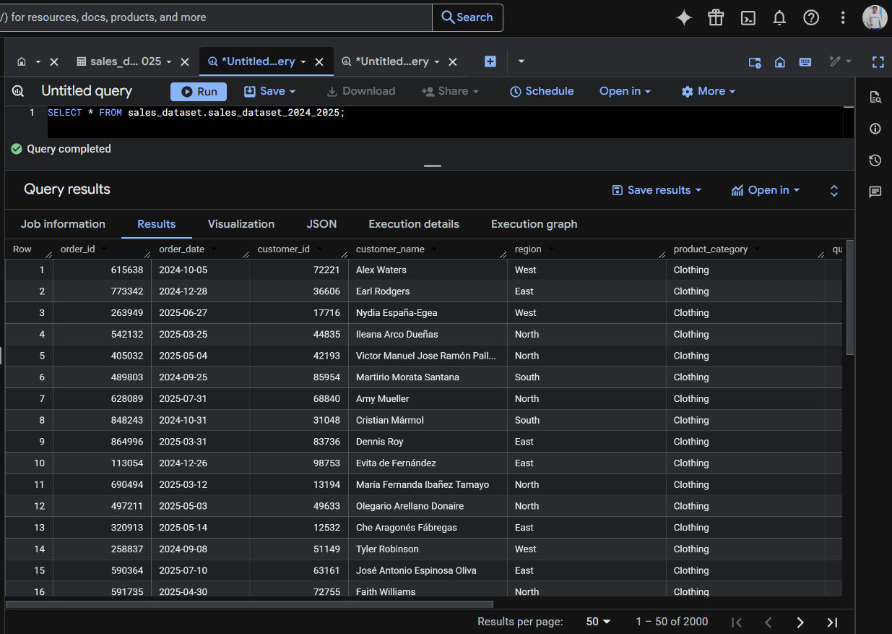
Exploring the Raw Data
First query: preview every order before aggregating
SELECT * FROM sales_dataset.sales_dataset_2024_2025; · BigQuery shows 2,000 rows.
BigQuery Sales Analysis · SQL · Retail Dataset
05 / 17

Slide 6
How BigQuery Was Used
All analysis was written and run in the BigQuery SQL editor
1
2
3
4
5
Load
Explore
Aggregate
Rank
Go deeper
Store the retail file as a BigQuery table.
Preview rows with SELECT * and check the schema.
Use SUM, AVG, and COUNT to build metrics.
ORDER BY and LIMIT to find leaders.
CTEs, JOIN, and ROW_NUMBER() for repeat buyers.
SQL used for each question
GROUP BY + SUM
FORMAT_DATE
AVG
Total sales by region and units by product.
Roll daily orders into a clean monthly trend.
One number for average order value.
CTE + ROW_NUMBER()
JOIN + HAVING
ORDER BY + LIMIT
Keep one customer name, then count their orders.
Keep only customers with more than one order.
Rank regions and show the top five categories.
BigQuery Sales Analysis · SQL · Retail Dataset
06 / 17

Slide 7
Five Questions We Asked
Every query in the project answers one of these
A
Regions
Which regions generate the most revenue?
B
Months
How did sales move from Sep 2024 to Sep 2025?
C
Products
Which product categories sold the most units?
D
Order value
How much do customers spend per order, on average?
E
Repeat buyers
Which customers placed more than one order?
BigQuery Sales Analysis · SQL · Retail Dataset
07 / 17

Slide 8
Finding 1 · Sales by Region
Question: which regions generate the most revenue?
Highest
Medium
Lowest
WHAT THE QUERY SHOWED
South
$735,972
1
East
$707,180
2
North
$696,524
3
West
$660,939
4
South leads. The four regions are fairly close — West is only about 10% below South.
SQL: SELECT region, SUM(total_amount) … GROUP BY region ORDER BY total_sales DESC;
BigQuery Sales Analysis · SQL · Retail Dataset
08 / 17

Slide 9
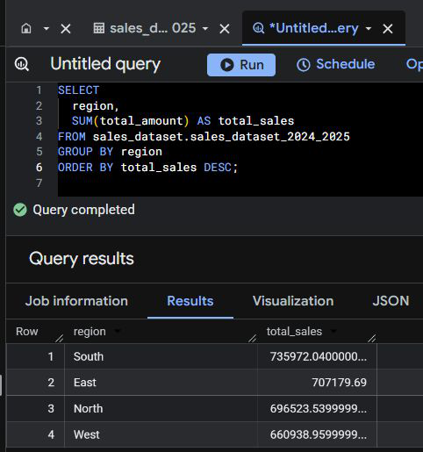
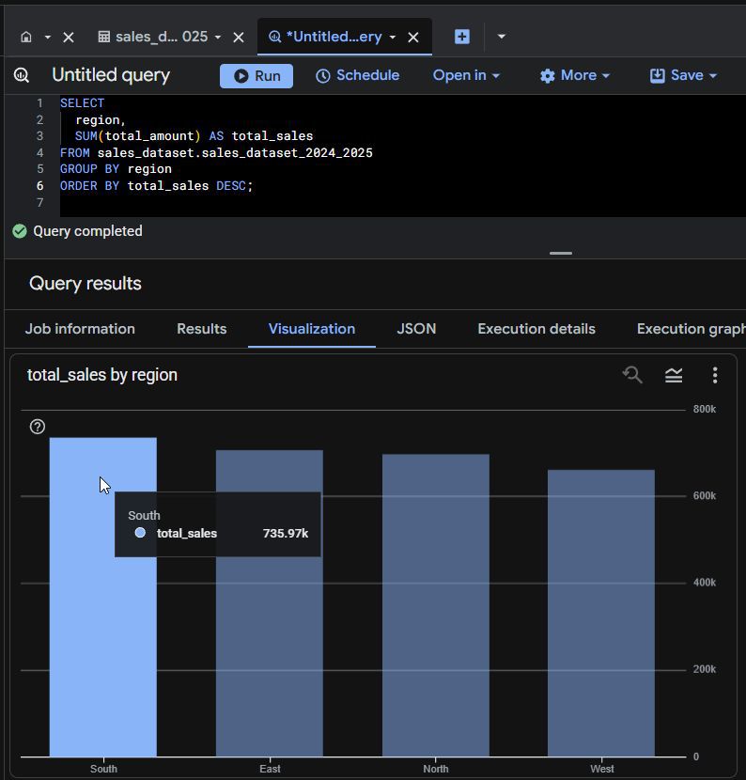
Finding 1 in BigQuery
The exact query, result grid, and BigQuery chart
Query + result grid
BigQuery visualization
South is first at about $736k. The same ranking appears in the grid and in the chart.
BigQuery Sales Analysis · SQL · Retail Dataset
09 / 17

Slide 10
Finding 2 · Monthly Sales Trend
Question: are sales growing, falling, or holding steady?
Highest
Medium
Lowest
HIGHEST
TYPICAL MONTH
WATCH
May 2025 · $268,587
About $210k–$250k
Sep 2025 looks incomplete
FORMAT_DATE('%Y-%m', order_date) groups daily orders into months. Sep 2025 is likely a partial month, not a collapse.
BigQuery Sales Analysis · SQL · Retail Dataset
10 / 17

Slide 11
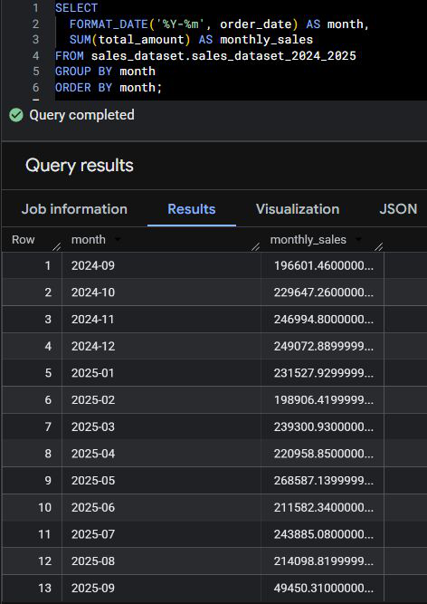
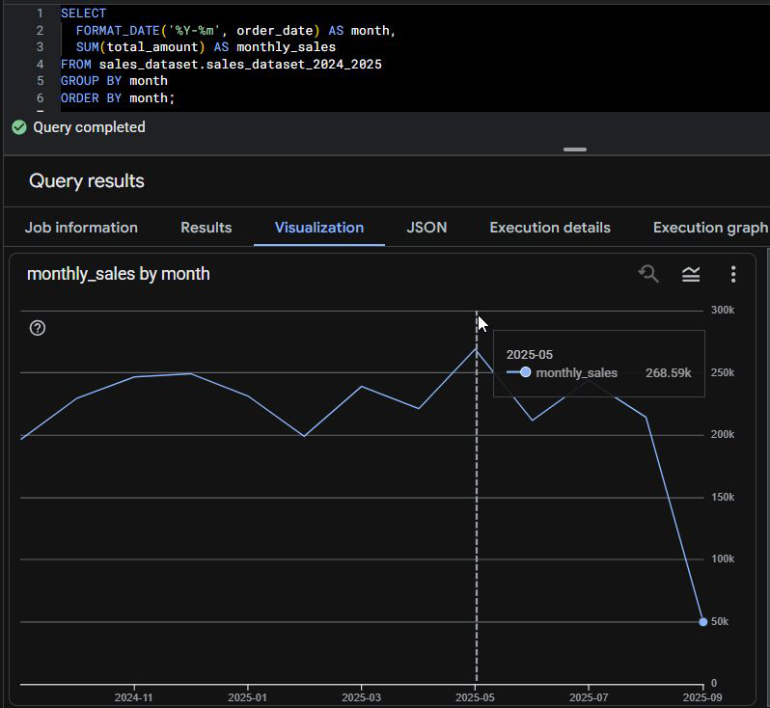
Finding 2 in BigQuery
Monthly totals in the result grid and the BigQuery line chart
Monthly totals
Sales over time
The line rises into late 2024, dips in February, peaks in May, then Sep 2025 drops because the month is not complete.
BigQuery Sales Analysis · SQL · Retail Dataset
11 / 17

Slide 12
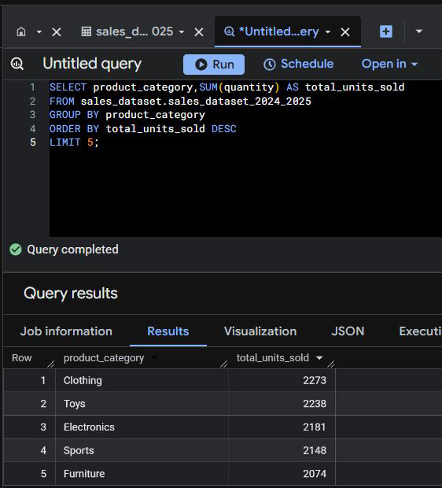
Finding 3 · Top Product Categories
Question: which categories sell the most units?
Query + units sold
Clothing leads at 2,273 units, but the five categories are very close. Demand is broad, not one-product.
BigQuery Sales Analysis · SQL · Retail Dataset
12 / 17

Slide 13
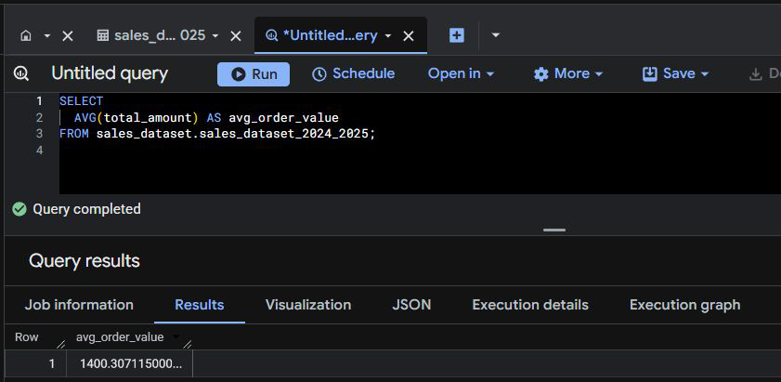
Finding 4 · Average Order Value
Question: how much do customers spend per order?
AVERAGE ORDER VALUE
$1,400
Exact result: 1,400.31
This is a single-number query:
AVG(total_amount) across all 2,000 orders.
BigQuery · AVG(total_amount)
A typical basket is about $1,400. Use this as a baseline when testing promotions or new products.
One clean metric from one function. No grouping required — just the average of total_amount.
BigQuery Sales Analysis · SQL · Retail Dataset
13 / 17

Slide 14
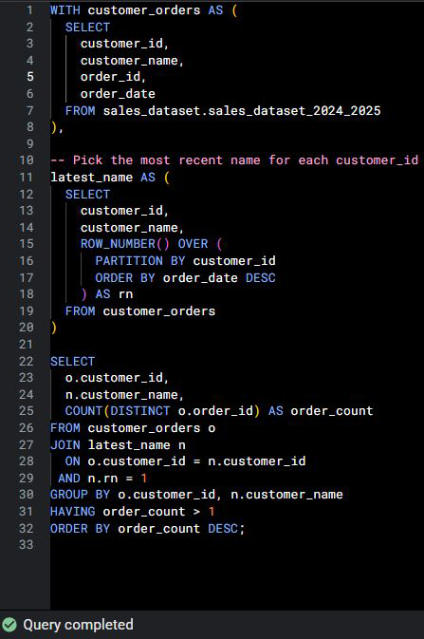
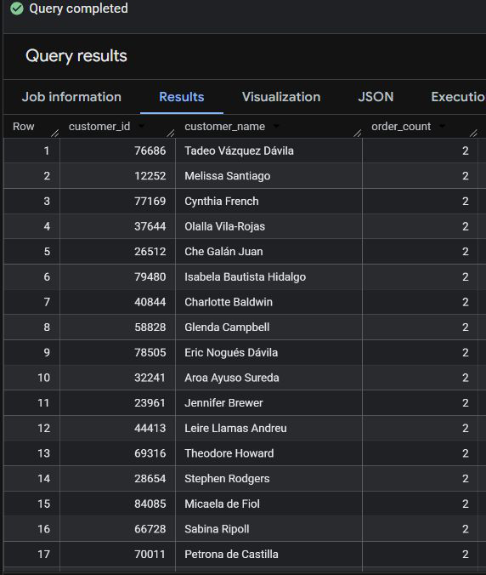
Finding 5 · Repeat Customers
Question: who bought more than once?
CTE + ROW_NUMBER() + JOIN + HAVING
Customers with more than one order
Every repeat buyer in the result has 2 orders. The query keeps the latest name, then counts distinct orders.
BigQuery Sales Analysis · SQL · Retail Dataset
14 / 17

Slide 15
Key Insights
The story the five queries tell
1
South leads, but not by much
2
May was the strongest month
South is first at $736k. West is last at $661k. Regional gaps are modest — all four markets matter.
Sales stay in a $200k–$250k band most months and peak at $269k in May 2025.
3
Sep 2025 is not a crash
4
Categories are evenly matched
The last month is $49k because the period looks incomplete. Treat it as a data-quality note.
Clothing is #1, but Toys through Furniture are close behind. The mix is balanced.
5
Baskets are large
6
Repeat buying exists
Average order value is $1,400. A few extra items per order would move revenue quickly.
Many customers placed two orders. The CTE and window function made that list reliable.
BigQuery Sales Analysis · SQL · Retail Dataset
15 / 17

Slide 16
Recommendations & Close
What to do with these BigQuery results
1
Study what South is doing
2
Plan around May
Replicate South’s mix and timing in West, where revenue is lowest.
May is the peak. Stock and campaigns should be ready before that month.
3
Do not overreact to Sep 2025
4
Grow the basket, not only traffic
Confirm the extract date before treating the drop as a real decline.
AOV is already $1,400. Bundles in Clothing and Toys can lift it further.
5
Nurture two-order customers
6
Keep the SQL pack
They already came back once. A simple second-purchase offer can create a third.
These five queries are a reusable monthly scorecard in BigQuery.
BigQuery turned one sales table into regional, monthly, product, and customer views — ready for BI decisions.
BigQuery Sales Analysis · SQL · Retail Dataset
16 / 17

Slide 17
Thank you
Questions and discussion
Happy to walk through any BigQuery SQL, result grid, or chart.
Table: sales_dataset_2024_2025
Tool: Google BigQuery
2,000 orders
Amado Jr Sombreno · BigQuery Sales Analysis
Thank you

