Slide 1
RTU HACKATHON 2018
TEAM DAEMON
MEMBERS :
- MADHAV DIXIT - PRATEEK NAVALAKHA
- KEYUR JAIN - NIKHIL JAIN
- HARSHIT SHARMA - HIMANSHU MODI

Slide 2

Problem Statement
“We would like to craft personalized travel experience for 5.2mn passengers who travel with us monthly, by rapidly making meaningful changes to PaxEx across touchpoints. How can AI and Big Data help IndiGo, the leading low-cost carrier, create ‘one in a million experience’ for every single customer? Also, accelerate personalized ancillary upsell throughout the travel journey of its leisure and business travellers?”

Slide 3
Need of improvement
Beyond cabin comfort, there are a lot of things that happen between flight check-in and deplaning that can impact a passenger’s enjoyment of a flight.
Unfortunately, many of those things are often unpredictable and can’t be controlled by the passenger, the crew or the airline.

Slide 4
Area of enhancement
Healthier Food — and More Exciting Beverage Options.
In-flight entertainment systems are a great way to pass the time during a flight.
Small, Personalized Touches like favorite music or movie genre, destination or airplane snack.
A Rewards Program for Frequent Flyers.
Improve the seat situation of your airplanes.
Enhancing the booking services for featured phone.

Slide 5
How Artificial intelligence helps in enhancing travel experience of passengers ?
Using AI we can create individual customer profile and could find out personal choices.
And we could recommend services which give them a personalized touch.
After flights, algorithms can monitor social media for passenger sentiment to understand the passenger experience.

Slide 6
Our Idea
Using Artificial Neural Network model is basically focusing on giving personalized services to customer and enhancing the company revenue .
We are using machine learning algorithm for predicting which customers are eligible for special services and offers which enhance customer experience.
Our model predicts probability of individual customer of getting special services from airline.
The service which company is providing is on meal provided during journey.
As a result there is a growth in selling of in-flight meal.

Slide 7
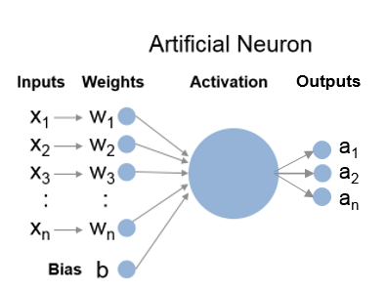

Slide 8
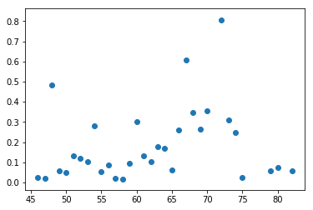
Graph of model:
Graph between Age of customer and Probability of getting services

Slide 9
Sentimental Analysis of indigo twitter data
First part: Data analysis on the dataset to find the best and the worst airlines and understand what are the most common problems in case of bad flight
Second part: Training two Naive-Bayesian classifiers: first to classify the tweets into positive and negative And a second classifier to classify the negative tweets on the reason. In this way is possible to upgrade the statistics, of the first point, with new tweets.

Slide 10
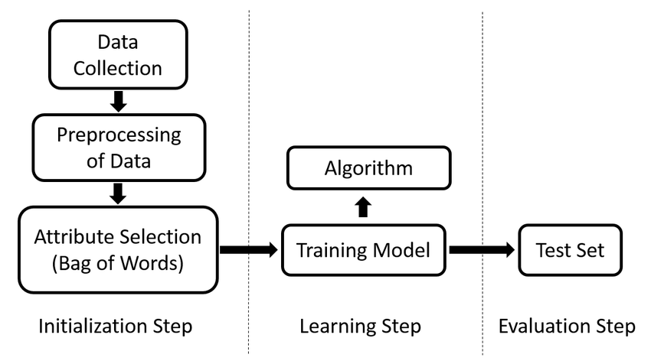

Slide 11
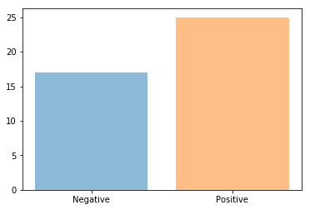
Graph of sentimental model
Graph between No. of tweets and their response

Slide 12
Role of big data
The Big Data analytics is indeed a revolution in the field of Information Technology. The use of Data analytics by the companies is enhancing every year. The primary focus of the companies is on customers. Hence the field is flourishing in Business to Consumer (B2C) applications.We divide the analytics into different types as per the nature of the environment. We have three divisions of Big Data analytics: Prescriptive Analytics, Predictive Analytics, and Descriptive Analytics.

Slide 13
Future Scope of our project
Making Flight booking easy which target every type of customer.
Creating self services for passengers like bag tag and collection.
Chatbots that help users navigate your support documentation or frequently asked questions (FAQs).
Monitoring social media for product mentions and automating responses based on sentiment.
In-flight sales and food supply: If a low-cost airline sells food on board, it has to know how to predict the amount of food it has to buy for a specific flights.

