Slide 1
GRE 单词训练营 #3
最好的方法 最高效的背 最地道的用
With Fiona

Slide 2



Slide 3
Frequently tested GRE Words of 2015
veracity
equanimity
dispute
condescending
buttress
repudiate
rectitude
insouciant
disdainful
recommence

Slide 4
Frequently tested GRE Words of 2015
veracious
longevity
integrity
collected
canny
nonchalant
voracious
decency
forswear
astute

Slide 5
Common Words that Students Always Get Wrong
extant
auspicious
enervate
equivocate
ambivalent

Slide 6
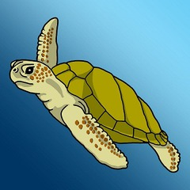
extant
Many think this word means extinct. Extant is actually the opposite of extinct.
Despite many bookstores closing, experts predict that some form of book dealing will still be extant generations from now.

Slide 7
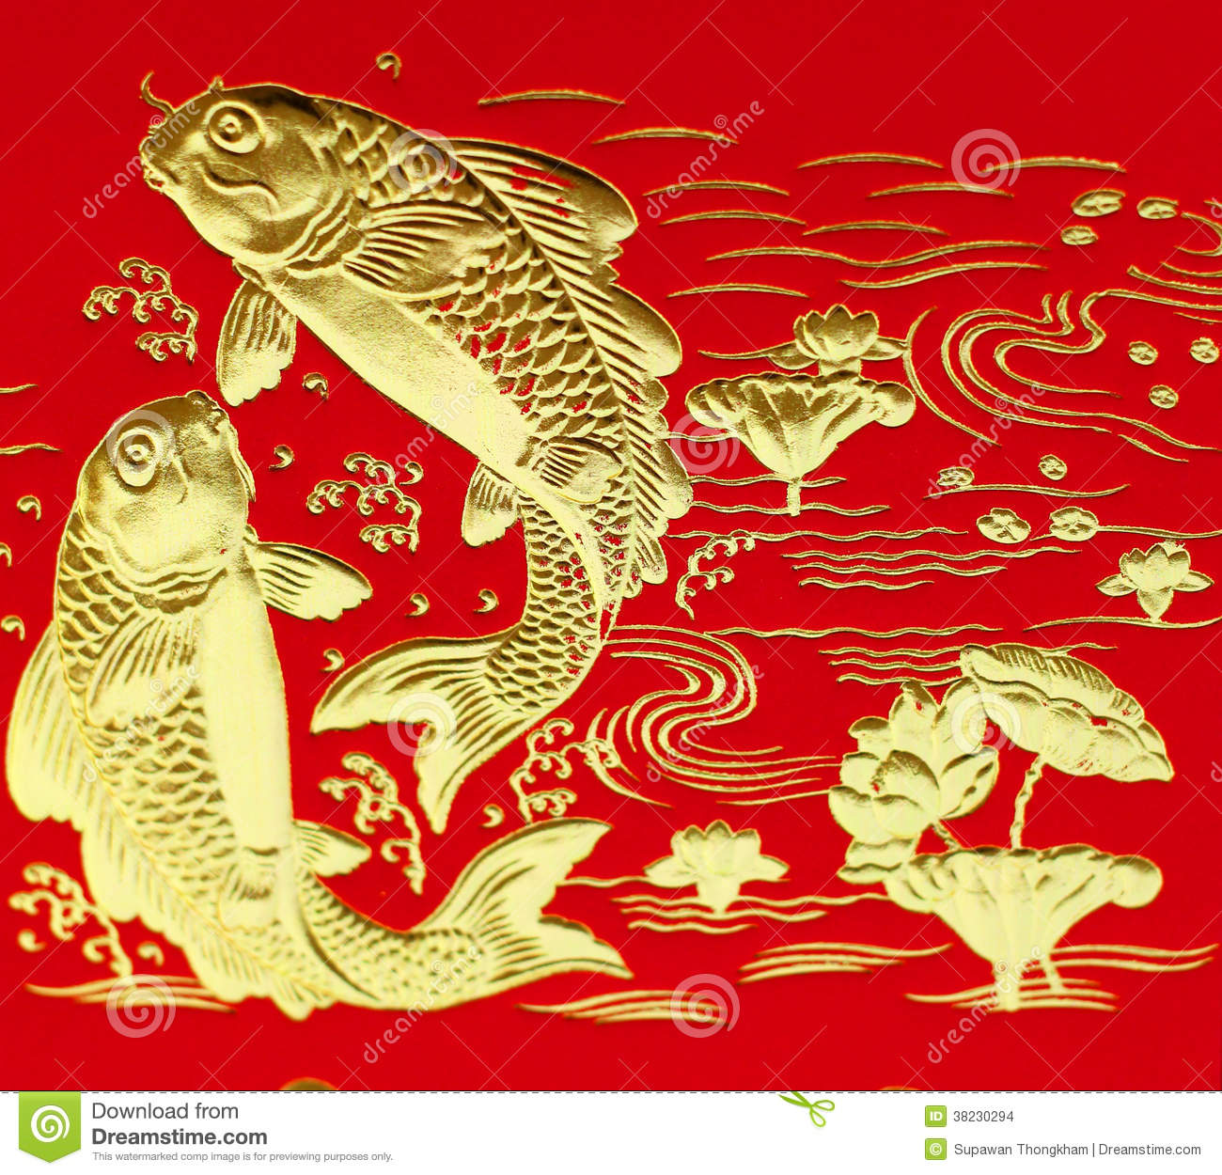
auspicious
Auspicious: conducive to success + favorable
If an occasion is auspicious, it is favorable.
The opposite, inauspicious, is also common on the GRE. It means unfavorable.
Despite an auspicious beginning, Mike’s road trip became a series of mishaps, and he was soon stranded and penniless, leaning against his wrecked automobile.
Propitious (giving or indicating a good chance of success)
Opportune/ providential/ felicitous

Slide 8
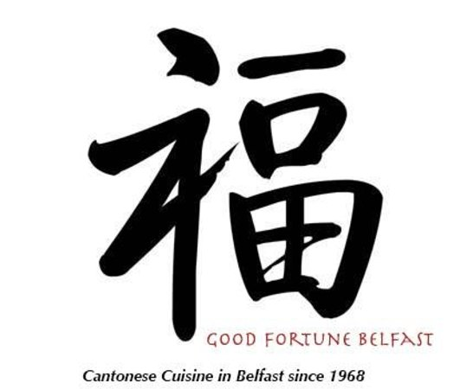
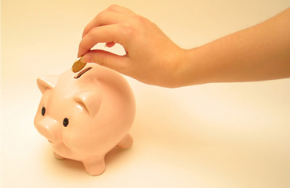
Providential/ provident
Providential: occurring at a favorable time+ favorable + appropriate
Provident: making or indicative of timely preparation for the future
Kaye was provident enough to be able to buy her first home at age 24

Slide 9
Felicitous/ opportune
Felicitous: well chosen or suited to the circumstances + pleasing and fortunate
his nickname was particularly felicitous
The company has a felicitous future
--------------------------------------------------------------------------------------------
Opportune: well-chosen + appropriate
the opportune use of humor to lower tension.
he couldn't have arrived at a less opportune moment.

Slide 10
Chairperson and CEO Andrea Jung has revitalized her company, considered ____ in recent years, to one whose products now attract millions of consumers worldwide.
A. avant-grade
B. moribund
C. auspicious
D. dying
E. propitious
F. spurious

Slide 11
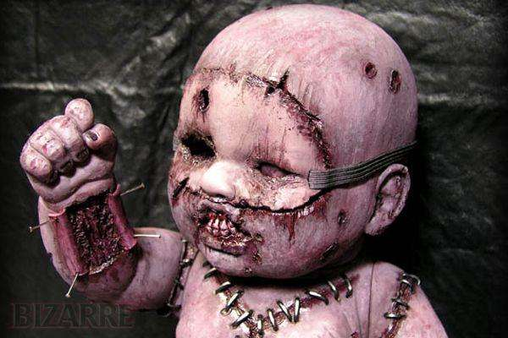
morbid
身体不健康（unwholesome, insalubrious)
+精神病不健康 (abnormal, aberrant, gruesome)
+不开心(melancholy, morose, gloomy)
he had long held a morbid fascination with the horrors of contemporary warfare.
the treatment of morbid obesity.
I felt decidedly morbid.

Slide 12
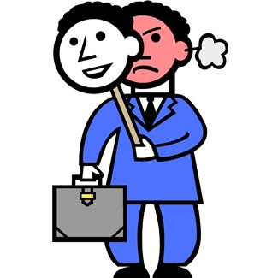
spurious
not being what it purports to be+ apparently but not actually valid+ false or fake
The con artist made a spurious claim about being a member of the royal family.
Frequently tested with: bogus, fraudulent
Forged, counterfeit, artificial
specious (superficially plausible, but actually wrong)
feigned

Slide 13
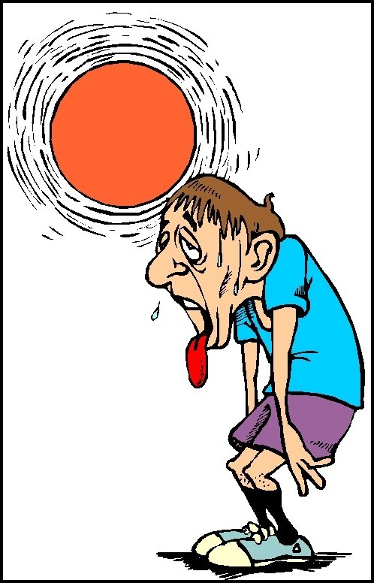
enervated
Enervated: exhaust
Enervate (v.) Most people think enervate means to energize. It actually means to sap the energy from.
John preferred to avoid equatorial countries; the intense sun would always leave him enervated after he’d spent the day sightseeing.

Slide 14
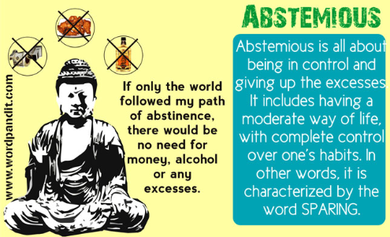
ABSTEMIOUS
sparing in consumption of especially food and drink
Not self-indulgent
餓不死的meals
One in eight Americans lives in poverty, which seems obscene given that the really rich are enjoying a level of privilege that makes the Gilded Age Vanderbilts look like abstemious Puritans.
Frequently tested with: ascetic, austere, abstinent

Slide 15
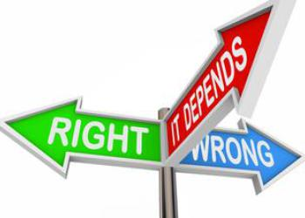
equivocate
It means to speak vaguely, usually with the intention to mislead or deceive.
More generally, equivocal can mean ambiguous.
To state something unequivocally is to state it in such a way that there is no room for doubt.
The findings of the study were equivocal—the two researchers had divergent opinions on what the results signified.
Frequently tested with: prevaricate

Slide 16
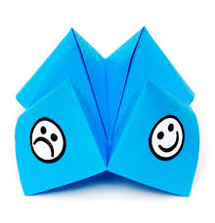
ambivalent
when you are ambivalent you have mixed or conflicting emotions about something.
some loved her, some hated her, few were ambivalent about her
Frequently tested with: equivocal, vacillating

Slide 17
To students accustomed to using calculators, the textbook`s suggestion that computations be made by hand was _____.
A. scholarly
B. prescient
C. erudite
D. unequivocal
E. anachronistic
F. outdated

Slide 19
Frequently tested GRE Words of 2015
abjure
nullify
paucity
enigmatic
elliptical
perspicacious
judicious
penitent
bellicose
gainsay

Slide 20
Frequently tested GRE Words of 2015
probity
impugn
dearth
contrite
sagacious
pugnacious
egregious
repentant
cryptic
belligerent

Slide 21
Frequently tested GRE Words of 2015
abstemious
abstinent
enervated
spurious
ambivalent
morbid
providential
auspicious
extant
provident

Slide 22


