Slide 1
GRE 单词训练营 #4
最好的方法 最高效的背 最地道的用
With Fiona

Slide 2
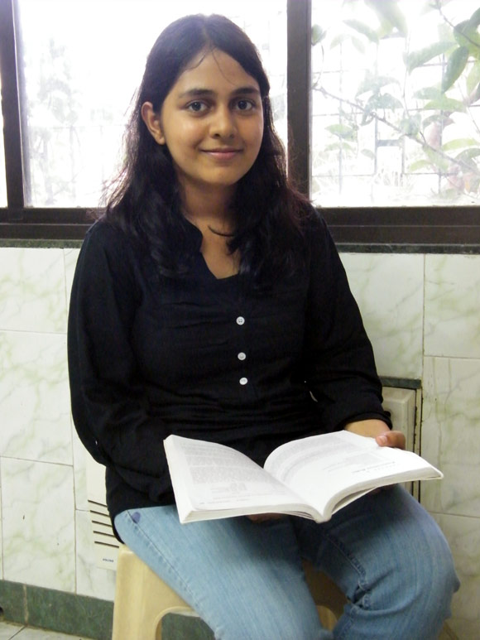
For the first time since a revised format was introduced in 2011, an Indian has topped the Graduate Record Examination with a perfect 340 out of 340 score.
All the words for her:
Shrewd, sagacious, sapient, astute
Let’s hope seeing this picture can help us be lucky:
Auspicious, propitious, fortune, providential, felicitous,

Slide 3
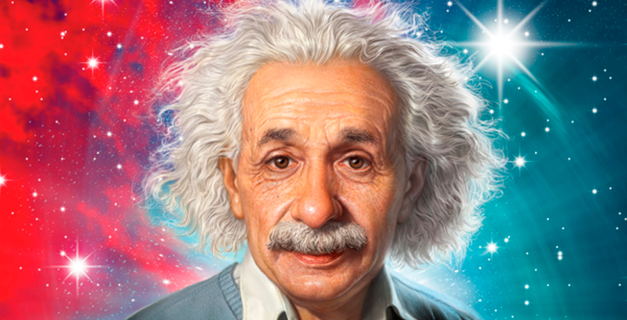
Scintillating
sparkling or shining brightly: the scintillating sun.
brilliantly and excitingly clever or skillful
If something gives off sparks, such as when photons collide, it is said to scintillate.
Figuratively, scintillating describes someone who is brilliant and lively (imagine Einstein’s brain giving off sparks).
Richard Feynman was renowned for his scintillating lectures—the arcana of quantum physics was made lucid as he wrote animatedly on the chalkboard.

Slide 4
The professor`s _____ lecture on American history served more to confuse the students than to clarify the difficult material.
A. incoherent
B. persuasive
C. cogent
D. scintillating
E. disjointed
F. perspicacious

Slide 5
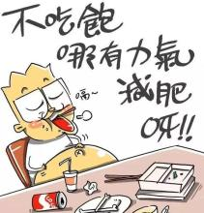
cogent
(argument) clear +logical+ convincing
Frequently tested with: compelling
Compelling= enthralling(performance) convincing (argument)

Slide 6
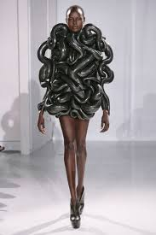
Avant-garde
new and unusual or experimental ---Innovative
(ideas or people, especially in the arts)
avant-garde composer
Frequently tested with: bohemian, unorthodox, unconventional

Slide 7
Artists who are described as _____ are the first to experiment with new forms or concepts.
A. aesthetic
B. partisan
C. pioneering
D. biased
E. avant-garde
F. decorous

Slide 8
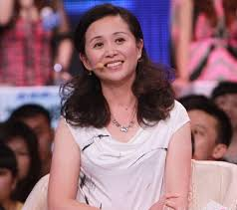
Decorous adj. Decorum n.
good taste + propriety + polite
Frequently tested with : decent, genteel, sophisticated, mannerly, civilized, polished, refined
Antonym: uncouth, plebeian, vulgar, churlish
Differentiate: decorative

Slide 9
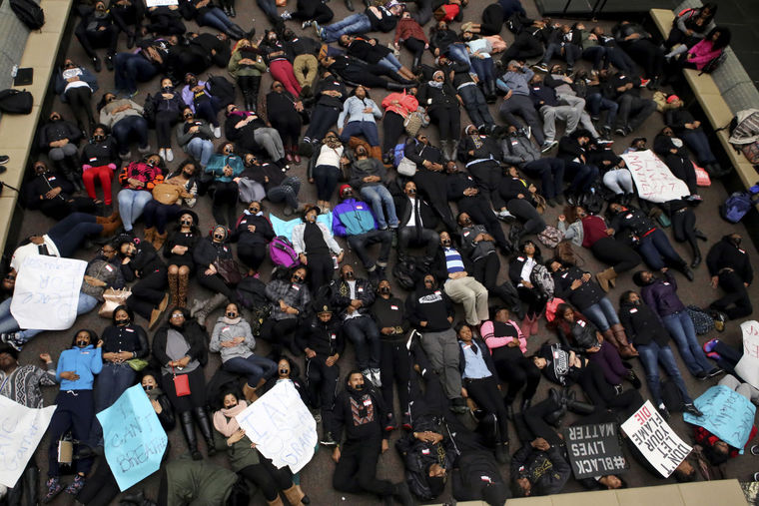
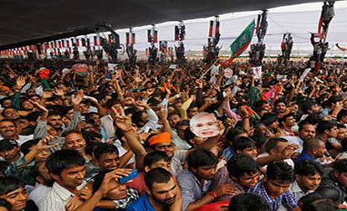
commotion
noisy disturbance + civil insurrection
a commotion broke out in the street behind us
Frequently tested with : uproar, tumult, turmoil
ruckus, clamor
Unrest

Slide 10
Since the foreign correspondent was accustomed to completing his assignments under (i)______ conditions, the commotion of the subway at rush hour presented no (ii)_____ his creativity.
A. tumultuous | D. inspiration for
B. flagrant | E. boon for
C. tranquil | F. obstruction to

Slide 11
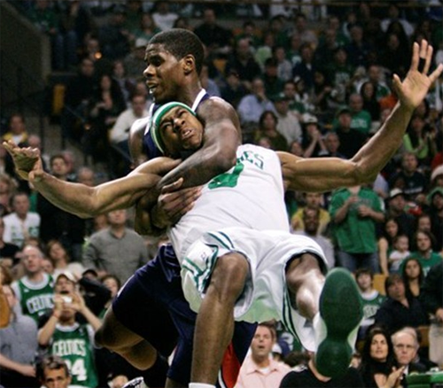
flagrant
(of something considered wrong or immoral) conspicuously or obviously offensive
a flagrant violation of the law.
Frequently tested with : blatant (of bad behavior) done openly and unashamedly
Brazen(bold and without shame)

Slide 12
Unlike the _____ presentations of the other students in class, Mary Catherine`s presentation demonstrated a thorough and mature grasp of the material.
A. dabbling
B. sophomoric
C. incredulous
D. canny
E. scintillating
F. astute

Slide 13
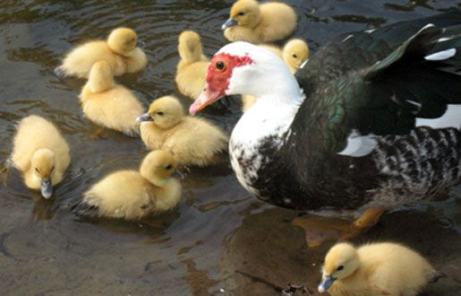
dabble
take part in an activity in a casual or superficial way
he dabbled in writing as a young man.

Slide 14
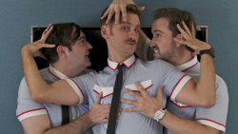
sophomoric
having or showing a lack of emotional maturity : foolish and immature
Frequently tested with:
Too young: Callow, juvenile, puerile.
Too simple: Unworldly, naïve, unsophisticated, jejune

Slide 15

incredulous
(of a person or their manner) unwilling or unable to believe something
we were incredulous when the congressman was not more forthcoming in his first broadcast interview about the case
Frequently tested with: skeptical, suspicious, dubious
Cynical(most residents are cynical about efforts to clean mobsters out of their city.)

Slide 16
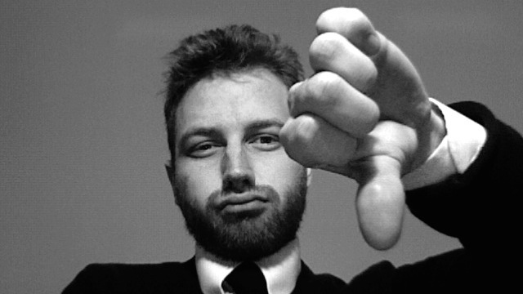

cynical
1： believing that people are motivated by self-interest; distrustful of human sincerity or integrity (人性本恶啊。。。）
2： doubtful as to whether something will happen or whether it is worthwhile （怀疑人家）
concerned only with one‘s own interests （就知道考虑自己的利益）
Contemptuous （还瞧不起人家）he gave a cynical laugh.

Slide 17



Slide 18
Frequently tested GRE Words of 2015
sapient
felicitous
scintillating
cogent
unorthodox
disjointed
perspicacious
enthralling
bohemian
decorous

Slide 19
Frequently tested GRE Words of 2015
avant-garde
uncouth
genteel
commotion
unworldly
flagrant
brazen
dabbling
incredulous
callow

Slide 20
Frequently tested GRE Words of 2015
dubious
cynical
blatant
tranquil
clamor
tumultuous
partisan
dabbling
plebeian
callow

