Slide 1
GRE 单词训练营 #7
最好的方法 最高效的背 最地道的用
With Fiona

Slide 2


Slide 3
bonus

Slide 4

Apocalyptic
describing or prophesying the complete destruction of the world: pertaining to revelations especially of disaster
The conflict between the two countries is reaching apocalyptic proportions.
Frequently tested with: ominous, portentous, catastrophic

Slide 5
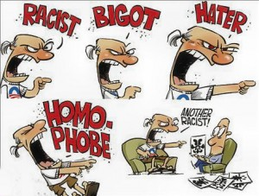
bigoted
having or revealing an obstinate belief in the superiority of one's own opinions and a prejudiced intolerance of the opinions of others
Bigot (n.)
a bigoted group of reactionaries
Frequently tested with: prejudiced, sectarian, opinionated, dogmatic
Chauvinistic, jingoistic

Slide 6
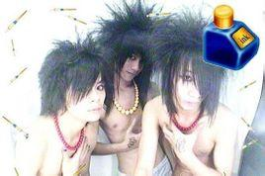
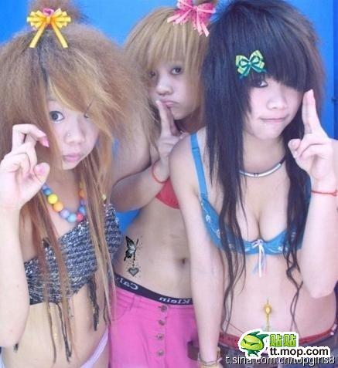
tawdry
showy but cheap and of poor quality+ sordid or unpleasant
tawdry jewelry.
the tawdry business of politics.
Frequently tested with: showy, garish, vulgar, trashy
Gaudy lurid

Slide 7
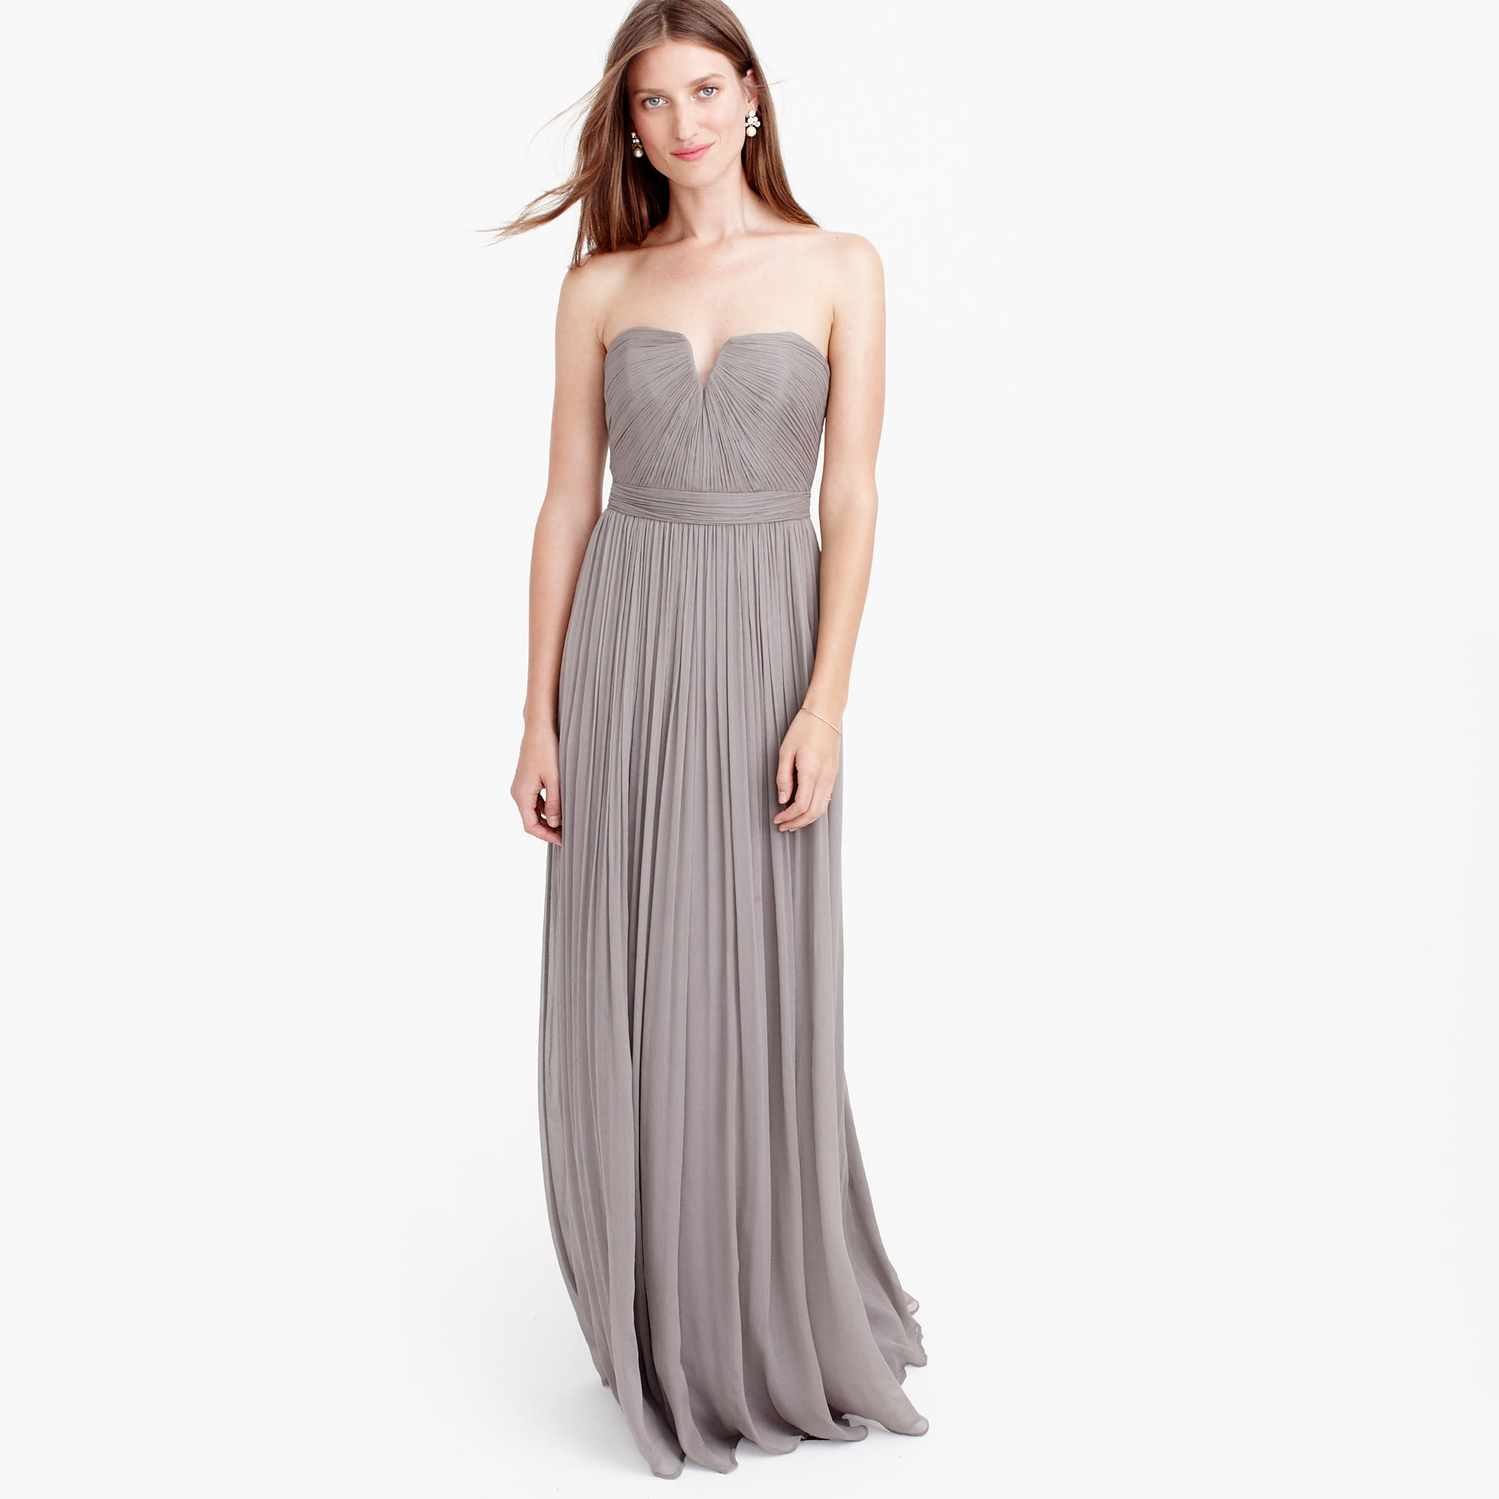
becoming
Another secondary meaning that changes parts of speech, becoming an adjective.
If something is becoming, it is appropriate, and matches nicely.
Her dress was becoming and made her look even more beautiful.
Frequently tested with: comely,, stunning, prepossessing
beguiling, fetching, captivating, bewitching, enchanting

Slide 8
The mayor is renowned for her ____ temperament, she can be warm and talkative one moment, aloof and supercilious the next.
A. acrimonious
B. fickle
C. mercurial
D. beguiling
E. officious
F. meddling

Slide 9
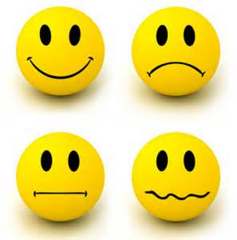
Fickle
changing frequently, especially as regards one's loyalties, interests, or affection
he weather is forever fickle
Frequently tested with:
Capricious, mercurial, volatile, whimsical

Slide 10
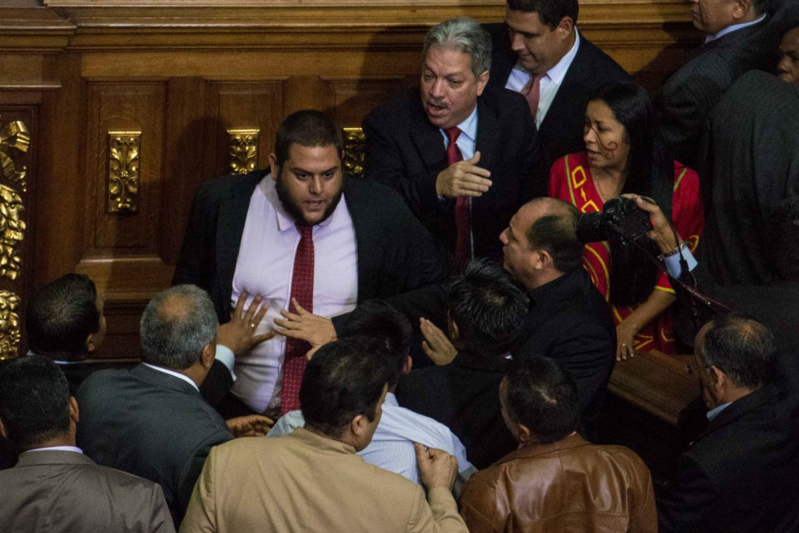
acrimonious
(typically of speech or a debate) angry and bitter
讥讽+言辞激烈+充满怒火+恶毒
they had a heated and acrimonious discussion
Frequently tested with:
敌意： Rancorous (characterized by bitterness or resentment)
刻薄讥讽Caustic, acerbic, sarcastic,
恶毒： Spiteful, malignant, malevolent, malicious
恶意有了，但还多了诽谤的意思： malign

Slide 11
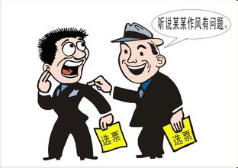
slander
the action or crime of making a false spoken statement damaging to a person's reputation
they were accused of slandering the head of state.
Frequently tested with:
诽谤Defame, libel, smear, besmirch, tarnish, vilify, sully
公开谴责Obloquy, denunciation
贬低disparage

Slide 12
Some critics of congressional proceedings contend that important debates on issues are marred by a _____ of denunciations and accusations that precludes _____ discourse.
A. paucity | D. expendable
B. cacophony | E. orderly
C. rehash | F. libelous

Slide 13



Slide 14
Frequently tested GRE Words of 2015
ominous
bigoted
becoming
garish
acrimonious
fickle
slander
beguiling
tawdry
denunciation

Slide 15
Frequently tested GRE Words of 2015
besmirch
spiteful
prepossessing
whimsical
lurid
dogmatic
apocalyptic
vilify
mercurial
malevolent

