Slide 1
GRE 单词训练营
最好的方法 最高效的背 最地道的用
With Fiona

Slide 2




Some many arcane words……
I have been memorizing these words for more than a month…
but every time we meet, they all pretend they’ve never seen me before
It’s time to find new ways to memoriz GRE words, and get out of the predicament once and for all!!

Slide 3
如何走出GRE单词背不会的困境，理解不准确，以及作文用不出的困境？
关于理解不准确 究竟是中英背，还是英英背： 中英背单词—速度 英英背单词—准确 中英结合背单词
“Know thy enemy” is a hoary adage, but it still holds true when it comes to memorizing GRE words.
认识这个词，不是认识他的中文翻译。
要懂他在英文中有哪些含义，在英文中通常怎么用，以及在GRE中考它的那个意思，和经常和哪些词一起考
最后呢，对于部分GRE单词，我们还要学会如何能够用到作文里

Slide 4
A.noun
顾虑
he has no scruples
他无所顾忌
without scruple
毫无顾忌地
to have no scruples about [something]/doing [something]
对某事/做某事无所顾忌
B.intransitive verb
顾虑 gùlǜ
not to scruple to do [something]
无所顾忌地做某事
scruple

Slide 5
如何走出GRE单词背不会的困境，理解不准确，以及作文用不出的困境？
2：关于作文用不出 不仅背意思，部分作文得分GRE单词—熟练掌握在何种情况下应用，如何应用
Bleak ---landscape/ writer/literature/future 3： 关于背不会，记不住 从记忆科学来讲，记住一个东西，是因为大脑可以将新的知识和已知的东西达到一种联系，而这种感官的联系建立的越多，越不容易忘记。比如profuse记胸毛，虽然恶心，但是形象，又很难忘记。
搭配图片，搭配地道的英文解释，搭配GRE 原题例句，背单词速度翻倍。

Slide 6

千百遍的刷，不如有技巧的刷
GRE3000要刷多少遍？？ 这个是每个学生都要问我的问题 首先3000是国内目前能找到的非常好的词汇总结，但是其中很多单词其实真心是用不上的，背单词要先地毯式刷一遍，但更关键的是掌握好ETS最喜欢考的1000个单词。 《3000要你命》在这方面做的不好的是没有标清重点。
那哪些是重点单词？就是填空题，阅读里最爱出现的单词。所以这次的单词都是ETS最爱考的1000中的，例句尽量都是找GRE填空题原题原句，背单词同时就知道这个单词ETS会怎么考， 考它的哪个意思。

Slide 7
与其一遍一遍刷，不如刷两遍以后就开始找方法去刷
使用科学的记忆方法，尊重大脑工作方式~！通过不同的组合可以达到最佳的记忆效果。分类记单词要比不停从头到尾刷单词更有效。
这最爱考的1000怎么分呢？描述人内心的，与宗教有关的，明明简单的单词但是只考你不知道的那个意思， 超级容易混淆的单词，正情感，负情感，中性词分类，etc.

Slide 8
如何在自己的单词学习中建立最适合自己的vocabulary list
做填空题以及背单词时，记录自己不会的单词，做成list. 我上面所讲的高频词，分类，也是我自己多年的GRE教学，以及自己的考试备考中总结出来的容易混淆，搞错，理解不到位的单词。
在这次的训练营中，我也会把这个自己教学中总结的1000个高频词汇list share给大家，但是不要忘记做你们每个人自己的list哦~！

Slide 9
Frequently tested GRE Words of 2015
alacrity
assiduous
petulant
extemporaneous
brisk
swift
prompt
perfunctory
industrious
sedulous

Slide 10
Frequently tested GRE Words of 2015
improvise
peevish
pettish
arcane
punctilious
predicament
sulky
choleric
fastidious
scrupulous

Slide 11
Frequently tested GRE Words of 2015
meticulous
nitpicking
fussy
fretful
perfunctory
irritable
prompt
perfunctory
industrious
sedulous

Slide 12
Frequently tested GRE Words of 2015
filibuster
succinct
grandiloquent
comprehensive
mosaic
platitude
vengeful
vindictive
mercenary
prosaic

Slide 13
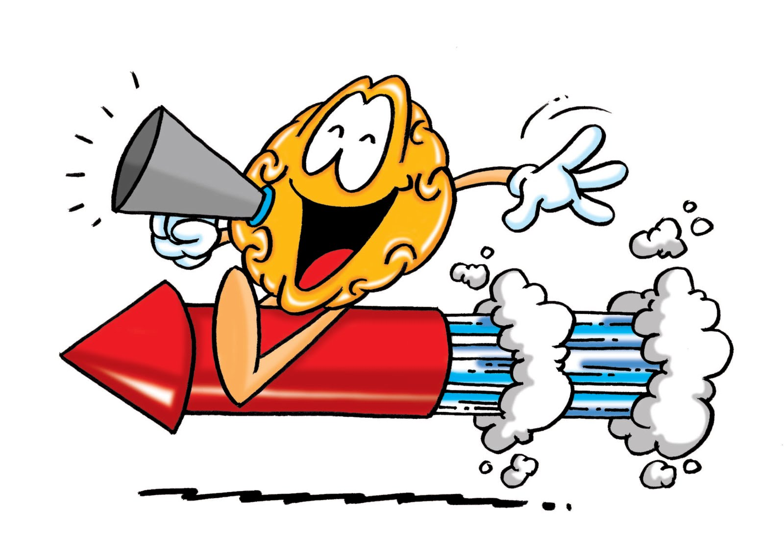
Alacrity
Alacrity means brisk and cheerful readiness
So imagine the girl/ guy you’ve been secretly loving for a while asked you to a dinner, how will you respond? Saying yes With alacrity, of course.
The first three weeks at his new job, Mark worked with such alacrity that upper management knew they would be giving him a promotion.
Frequently tested with: eagerness, willingness, readiness; promptness, haste, swiftness

Slide 14
Question:
The senator was skilled at defending his policies ___________ , answering his colleagues’ challenges with _______________.
A. assiduously . . petulance
B. extemporaneously . . alacrity
C. perfunctorily .. filibusters
D. succinctly . . grandiloquence
E. comprehensively . . platitudes

Slide 15
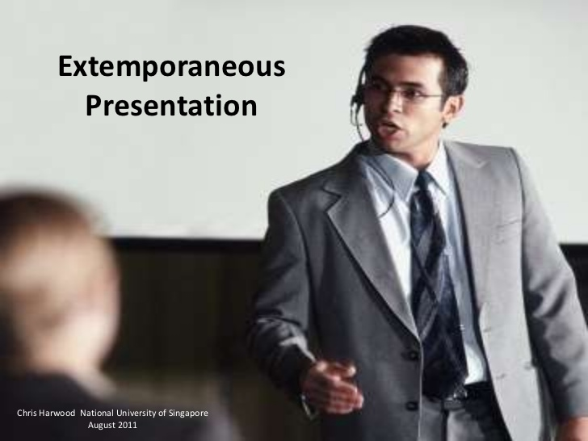
extemporaneous
spoken or done without preparation
an extemporaneous speech
V. extemporize
填空题例句：The legislator is known on Capitol Hill for his oratorical spontaneity, his ability to deliver an extemporaneous speech.
Frequently tested with: improvised

Slide 16
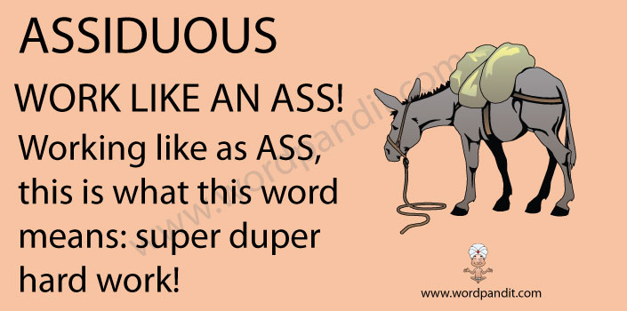
assiduous
Assiduous :showing great care and perseverance
Attentive + persevering+ hardworking
she was assiduous in pointing out every feature.

Slide 17



Words having similar meanings
assiduous
Hard-working
diligent
industrious
conscientious
sedulous

Slide 18
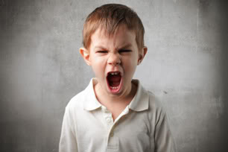

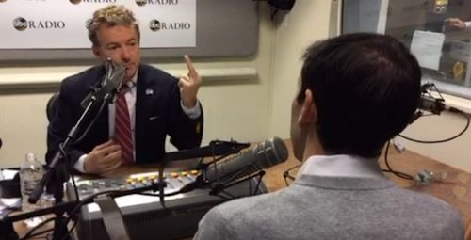
petulant
(of a person or their manner) childishly sulky or bad-tempered
he's as petulant as a spoiled child
Frequently tested with: peevish, pettish, fretful, irritable, sulky, choleric

Slide 19
The actor was noted for his _____ behavior: he quickly became irritated if his every whim was not immediately satisfied.
A. fastidious
B. vengeful
C. vindictive
D. petulant
E. mercenary F. choleric

Slide 20

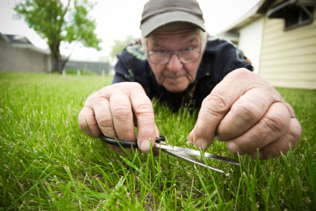
fastidious
scrupulous
nitpicking
careful attention to detail
hard to please
Punctilious
assiduous
fussy
meticulous

Slide 21
Fastidious has three correlated meanings: giving careful attention to detail; hard to please; excessively concerned with cleanliness
Punctilious: marked by precise accordance with details
Meticulous: showing great attention to detail; very careful and precise:
Scrupulous: describes a person or process. Which means diligent, thorough, and extremely attentive to details:
Assiduous :showing great care and perseverance: she was assiduous in pointing out every feature.
Nitpicking: looking for small or unimportant errors or faults, especially in order to criticize unnecessarily

Slide 22

prosaic
Prosaic means dull and lacking imagination.
It can be used to describe plans, life, language, or just about anything inanimate that has become dull (it is not used to describe people).
Unlike the talented artists in his workshop, Paul had no such bent for the visual medium, so when it was time for him to make a stained glass painting, he ended up with a prosaic mosaic.
Frequently tested with: dreary, pedestrian, insipid, mundane

Slide 23
回顾

Slide 24
Frequently tested GRE Words of 2015
alacrity
assiduous
petulant
extemporaneous
brisk
swift
prompt
perfunctory
industrious
sedulous

Slide 25
Frequently tested GRE Words of 2015
improvise
peevish
pettish
arcane
punctilious
predicament
sulky
choleric
fastidious
scrupulous

Slide 26
Frequently tested GRE Words of 2015
meticulous
nitpicking
fussy
fretful
perfunctory
irritable
prompt
perfunctory
industrious
sedulous

Slide 27
Frequently tested GRE Words of 2015
filibuster
succinct
grandiloquent
comprehensive
mosaic
platitude
vengeful
vindictive
mercenary
prosaic

Slide 28
Let’s conquer GRE vocabulary Once and For All!
在这里找到小伙伴，坚持! 共勉!

