Slide 1
GRE 单词训练营 #2
最好的方法 最高效的背 最地道的用
With Fiona

Slide 2

Keep up the good work!!!
When it comes to the GRE, There is no substitute for hard work

Slide 3
Frequently tested GRE Words of 2015
veracity
equanimity
dispute
condescending
buttress
repudiate
rectitude
insouciant
disdainful
recommence

Slide 4
Frequently tested GRE Words of 2015
veracious
longevity
integrity
collected
canny
nonchalant
voracious
decency
forswear
astute

Slide 5
Frequently tested GRE Words of 2015
abjure
nullify
paucity
enigmatic
elliptical
perspicacious
judicious
penitent
bellicose
gainsay

Slide 6
Frequently tested GRE Words of 2015
probity
impugn
dearth
contrite
sagacious
pugnacious
egregious
repentant
cryptic
belligerent

Slide 7
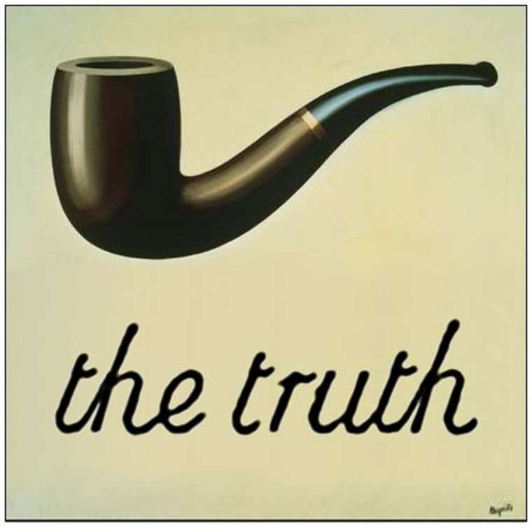
veracity
Veracity means truthfulness + accuracy
Veracious, the adjective form of veracity, sounds a lot like voracious. So be careful.
After years of political scandals, the congressman was hardly known for his veracity; yet despite this distrust, he was voted into yet another term.

Slide 8
1.3 As health care and nutrition continue to improve, Americans on average are enjoying increased ____, living to a more advanced age than ever before.
A. equanimity
B. proximity
C. veracity
D. longevity
E. integrity
F. seniority

Slide 9

equable
Equable means even-tempered +calm +stable
(of a person) not easily disturbed or angered; calm and even-tempered.
Weather: not varying or fluctuating greatly: an equable climate.
Frequently tested with: composed, collected. Imperturbable, placid
Nonchalant, insouciant,

Slide 10
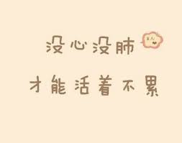
Nonchalant / insouciant
she acts nonchalant, but I think she's quite nervous
he possess an insouciant attitude about the disease

Slide 11
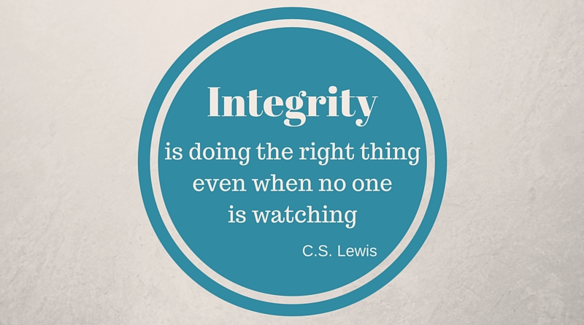
integrity
the quality of being honest and having strong moral principles + the state of being whole and undivided.
honesty +unity (wholeness)
A man of integrity
Territorial integrity
Frequently tested with: probity, rectitude, righteousness, morality, decency, scrupulousness

Slide 12
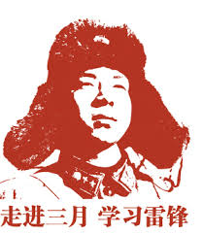
就是人好~！
Probity----Integrity : honesty, uprightness
Rectitude– righteousness: virtue, morality, honesty
Morality ---ethics, moral
Decency—propriety, courtesy
Scrupulous --- careful, honest

Slide 13
Once his integrity had been _____, the mayoral candidate was quick both to _____ these attacks and to issue counterattacks.
A. impugned | D. buttress
B. restored | E. recommence
C. enhanced | F. repudiate

Slide 14
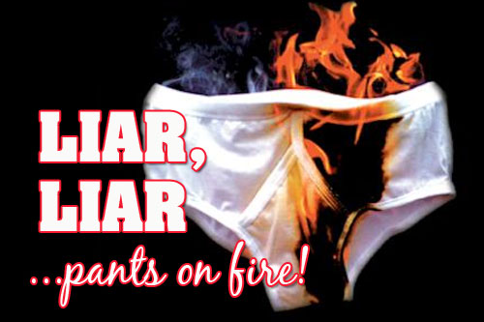
impugn
Call into question
dispute the truth, validity, capability, or honesty of
Frequently tested with: dispute
are you impugning my judgment?

Slide 15


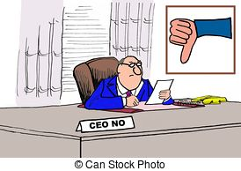
Repudiate: reject+ deny+ cancel
When repudiate means “reject”, it is frequently tested with: forswear, abjure, renounce.
When repudiate means “deny”, it is frequently tested with: rebut, dispute, gainsay, dismiss
When repudiate means “cancel”, it is frequently tested with: revoke, rescind, nullify

Slide 16
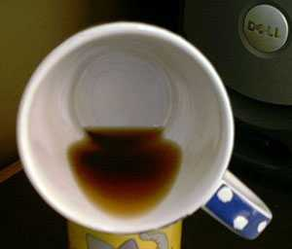
paucity
Paucity is a lack of something.
There is a paucity of jobs hiring today that require menial skills, since most jobs have either been automated or outsourced.
Frequently tested with: scarcity, dearth, sparseness.

Slide 17

maintain
The second definition of this word—and one the new GRE favors—is to assert.
One can maintain their innocence. A scientist can maintain that a recent finding supports her theory.
The latter context is the one you’ll encounter on the GRE.
The scientist maintained that the extinction of dinosaurs was most likely brought about by a drastic change in climate.

Slide 18
Top 10 GRE Words of 2015
contrite
egregious
pugnacious

Slide 19
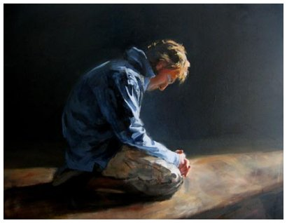
contrite
To be contrite is to be remorseful.
None: contrition
Though he stole his little sister’s licorice stick with malevolent glee, Chucky soon became contrite when his sister wouldn’t stop crying.
Frequently tested with: remorseful, repentant, penitent, rueful.

Slide 20
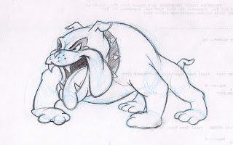
pugnacious
Much like a pug dog, which aggressively yaps at anything near it, a person who is pugnacious likes to aggressively argue about everything.
eager or quick to argue, quarrel, or fight
Frequently tested with: combative, belligerent, bellicose, quarrelsome, contentious, truculent, antagonistic

Slide 21
1.5 After winning the award, Phillip adopted a haughty pose, treating even his best friends in a _____ manner.
A. cryptic
B. arrogant
C. judicious
D. shrewd
E. supercilious
F. pugnacious

Slide 22

cryptic
having a meaning that is mysterious or obscure
Frequently tested with:
Enigmatic, arcane
Abstruse, elliptical

Slide 23
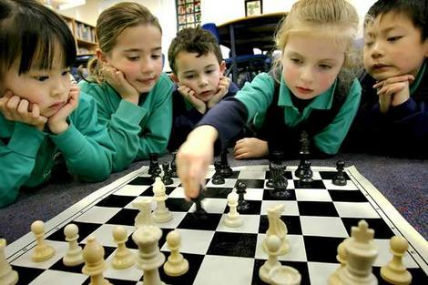
shrewd
sharp judgment+ wise
GRE 原题例句： Colonial American playwright Mercy Otis Warren was known for her political shrewdness: her keen judgment and insight were widely acknowledged.
Frequently tested with:
astute, acute, canny, perceptive, perspicacious, judicious
sagacious, sapient

Slide 24
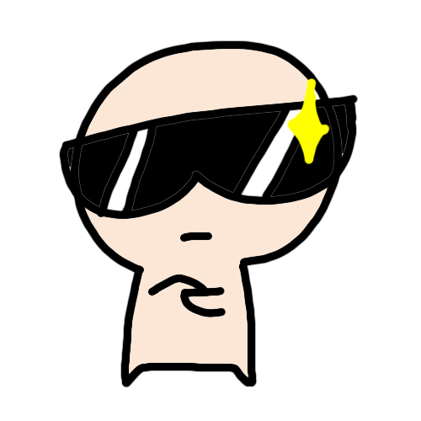
Supercilious
behaving or looking as though one thinks one is superior to others
Frequently tested with: arrogant, haughty
Conceited
Disdainful, contemptuous, disparaging, condescending

Slide 25
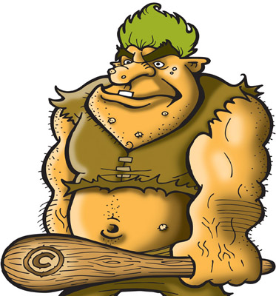
egregious
‘egregious’ meant standing out in a bad way.
The dictator’s abuse of human rights was so egregious that many world leaders asked that he be tried in an international court for genocide.
Frequently tested with: appalling, dreadful, hideous, horrendous, frightful, atrocious, abominable, abhorrent, grisly, heinous

Slide 26
回顾

Slide 27
Frequently tested GRE Words of 2015
veracity
equanimity
dispute
condescending
buttress
repudiate
rectitude
insouciant
disdainful
recommence

Slide 28
Frequently tested GRE Words of 2015
veracious
longevity
integrity
collected
canny
nonchalant
voracious
decency
forswear
astute

Slide 29
Frequently tested GRE Words of 2015
abjure
nullify
paucity
enigmatic
elliptical
perspicacious
judicious
penitent
bellicose
gainsay

Slide 30
Frequently tested GRE Words of 2015
probity
impugn
dearth
contrite
sagacious
pugnacious
egregious
repentant
cryptic
belligerent

Slide 31
Let’s conquer GRE vocabulary Once and For All!
在这里找到小伙伴，坚持! 共勉!

