Slide 1
GRE 单词训练营 #5
最好的方法 最高效的背 最地道的用
With Fiona

Slide 2
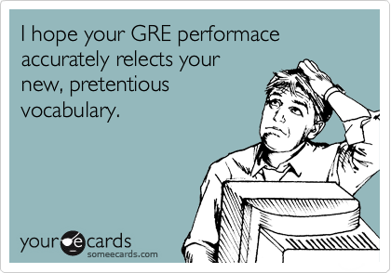
NORMAL PERSON : You can’t try to teach an old dog new tricks
GRE STUDENT : It is fruitless to attempt to indoctrinate a elderly canine with innovative maneuvers..
NORMAL PERSON : Twinkle, twinkle, little star
GRE STUDENT : Scintillate, scintillate, asteroid.
NORMAL PERSON : Beginner’s luck
GRE STUDENT : Neophyte’s serendipity.

Slide 3
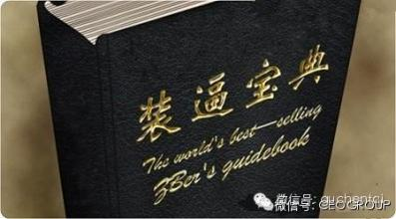
pretentious
attempting to impress by affecting greater importance, talent, culture, etc., than is actually possessed
Frequently tested with: affected, ostentatious(books that people buy and display ostentatiously but never actually finish.)

Slide 4
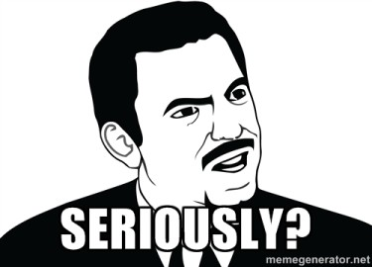
incredulous
(of a person or their manner) unwilling or unable to believe something
we were incredulous when the congressman was not more forthcoming in his first broadcast interview about the case
Frequently tested with: skeptical, suspicious, dubious
Cynical(most residents are cynical about efforts to clean mobsters out of their city.)

Slide 5
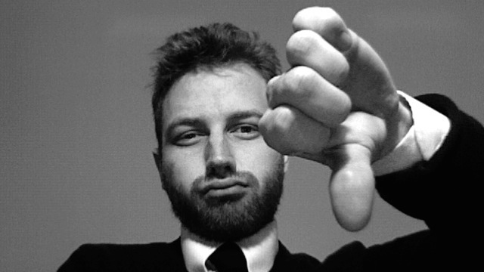
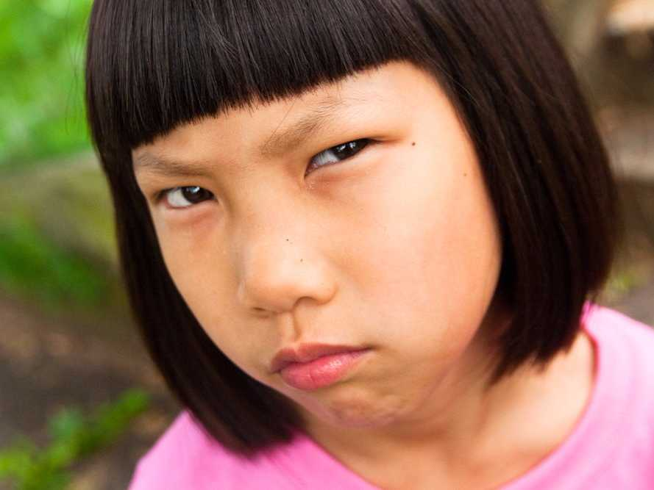
cynical
1： believing that people are motivated by self-interest; distrustful of human sincerity or integrity (人性本恶啊。。。）
2： doubtful as to whether something will happen or whether it is worthwhile （怀疑人家）
concerned only with one‘s own interests （就知道考虑自己的利益）
Contemptuous （还瞧不起人家）he gave a cynical laugh.

Slide 6
Darren`s sensitivity to his celebrity clients is nothing short of ______: he is able to ______ their needs before they themselves are fully aware of them.
A. superfluous | D. forestall
B. interminable | E. anticipate
C. preternatural | F. minimize
Nothing short of : almost (or equal to); little (or nothing) less than.

Slide 7
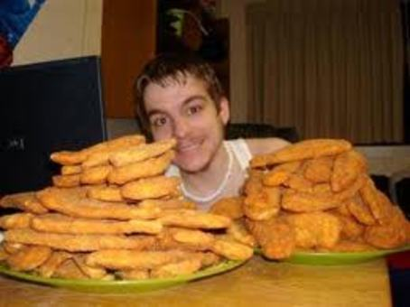
superfluous
unnecessary, especially through being more than enough
Frequently tested with : surplus, redundant,

Slide 8
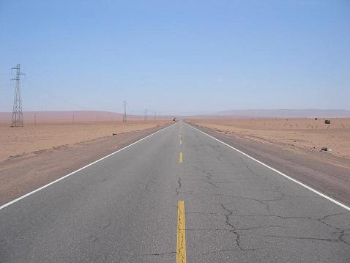
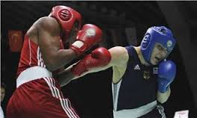
Interminable+ unrelenting
endless (often used hyperbolically)
we got bogged down in interminable discussions.
Frequently tested with : everlasting, ceaseless, unceasing, incessant, sustained
Unrelenting not yielding in strength, severity, or determination(程度不减弱） + not giving way to kindness or compassion（ 求我也没用）

Slide 9
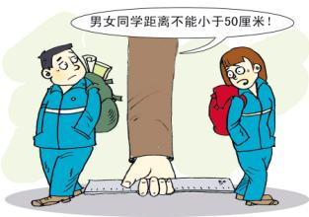
forestall
prevent or obstruct (an anticipated event or action) by taking action ahead of time
也就是nip in the bud
they were unable to forestall Roosevelt's reelection:
Frequently tested with :preempt
联系到阻挠的意思：thwart, check, impede, hinder

Slide 10

anticipate
expect or predict+ act as a forerunner or precursor of
these early sketches anticipate her later work
I didn't anticipate him doing that
Frequently tested with : foresee, forecast, envision
Envisage
Prophecy (n.) prophesy (v.) prophet (n.)

Slide 11
To keep their negotiations ______, the leaders of rival groups in the country arranged meetings that were ______.
A. relaxed | D. clandestine
B. secret | E. illicit
C. productive | F. prestigious

Slide 12
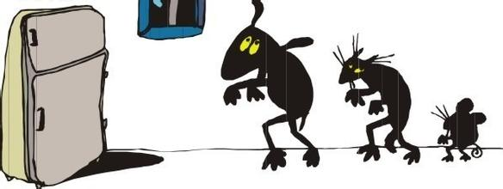
clandestine
kept secret or done secretively, especially because illicit
Illicit (forbidden by law, rules, or custom)
Frequently tested with:
Covert, furtive, surreptitious, stealthy

Slide 13
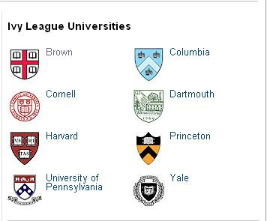
prestigious
inspiring respect and admiration; having high status
Frequently tested with: reputable, distinguished, esteemed, eminent, prominent,
acclaimed, celebrated, illustrious, renown

Slide 14
While most pets are relatively _____ in a veterinarian`s office, occasionally vets have to treat more aggressive animal patients.
A. fastidious
B. tractable
C. surreptitious
D. docile
E. clandestine
F. minuscule

Slide 15
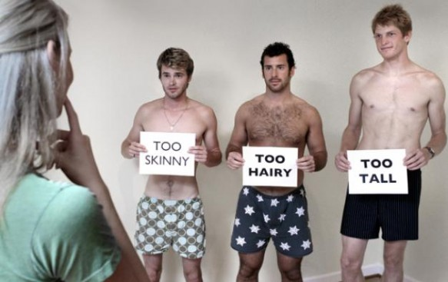
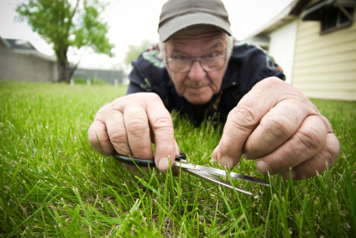
Review: fastidious
scrupulous
nitpicking
careful attention to detail
hard to please
Punctilious
assiduous
fussy
meticulous

Slide 16
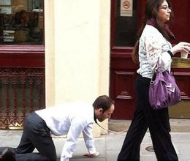
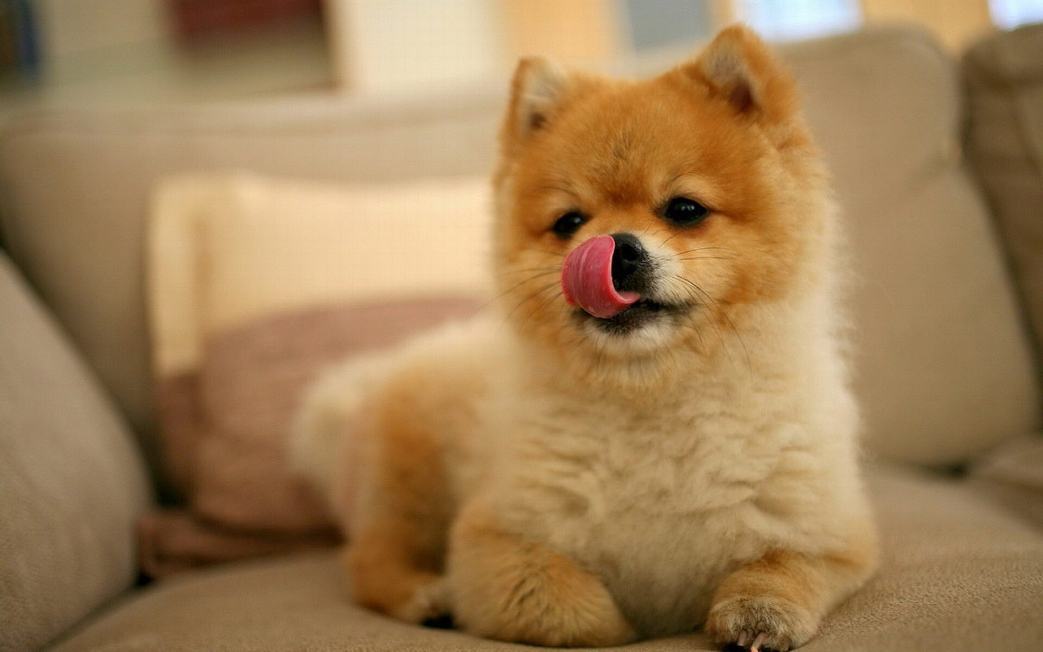
tractable
(of a person or animal) easy to control or influence:
our preschool teachers disagree with the statement that children are becoming less tractable every year
(of a situation or problem) easy to deal with
Tractable problem
Frequently tested with: amenable, complaisant, docile
obedient, submissive
Malleable, pliable,

Slide 17



Slide 18
Frequently tested GRE Words of 2015
dubious
cynical
blatant
tranquil
clamor
tumultuous
partisan
dabbling
plebeian
callow

Slide 19
Frequently tested GRE Words of 2015
tractable
fastidious
docile
acclaimed
clandestine
eminent
foresee
prosaic
surreptitious
illicit

Slide 20
Frequently tested GRE Words of 2015
pretentious
indoctrinate
interminable
hinder
preternatural
unrelenting
forestall
surplus
neophyte
thwart

