Slide 1
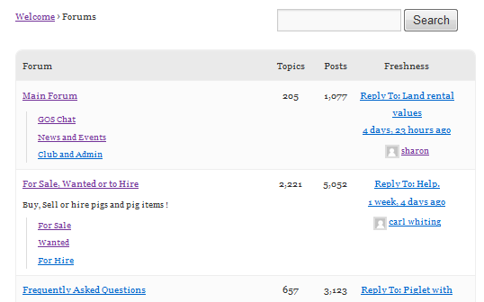
1
5
4
14
3
3
3
2
3
3
5
6
9
12
13
1
7
10
8
1
11
2

Slide 2
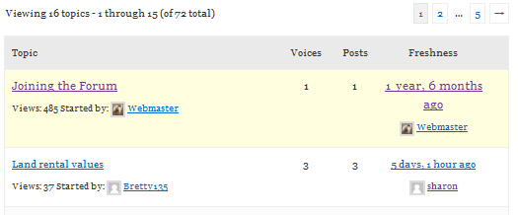


2
2
2
2
12
10
11
1
13
13
13
13
15
3
4
9
2
2
525620000
8
14
17
7
18
19
5
6
7
16
6

Slide 3
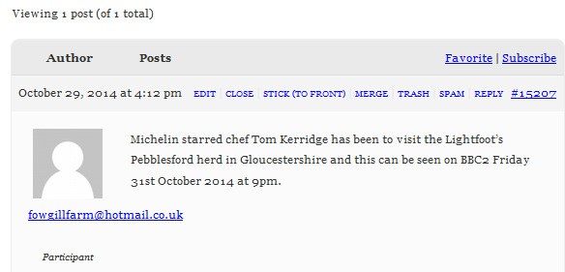

This box is styled in Topics Index 10, 11 & 12
10
10
5
2
11
17
18
8
19
16
6
15
1
7
3
9
12
4
13
14
21
22
20

Slide 4


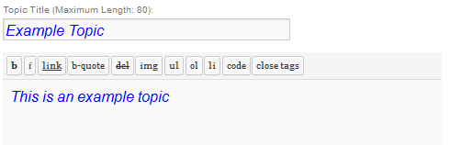
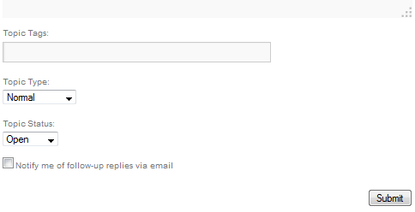
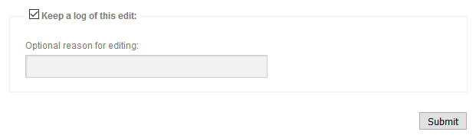
10
12
1
3
2
4
2
9
3
2
1
3
11
2
1
1
6
1
7
8
5

Slide 5
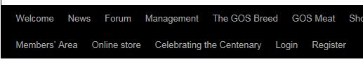


Slide 6
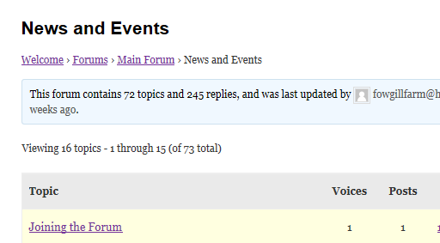
Home
Root
Current
Breadcrumbs

Slide 7
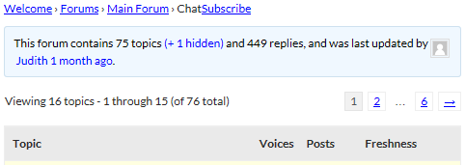
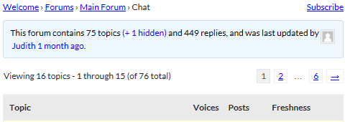

Slide 8
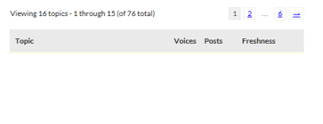

Slide 9

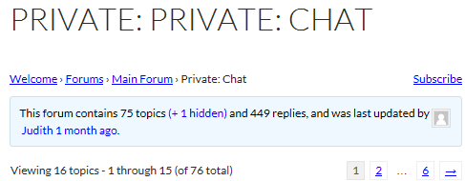
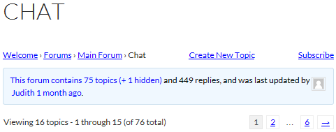

Slide 10
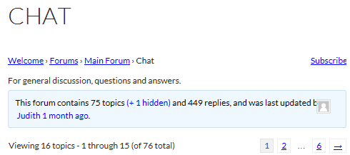
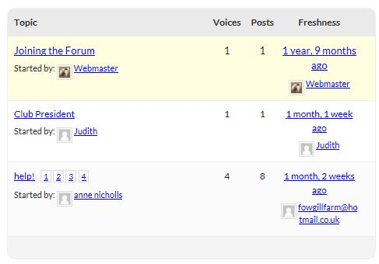

Slide 11
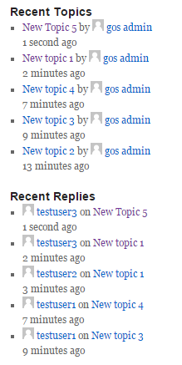
Original topic author always shown
Repeated topics for multiple replies

Slide 12
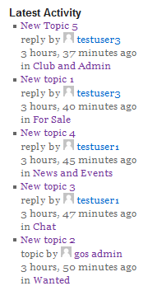

Slide 14
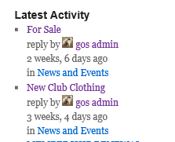
1
2
3
4
5
3
6
7
8

Slide 15
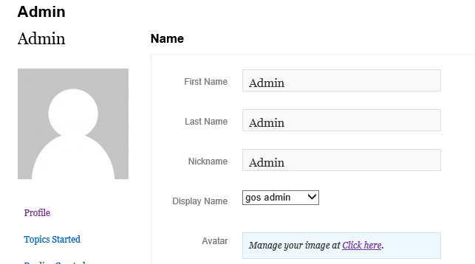
1
2
4
3
The url this links to

Slide 16
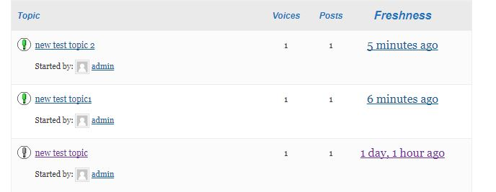
1
2

Slide 17
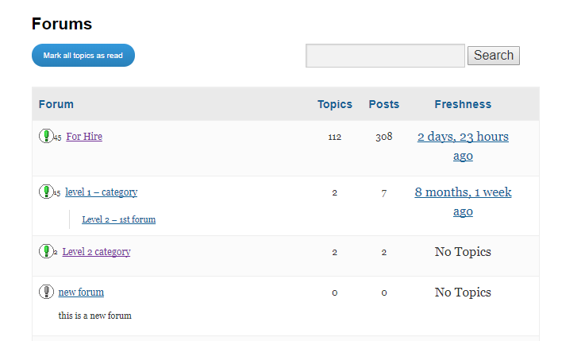
4
3
1
2

Slide 18
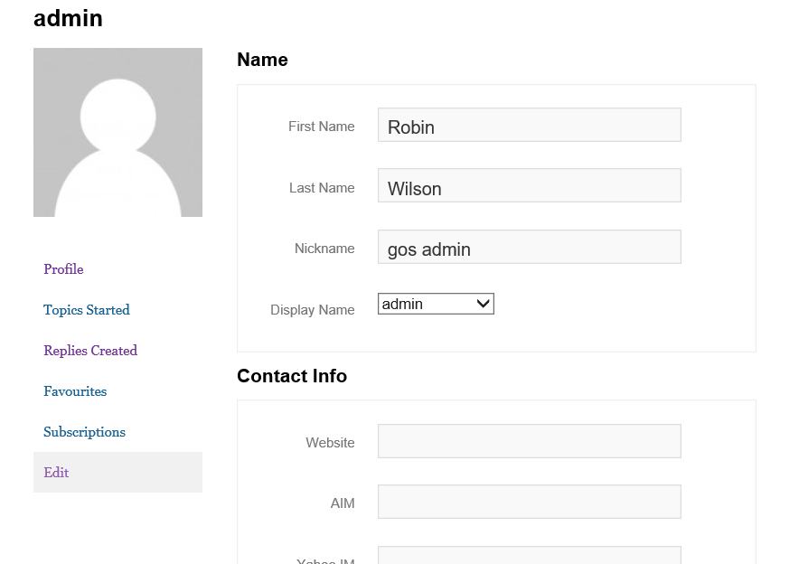
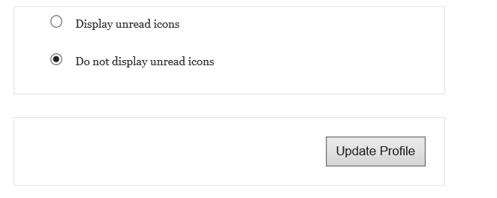
5

Slide 19
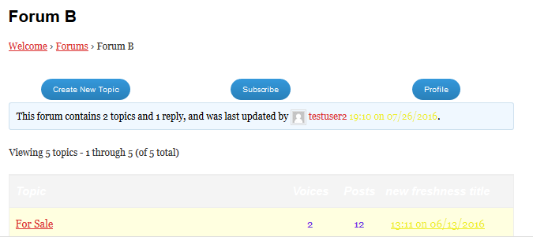

Slide 20
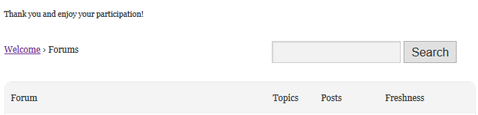
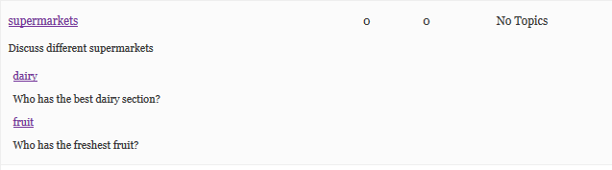

Slide 21
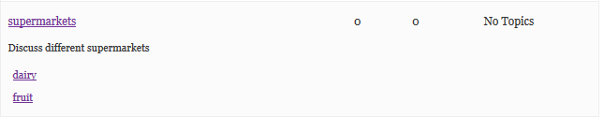

Slide 22


1
2
4
5
3
6
7

Slide 23
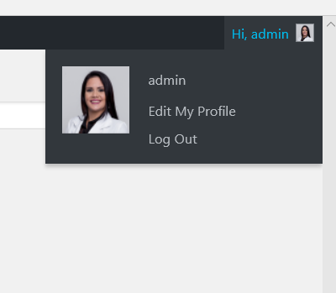
6

Slide 24
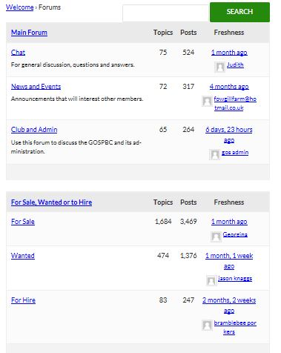
Category
Forums with
above category as parent

Slide 25
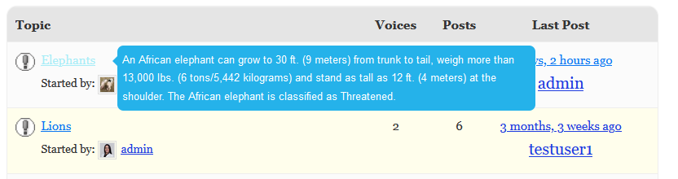
Cursor hover on title
Topic content appears

Slide 26
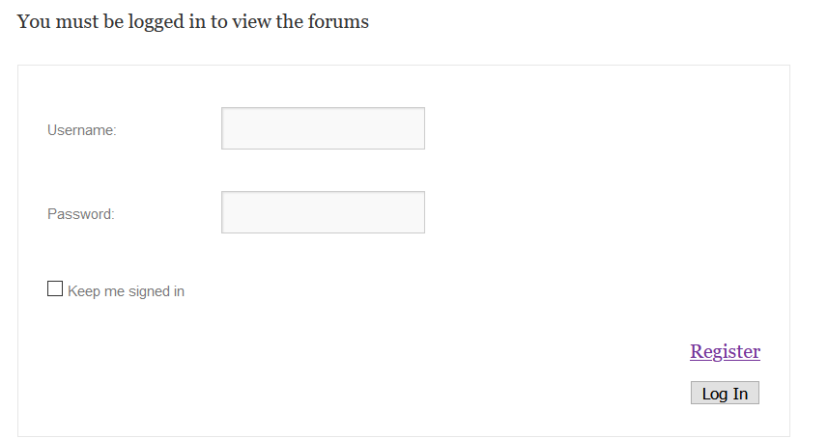
Message
Not Logged in
Logged in

