Slide 1
CHAPTER 2
Database security and administration
Section 2

Slide 2
Countermeasure
Authentication
Authorization
Encryption
Creating views
Backup and recovery
RAID technology
Auditing

Slide 3
Encryption
Encryption is the process of encoding a message or information in such a way that only authorized parties can access it and those who are not authorized cannot.
Encryption does not itself prevent interference but denies the intelligible content to an interceptor.
Important components
Encryption key
Encryption algorithm
Encryption algorithm
Decryption key

Slide 4
Advantage and disadvantage of encryption
Sensitive data needs to encode it as a precaution against possible external threats or attempts to access.
Sensitive data stored in disk.
Sensitive data transmitted via network.
This is a degradation in performance due to the time taken to decode it.

Slide 5
Techniques to hind data
Reversible technique - user data is encrypted and stored to prevents clear text from being accessed by any users including the system administrators.
MD5
SHA-2
Irreversible - data are encrypted while stored in the database or transmitted, and decrypted when returned to an authorized client.
AES
lpJu5iIMQuuldV9QS2G9FA==
Kittipong
Kittipong
abcdef1234567890
abcdef1234567890
Decryption
Reversible technique
Encryption
(irreversible)
Kittipong
3b3ec2bbc47e3d04e494e4fb2b1422fc
lpJu5iIMQuuldV9QS2G9FA==

Slide 6
Solutions to handle the password in database
Create function in database to encrypt the password.
Use encryption features come with DBMS.
Encrypt the password at the application level.
Use the external component for authentication process.

Slide 7
Create function in database to encrypt the password
CREATE OR REPLACE
FUNCTION hash_key (v_input VARCHAR2)
RETURN dbms_obfuscation_toolkit.varchar2_checksum
AS
BEGIN
RETURN dbms_obfuscation_toolkit.md5(input_string => v_input);
END hash_key;
INSERT INTO table_name ( pass_col ) VALUES ( hash_key('password') );

Slide 8
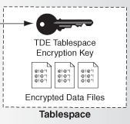
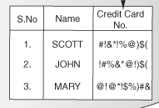
Use encryption features come with DBMS
Some DBMS provide an encryption facility.
Encryption used in Oracle
Column encryption
Tablespace encryption

Slide 9
View
View is a logical table based on one or more tables or views.
A view contains no data itself.
A view is nothing more than a SQL statement that is stored in the database with an associated name.
A view is the result set of a stored query on the data, which the database users can query.

Slide 10
Advantages of view
Provides a powerful and flexible security mechanism by hiding parts of the database from certain users
Permits users to access data in a customized way, so that same data can be seen by different users in different ways, at same time.
Can simplify complex operations on base relations

Slide 11
SQL commands : creating view
CREATE VIEW view_name AS
SELECT columns
FROM tables
[WHERE conditions];
CREATE VIEW sup_orders AS
SELECT suppliers.supplier_id, orders.quantity, orders.price
FROM suppliers INNER JOIN orders
ON suppliers.supplier_id = orders.supplier_id
WHERE suppliers.supplier_name = 'Microsoft’;

Slide 12
SQL commands
SELECT * FROM sup_orders;
DROP VIEW view_name;
REPLACE VIEW view_name AS

Slide 13
Example
Create staff_view that can see only name, surname and e-mail of all employees in the company. create view staff_view as
select first_name, last_name, email
from employees;
select * from staff_view;

Slide 14
Example
Create view that show only the employees whose job_id is IT_PROG.
Create view that show only name, surname, e-mail and department’s name of all employees who work in the accounting department.

Slide 15
Backup and recovery
Backup and recovery refers to the process of backing up data in case of a loss and setting up systems that allow that data recovery due to data loss.
Backing up data requires copying and archiving computer data, so that it is accessible in case of data deletion or corruption.
Data backup cannot always restore all of a system's data and settings.
Data backup is a form of disaster recovery and should be part of any disaster recovery plan.

Slide 16
Backup and recovery in database
The most crucial structure for recovery operations is the redo log, which stores all changes made to the database as they occur.
Having a redo log makes it possible to replay SQL statements.
Before changing data in a datafile, database writes changes to the redo log.
If something happens to one of the datafiles, a recovery procedure can restore a backed-up datafile and then replay the redo lof

Slide 17
RAID technology
RAID (Redundant Array of Inexpensive (Independent) Disks) combines multiple physical disk into one or more logical units
system fault tolerance
data redundancy
performance improvement
Data is distributed across the drives in one of several ways, referred to as RAID levels, depending on the required level of redundancy and performance.
Each RAID level provides a different balance among the key goals
Reliability
Availability
Performance
Capacity.

Slide 18
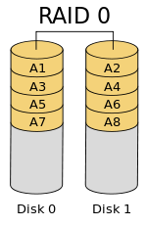
RAID 0
It consists of striping, but no mirroring or parity.
The capacity of a RAID 0 is the sum of the capacities of all disks in the set.
The failure of any disk causes all files, the entire RAID0 volume, to be lost.
The average failure rate is worse than that of an equivalent single non-RAID drive.
The benefit of RAID 0 is that read and write are done concurrently.

Slide 19

RAID 1
It consists of data mirroring, without parity or striping.
Data is written identically to two drives, thereby producing a "mirrored set" of drives.
Reading request can be serviced by any drive in the set.
Actual read throughput of most RAID 1 implementations is slower than the fastest drive.
Write throughput is always slower because every drive must be updated, and the slowest drive limits the write performance.
The array continues to operate as long as at least one drive is functioning.

Slide 20
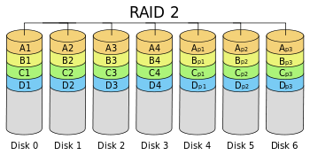
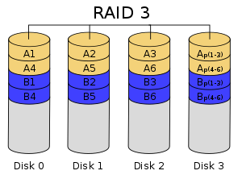
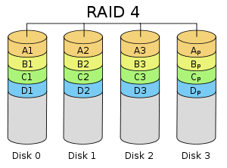
RAID 2 - 3 - 4
RAID 2 consists of bit-level striping with dedicated parity.
RAID 3 consists of byte-level striping with dedicated parity.
RAID 4 consists of block-level striping with dedicated parity.

Slide 21
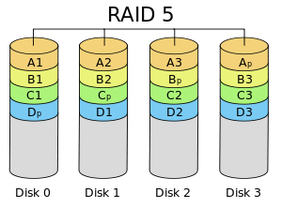
RAID 5
It consists of block-level striping with distributed parity.
It requires at least three disks.
Upon failure of a single drive, subsequent reads can be calculated from the distributed parity such that no data is lost.
Rebuilding an array requires reading all data from all disks, opening a chance for a second drive failure and the loss of the entire array.

Slide 22
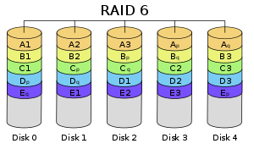
RAID 6
It consists of block-level striping with double distributed parity.
It requires a minimum of four disks.
Double parity provides fault tolerance up to two failed drives.
A single drive failure results in reduced performance of the entire array until the failed drive has been replaced.

Slide 23
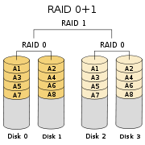
RAID 0+1
It creates two stripes and mirrors them.
If a single drive fail, it is running as RAID0 with no redundancy.

Slide 24
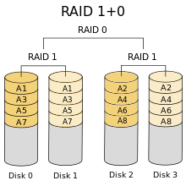
RAID 1+0 (RAID 10)
It creates a striped set from a series of mirrored drives.
The array can sustain multiple drive losses so long as no mirror loses all its drives.

Slide 25
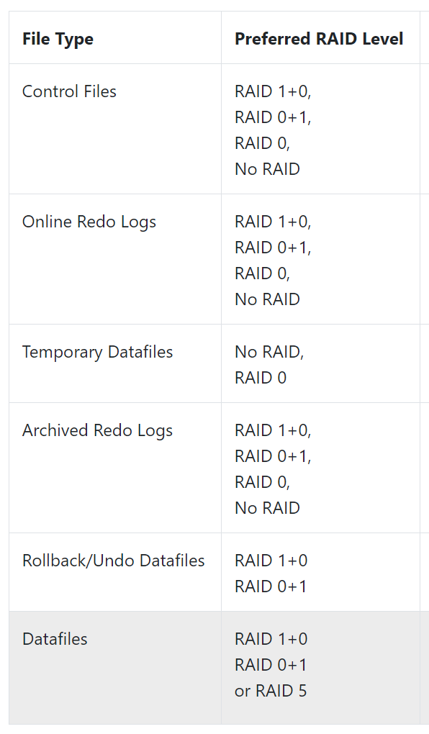
Oracle RAID recomendations
https://oracle-base.com/articles/misc/oracle-and-raid

Slide 26
IT auditing
IT audit is an examination of the management controls within an Information technology (IT) infrastructure.
An IT audit encompasses review and evaluation of information processing systems.
Planning the IT audit involves two major steps.
To gather information and do some planning
To gain an understanding of the existing internal control structure.

Slide 27
Risk-based audit
More organizations are moving to a risk-based audit approach which make the decision as to whether to perform compliance testing or substantive testing.
In a risk-based approach, IT auditors are relying on
Internal and operational controls
The knowledge of the company or the business.
The cost-benefit analysis of the control to the known risk.

Slide 28
IT auditors
Gathering Information step the IT auditor needs to identify five items:
Knowledge of business and industry
Prior year’s audit results
Recent financial information
Regulatory statutes
Inherent risk assessments

Slide 29
Database auditing
Database auditing involves observing a database so as to be aware of the actions of database users.
Auditing is the monitoring and recording of selected user database actions.
It can be based on individual actions.
Database administrators and consultants often set up auditing for security purposes.
for example; to ensure that those without the permission to access information do not access it.

Slide 30
Database auditing
Database auditing helps to answer questions like
“Who accessed or changed data?”
“When was it actually changed?”
“What was the old content prior to the change?”
It may be necessary to review certain audit data in greater detail to determine how, when and who changed the data.

Slide 31
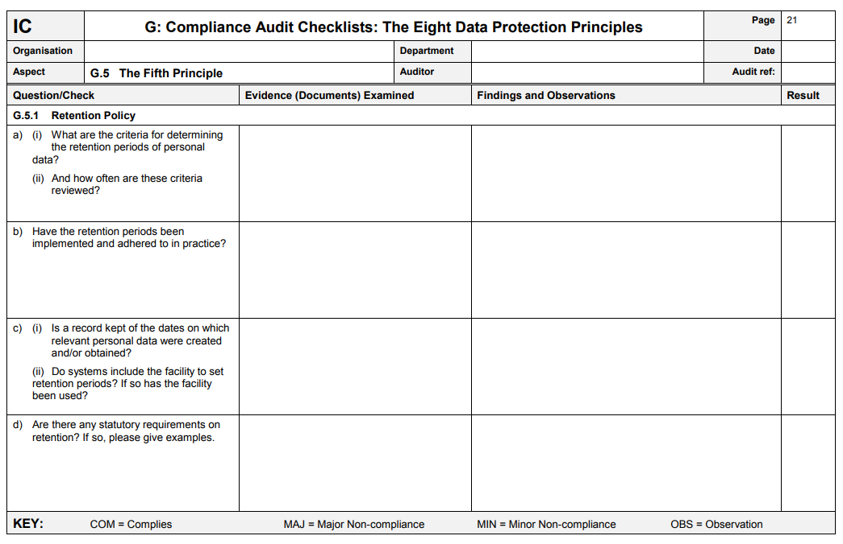
Example of auditing checklist

Slide 32
Countermeasure
Authentication
Authorization
Encryption
Creating views
Backup and recovery
RAID technology
Auditing

Slide 33
Approaches for system access control
Discretionary Access Control (DAC) - admins provides access by identity of the user and not by permission level. Each resource in DAC has a list of users who can access it.
Mandatory Access Control (MAC) - admins creates a set of levels and each user is linked with a specific access level. User can access all the resources that are not greater than his access level.

Slide 34
Role-based access control
Role-based access control (RBAC) is a policy-neutral access-control mechanism defined around roles and privileges.
Data is protected in exactly the way it sounds like it is, by user roles.
Users are sorted into groups or categories based on their job functions or departments, and those categories determine the data that they’re able to access.
Example: Human Resources team members, for example, may be permitted to access employee information while no other role-based group is permitted to do so.

Slide 35
SQL commands
Create role role_name;
Grant select on table_name to role_name;
Grant role_name to user_name;
Revoke role_name from user_name;

