Slide 1
Presentation
Ooh, fancy!
Its purpose is for integration tests; To verify that this text is correctly extracted.
Notes:
I forgot what to said in this slide; but that’s fine

Slide 2
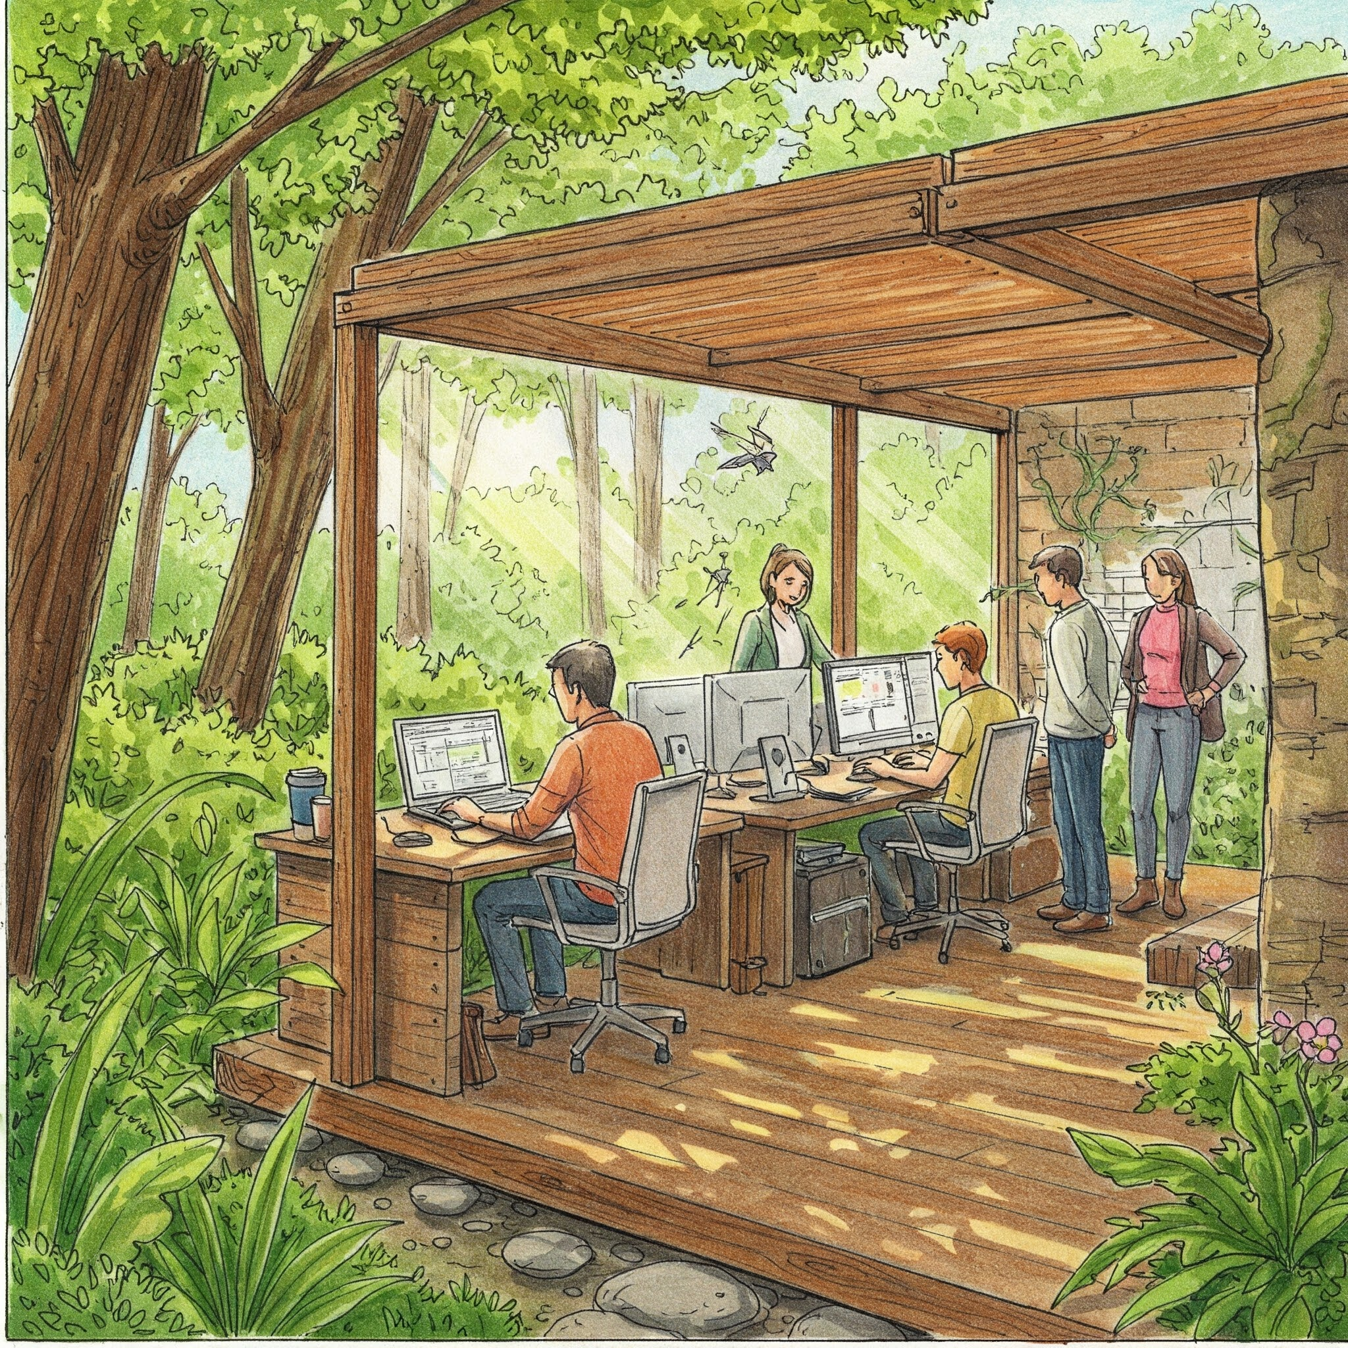
This is a fancy image
Good desks nice 😀

Slide 3
Hello
Sales are important
You start here
I’m an important table | Very important numbers
Boredom level | 0%
Done!
Know your customer
$$$
Then you do that

Slide 4
Hierarchy of the business
Boss
Not boss
Not boss too
Muscle 1
Muscle 2
The brain
He’s here

Slide 5
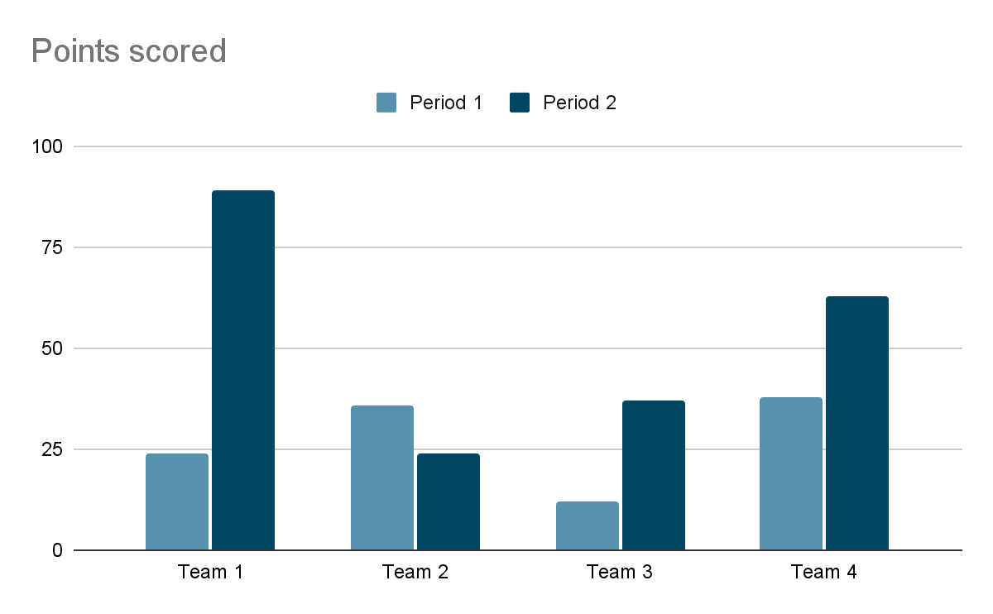
More graphs (you like them right?)

