Slide 1

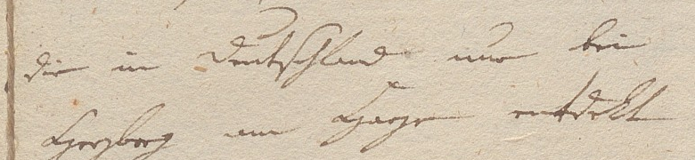
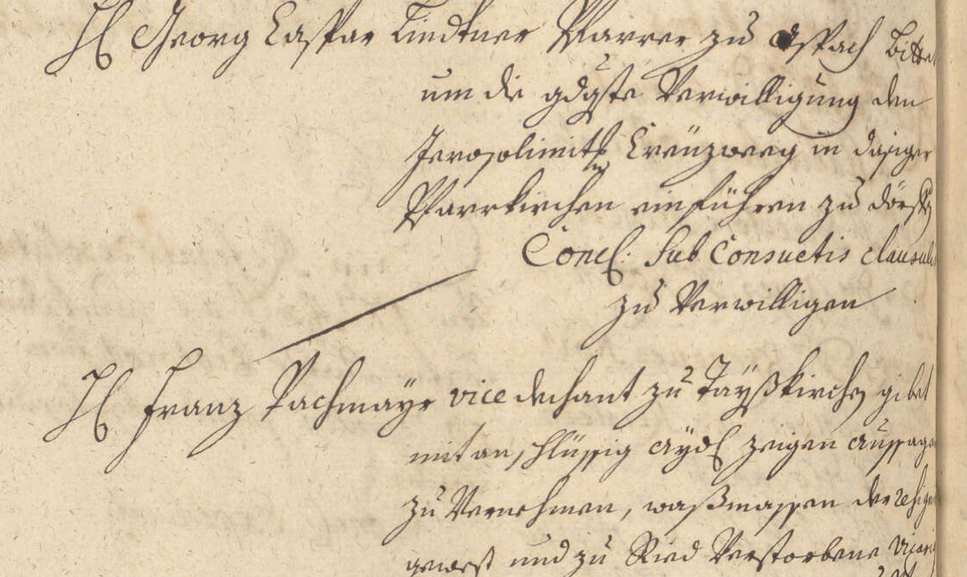
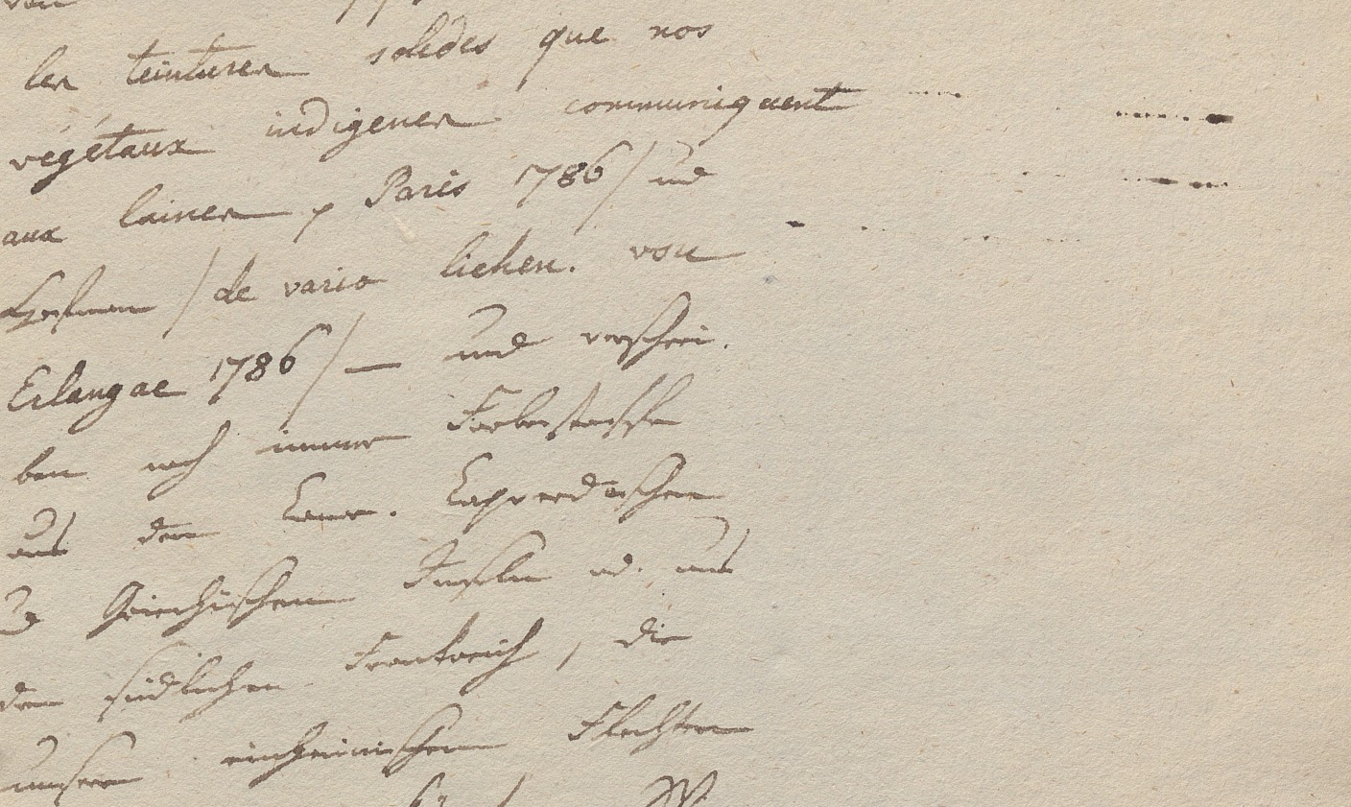
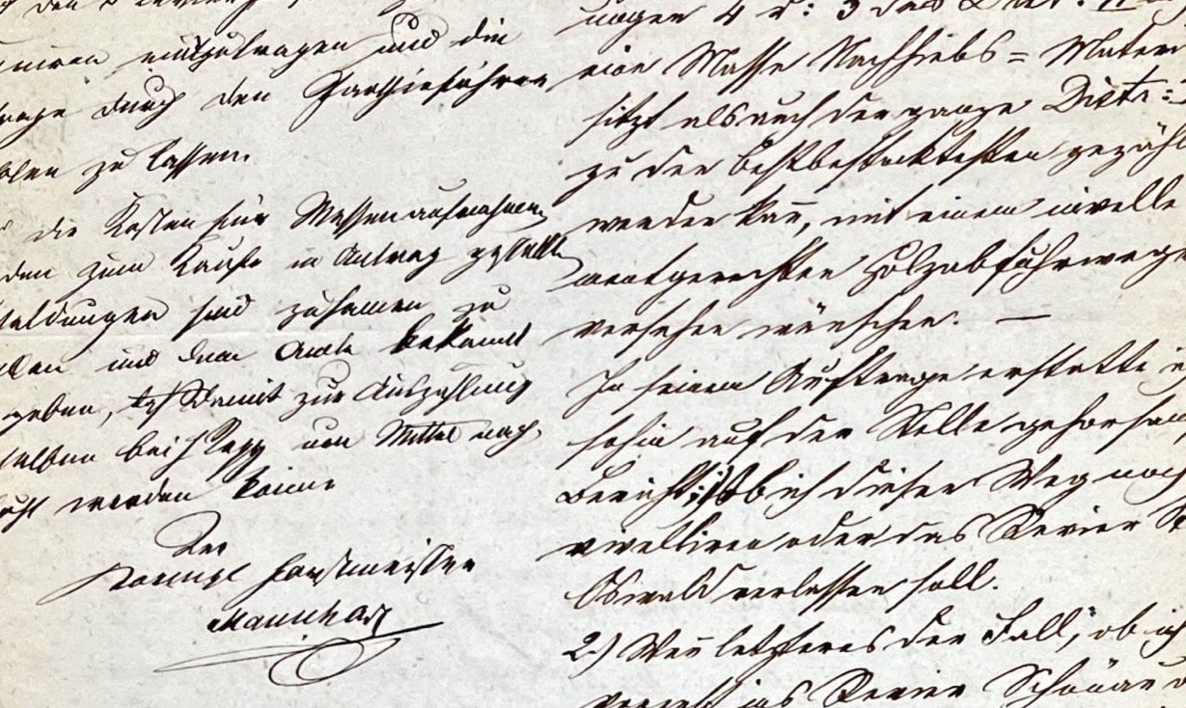
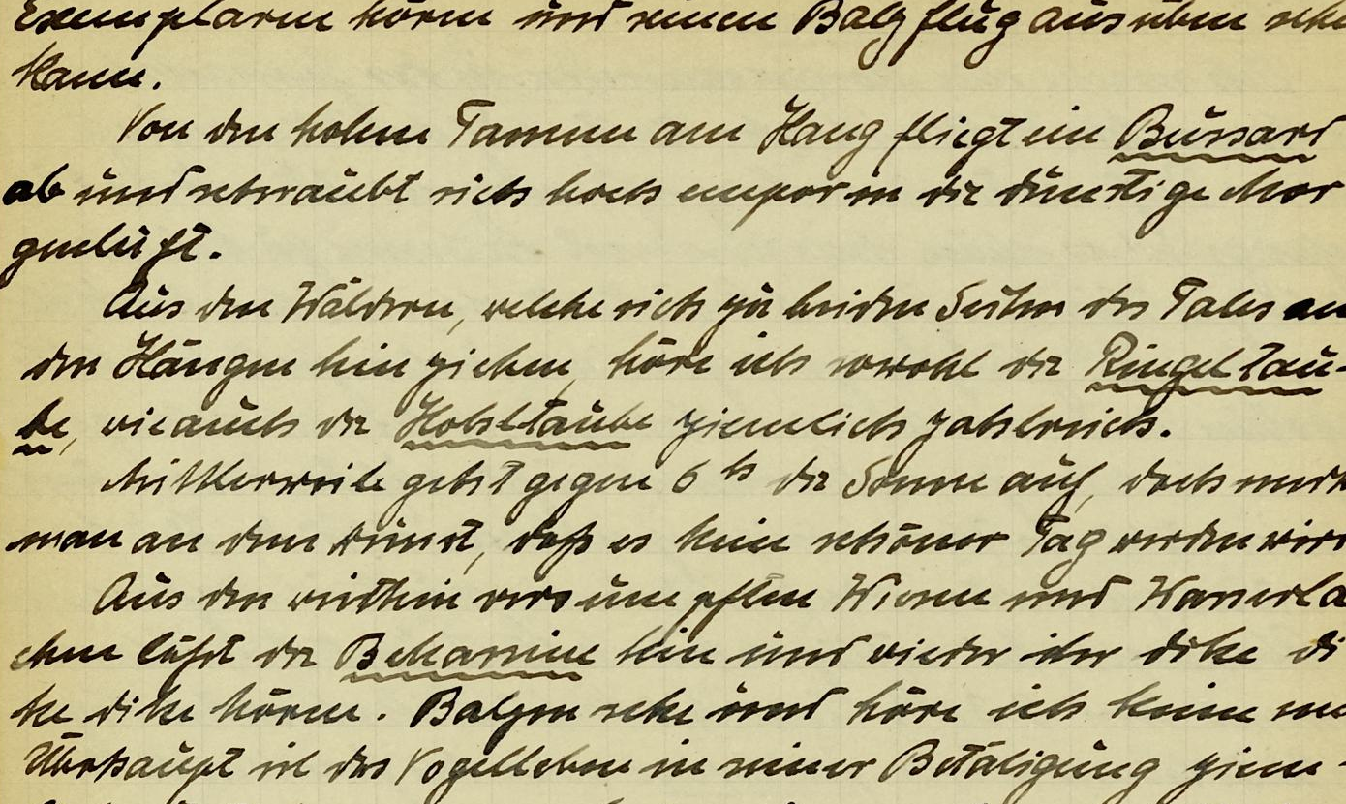
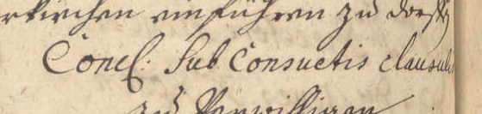
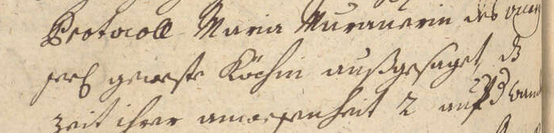
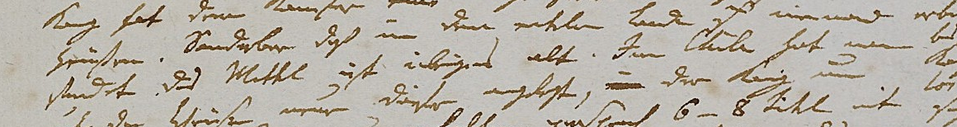
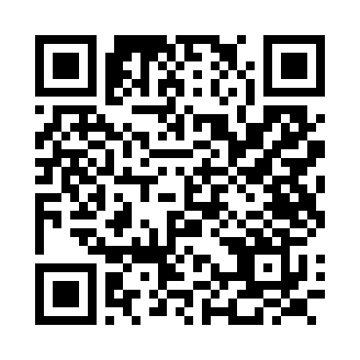
TRANSKRIBUS USER CONFERENCE 2026 · PASSAU, 21–23 SEPTEMBER
Towards a Living Benchmark for Historical HTR
Tobias Perschl, Malte Rehbein
Chair of Computational Humanities, University of Passau
One error rate hides three different mistakes.
Which system, for which need?
One score 0–1 per dimension; orange = best
Gemini
3.5 Flash
Transkribus
German Genius
Transkribus
Text Titan II
Claude
Sonnet 5
TrOCR
Kurrent XVI–XVII
Kraken
19th-c. Kurrent
olmOCR-2
7B
PaddleOCR-VL
1.6
D5
D1
D2
Alexander von Humboldt, England journal 1790, fol. 8r; edition humboldt digital
D4
D3
Ground Truth die in Deutschland nur bei Harzburg am Harze entdekt
Gemini 3.5 Flash die in Deutschland nur bei Harzburg am Wege entdeckt
Transkribus Text Titan II die in Deutschland im bei Herzberg am Hage entdekt.
D1
Character accuracy
How much of the page came back right?
0.82
0.82
0.78
0.66
0.67
0.55
0.40
0.34
Wege a different word in place of “Harze”
Word accuracy
How many of the page's words came back right?
Herzberg a real, but wrong town 60 km away
D2
0.62
0.58
0.51
0.39
0.21
0.12
0.16
0.06
entdeckt modernised spelling
These errors differ in gravity. Orthographic variation does not influence understanding and meaning.
A plausible, yet wrong entity transcription is more drastic.
D3
Diplomatic fidelity
Is the text kept as written – letter forms, punctuation, capitals?
0.69
0.56
0.51
0.57
0.47
0.52
0.43
0.43
We need a benchmark for historical document HTR that goes beyond CER.
D4
Content integrity
Do the mistakes change the meaning – would a reader be misled?
0.79
0.77
0.69
0.57
0.59
0.50
0.50
0.58
How this benchmark works
1
Pages
2
Runs
3
Scores
D5
Efficiency
What does a page cost – in time, hardware and money?
0.56
0.31
0.28
0.39
0.79
0.97
0.59
0.67
86 pages from four archives, 1710–1965 with validated Ground Truth.
20 HTR systems read the page image – page readers as they are, line engines through one shared Kraken layout, one prompt for every VLM.
Five dimensions, 0–1, from the same outputs: whole-page character and word accuracy, three text fidelity facets, an LLM Judge for content integrity, speed, hardware and price for efficiency.
The material: 4 corpora of German handwriting, 1710–1965 86 pages ; 2,633 reference lines
Ratsprotokolle 1710–1803
Kurrent + Antiqua; council minutes; diplomatic transcription
34 pages; 870 lines
Humboldt journals 1790–1805
Kurrent / Latin; travel journal; scholarly edition EHD
20 pages; 602 lines
Forest operates 1857–1895
Kurrent; forestry reports and tables; corrected machine output
22 pages; 823 lines
Laubmann journals 1917–1965
Sütterlin era; field journals; corrected machine output
10 pages; 338 lines
D1
Character accuracy
D2
Word accuracy
How much of the page came back right?
How many of the page's words came back right?
0
.5
1
0
.5
1
▲ Transkribus German Genius 0.82 ▼ PaddleOCR-VL 1.6 0.34
▲ Gemini 3.5 Flash 0.62 ▼ PaddleOCR-VL 1.6 0.06
Transkribus German Genius gets 82.0 % of the page's characters right, PaddleOCR-VL 1.6 33.8 %.
Gemini 3.5 Flash gets 62.5 % of the page's words right, PaddleOCR-VL 1.6 6.5 %. One wrong character costs the whole word.
reference Concʆ: Sub Consuetis clausu[-]
Gemini 3.5 Flash Concl: Sub Consuetis clausulis CER 14 %
TrOCR Kurrent XVI–XVII Concl . sub consuetis clausulis CER 29 %
Transkribus Text Titan II Concl. Sub Consuetis clausus CER 11 %
reference Concʆ: Sub Consuetis clausu[-]
Gemini 3.5 Flash Concl: Sub Consuetis clausulis WER 50 %
TrOCR Kurrent XVI–XVII Concl . sub consuetis clausulis WER 100 %
Transkribus Text Titan II Concl. Sub Consuetis clausus WER 50 %
Measured 1 − CER over the whole page text.
Measured 1 − WER over the whole page text.
D3
Diplomatic fidelity
D4
Content integrity
D5
Efficiency
Is the text kept as written – letter forms, punctuation, capitals?
Do the mistakes change the meaning – would a reader be misled?
What does a page cost – in time, hardware and money?
Kraken 19th-c. Kurrent
speed
hardware
price
D5
TrOCR Kurrent XVI–XVII
1.3 s
laptop CPU
< 0.1 ¢
0.97
PaddleOCR-VL 1.6
4.2 s
GPU 8 GB
< 0.1 ¢
0.79
olmOCR-2 7B
12.7 s
GPU 8 GB
< 0.1 ¢
0.67
Gemini 3.5 Flash
13.3 s
GPU 24 GB
< 0.1 ¢
0.59
reference findet. Das Mittel ist übrigens alt. In Chile hat man
Gemini 3.5 Flash Stadt d. Viertel iſt übrigens alt. Im Thale hat man judge: misleading
Claude Sonnet 5
3.9 s
API
0.6 ¢
0.56
Transkribus German Genius
14.2 s
API
1.5 ¢
0.39
reference ſeeʆ geweſte Köchin außgeſaget d
Gemini 3.5 Flash praef: geweste Köchin außgesaget, dß
Kraken 19th-c. Kurrent ras gereſte. Lachm außgeſuget u.
Transkribus Text Titan II seel geweste Köchin außgesaget, da
Transkribus Text Titan II
11.1 s
web app
26 ¢
0.31
0
14.8 s
.5
web app
26 ¢
0.28
0
.5
1
1
▲ Gemini 3.5 Flash 0.79 ▼ olmOCR-2 7B 0.50
▲ Kraken 19th-c. Kurrent 0.97 ▼ Transkribus Text Titan II 0.28
0
.5
1
Of the lines with errors, the judge rated 23 % misleading for Gemini 3.5 Flash, 56 % for olmOCR-2 7B. Numbers: Gemini 3.5 Flash keeps 81 %, Kraken 19th-c. Kurrent 22 %.
Kraken 19th-c. Kurrent: 1.3 s a page on a laptop CPU, no fee. Transkribus Text Titan II: 14.8 s and 26 ¢ a page. Only on speed does a hosted system come close: Gemini 3.5 Flash, 3.9 s.
▲ Gemini 3.5 Flash 0.69 ▼ PaddleOCR-VL 1.6 0.43
No generalist keeps the letter forms: glyph F1 0.35 (Gemini 3.5 Flash) to 0.00 (olmOCR-2 7B). Punctuation survives for 77–37 % of the marks, capitals for 96–85 %.
Measured mean of: period-glyph F1 (Ratsprotokolle); punctuation kept in place; capitalisation kept.
Measured mean of: 1 − share of judged lines rated misleading (LLM judge); numeral F1 (dates, sums, entry numbers).
Measured ½ speed + ¼ hardware + ¼ price · log scales 1–100 s and 0.1 ¢–1 $ · hardware CPU 1; GPU 8 GB 0.8; 24 GB 0.5; hosted 0.1;
open weights priced by electricity.
A reader’s view (the LLM judge facet of D4)
Three things to take home
1 No single winner. 2 pre-trained systems win the 4 corpora (Gemini 3.5 Flash, Transkribus German Genius); which tool is the right one depends on source material, and budget.
If ground truth data for fine-tuning is obtainable, a specialist model might be the best choice.
2 Open-weight VLMs natively do not read Kurrent yet. The best of 7 (olmOCR-2 7B) gets 60.2% of the page wrong.
3 The fluent reader's errors are the ones nobody sees. 69 % of the frontier VLM's misread words are real words (line model: 40 %). Plausible errors are difficult to identify.
An LLM judge compared reference and machine line; differences per 100 words
PaddleOCR-VL 1.6
19 % misleading
Transkribus German Genius
22 % misleading
Kraken 19th-c. Kurrent
23 % misleading
Gemini 3.5 Flash
25 % misleading
29 % misleading
TrOCR Kurrent XVI–XVII
Transkribus Text Titan II
31 % misleading
Claude Sonnet 5
53 % misleading
olmOCR-2 7B
garble
spelling / normalisation
meaning preserved
meaning changed
57 % misleading
names & numbers
omitted / invented
reference Januar 1923. München.
Kraken 19th-c. Kurrent 15. Janiar is3. munmen.
judge 15. Janiar: hallucinated insertion (severity 1) Janiar: garble (severity 1) is3.: number error (severity 2) munmen.: name error (severity 2)
The machine transcription hallucinates a day, garbles the month, misreads the year, and severely misread the city name.
Every system on every corpus by dimension
Ratsprotokolle
Humboldt
Forest operates
Laubmann
Gemini 3.5 Flash
D1
D2
D3
D4
D5
D1
D2
D3
D4
D5
D1
D2
D3
D4
D5
D1
D2
D3
D4
D5
Transkribus German Genius
.80
.52
.64
.70
.57
.68
.47
.88
.80
.57
.89
.77
.92
.84
.56
.94
.84
.92
.86
.44
Transkribus Text Titan II
.88
.63
.52
.82
.31
.66
.38
.86
.71
.31
.85
.68
.82
.69
.31
.88
.64
.83
.82
.31
Claude Sonnet 5
.83
.54
.47
.71
.28
.61
.29
.81
.66
.28
.82
.61
.75
.62
.28
.86
.62
.86
.81
.28
TrOCR Kurrent XVI–XVII
.66
.33
.54
.60
.39
.51
.21
.76
.60
.41
.67
.43
.80
.70
.39
.89
.72
.89
.79
.36
Kraken 19th-c. Kurrent
.80
.31
.46
.58
.82
.44
.05
.67
.43
.79
.74
.31
.64
.43
.78
.62
.10
.70
.47
.76
olmOCR-2 7B
.55
.10
.49
.14
.98
.39
.04
.68
.22
.98
.66
.23
.65
.24
.95
.57
.13
.76
.26
.89
PaddleOCR-VL 1.6
.54
.20
.45
.53
.61
.20
.06
.60
.35
.64
.27
.09
.58
.50
.58
.61
.36
.73
.78
.57
.38
.08
.42
.22
.68
.20
.04
.63
.34
.52
.29
.04
.58
.33
.67
.54
.12
.75
.50
.65
Data:
Archiv des Bistums Passau (Ratsprotokolle);
BBAW, edition humboldt digital (Humboldt);
Staatsarchiv Landshut / Regierung von Niederbayern (Forsteinrichtungsoperate) Bayerisches Hauptstaatsarchiv/GDA Nachlass Alfred Laubmann (Laubmann)
References:
Code:
[1] Humphries, M. (2025). Gemini 3 Solves Handwriting Recognition and it's a Bitter Lesson. Generative History (Substack).
[2] Boillet, M. et al. (2026). METATR: A Multilingual, Evolving Benchmark for Automatic Text Recognition. arXiv:2605.26712.
[3] Clifford, J. et al. (2026). Reading the Archive by Machine: An OCR Benchmark for Historians, 1612–1921. Working Papers in Critical Search, no. 4.
[4] Levchenko, M. (2025). Evaluating LLMs for Historical Document OCR: A Methodological Framework for Digital Humanities. arXiv:2510.06743 (LM4DH @ RANLP 2025).
[5] Gardella, M. et al. (2026). When Low CER is Not Enough: An Analysis of Hallucinations in Vision-Language OCR Systems on Historical Uruguayan Documents. arXiv:2607.24077.
[6] Bourne, J. et al. (2026). The Character Error Vector: Decomposable errors for page-level OCR evaluation. arXiv:2604.06160 (ACL 2026).
[7] OECD and JRC European Commission (2008). Handbook on Constructing Composite Indicators: Methodology and User Guide. OECD Publishing.
[8] Luccioni, S., Jernite, Y. and Strubell, E. (2024). Power Hungry Processing: Watts Driving the Cost of AI Deployment? Proc. ACM FAccT.
[9] Semnani, S. J. et al. (2025). CHURRO: Making History Readable with an Open-Weight Large Vision-Language Model for High-Accuracy, Low-Cost Historical Text Recognition. arXiv:2509.19768.

