Slide 1
Representation of auditory signals by neuronal spike trains
Bachelor Project Presentation 1
Maëlle Colussi
LCN Lab Meeting 12/04/2013

Slide 2
Plan
Presentation in three parts :
  Introduction
  Results
  Summary & Outlook

Slide 3
Plan
Presentation in three parts :
  Introduction
  Results
  Summary & Outlook

Slide 4
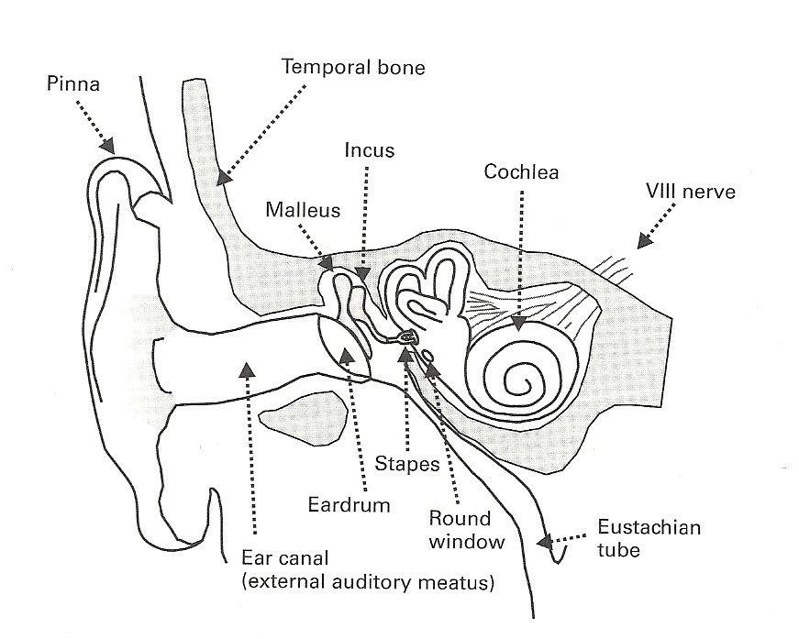
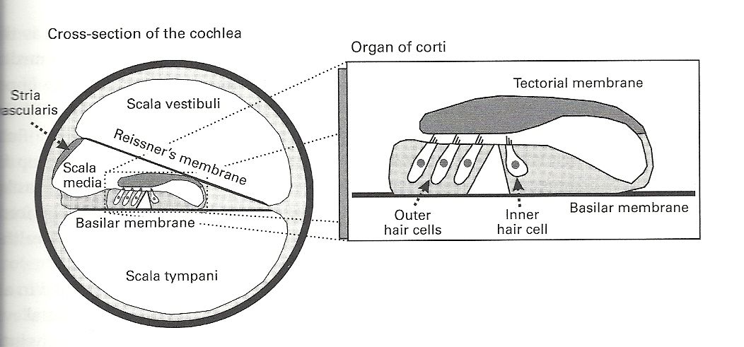
System studied
Auditory nerve
Image source : «Auditory Neuroscience », Schnupp et al., 2011, MIT p52, 65
  Input : air pression signal
  Output : spikes
Notes:
System studied
Auditory nerve :
Input : air pression signal, propagated through the ossicles to the cochlea and its hair cells
Output : spikes

Slide 5
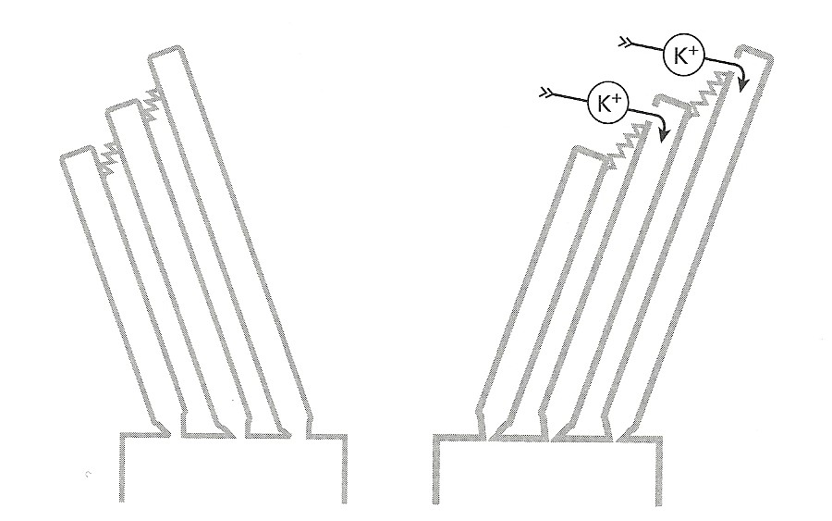
Purpose
Study the influence of absolute refractory period on signal encoding
Hair cell transduction mecanism
Image source : «Auditory Neuroscience », Schnupp et al., 2011, MIT p66

Slide 6
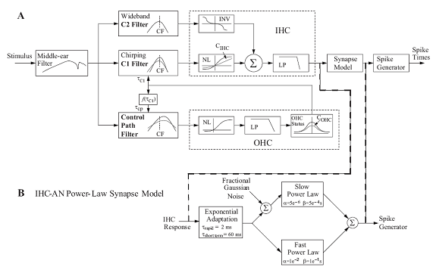
Approach
Use computational model for cat auditory-nerve responses from Zilany et al. (JASA, 2009)
Image source : http://www.bme.rochester.edu/people/faculty/bio/project.php?id=229&projectId=203 , 04.04.2013
Then, modify value of the absolute refractory period and study difference in output signal

Slide 7
Model use
Two main functions :
  catmodel_IHC : gives the inner hair cell (IHC) potential from a stimulus ; does simulation of repetitive exposures to stimulus, with some period
  catmodel_Synapse : gives the synapse output and the peri-stimulus time histogram (PSTH) from the IHC potential, this for some fiber type (according to their spontaneus rate)

Slide 8
Model use
Stimulus
Period time for experiment repetitions
IHC potential
IHC potential
Fibertype
Synapse output
Peri-stimulus time histogram (PSTH)
Arguments of both functions :
sampling rate
number of repetitions of experiments
characteristic frequency of the IHC and fiber we want to test
Notes:
Two functions :
catmodel_IHC : gives the inner hair cell (IHC) potential from a stimulus, for an hair cell of some characteristic frequency (CF)
catModel_Synapse : gives the synapse output and the peri-stimulus time histogram (PSTH) from the IHC potential
Fibertype : according to the fiber spontaneus rate

Slide 9
Plan
Presentation in three parts :
  Introduction
  Results
  Summary & Outlook

