Slide 1
Representation of auditory signals by neuronal spike trains
Bachelor Project Final Presentation
Maëlle Colussi
LCN Lab Meeting 7 June 2013

Slide 2
Plan
Presentation in three parts :
  Introduction
  Results
  Summary

Slide 3
Plan
Presentation in three parts :
  Introduction
  Results
  Summary

Slide 4
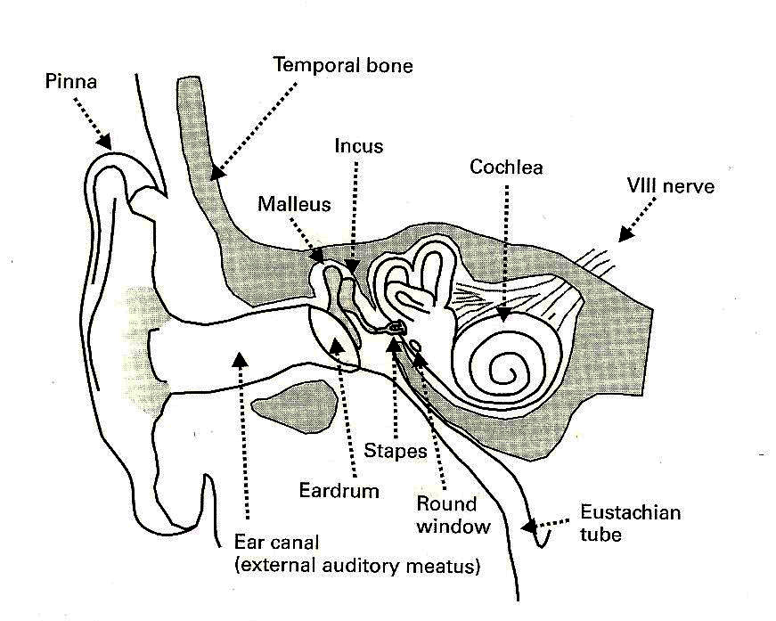
Auditory System
Auditory nerve
  Output
  Input
  Input : air pressure signal
  Output : spikes
Image source : «Auditory Neuroscience », Schnupp et al., 2011, MIT Press p52
Notes:
System studied
Auditory nerve :
Input : air pression signal, propagated through the ossicles to the cochlea and its hair cells
Output : spikes

Slide 5
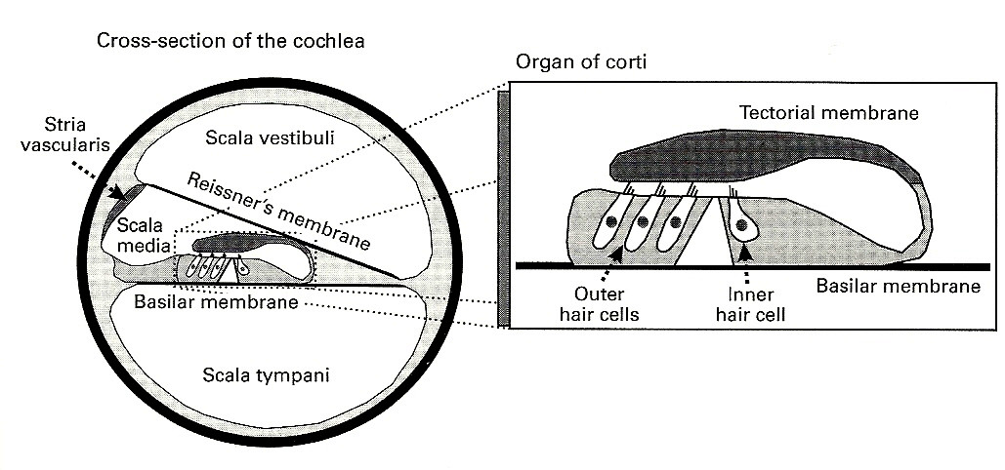
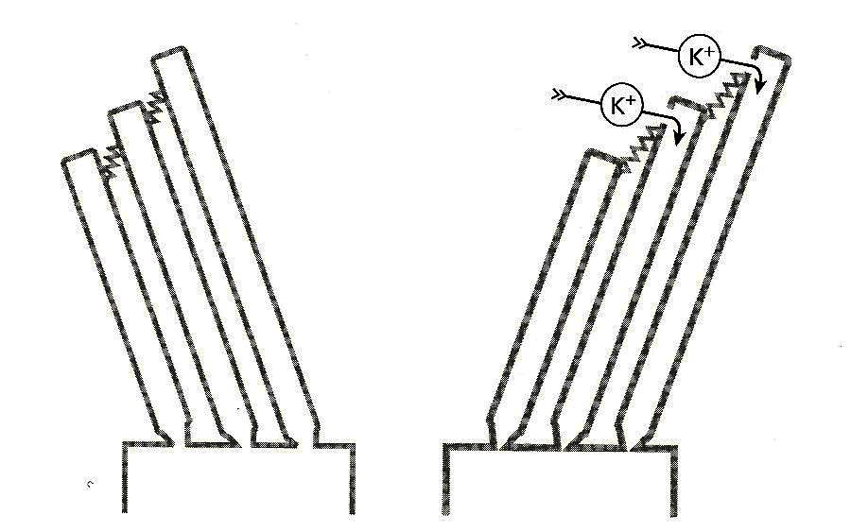
Auditory System
Cross-section of cochlea
Hair cell transduction mechanism :
Image source : «Auditory Neuroscience », Schnupp et al., 2011, MIT Press p 65, 66

Slide 6
Goal of project
Study the influence of absolute refractory period on signal encoding

Slide 7
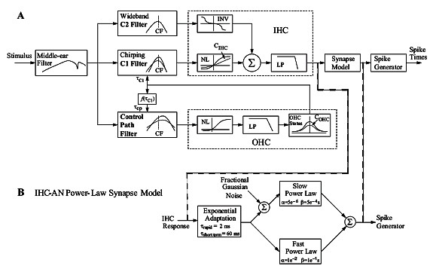
Approach
Use computational model for cat auditory-nerve responses from Zilany et al. (JASA, 2009)
Image source : http://www.bme.rochester.edu/people/faculty/bio/project.php?id=229&projectId=203 , 04.04.2013
Modify value of the absolute refractory period

Slide 8
Model use
Main shema:
Stimulus
catmodel_IHC
IHC potential
Synapse output
Peri-stimulus time histogram (PSTH)
IHC potential
catmodel_Synapse
We must also specify to the model :
sampling rate
time before repetition and number of repetitions of experiments
characteristic frequency (CF) of the IHC and fiber we want to test
type of fiber : low, medium or high spontaneus rate (SR)
Notes:
Two functions :
catmodel_IHC : gives the inner hair cell (IHC) potential from a stimulus, for an hair cell of some characteristic frequency (CF)
catModel_Synapse : gives the synapse output and the peri-stimulus time histogram (PSTH) from the IHC potential
Fibertype : according to the fiber spontaneus rate

Slide 9
Plan
Presentation in three parts :
  Introduction
  Results
  Summary

Slide 10
Experiments
4 types of experiments (stimuli):
  Pure tone
  Click
  Noise step
  Pure tone step
Each of them with or without absolute refractory period

Slide 11
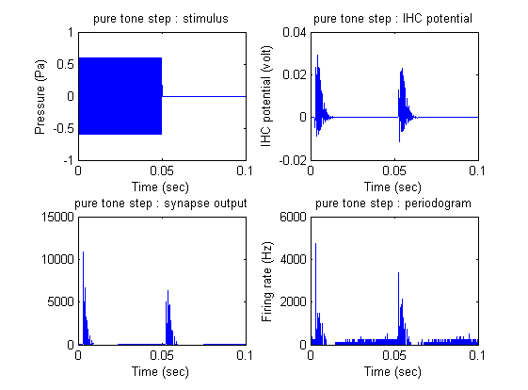
Pure tone step experiment
Stimulus : pure tone 10kHz in 50 ms steps
Period time : 100ms
Fibertype : high SR
Sampling rate :
0.01 ms
800 repetitions
CF : 1kHz
With absolute refractory period

Slide 12
Pure tone experiment
Stimulus : pure tone 1kHz, amplitude 6.32e-3 Pa
Period time : 1ms
Fibertype : medium SR
Sampling rate : 0.01 ms
10'000 repetitions
CF : 1kHz
With absolute refractory period

Slide 13
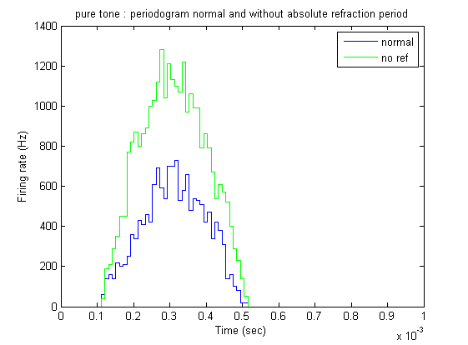
Refractory period comparison
Example for the pure tone:

Slide 14
Rate modulation depth (RMD)
Tool to compare experiments with and without absolute refractory period (ARP)
On the form (x-y)/y, x = max(periodogram) for all experiments; y is the baseline
  Click : y = periodogram on 0 Pa stimulus
  Pure tone : y = mean(periodogram)
  Modulated noise : y = periodogram just before the end of the step
  Modulated pure tone : y = mean of periodogram when IHC saturated

Slide 15
RMD graph on the whole page

Slide 16
Rate modulation depth result
Experiment done for each fiber type and for 3 different intensities (49 dB, 84 dB, 120 dB)
Similar results for each experiment for difference between the two cases
  Clicks and steps (either of noise or of pure tone) have bigger RMD without ARP
  Pure tone have lower RMD without ARP
Explanation ......

Slide 17
Plan
Presentation in three parts :
  Introduction
  Results
  Summary

Slide 18
Summary
Absolute refractory period influences output
Without it, the RMD is bigger for the stimuli that are composed of sudden changes
More data is needed for verifying the prediction of Deger(2010)

