Slide 1


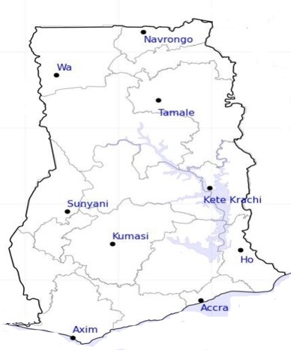


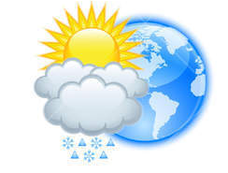







Department of
Meteorology and Climate Science KNUST
24-HOUR FORECAST
3-11-2022 @ 1200 UTC
Rain
Wind
Dust
Forecast Summary (KUMASI)
 | DAY | NIGHT
Temperature | 31 $℃$ | 2$4 ℃$
Rain | - | -
Probability | - | -
Rel. Humidity | 74 % | 95 %
Winds from | SW | S
Wind Speed | 2 ms⁻¹ | 2 ms⁻¹
Wind Gust | 6 ms⁻¹ | 6 ms⁻¹
Low risk
Be aware
Be Prepared
Take Action
SUNSET: 05:56 PM SUNRISE: 05:54 AM

