Slide 1
QUIZ MASTER
Your smart GCE Multiple Choice Question Platform.
By
Kaze Igor,
Okale Brandon,
Bright Achia,
Zoe Malaika Ngundue.

Slide 2
The problem
There are no pamphlets that have all the GCE MCQs for each subject for students’ use.
Pamphlets are not accessible for all students. Thus, limiting their ability to prepare for MCQs.
Most platforms that offer Cameroon GCE type quizzes are not available for all devices such as (IOS).
There is no collective platform providing all GCE questions and answers to ease accessibility for students.

Slide 3

Quiz Master, an interactive platform for students
Quiz Master brings to students nothing but the best in order to enhance their critical thinking, speed and accuracy when taking tests and performance.
Quiz Master provides quizzes to prepare students for their different official exams (O-level or A-level).
Quiz Master also allows teachers to sign up as tutors in order to facilitate the learning process for students.

Slide 4
Unlock Your Potential from Your Place of Comfort.
Enhance your learning journey with our intelligent question bank.
Master any subject and solve multiple choice questions from any location across the globe.

Slide 5
Quiz Master or Nothing.
Why choose our platform ?
This platform provides resources to simplify interaction for its users like no other platform:
We provide adaptive GCE questions that match user skill with answers.
We provide a base to interact, collaborate and compete with peers.
There is also provision of timed quizzes for speed and accuracy improvement.

Slide 6
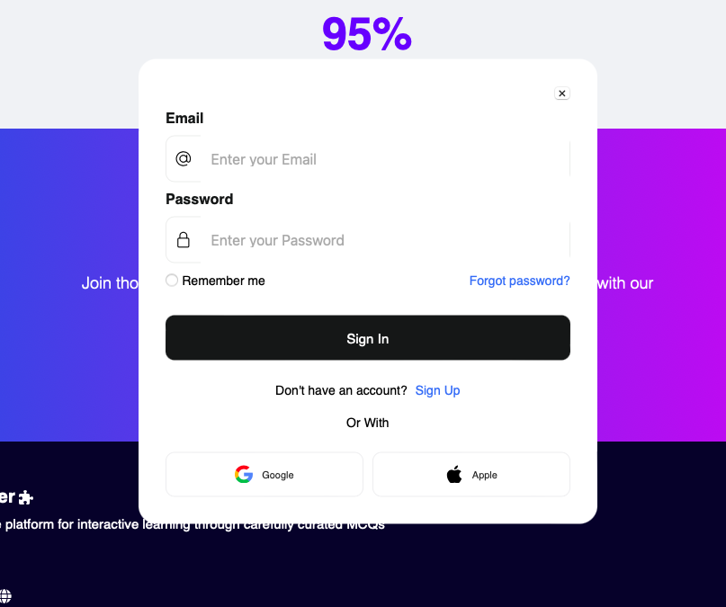
Sign up and get full access to our resources.

Slide 7
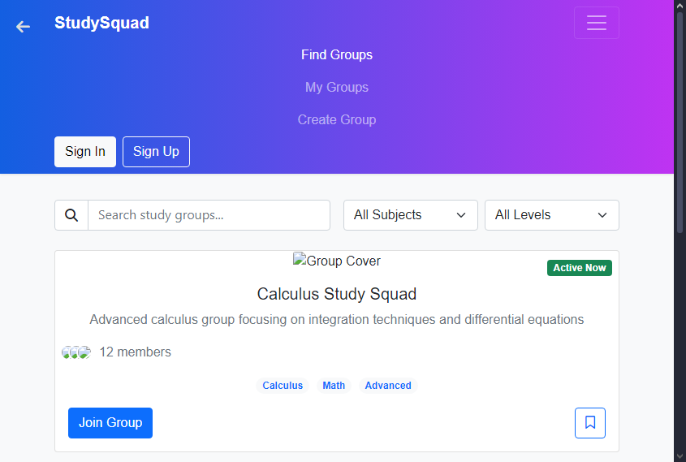
StudySquad
Join study groups at your level(Beginner, Intermediate, and Advanced) and in any subject to improve your understanding. While connecting with peers.

Slide 8
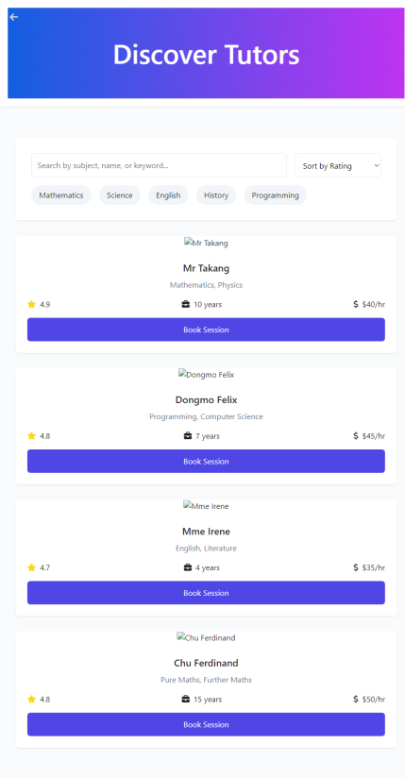
Tutoring
Connect and work with qualified tutors who are ready and able to simplify problems by breaking them down in any field of work.
Hence enabling you have a mastery of your subjects

Slide 9
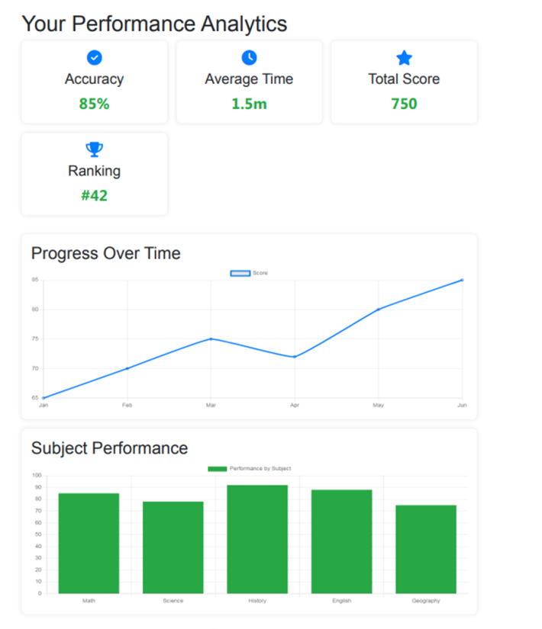
Improve Your Skills Over Time with Quiz Master
Quiz Master cares about how you improve and grow with us.
We track users’ progress and evaluate their performance; So they can see their weak points and sharpen it.

Slide 10
Quizzes
We provide GCE multiple choice questions in different subjects.
The MCQs come from various standardized tests such as GCE O level, GCE A level, O level Mock, and A level Mock.

Slide 11
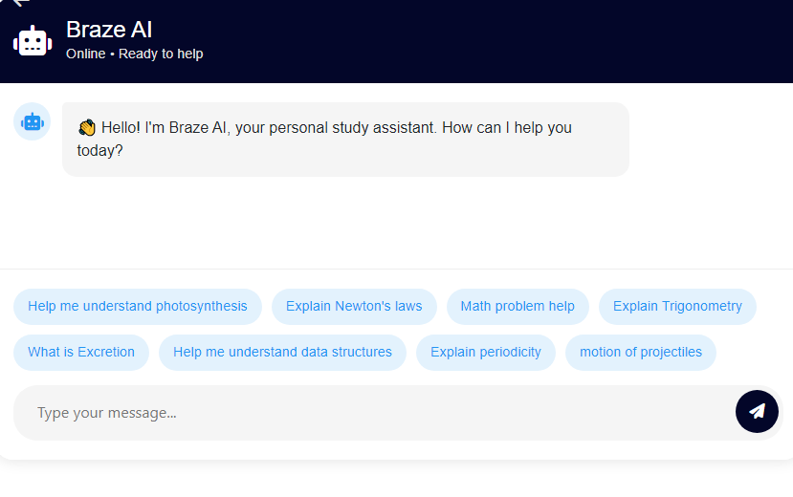
Braze AI Chat Box
Braze AI chat box is a personal study assistant which is user-friendly and helps users understand complex concepts.

Slide 12
Get in touch with Quiz Master.
Connect with Quiz Master through any device (Mobile phones, Tablets, Computers…) through the web application.
The mobile app for Quiz Master will soon be released to ease access for students and teachers.
The GCE questions will have answers provided by Qualified teachers and trusted GCE examiners.

Slide 13
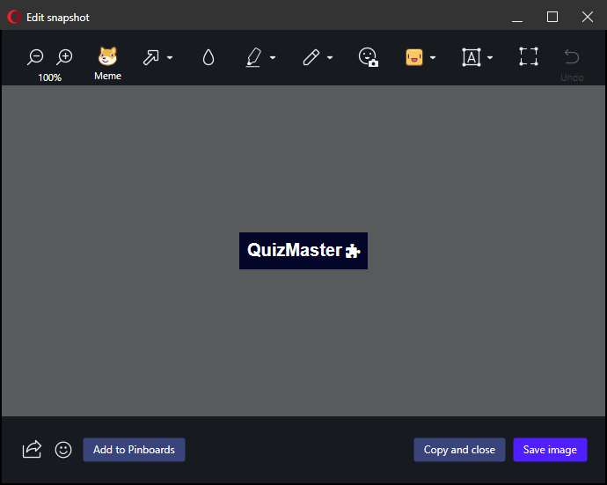
Your alternate platform for interactive learning through carefully curated MCQs.
Quiz Master is free and accessible to all.
Thank You for Your Keen Attention.

