Slide 1

Certificate Management App
Submitted By:-
Name- Abhilash Kar
Employee Id:- 46022584

Slide 2
Abstract :-
The Certificate Management app is a salesforce app which is used to handle the certification request made by the employee for the voucher. This app is made by using a CRM tool i.e. salesforce. Here the employees can send their details and the choice of certification they want the voucher for to the app user who generates a request for the voucher to the app admin filling out the details for the approval. Here the app admin can only create, delete and edit the certification and voucher. The vouchers will get automatically assigned to the request once it gets approved by the app admin. After the employee appears the certification exams for whom the voucher was assigned for will have to give the details about the results to the app user so that app user can update the status to pass or fail. This will help to know about the certified employees in the company and can keep a track about the people who appear for those certification exams.

Slide 3
Objectives :-
Create a lightning certificate management app
App user should able to create a employee record whenever the employee sends a request to app user for voucher.
Voucher and Certification record should be created and modified by the app admin.
The app user should send a request for the approval of voucher from the app admin.
When the app admin approves the certification request the voucher should get automatically assigned by the system.
The app should show the report in the graph format about the pass/fail employees, unused vouchers and certified resources.

Slide 4
Technology Used :-
CRM tool - Salesforce
Visual Studio Code
Within Salesforce :-
Lightning Web Components
Apex
Aura
Salesforce Lightning experience
Lightning Design System
Lightning Data Service

Slide 5
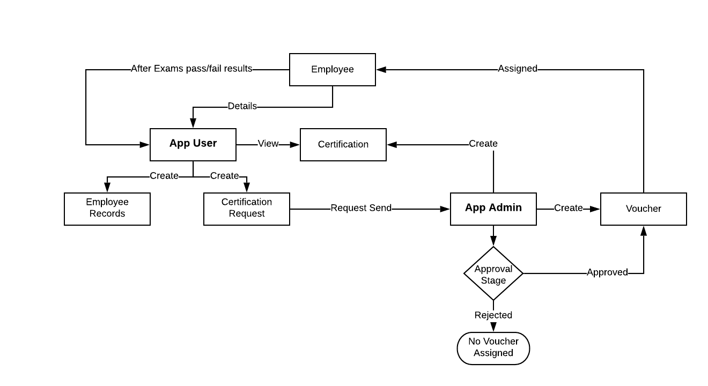
Steps :-

Slide 6
Scope:-
There are two categories of people who would access the system:-
1. The App User can:
a. Login into the application.
b. Create an employee record.
c. View Certification.
d. View Voucher.
e. Make a certification request.
f. View the certification request made.
g. Cancel or modify a certification request.
2. The App Admin can:
a. Login into the application.
b. Add, delete and edit certification.
c. Add, delete and edit certification.
d. Check for available flights.
e. View the certification request details.
f. View the employee details.
g. Approve/Reject the request.

Slide 7
Out of Scope :-
The following functionalities have not been covered under the application:
The application does not allow employee to add their own details or send a certification request.
One voucher cannot be used again by different employees.

Slide 8
Conclusion :-
The Certificate Management App allows the employees to request for the voucher in which skill or course want to get certified. It shows the role hierarchy the process follows so as the employee can be assigned the voucher. The certification management app assigns vouchers to the approved employees according to their given certification. This app helps to keep track of the certified resources and the pass or failed employees and the unassigned vouchers remaining.

