Slide 1



Potato Maze
Affan Dhankwala
Brian Ying
Tejas Kalyan
Skyler Nickel

Slide 2
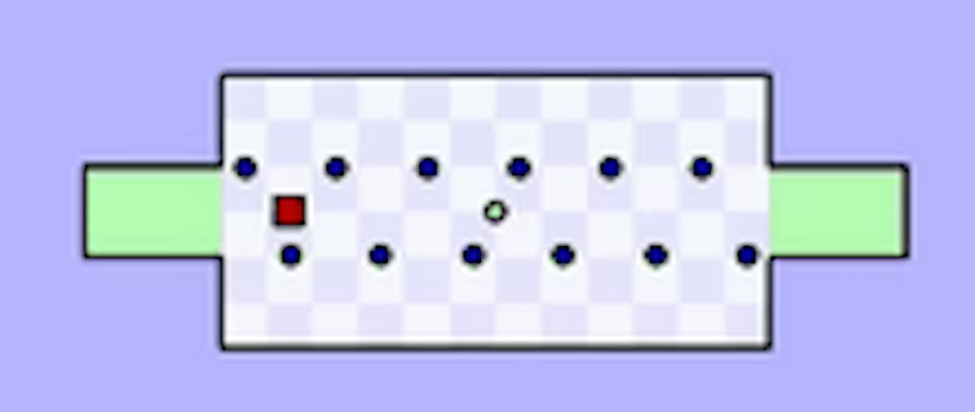

Concept
Worlds Hardest Game inspired
Grab all collectibles, reach the flag, don’t die
Additional challenge of mobility impairment
Challenges:
Skill
Patience
Persistence
Tactics
Simple
Addictive
Notes:
We were inspired form the Worlds Hardest Game and wanted to create something like that
Very simple game concepts: Collect all the collectibles then touch the flag to get to the next level. Just dont die
However, we dont just want to stop at copying an already well-known game so we decided to play with your mobility. Every collectible slows you down by a specific amount. So you have to be crafty on which ones to take and how
Now, to get into what makes this game challenging, we chose 4 topics.
You need a lot of skill to navigate some of the levels. This game challenges your patience to time your movements and backtracking. It tests your persistence to keep trying even after 10-20 deaths. Tactics are also tested by how you approach the problem.

Slide 3
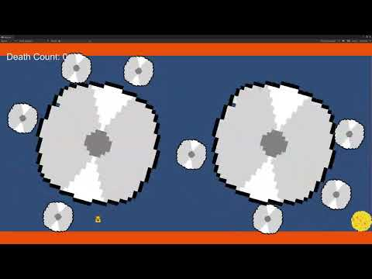
Final game

Slide 4

Playtest Results
1 person beat our game
Addicting game
Simple to understand
People tend to not read the tutorial?
Collisions are aggressive

Slide 5

Next Steps
More levels
Timer per level
At end of each level, shows your best runs
Leaderboard
After completion of each level show best times/deaths
After completion of all levels, show total elapsed time, deaths, etcs
Add more obstacles (flamethrower?)
Add new types of pickups/stage hazards
More path-oriented levels

