Slide 1
Text Indexing Project
Natural Language Processing and Information Retrieval
Maëva Lecavelier / 마에바 르꺄블리에 – 50191580

Slide 2


Assumption
Our hypothesis is: « Depending on features of movies, the word distribution is statistically different. »
I choose two different genres for studying this assumption : horror movies and family movies.
Horror :
The Hauting Of Hill House
The Mummy
Alien III
Book Of The Dead
Evil Dead Ii
Friday The 13th
The Grudge
Halloween
Hannibal
Insidious
It
Family:
American Pie
Bean
The Brothers Bloom
Crazy, Stupid, Love
Happy Feet
The Incredibles
Kung Fu Panda
The Mask
The Proposal
Shrek
Ted

Slide 3

Programming language
I choose Python for this project: easier for manipulating files.

Slide 4

How I have proceeded
Get movies scripts in one file for each genre
Tokenize the scripts according to blank space and get off of ponctuation
Make a list of stop words and delete them from the scripts
Count each words and sort them by frequency
Get the 40 first terms and get a graph in excel for better results
Analyze results

Slide 5
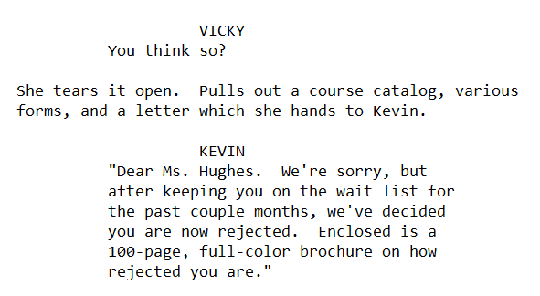

Difficulties
Difficulties:
  The stop words list
  Comparison between words for counting
  Efficacity for treating information
How to improve:
  Better performance
  Better results by improving stop words list

Slide 6
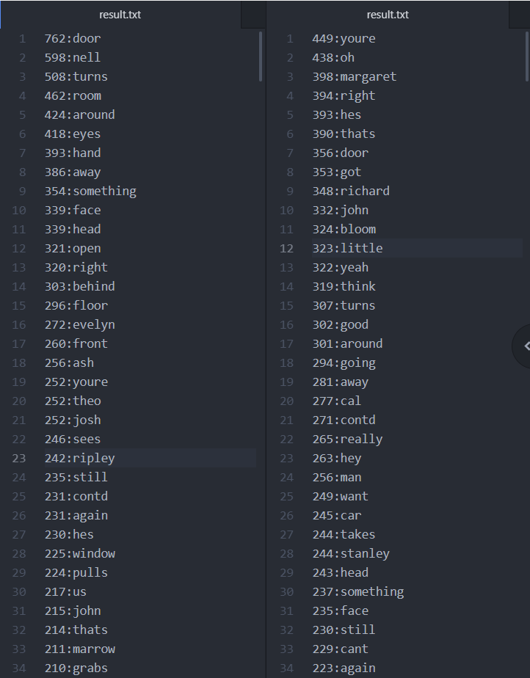
Results - files

Slide 7
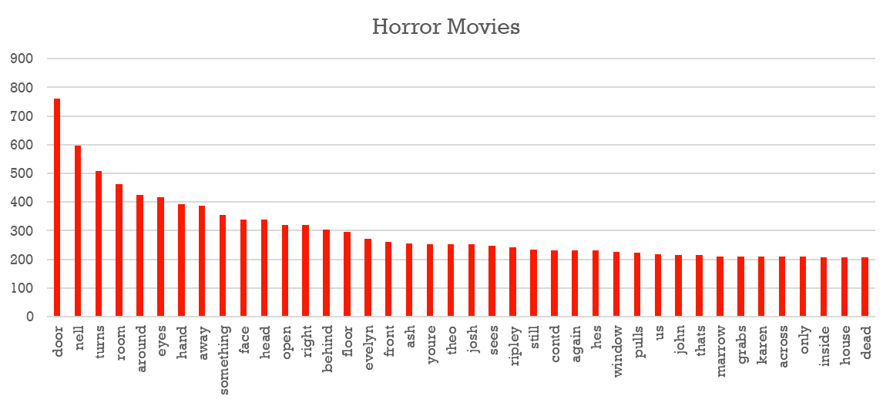
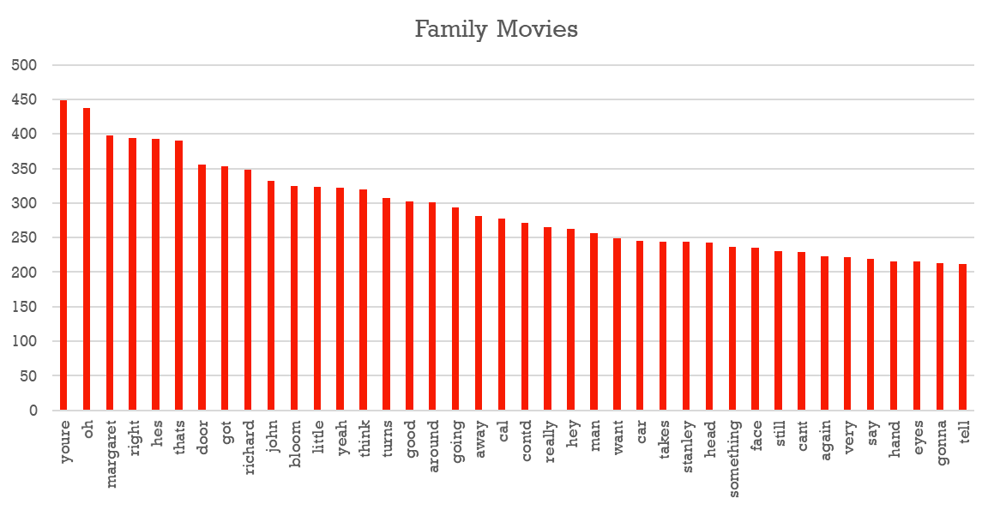
Result - graph

Slide 8
Results - Interpretation
Horror Movies
762 | door
598 | nell
508 | turns
462 | room
424 | around
418 | eyes
393 | hand
386 | away
354 | something
339 | face
339 | head
321 | open
320 | right
303 | behind
296 | floor
272 | evelyn
260 | front
256 | ash
252 | youre
252 | theo
252 | josh
246 | sees
242 | ripley
235 | still
231 | contd
231 | again
230 | hes
225 | window
224 | pulls
217 | us
215 | john
214 | thats
211 | marrow
210 | grabs
210 | karen
209 | across
209 | only
208 | inside
208 | house
207 | dead
Family Movies
449 | youre
438 | oh
398 | margaret
394 | right
393 | hes
390 | thats
356 | door
353 | got
348 | richard
332 | john
324 | bloom
323 | little
322 | yeah
319 | think
307 | turns
302 | good
301 | around
294 | going
281 | away
277 | cal
271 | contd
265 | really
263 | hey
256 | man
249 | want
245 | car
244 | takes
244 | stanley
243 | head
237 | something
235 | face
230 | still
229 | cant
223 | again
222 | very
219 | say
215 | hand
215 | eyes
213 | gonna
212 | tell

Slide 9
Sources
https://www.guru99.com/reading-and-writing-files-in-python.html
https://www.tutorialspoint.com/python/string_replace.html
https://www.programiz.com/python-programming/methods/list/index
https://snakify.org/fr/lessons/dictionaries_dicts/
https://www.codespeedy.com/sorting-associative-array-in-python/
https://www.programiz.com/python-programming/regex
https://www.rypeapp.com/most-common-english-words/

