Slide 1
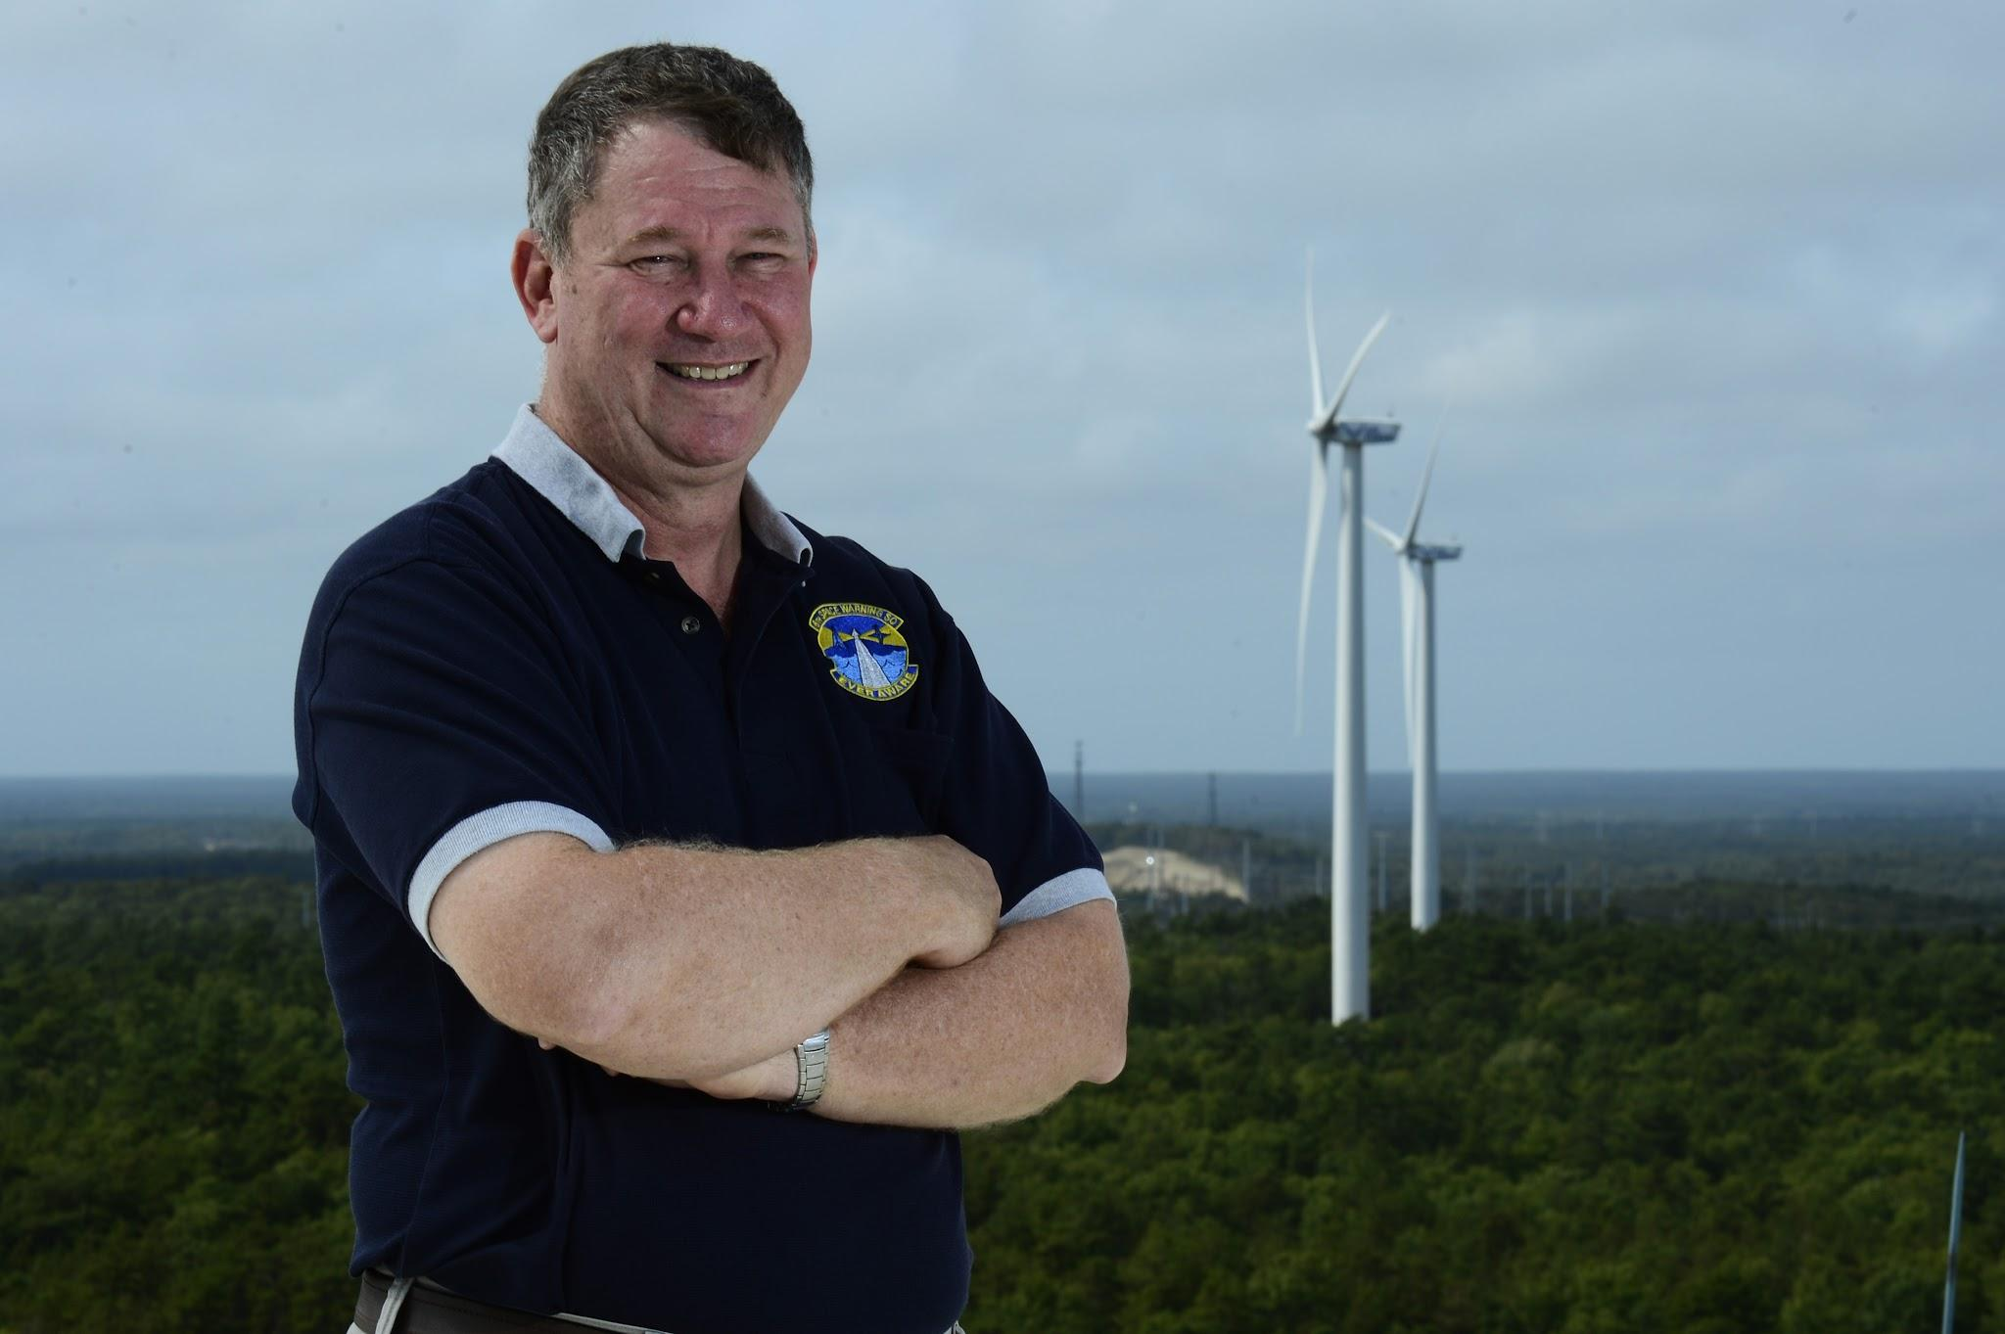
Airborne Wind Turbine
Zoey Smolka & Maeve Yandell

Slide 2
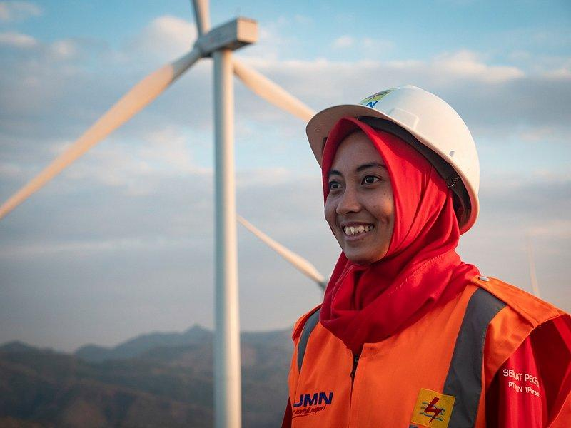
Overview
Title
Overview
History
Plan & implementation
Pros of Airborne Wind Turbine
Cons of Airborne Wind Turbine
Summary
Resources

Slide 3
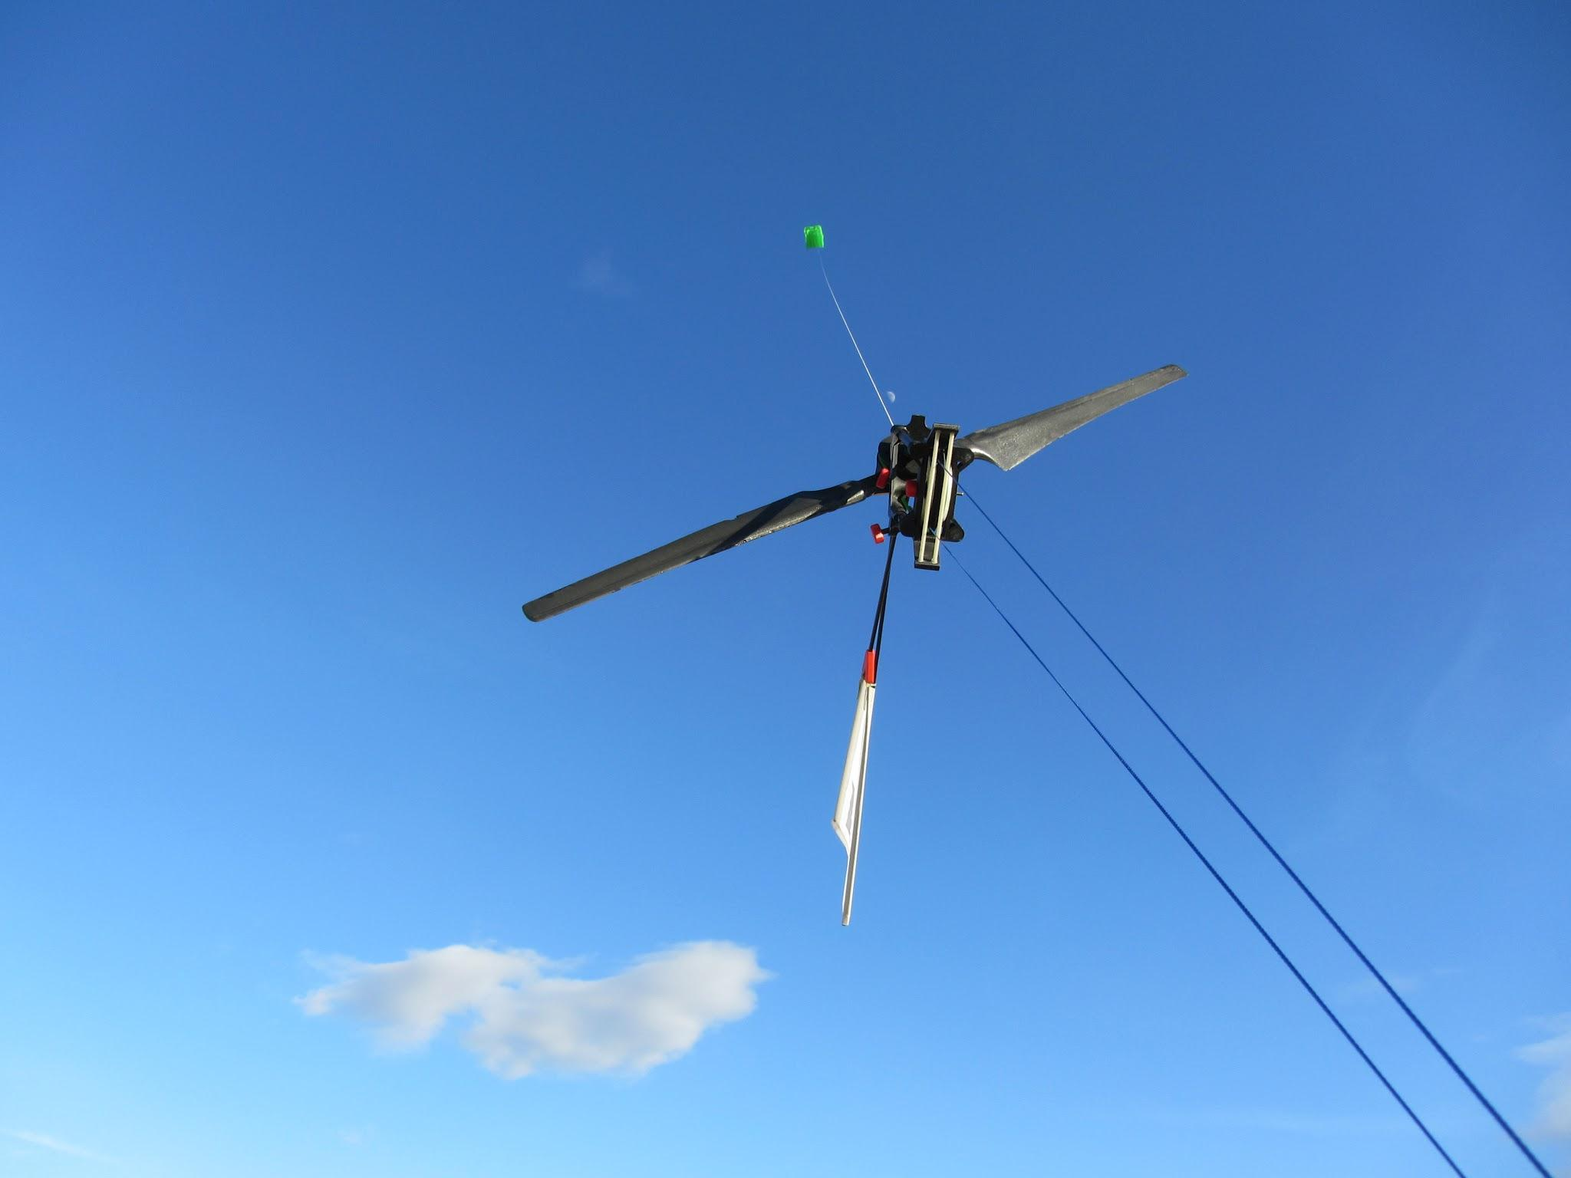
History - Who & When it was Conceived
1930s german engineer Hermann Honnef first speculated about the physics
The concepts “tethered airfoil” as a way to generate power was created in the late 1970s.
Number of companies has increased sense 2000s
Notes:
In the early 1900s there was speculation from two German Engineers about the idea of airborne energy. The most recognized was Hermann Honnef in 1930 who openly speculated about the physics that would allow for the concept of this kind of energy. Later on the the “ tethered airfoil” was created which allowed for the construction of today's wind turbines. Then in the 2000s the development industry started to gain traction after a man named Wubbo Ockels spurred the idea of airborne energy. After Ockels and a research group formed in 2004 several companies including Ampyx Power which is mentioned in slide 5 have paved the way for the rising interest in the industry.

Slide 4
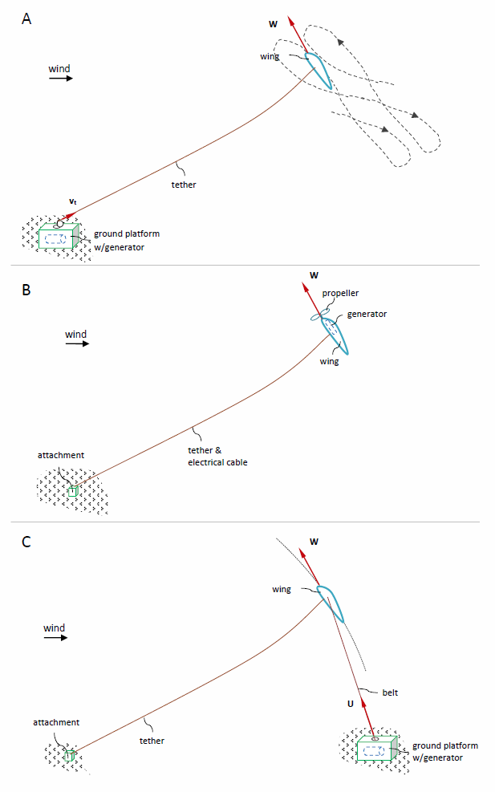
Possible prototypes of an airborne wind turbine -

Slide 5
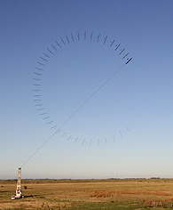
Plan and Implementation - Who or What it will Impact
Several companies have made and tested prototypes in the last decade
Different approaches have been made as to the design
Long term ideas include personal power sources
Notes:
Several companies including Makani Power have started in the development of making several prototypes in the last six years. There prototypes have been successful in terms of energy efficiency but the cost of creation and instalment can reach up to $20 million. But while the cost is high Makani power predicts that just one of their turbines could produce enough energy to power 150 households. Makani hopes in the near future to build an offshore wind farm off the coast of California. Another company based in the Netherlands Ampyx’s PowerPlane Is also close to producing a functioning wind turbine. There are hopes and ideas from companies like this for this idea to go wide scale and maybe even one day people to have these turbines to power houses all over the world.

Slide 6
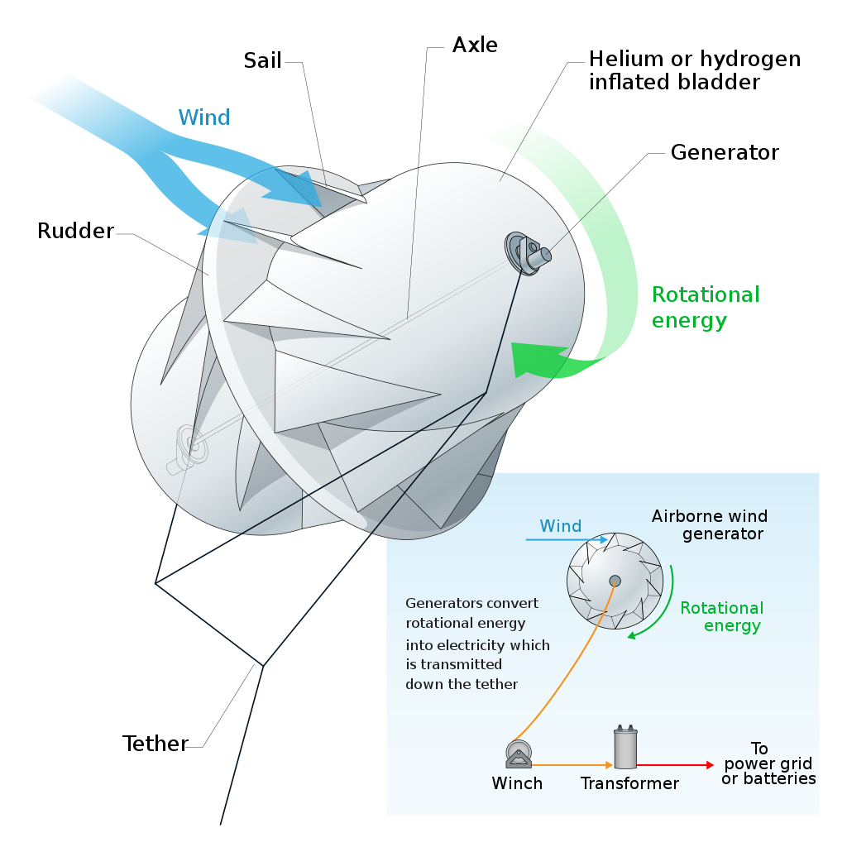
Pros of the Airborne Wind Turbine
Leaves more land access
No cost of tower construction
Able to reach stronger wind power
Gives people high paying jobs
Clean and renewable way to get power
Benefits local communities
Notes:
The power of wind is a good, clean, renewable, and a more affordable way to power our world and communities. When the turbine is airborne instead of on the ground it leaves more land for us to work with. Also when the turbine is in the air is gets a much more strong wind then it does when its on the ground. Not only is it beneficial for our communities but it is also beneficial for people individually. People working for the companies that are making these wind turbines possible get paid a plentiful amount of money. So as you can see they have a lot more pros to them than they cons.

Slide 7
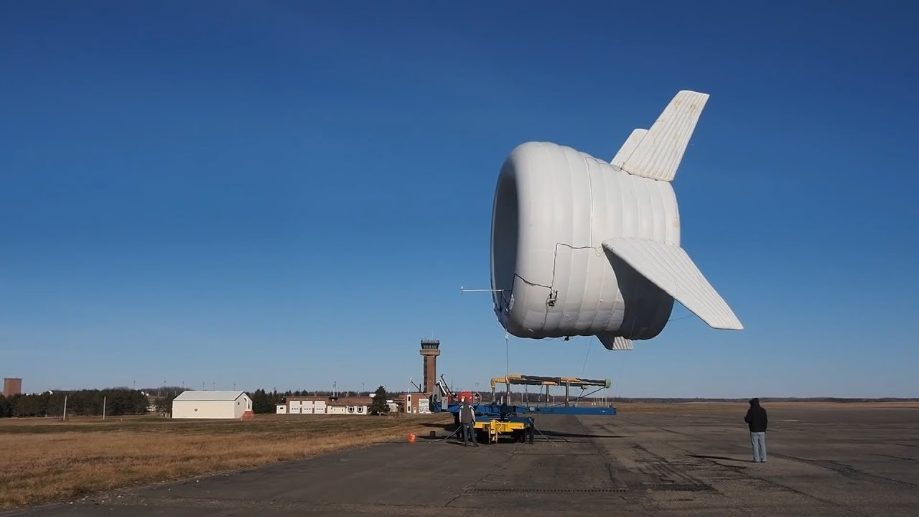
Cons of the Airborne Wind Turbine
Difficult to suspend and maintain turbines safely
Interference with Aviation
Noise and vibrations can disturb wildlife
It is dangerous for workers
Can be expensive
Notes:
Even though airborne wind turbines sound like a good thing they still have their cons. Maintaining and making these turbines are difficult and dangerous especially for the workers. They can also upsetting to wildlife for example it can kill a lot of birds. They also can interfere and disturb aircraft traffic. There are still cons to this invention even though there is a lot of pros.

Slide 8
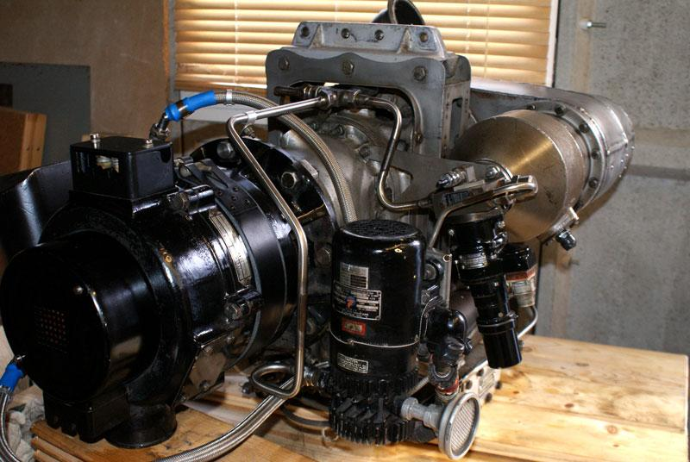
Summary
After researching Airborne wind turbines the pros are greater than the cons; they have many potential benefits for the environment, economy, and power industry. While it's still uncertain if this technology will be fully implemented it has potential to be successful.

Slide 9
References
Wind Energy Facts
Wind Energy and Environmental Impacts
Airborne wind energy
Potential of High Altitude Wind Energy and Hurdles
History of Airborne Wind Turbines

Slide 10
End.

