Slide 1
Android App For Food Allergy Sufferers
Student: Maeve Rooney DT265
Supervisor: Michael Collins

Slide 2
Project Idea
To create an Android App targeted at food allergies sufferers for the following reasons:
Personal knowledge of the niche market
Good platform from which to learn Java language.
Many technologies necessary to build complete system which will broaden my education

Slide 3
The Problem
When looking for somewhere to eat a person with a food allergy faces a problem:
Does the restaurant cater to my allergy?
What is the quality of the food like?
Is it favoured by other food allergy sufferers?
Is there a better option nearby?

Slide 4

Existing Solutions
Allergy Caddy
User selects their allergies
App shows allergens in menu item of restaurants
Problems
Only major chains in USA covered
No opinion/reviews on quality of food

Slide 5
Existing Solutions
Dublin With food Allergies Website
List of restaurants catering to food allergy sufferers
Problems
Reviews based on only one opinion
Only small number of restaurants covered

Slide 6
My Solution
Create an app which is a database of restaurants that cater to allergy sufferers.
The content will be dynamic and user generated.
Users will rate a restaurant for how it caters to each of their allergies as well as an overall rating.
When searching for a restaurant an average of all the users rating will be presented to the user.
A Google map based search will help the user find restaurants near them.

Slide 7
Research Conducted
Eclipse and Java to create Android apps
RESTful services to implement dynamic content
PHP based website with MySQL database
Google Maps API

Slide 8
Eclipse and Java
Eclipse comes with an official Android Plugin
Easy debugging of code
Graphical layout of screens
Can run project on Emulator
Easy testing with jUnit built in
Java comes with code completion and many powerful libraries

Slide 9
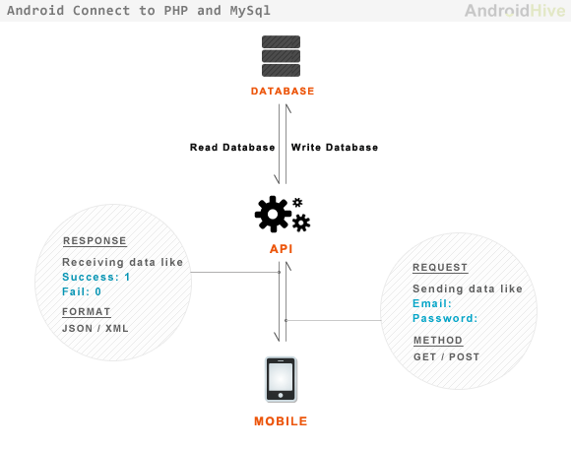
RESTful Services
Representational State Transfer (REST) used to represent content of the database on the android device
Content stored on webserver in MySQL database
HTTP request for information gets JSON object response from web server
Java parses JSON object and displays results

Slide 10

Website With MySQL Database
I signed up for free hosting with x10hosting.com
MySQL database used to store app content
PHP used to connect to the database, query and update it
Using a file transfer protocol program, the scripts are stored on the webserver
Http requests to the scripts retrieve content for the app

Slide 11
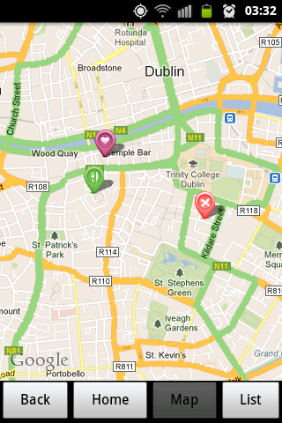
Google Map API
To build an app using the Google Maps API you must first obtain a unique API key
To get a key you register on the Google Developers Website
Then you use this key in the layout xml file for the map screen
Google Maps API has built in classes to place pins on the map and locate the mobile device on the map

Slide 12
Design & Methodology
Spiral Methodology
Five tier System Architecture
MySQL Schema
User Interface

Slide 13
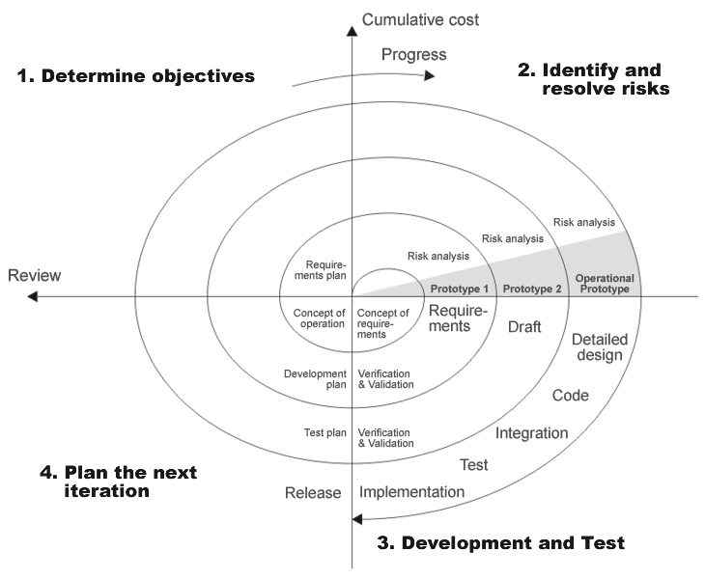
Spiral Methodology
Used so that scope of project could increase as work commenced
With each iteration, and as my knowledge and skill set improved I could review and revise the project plan
The initial plan was to implement a few key features
Using the spiral methodology I added features and improved upon those already implemented in previous prototypes
Several prototypes were creating during the process of this project

Slide 14
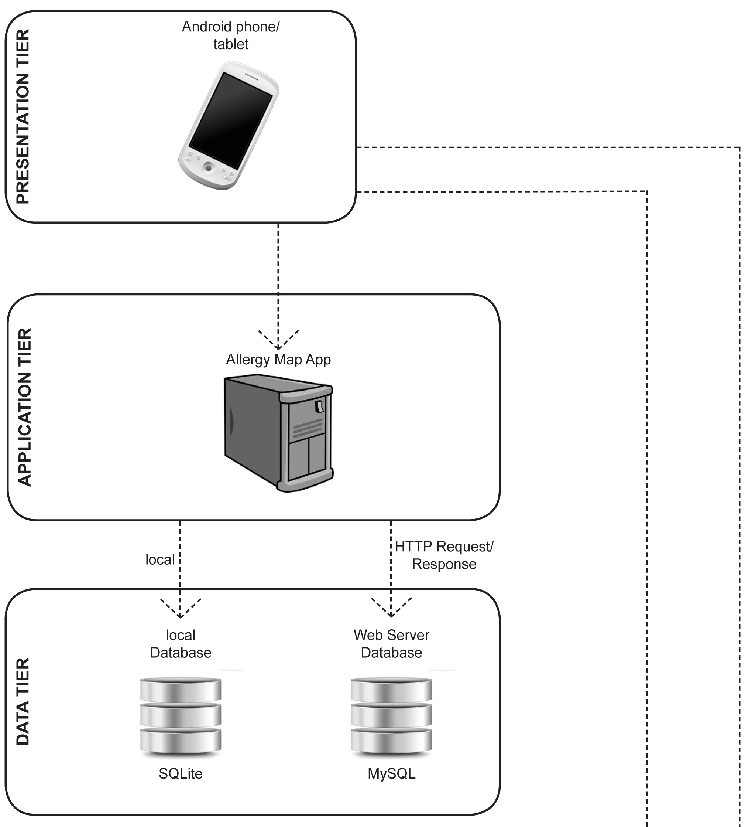
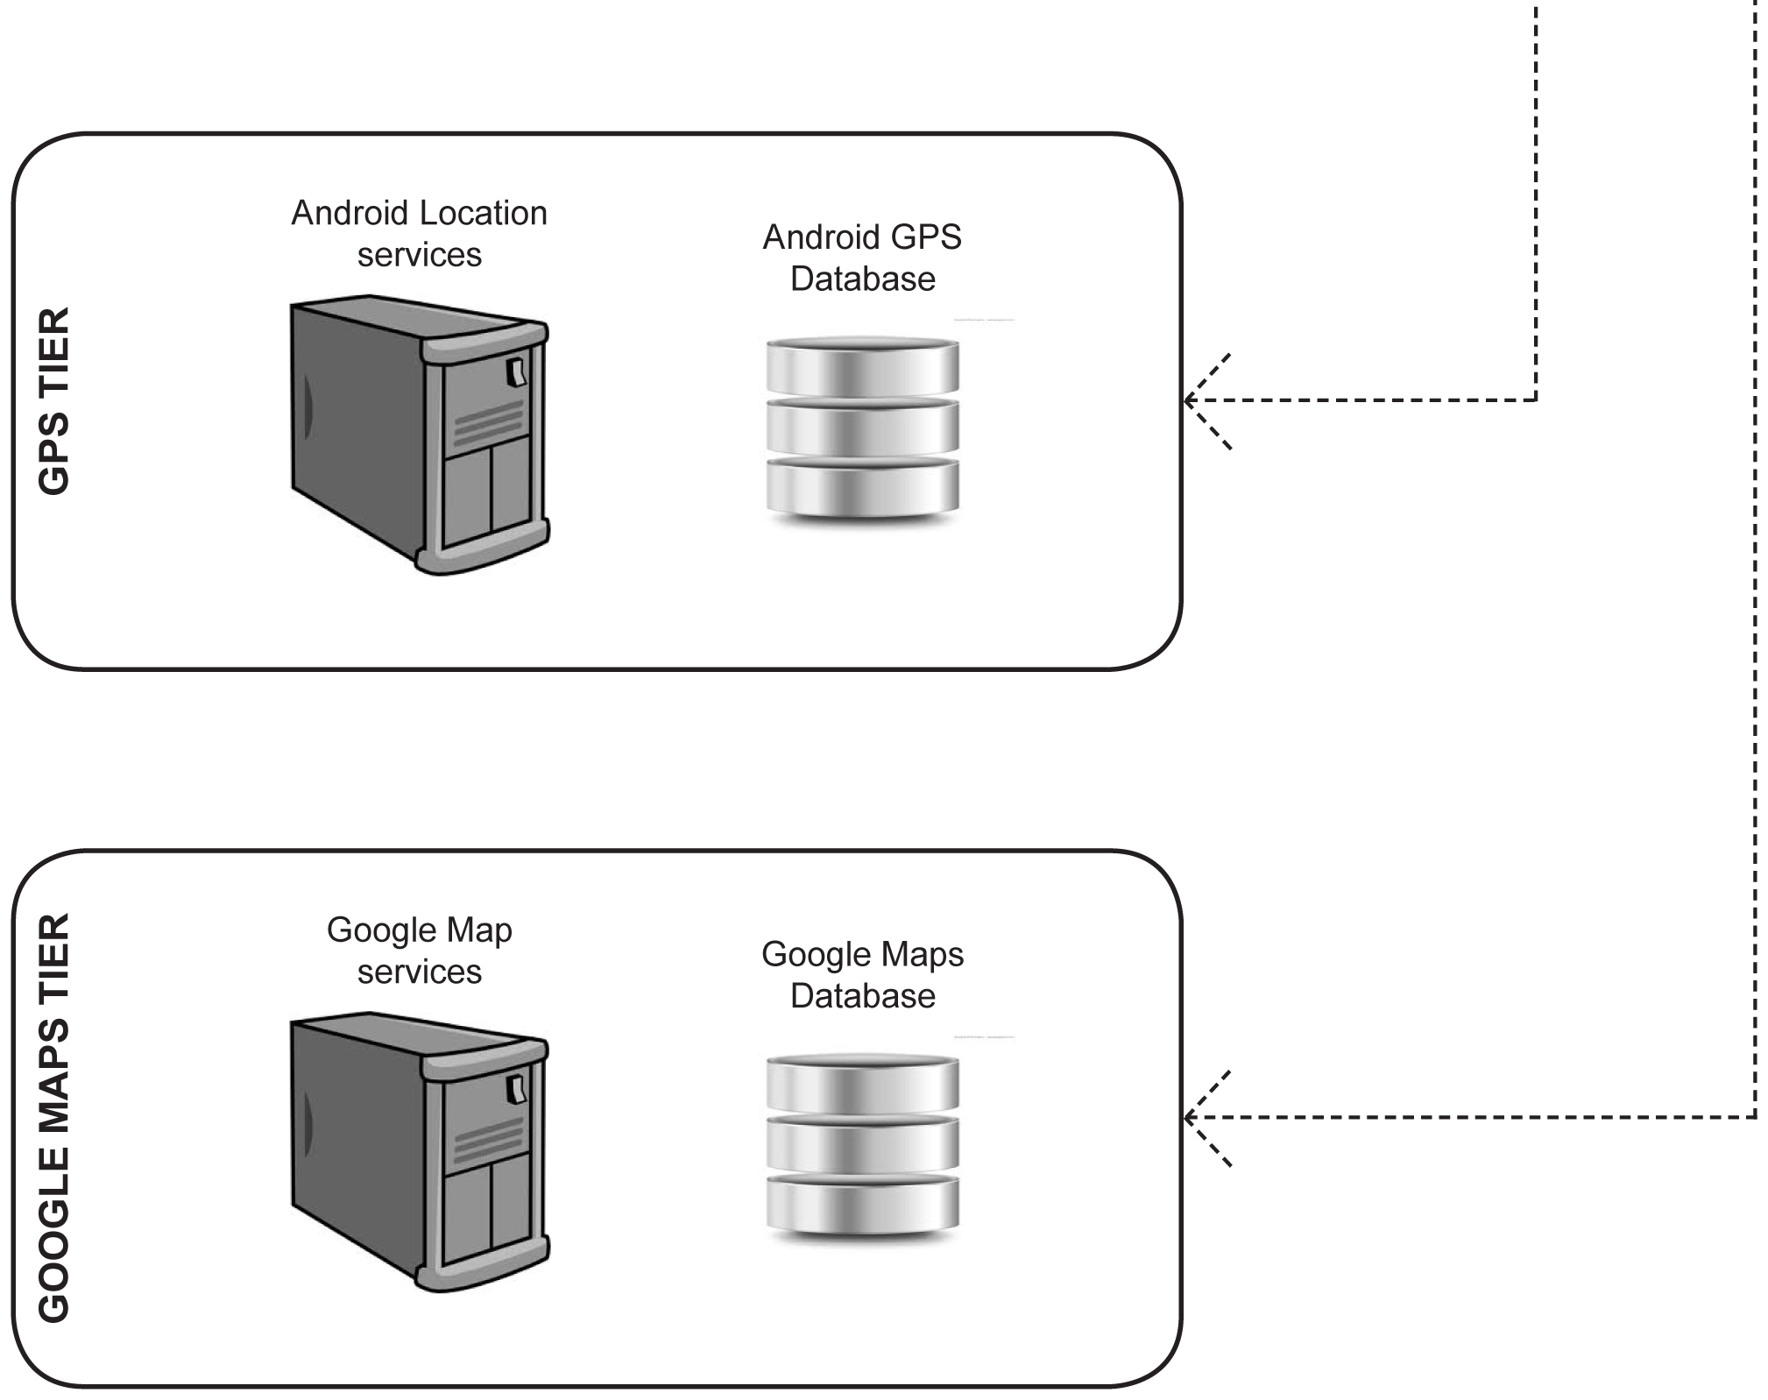
Five tier Architecture
Tier 1: Presentation. Implemented with XML layout files
Tier 2: Application Tier. Java classes
Tier 3: Data Tier. MySQL web database and local SQLite database
Tier 4: GPS Tier. Uses Android framework location services
Tier 5: Google Map Tier. Implemented using Google Maps API

Slide 15
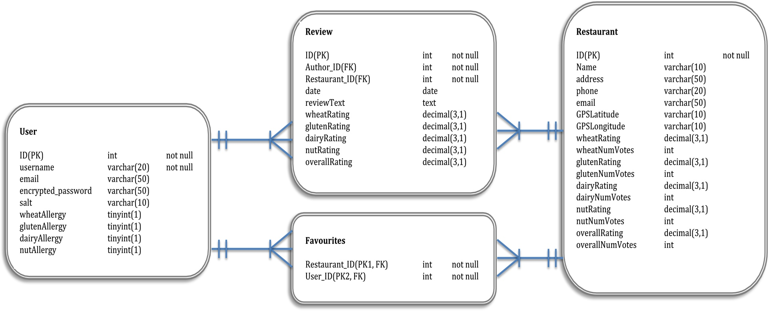
MySQL Database Schema
The MySQL database was implemented with 4 tables: Users, Restaurants, Reviews and Favourites
The Favourites table stores which restaurants are favoured by which users
The Reviews table has foreign key to the restaurant being reviewed and the author (user) of the review

Slide 16
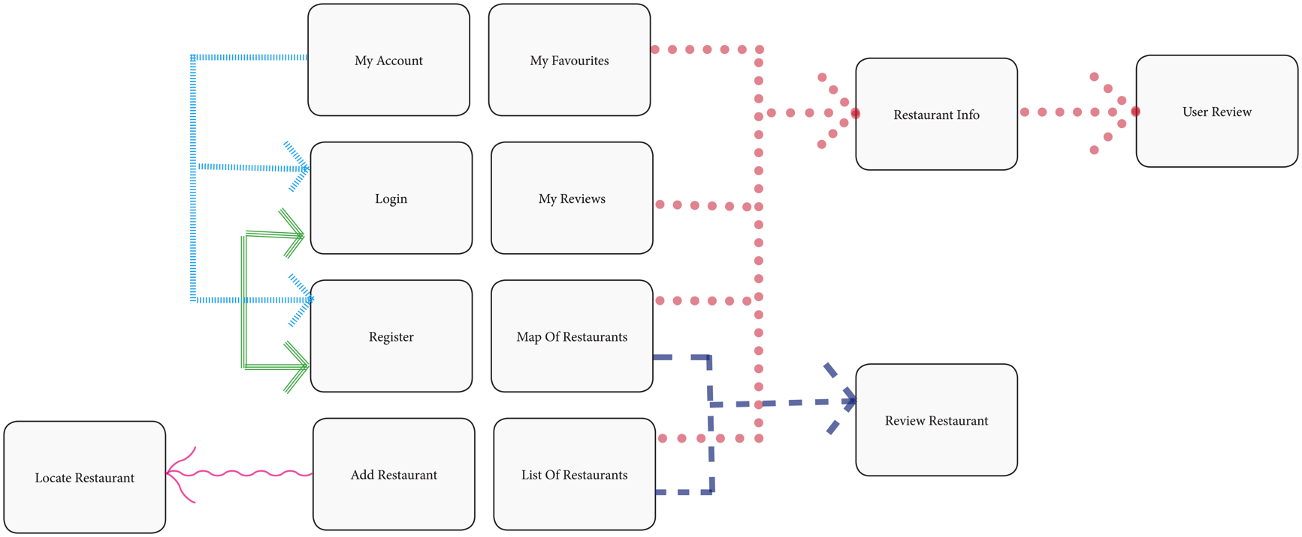
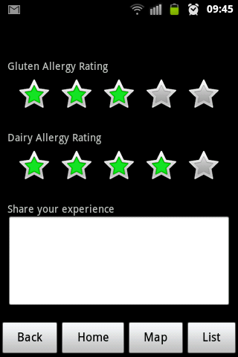
User Interface
User Interface must be simple to use, intuitive and easy to navigate
A navigation bar at the bottom of all screens is used to help user get to desired screens quickly
All screens can be arrived at via 3 taps max
Rating bars used to reduce keyboard use and make reviewing process easier

Slide 17
Development
Setup of Activities
Setup of Website with MySQL database
Making Http request to Website from device
Validation of login and registration forms
Running Google Maps API
Integration Rating Bars to Review Activity

Slide 18
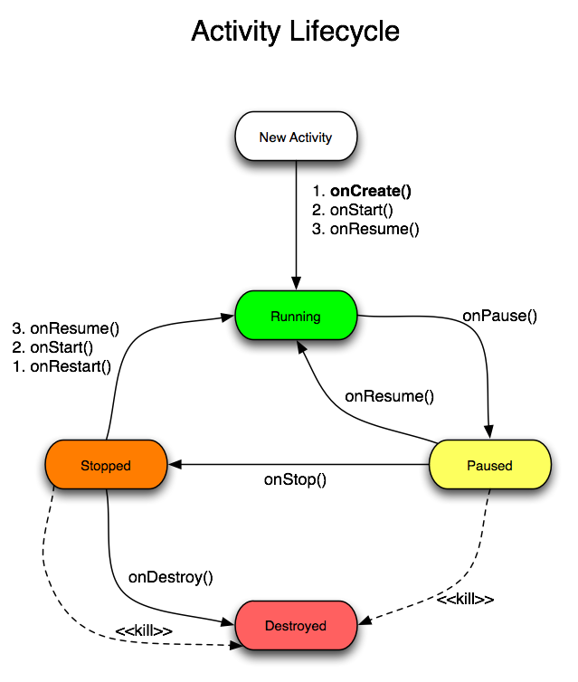
Setup of Activities
In order to create Android screens that user can interact with a developer must set up a Java class that extends an Activity
An Activity is controlled by the android runtime environment which calls the various Activity methods
To create an Activity the developer must override at least the onCreate() method
Apart from the basic activity a class can also inherit from MapActivity and ListActivity classes

Slide 19
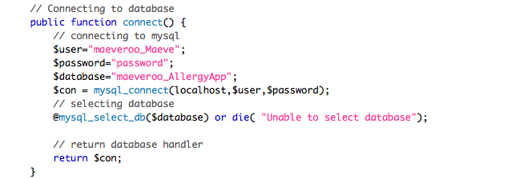
Setup Of Website With MySQL
I signed a website on a hosting service as http://http://maeverooney.x10.mx/
Using the cPanel on the site I setup a MySQL database with a username and password.
Then I can connect to the database using a 3 main PHP scripts:
1: DBConnect which creates a connection to the database
2: UserFunctions which contains functions to interact with the database
3: UserGetAndPost which handles http requests, extracts parameters and calls
the required function from UserFunctions. It then returns the requested
information

Slide 20
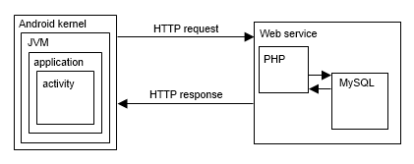
Making HTTP Requests
HTTP requests from an Android device must be made on a different thread to the main user interface thread. This is done using the java class AsyncTask
I add parameters to the post using BasicNameValuePair.
List<NameValuePair> params = new ArrayList<NameValuePair>();
params.add(new BasicNameValuePair("username",”maeve”));
TaskAsyncHttpPost httpRequest = new TaskAsyncHttpPost(params, Context);
String response = httpRequest.execute(loginURL).get();
When a response string is retrieved is is then parsed as a JSON object

Slide 21
Form Validation
During registration the system must check that the username and email are not already in the database and the passwords match. Login requires that a correct username and password are entered.
I use the principles of AJAX to perform this function
After a user inputs a value a call to the database is made.
If there is an error the user is informed before they submit the form

Slide 22
Running Google Maps
I obtained and integrated a Google Maps API into a layout xml
To create a Map based Activity the java class must extend MapActivity which is part of the Google Maps library
Map pins can be added using the ItemizedOverlay class
Each pin must have a longitude and latitude coordinate as well as a “title” and “snippet”
When a pin is tapped the ItemizedOverlay class detects which pin was tapped an displays the relevant “title” and “snippet” in an alert box

Slide 23
Rating Bar Integration
A rating bar is more favourable to a text input to obtain ratings from the user. It is more aesthetically pleasing, easier to use and eliminates incorrect input.
It is set up in the layout xml with the number of stars and step size
In the Activity class an event listener is added to the rating bar
When the user interacts with it the rating value is saved to a variable

Slide 24
Testing
Black Box Testing
Web Performance Testing

Slide 25
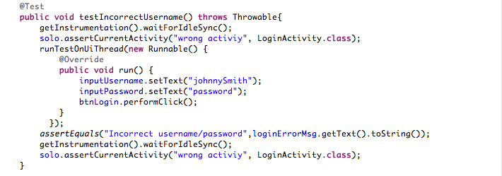
Black Box Testing
Used to perform functional tests of app
Several scenarios of possible user interactions determined
Testing toolkit jUnit used in conjunction with the plugin “Robotium”
With Robotium you can mock user interactions easily such as:
solo.clickOnButton(“save”);
All the test are run in Eclipse using a test suite class

Slide 26
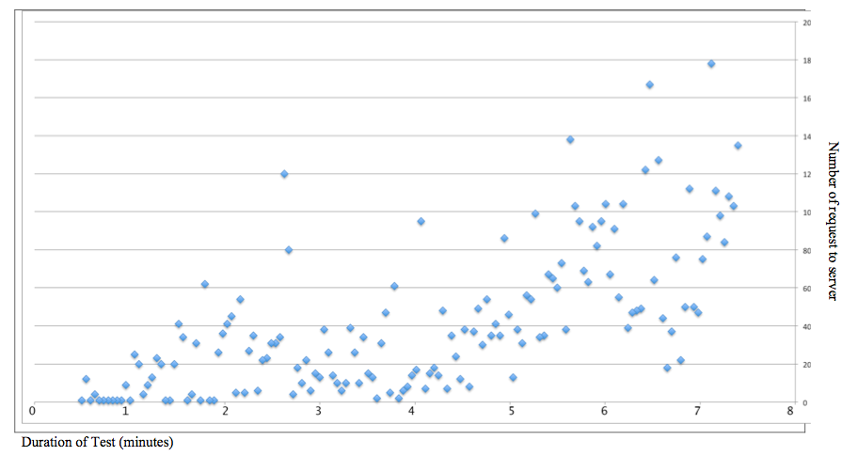
Web Performance Testing
Pylot Web Performace Tool used to test the website
It makes a http request with a chosen number of users for a set duration
The number of user can be increased from 1 to many over a set time to stress test the website
The website performed well with a low level of concurrent users.
When the number of concurrent users was increased to 150 there were some timeouts

Slide 27
Summary
Increase in project scope
Future Development
Steps to Launch

Slide 28
Increase in Project Scope
Initial Features
Added Features
Map of restaurants in database
List of restaurants in database
Activity to review restaurant
Activity to view a review
Activity to add a restaurant to the database
User account with registration/login
User account allows user to select their allergy/allergies from a set list
User can ‘favourite’ a restaurant
Ratings only relevant to users allergies show when user is logged in
Different coloured icons on map used to show restaurants with good and bad
reviews as well as users favourites
Activity to list users favourites
Activity to list users reviews

Slide 29
Future Development
I would consider adding the following features:
“Our Recommendations”. Calculated from the restaurants favourited most often or with highest ratings
Ability for user to “blacklist” a restaurant so that user no longer see it
Integration of phone and email functions. User can tap on restaurant information to make call/send email
Premium listings. Restaurants can purchase favourable position on restaurant list. Would be shown with larger icon in map view

Slide 30
Steps To Launch
Approach the various websites dedicated to food allergies to get initial users and testers. For example dublinwithfoodallergies.blogspot.ie. Also users could be found in forums such as boards.ie.
These users would help to add a number of restaurants to the database as well as reviews for these restaurants.
When a sufficient amount of content is in the database launch the app for free on the Google Play Store. This would be for a limited time.
After a period, when the free users have added enough data to make
the content comprehensive I would then re-launch the app for a fee to be determined.

