Slide 1

Swiggy Delivery Time Prediction
Project by Mohd Mafaiz Uddin
Batch No. 502
Innomatics Research Labs

Slide 2

Agenda
Introduction
Project Workflow(CRISP-ML(Q))
Business and Data Understanding.
Data Pre-processing
Model Building
Cross Validation
Hyperparameter Tuning
Final Pipeline of Model
Streamlit Deployment
Challenges Faced
Future Scope
Conclusion

Slide 3
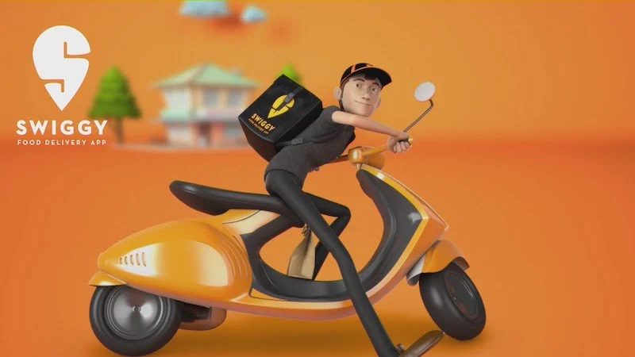
Introduction
Swiggy is one of India's leading online food delivery platforms, serving millions of customers every day.
Customers expect accurate Estimated Time of Arrival (ETA) for their orders.
Delivery time depends on factors such as weather, traffic, distance, rider performance, and multiple deliveries.
This project uses Machine Learning to predict delivery time accurately, helping improve customer satisfaction and delivery efficiency.

Slide 4
Project Workflow – CRISP-ML(Q)
Business & Data Understanding.
Data Pre-processing
Model Building
Model Evaluation
Model Deployment

Slide 5
Problem statement & Objective
Business Problem:
Swiggy delivers millions of food orders every day, but accurately estimating delivery time is challenging due to dynamic factors such as traffic, weather, delivery distance, rider performance, and multiple deliveries. Inaccurate delivery time estimates can reduce customer satisfaction and affect operational efficiency.
The objective of this project is to develop a Machine Learning model that predicts food delivery time accurately using delivery partner details, order information, weather, traffic, and location-based features. The final model is deployed using Streamlit for real-time delivery time prediction.
Business Goal:
Improve delivery time prediction accuracy.
Enhance customer satisfaction with reliable ETAs.
Support efficient delivery planning and operations.

Slide 6
Dataset Overview
Column Name | Description
rider_id | Unique identifier for each delivery partner
age | Age of the delivery partner
ratings | Average customer rating of the rider
vehicle_condition | Condition of vehicle (0 = Poor, 1 = Average, 2 = Good)
type_of_vehicle | Vehicle used for delivery (motorcycle, scooter, etc.)
type_of_order | Type of food ordered (snack, meal, drinks, buffet)
multiple_deliveries | Number of deliveries assigned in a single trip
pickup_time_minutes | Time taken by restaurant to prepare the order (minutes)
restaurant_longitude | Longitude of the restaurant location
delivery_longitude | Longitude of the customer delivery location
is_weekend | Whether the order was placed on a weekend (Yes/No)
order_time_hour | Hour when the order was placed (0–23)
order_time_of_day | Time bucket (morning, afternoon, evening, night)
weather | Weather during delivery (sunny, cloudy, fog, stormy, sandstorms)
traffic | Traffic condition during delivery
festival | Whether the order was placed on a festival day (Yes/No)
city_type | Classification of city (urban, metropolitan)
city_name | Name/code of the city (BANG, HYD, CHEN, etc.)
time_taken | Actual delivery time (minutes) — Target Variable
distance | Distance between restaurant and delivery location (km)
order_date | Date when the order was placed
order_day | Day of the month
order_month | Month of the order
order_day_of_week | Day of the week (Monday–Sunday)

Slide 7
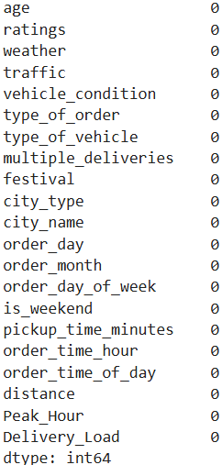
Data Cleaning & Preprocessing
Missing Value Handling: Missing values were identified in both numerical and categorical features.
Numerical Columns: ['age', 'ratings', 'vehicle_condition', 'multiple_deliveries','order_day', 'order_month', 'is_weekend', 'pickup_time_minutes','order_time_hour', 'distance', 'Peak_Hour’]
Technique Used: Median Imputation
Reason: The median is robust to outliers and provides reliable values for numerical data.
Categorical Columns: ['weather', 'traffic', 'type_of_order', 'type_of_vehicle', 'festival','city_type', 'city_name', 'order_day_of_week', 'order_time_of_day','Delivery_Load’]
Technique Used: Most Frequent (Mode) Imputation
Reason: Replacing missing categorical values with the most common category preserves the distribution of the data.

Slide 8
Data Cleaning & Pre-processing
Duplicate Values: No Duplicates values detected.
Outlier Handling: Outliers were analyzed in the following numerical columns: [age, ratings, vehicle_condition, multiple_deliveries, pickup_time_minutes, distance].
Method Used: Box Plot Visualization Analysis
Treatment: Extreme outliers were handled during preprocessing to reduce their impact on model performance.
Feature Engineering: Feature engineering was performed to create additional features that improve the model's ability to learn delivery patterns.
1. Peak_Hour: Identify whether an order was placed during peak delivery hours.
2. Delivery_Load: Represent the delivery partner's workload.
Feature Scaling: Applied StandardScaler to normalize numerical features and improve model performance.

Slide 9
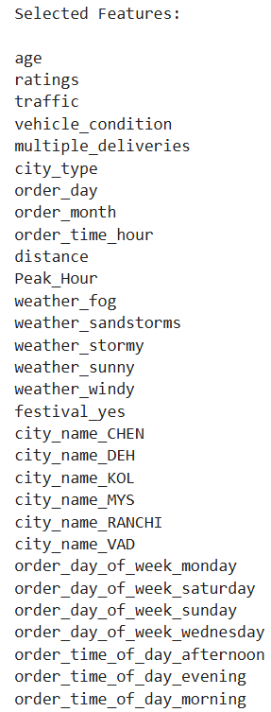
Data Cleaning & Pre-processing
Feature Selection:
Technique Used: Recursive Feature Elimination (RFE)
Feature Selection: Total Selected Features: 30
Encoding:
Numerical Features: [age, ratings, pickup_time_minutes, multiple_deliveries, distance]
Processing: → Median Imputation
→ StandardScaler
Ordinal Features: [traffic, city_type]
Processing: → Most Frequent Imputation
→ Ordinal Encoding
Nominal Features: [weather, type_of_order, type_of_vehicle, city_name, festival, order_day_of_week, order_time_of_day, Delivery_Load]
Processing: → Most Frequent Imputation
→ One-Hot Encoding

Slide 10
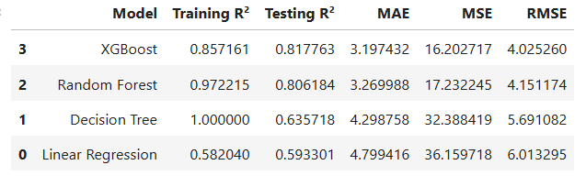
Model Building
Target Variable: Time_taken (Minutes)
Regression Models Used: Linear Regression, DecisionTree, Random Forest Regressor, XGBoost
Comparision Table Based on R2 Score
→ XGBoost achieved the highest testing performance and was selected as the best model.

Slide 11
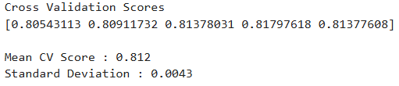
Cross Validation
Technique Used: 5-Fold Cross Validation
Why?
Reduces overfitting
Ensures model stability
Evaluates performance on different subsets of data
Average cross-validation R² score:

Slide 12
Hyperparameter Tuning
Technique Used: RandomizedSearchCV
Purpose:
Find the optimal hyperparameter combination
Improve model accuracy
Reduce overfitting
Hyperparameter | Best Value
n_estimators | 200
learning_rate | 0.05
max_depth | 7
subsample | 1.0
colsample_bytree | 1.0
XGBoost model was rebuilt using these optimized parameters.
Final Comparision after Tuning
Model | Training r2 | Testing r2
XGBoost | 0.860773 | 0.814533

Slide 13
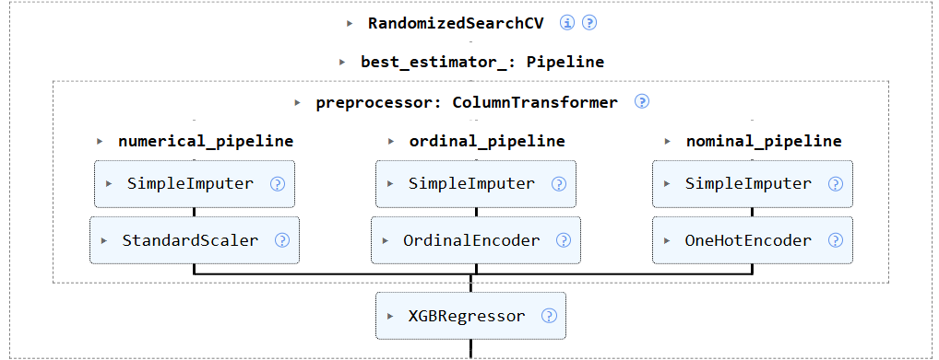
Final Pipeline of Model
The complete preprocessing and model were integrated into a single Scikit-learn Pipeline, simplifying training and deployment.

Slide 14
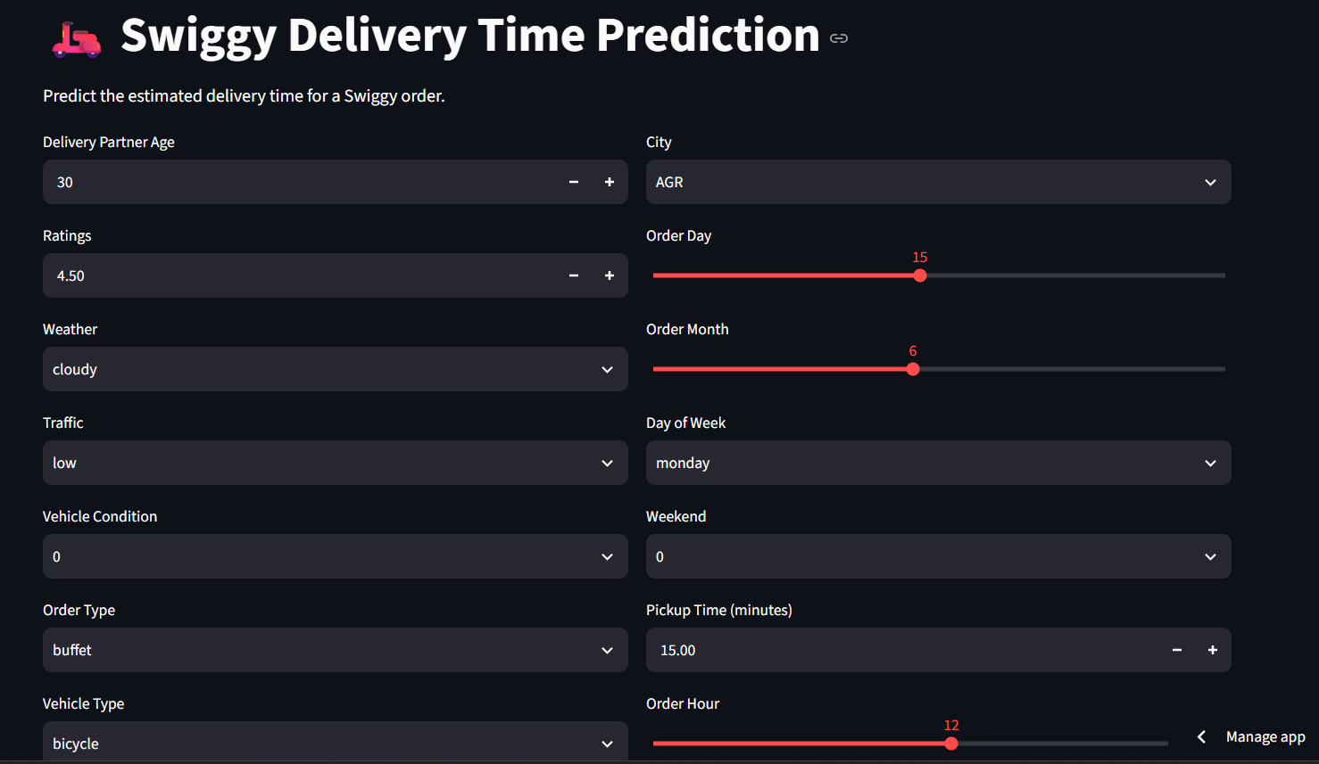
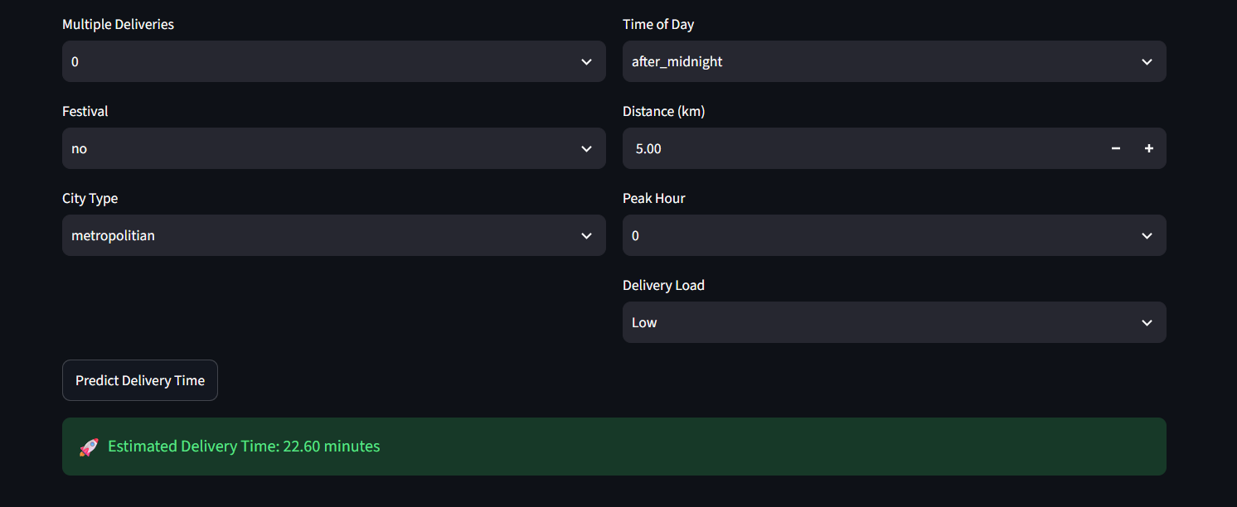
Streamlit Deployment
The final trained pipeline was deployed using Streamlit.

Slide 15
Challenges Faced
Handling Missing Values: Managing missing data in both numerical and categorical features without affecting model performance.
Feature Engineering: Creating meaningful features such as Peak_Hour and Delivery_Load to improve prediction accuracy.
Categorical Data Encoding: Converting multiple categorical variables into machine-readable format using appropriate encoding techniques.
Model Selection & Optimization: Comparing multiple regression models and selecting the best one using evaluation metrics, cross-validation, and hyperparameter tuning.
Model Deployment: Integrating the trained pipeline into a Streamlit application for real-time delivery time prediction.

Slide 16
Future Scope
Live Traffic Integration: Use real-time traffic data to improve ETA prediction accuracy.
Weather API Integration: Incorporate live weather information for more reliable delivery estimates.
Google Maps API: Utilize actual route distance and travel time instead of calculated distance.
Mobile Application: Develop an Android/iOS application for real-time delivery time prediction.
Cloud Deployment: Deploy the application on cloud platforms (AWS, Azure, or Google Cloud) for scalability and public access.

Slide 17
Conclusion
Successfully developed an end-to-end Machine Learning model to predict Swiggy food delivery time.
Performed data preprocessing, feature engineering, feature selection, and hyperparameter tuning to improve model performance.
Compared multiple regression models, with XGBoost achieving the best prediction accuracy.
Deployed the final trained pipeline using Streamlit for real-time delivery time prediction.
The solution can help improve ETA accuracy, customer satisfaction, and delivery operations.

Slide 18

THANK YOU

