Slide 1

Mini-Project: Week 1 Message Encryption & Decryption Mafalda Fragoso Data Analytics Bootcamp 22/02/2020

Slide 2
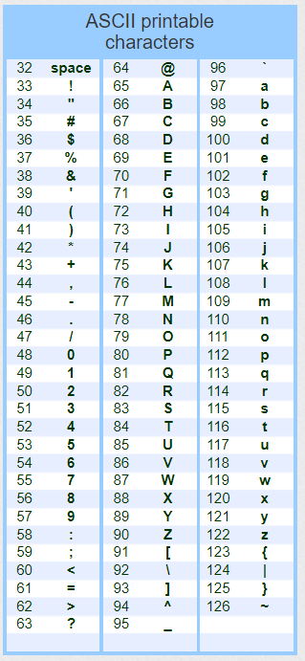
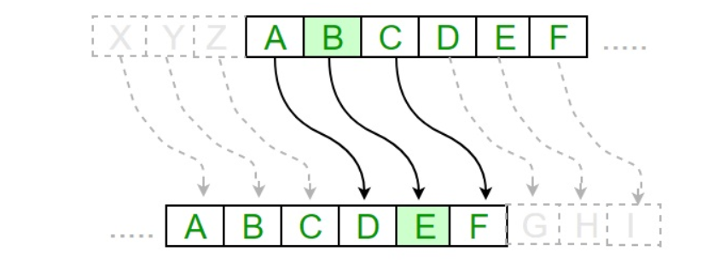
Message Encryption & Decryption challenge
Challenge:
Cryptography with Python: communication between two users via coded messages
Method used: Caesar Cipher method
Each letter of plain text is replaced by a letter with some fixed number of positions down
I’ve used the complete ASCII printable characters to include special characters and not just the alphabet
Example: Caesar Cipher
ASCII printable
characters

Slide 3
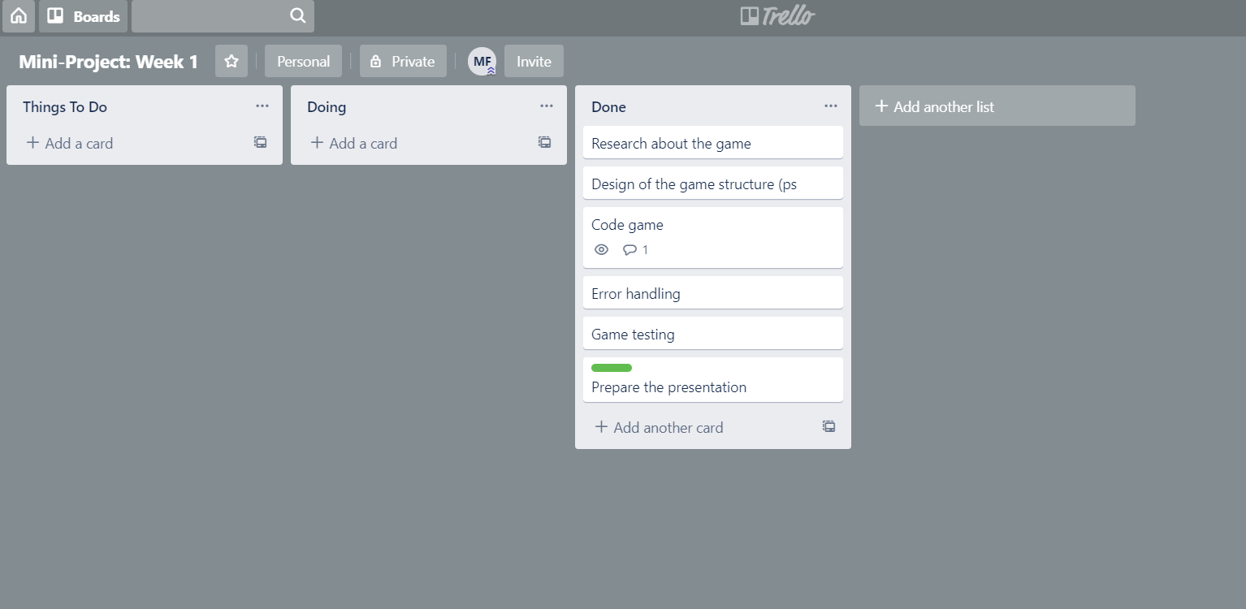
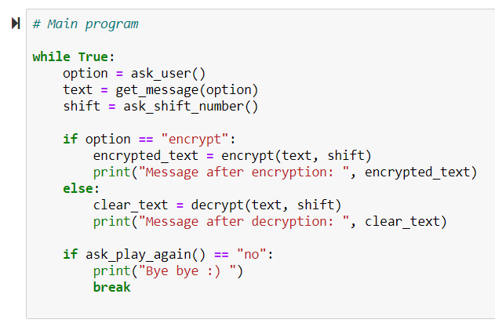
Process
Process
Planning of the project on the Trello board
1
Design of the game structure (pseudocode)
Coding of the game
Create a function that asks if users wants to encrypt or decrypt
Create a function that returns the message the user wants to encrypt or decrypt
Create a function that applies encryption or decryption methods
Print resulting message
3
Game testing and error handling

Slide 4
Challenges, learnings and improvements
Challenges
Use a function inside another function
Error checking in the code
Verification of potential exceptions in the code
Learnings
How to create a game that interacts with the user
How to provide input to a Python function and receive output
Perform calculations with Python
Understanding of the components of functions and how to write them in Python
Improvements
Run the code with the extended ASCII characters
Run a new code with more advance/complex methods of encryption and decryption

Slide 5
Trello template

Slide 6
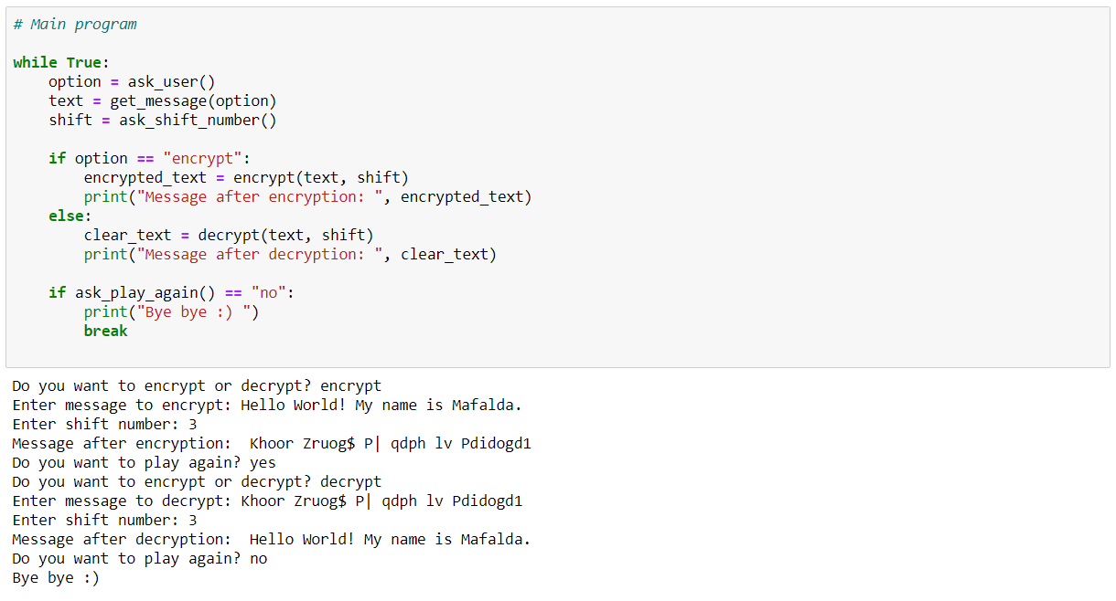
Demo

Slide 7
ASCII printable characters

